Slide 1
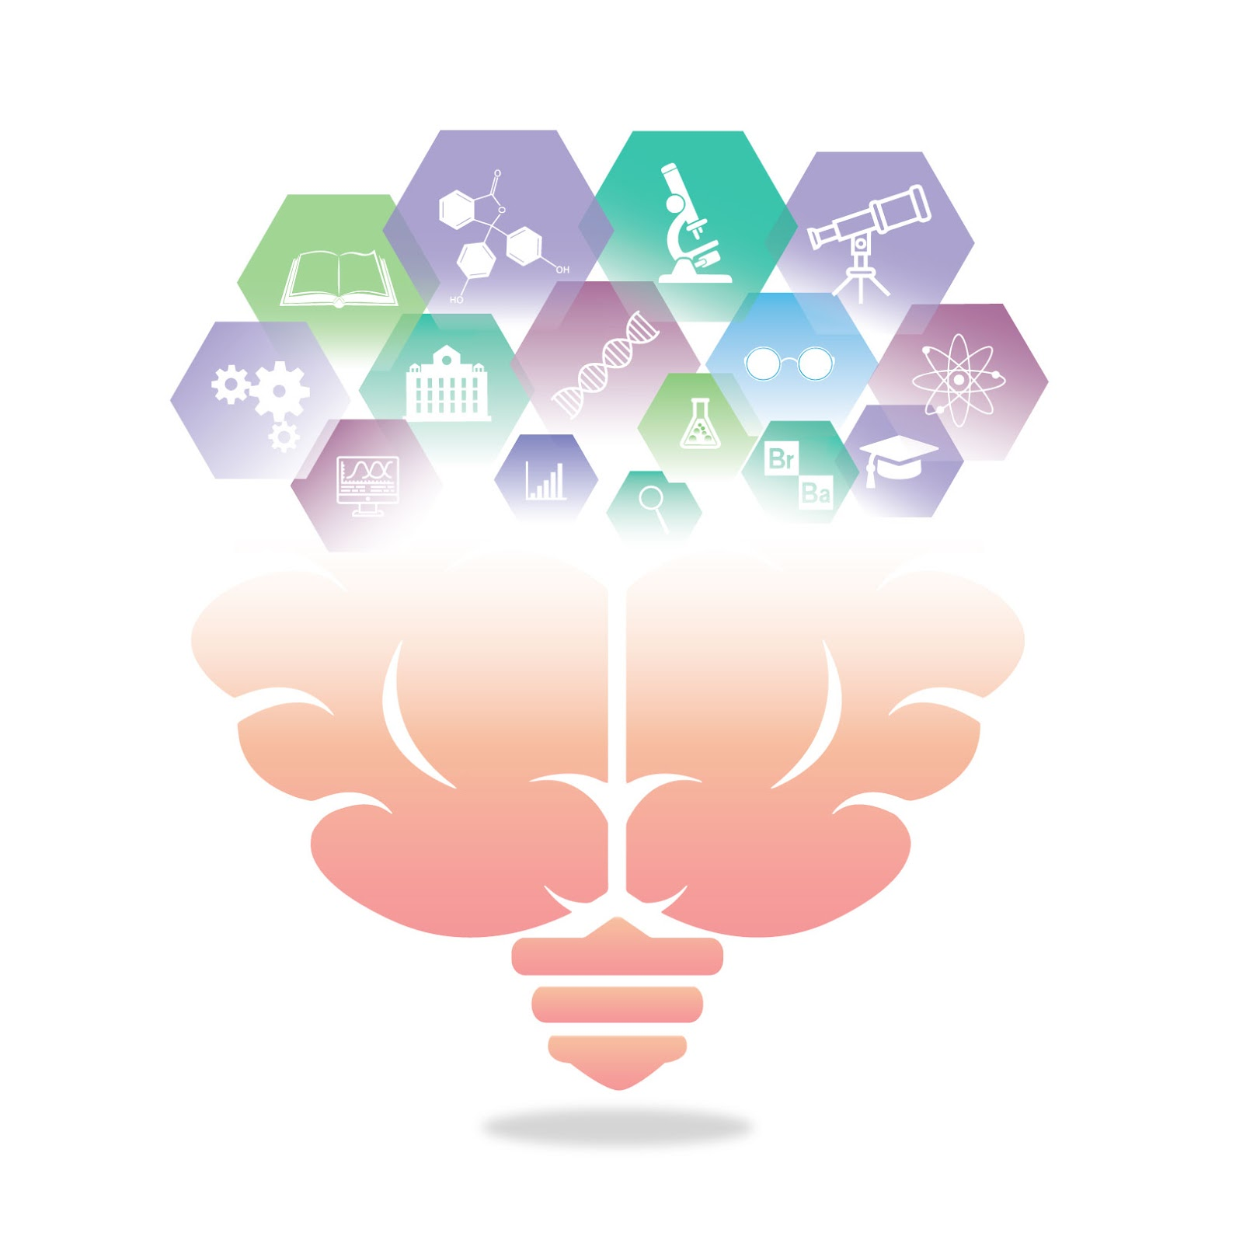
Equity, diversity, & Inclusion in Open Science
Open Science Student Support Group
February 26, 2021
Emiko Muraki + Chelsie Hart
Image by Adam Douglas
©️ 2020 This work is licensed under a CC BY 4.0 license

Slide 2

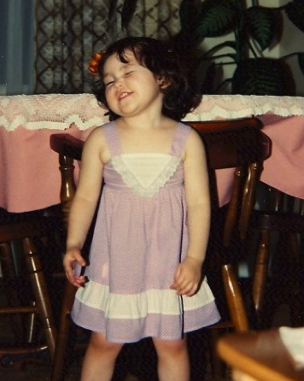
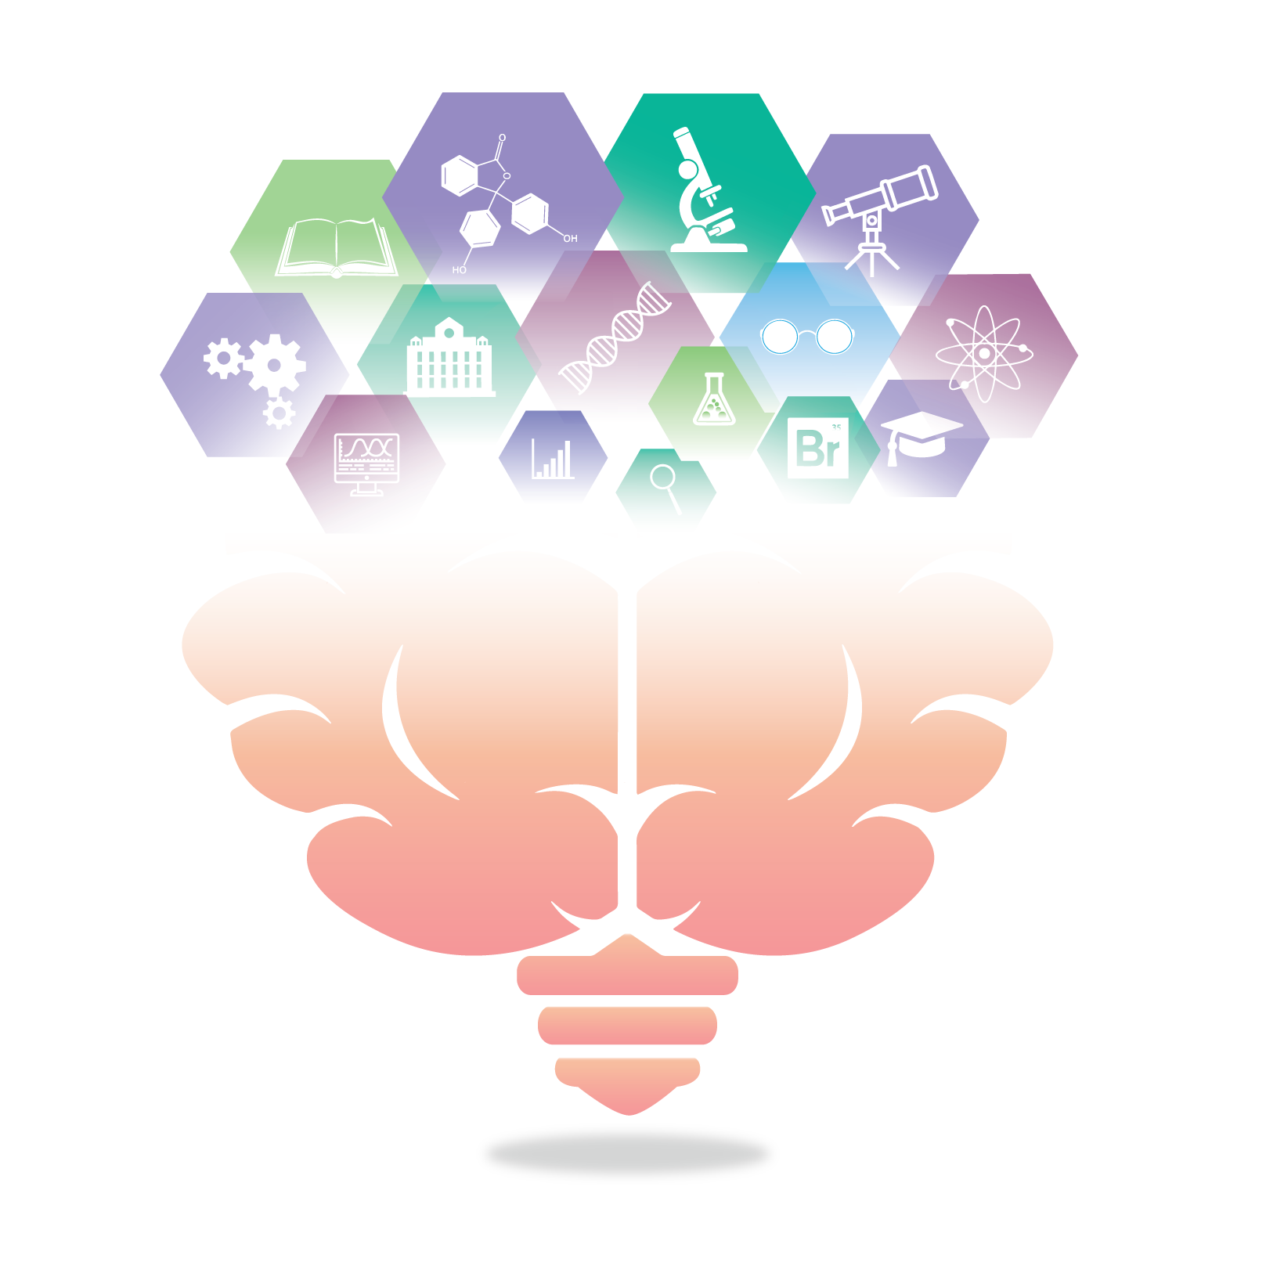
Emiko she/her
Supervised by Dr. Penny Pexman (Language Processing Lab)
Semantic representation, individual differences in language processing, embodied cognition.
What motivated you to join our group and introduce an aspect of open science today?
I'm excited to discuss open science with peers, rather than just during conference sessions about open science!

Slide 3

Chelsie (she/them)
Supervised by Dr. Julia Kam (Internal Attention Lab) and Dr. Brandy Callahan (Neurocognitive Disorders Lab)
ADHD, mind-wandering, executive functioning, (sex, and gender).
What motivated you to join our group and introduce an aspect of open science today?
I want to support accessibility of data and results
Spreadsheet enthusiast

Slide 4
Contributions
University of Calgary, Department of Psychology Equity, Diversity, and Inclusion Committee members:
Lorena Solis
Elaine Atay
Franci Sterzer
Tamara Williamson

Slide 5
Defining EDI
Equity
Equity acknowledges and aims to correct unequal distributions of power where those with power and privilege experience advantages while those without experience disadvantages.
Diversity
Varies by context, research area, etc.
May be discussed in terms of group-based dimensions (gender, race, ethnicity, disability, etc.), include many differences grouped into broader categories (visible/invisible, surface/deep), or may be defined by a specific conceptual rule
Inclusion
Valuing and welcoming individuals with different identities as part of a group

Slide 6
Importance of EDI
A main tenet of open science in transparency and accessibility - both important tenets to equity, diversity and inclusion.
But Open Science practices are being implemented within an existing academic research context that has systemic inequities.
Open Science was not intentionally designed to address all those inequities, nor can it be expected to be a panacea for the issues related to equity, diversity, and inclusion in academia.
Therefore, we must consider how those contextual influences may affect the application of open science practices.

Slide 7
Considerations for Open Science
What assumptions are being made when considering how these practices are implemented?
What are barriers to implementation?
Where do open science practices make positive changes for equity, diversity, and inclusion in science ?

Slide 8
Assumptions of Open Science
Open = Good
Researchers Who Value Open Science Will Do It
Open Science Doesn’t Reinforce Existing Issues

Slide 9
Assumption: Open = Good
Openness is foundational to open science but isn’t necessarily ‘good’, ‘ethical’, and ‘desirable’ in research
Contextual Definitions
Discomfort with Openness
Potential Data Misuse
Homogenization of Knowledge

Slide 10
Assumption: Open = Good
Homogenization of Knowledge
“…open access cannot be separated from issues like difficult access to computers, the internet and local research grants, and weak digital literacy…. In this context, open access tends to reinforce the hegemony of science done and published in the Global North at the expense of local knowledge, seldom in open access. This reduces intellectual diversity and contributes to the homogenization of science and creativity…. the ‘monoculture of the mind’”
- Chan et al., 2020

Slide 11
Assumption: Researchers Who Value Open Science Will Do It
Assumes: not open = not trustworthy
Ignores differences in resources
There are multiple barriers to open science

Slide 12
Assumption: Researchers Who Value Open Science Will Do It
Some barriers to open science
Finances
Impact Factor vs Open Access
Open Access Fees
Limited access to information
Time
Extra jobs
Unequal distribution of labour
Other Responsibilities
Cultural Taxation
Registration
Knowledge
Language Barriers
Software/Programming

Slide 13
Assumption: Open Science Doesn’t Reinforce Existing Issues
Open Science incentives are biased to quantitative research
Pre-registration concerns
Inductive qualitative research is not hypothesis-based
Protocols often change
Theoretical/iterative pre-registration
Reproducible Open Coding Kit
Data sharing concerns
De-identifying qualitative data also removes crucial contextual information

Slide 14
Assumption: Open Science Doesn’t Reinforce Existing Issues
Open Peer Review & Open Writing
Riskier for women, BIPOC, early-career researchers, etc.
Reviewer credibility may be questioned
Double-blind review can reduce active and unconscious bias
Single-blind review confers advantage to well-established authors from high-prestige institutions
Some bias against non-US authors

Slide 15
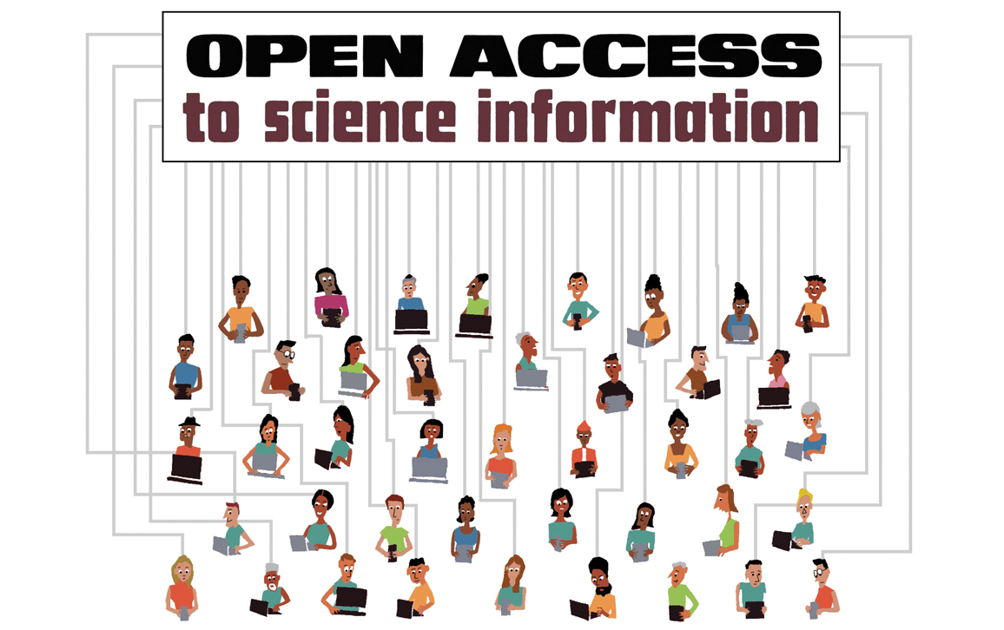
The Positives of Open Science
Open access
Accessibility of findings
Greater citation rates
Reduced financial barriers
Subverts existing biases in trust
Photo credit: Tom Dunne

Slide 16
Take home messages
There are many false assumptions in Open Science.
Many of the issues related to equity, diversity, and inclusion in Open Science apply to scientific research in general.
Open Science practices are not accessible or possible for all researchers.
Open Science is not a “one size fits all” situation.

Slide 17
Challenges
Learn more about it!
Read or listen to one of the resources on the next slide.
Reflect about it!
Take some time to consider what assumptions are built into the open science practices you use. What resources/support do you have that make it easier or more difficult to implement some of these practices?
When considering open science practices, take some time to think of who stands to benefit the most from these practices?
Take some action!
Check the author diversity of one of your bibliographies.
Check what journals you frequently cite are open access (or potentially predatory).
Start implementing some of the best practice recommendations for qualitative research.

Slide 18
resources
cleanBib R package to examine gender proportions in reference lists
Citation Transparency Chrome extension adds probabilistic gender info to Google Scholar and PubMed
Directory of Open Access Journals
Website for checking if open-access publishers may be predatory
NYTimes article on the wider effects of public criticism of research
Blog post on the ambiguous use of “open science”
Nature article on Cultural Taxation
PLOS article on data misuse
Reproducible Open Coding Kit to facilitate reproducible and open coding for qualitative research
The State of Open Data 2019 summary of results from Digital Science survey of scientists on open science
Notes:
Articles on research involving indigenous populations
https://academic.oup.com/gerontologist/article/54/1/117/559329?login=true https://journals.sagepub.com/doi/full/10.1177/160940690600500401 https://bmcmedethics.biomedcentral.com/articles/10.1186/s12910-016-0139-8
https://academic.oup.com/heapro/article/32/3/581/3062461?login=true
Article on defining predatory journals:
https://www.nature.com/articles/d41586-019-03759-y

Slide 19
References
Traynor, C., Foster, L., & Schonwetter, T. (2019). Tensions related to openness in researching indigenous peoples’ knowledge systems and intellectual property rights. In Chan, L., Okune, A., Hillyer, R., Albornoz, D., & Posada, A. (Eds.), Contextualizing openness: Situating open science. (pp. 223-236). University of Ottawa Press.
Elsevier. (2021). Article publishing charge (APC) price list. [spreadsheet of open and hybrid model journal list prices]. Retrieved from https://www.elsevier.com/about/policies/pricing
Kitchener, C. (2020, April 24). Women academics seem to be submitting fewer papers during coronavirus. ‘Never seen anything like it,’ says one editor. The Lily. https://www.thelily.com/women-academics-seem-to-be-submitting-fewer-papers-during-coronavirus-never-seen-anything-like-it-says-one-editor/
Gewin, V. (2020, June 24). The time tax put on scientists of color. nature. https://www.nature.com/articles/d41586-020-01920-6
Franklin, R. (2018, June 21). R – The future of psychology statistics is open source. Noba Blog. http://noba.to/hrcy4etz
Albornoz, D., & Chan, L. (2018). Power and inequality in open science discourses. Iris – Informação, Memória e Tecnologia, 4(1), 70 – 79. https://periodicos.ufpe.br/revistas/IRIS/article/view/238912/30639
Chan, L., Hall, B., Piron, F., Tandon, R., & Williams, L. (2020). Open science beyond open access: For and with communities. A step towards the decolonization of knowledge. The Canadian Commission for UNESCO’s IdeaLab. https://unescochair-cbrsr.org/wp-content/uploads/2020/07/OS_For_and_With_Communities_EN.pdf
Braun, K. L., Browne, C. V., Ka ‘opua, L. S., Kim, B. J., & Mokuau, N. (2014). Research on indigenous elders: From positivistic to decolonizing methodologies. The Gerontologist, 54(1), 117-126. https://doi.org/10.1093/geront/gnt067
Mohindra, K. S. (2017). Research and the health of indigenous populations in low-and middle-income countries. Health promotion international, 32(3), 581-586. https://doi.org/10.1093/heapro/dav106
Hrynaszkiewicz, I. (2019, October 24). Building trust to break down barriers. Public Library of Science. https://plos.org/announcement/building-trust-to-break-down-barriers/
Yarkoni, T. (2019, July 13). I hate open science. [citation needed]. https://www.talyarkoni.org/blog/2019/07/13/i-hate-open-science/
Reischer, H. N., &. Cowan, H. R. (2020). Quantity Over Quality? Reproducible Psychological Science from a Mixed Methods Perspective. Collabra: Psychology, 6(1): 26. https://doi.org/10.1525/collabra.284
Pratt, M.G., Kaplan, S., & Whittington, R. (2020). The tumult over transparency: Decoupling transparency from replication in establishing trustworthy qualitative research. Administrative Science Quarterly, 65(1), 1–19. https://doi.org/10.1177/0001839219887663
Jackosn, A. (2019, October 23). The stat of open data 2019 – Global attitudes towards open data. Digital Science. https://www.digital-science.com/blog/news/the-state-of-open-data-2019/

