Slide 1
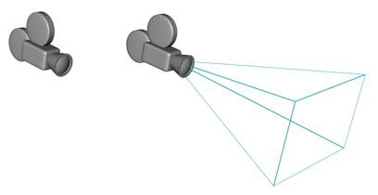
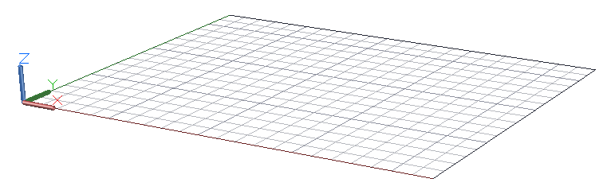
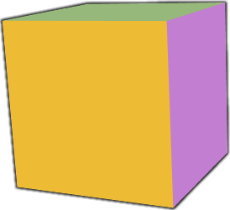
Eye Space
Object Space
World Space

Slide 2
Object Space
Model Matrix
World Space
View Matrix
Eye Space
Projection Matrix
Clip Coords.

Slide 3
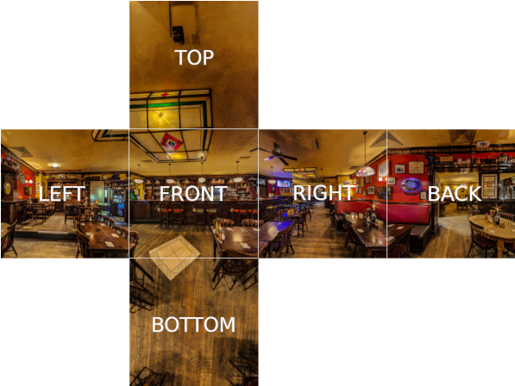

TOP
i
BACK
n
RIGHT
r
BOTTOM
Textures d'environnement
r = i - 2n(n.i)

Slide 4
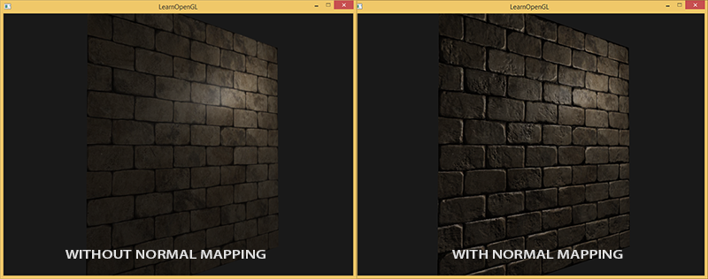
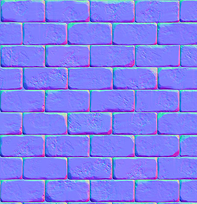

+
=
Texture
Normal Map
newNormal = normalMap x Matrice[TBN]
B (Bi-Tangente)
N (normale)
T (tangente)

