Slide 1
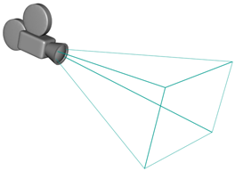
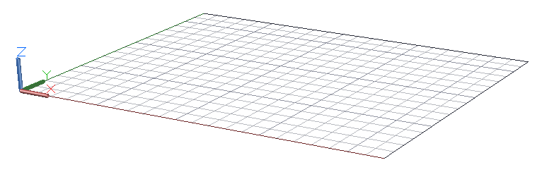
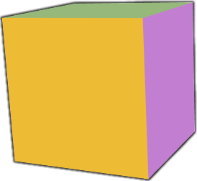
Eye Space
Object Space
World Space

Slide 2
Object Space
Model Matrix
World Space
View Matrix
Eye Space
Projection Matrix
Clip Coords.

