Slide 1

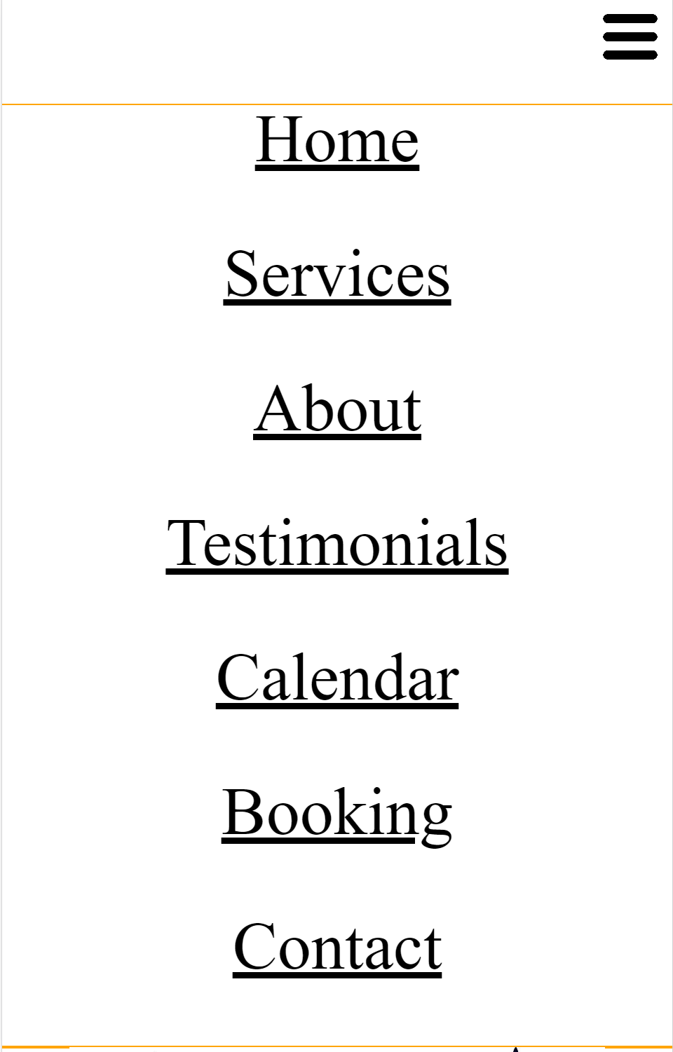
Mobile – Home Page
Nav Menu Not Expanded
Nav Menu Expanded
Lines are for layout visualization only and will not be visible in your webpage.

Slide 2

Desktop – Home Page

Slide 3
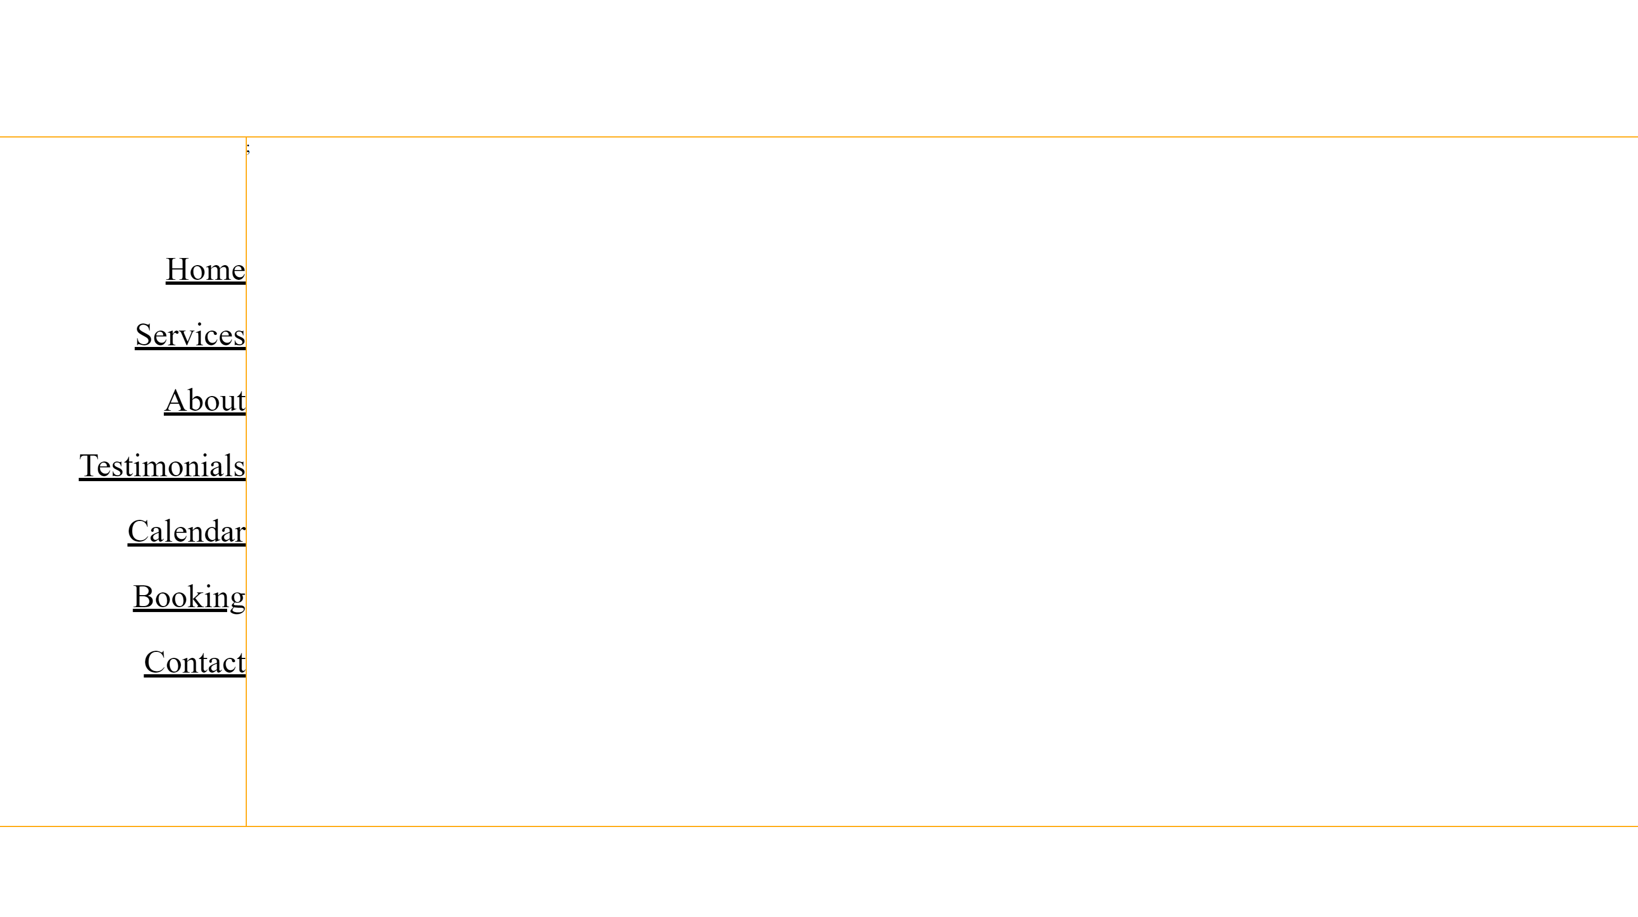
Desktop – All Pages
All pages use this format. This section on each page is reserved for page-specific content as follows:
About: DJ bios
Services: menu of services you offer
Testimonials: images of customers and quoted feedback
Booking: www.wedj.com will load and fill this section
Contact: your custom contact form
Do you concur with the content? Anything to add or change?
Are you satisfied with the layout (not colors, just the structure)? Anything to change?

