Slide 1
ECE 435 Final Project
Secure Data Delivery Protocol (SDDP)
Grady White
4/28/22

Slide 2
Related works:
Secure Copy Protocol (SCP)
Has a source and sink mode, very similar to my model
Operates with SSH, requires authentication
SSH File Transfer Protocol (SFTP)
Similar to SCP but with more features
Acts like a remote file system with directory indexing and file removal

Slide 3
OSI Layers:
Application Layer (7)
Simple program to interface with protocol
Presentation Layer (6)
Data file segmentation and encryption
Session Layer (5)
Specialized headers and data frames

Slide 4
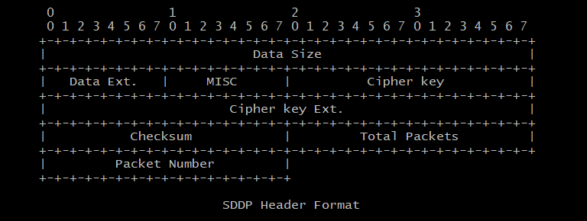
Headers:

Slide 5
Security:
Asymmetric RSA encrypted headers
Sender encrypts all headers with Receivers public key
Receiver responds with headers encrypted with Senders public key
RC5 32/12/6
32-bit words, 12 rounds, 6 bytes per key
Frame shuffling
Frames can be sent in a random order
Checksum
Protects against man in the middle attacks
Trust level system
Data from untrusted addresses gets dropped

Slide 6
Implementation:
Written in Python 3.10
Python byte manipulation is tedious
No new types in Python, only classes
Limited built-in types (no unsigned integers)
Communicates over UDP sockets
Reliability:
Sender and Receiver are both state machines
Connections allow for dropped packet detection and recovery

Slide 7
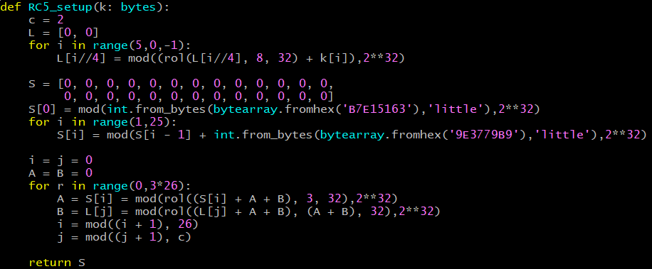
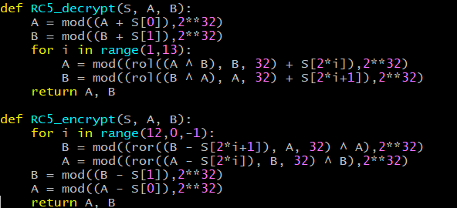
Sample code:

Slide 8
Future plans:
Modularize
Create actual standalone library for SDDP
Create a complex program to handle multiple connections at once
Expand standard document to include file requests
Re-write in C
Faster encryption, more secure key management
Better memory management
Larger maximum file size

