Slide 1
Linear regression
고태훈 (thoon.koh@gmail.com)

Slide 2
Predictive modeling
Split the data into train set and test set
Fit the model to train set ➔ Test the model to train set and test set

Slide 3
Predictive modeling
Given data
X
Y
X
Y
Train data
X
Y
Test
data

Slide 4
Predictive modeling
Training/Learning /Estimating
X
Y
Supervised model
Train data
Test
data
X
Y

Slide 5


Predictive modeling
Calculating “train error” using Y and $\hat{Y}$ of training data
X
Y
$$\hat{Y}$$
Predicting Y values
Train data
Supervised model
Test
data
X
Y
$$\hat{Y}$$
Predicting Y values
Calculating “test error” using Y and $\hat{Y}$ of test data

Slide 6
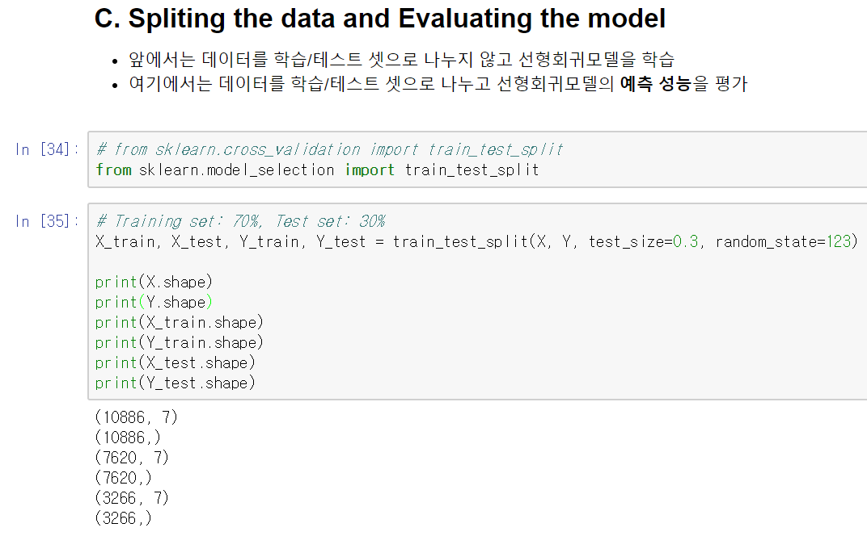
Predictive modeling: train_test_split

Slide 7
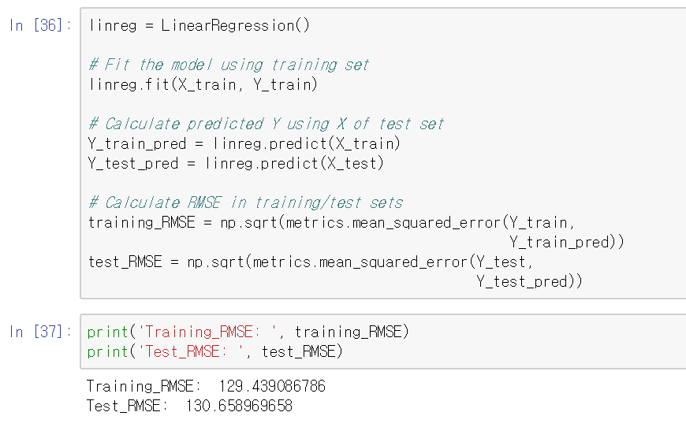
Predictive modeling: Calculate train_error and test_error

Slide 8
Parameter control
All estimators (or models) have parameters.
If you want to get good estimators, you have to control parameters!

Slide 9

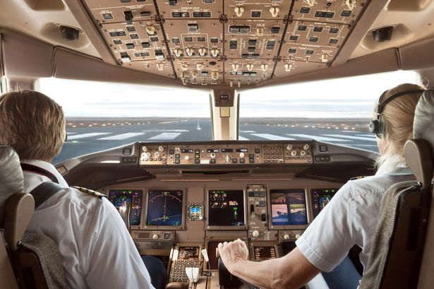
Control parameters of the estimator
Club DJ, pilot and data scientist
DJ set, airplane ➔ machine learning model
Buttons, dials ➔ parameters for model

Slide 10
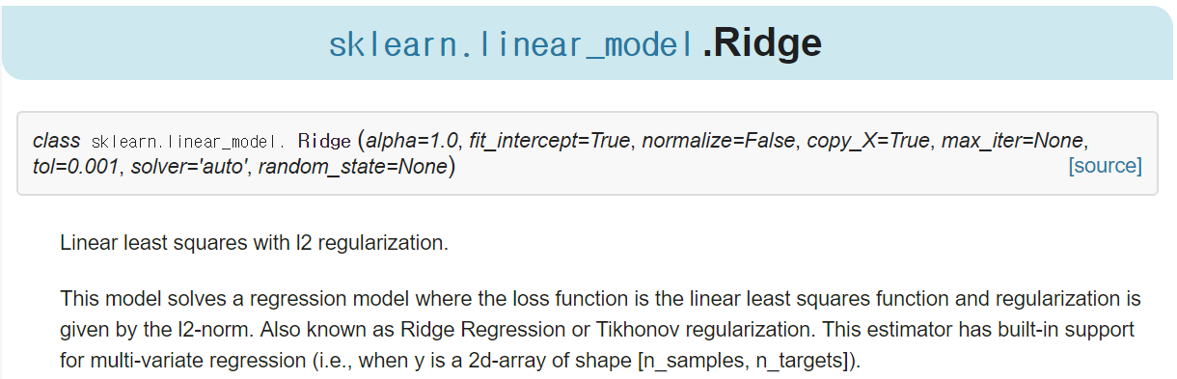
Control parameters of the estimator
Example: Ridge
Initial parameters
http://scikit-learn.org/stable/modules/generated/sklearn.linear_model.Ridge.html

Slide 11
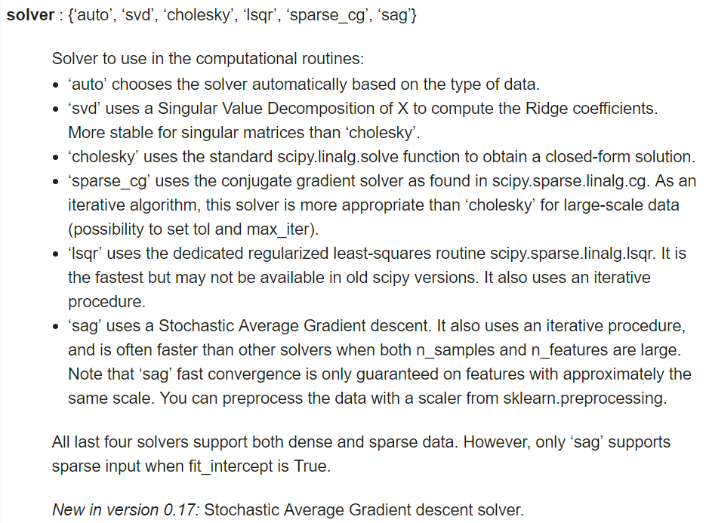
Control parameters of the estimator
Example: Ridge
You can see parameters and responding values
‘solver’ parameter for Ridge
http://scikit-learn.org/stable/modules/generated/sklearn.linear_model.Ridge.html

Slide 12
Ridge and Lasso: Parameters

Slide 13
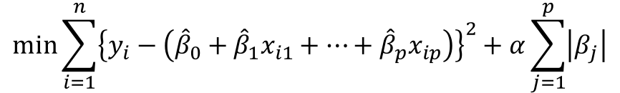
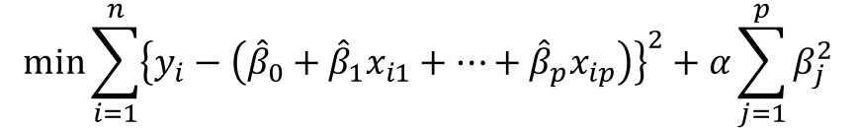
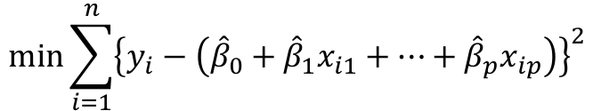
Simple linear regression vs. Ridge vs. Lasso
Objective functions (or cost functions)
Linear regression (f)
Ridge (f + L2-norm regularization)
Lasso (f + L1-norm regularization)
$$min\sum_{i=1}^{n}{{\left\{y_{i}−\left({\hat{β}}_{0}+{\hat{β}}_{1}x_{i1}+…+{\hat{β}}_{p}x_{ip}\right)\right\}}^{2}}$$
$$min\sum_{i=1}^{n}{{\left\{y_{i}−\left({\hat{β}}_{0}+{\hat{β}}_{1}x_{i1}+…+{\hat{β}}_{p}x_{ip}\right)\right\}}^{2}+α\sum_{j=1}^{p}{β_{j}^{2}}}$$
$$min\sum_{i=1}^{n}{{\left\{y_{i}−\left({\hat{β}}_{0}+{\hat{β}}_{1}x_{i1}+…+{\hat{β}}_{p}x_{ip}\right)\right\}}^{2}+α\sum_{j=1}^{p}{\left|β_{j}\right|}}$$

Slide 14
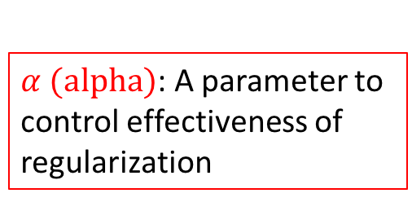
Simple linear regression vs. Ridge vs. Lasso
Objective functions (or cost functions)
Linear regression (f)
Ridge (f + L2-norm regularization)
Lasso (f + L1-norm regularization)
$$min\sum_{i=1}^{n}{{\left\{y_{i}−\left({\hat{β}}_{0}+{\hat{β}}_{1}x_{i1}+…+{\hat{β}}_{p}x_{ip}\right)\right\}}^{2}}$$
$α (alpha)$: A parameter to control effectiveness of regularization
$$min\sum_{i=1}^{n}{{\left\{y_{i}−\left({\hat{β}}_{0}+{\hat{β}}_{1}x_{i1}+…+{\hat{β}}_{p}x_{ip}\right)\right\}}^{2}+α\sum_{j=1}^{p}{β_{j}^{2}}}$$
$$min\sum_{i=1}^{n}{{\left\{y_{i}−\left({\hat{β}}_{0}+{\hat{β}}_{1}x_{i1}+…+{\hat{β}}_{p}x_{ip}\right)\right\}}^{2}+α\sum_{j=1}^{p}{\left|β_{j}\right|}}$$

Slide 15
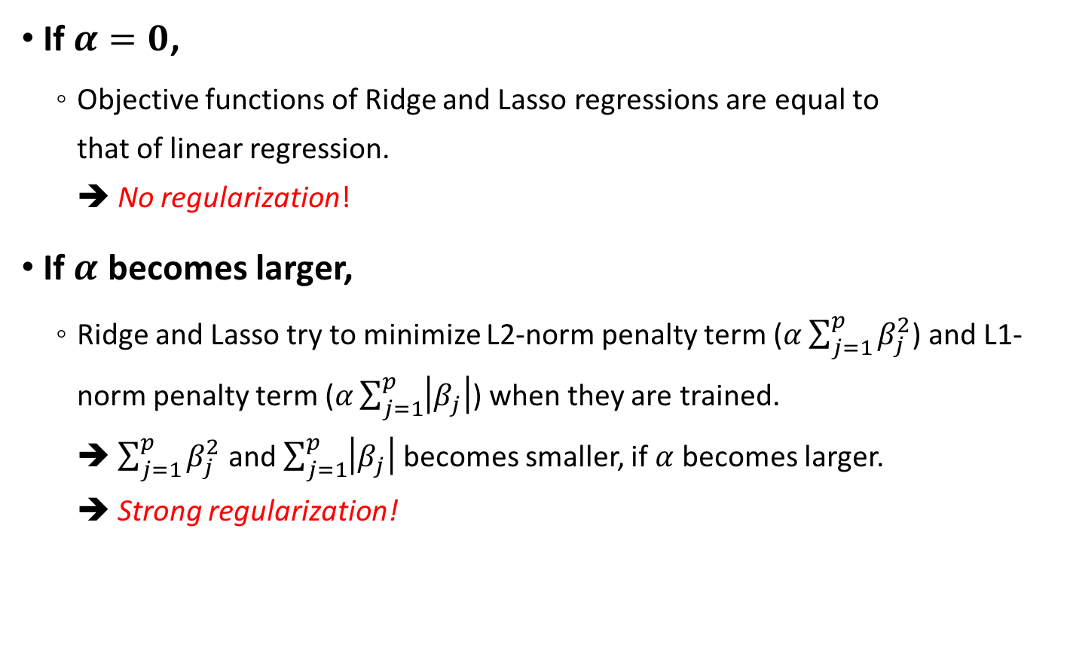
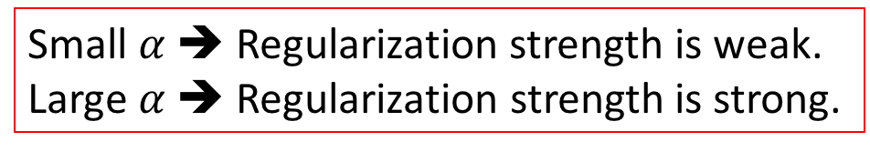
Parameter: $α$ (alpha)
If $α=0$,
Objective functions of Ridge and Lasso regressions are equal to that of linear regression. ➔ No regularization!
If $α$ becomes larger,
Ridge and Lasso try to minimize L2-norm penalty term ($α\sum_{j=1}^{p}{β_{j}^{2}}$) and L1-norm penalty term ($α\sum_{j=1}^{p}{\left|β_{j}\right|}$) when they are trained. ➔ $\sum_{j=1}^{p}{β_{j}^{2}}$ and $\sum_{j=1}^{p}{\left|β_{j}\right|}$ becomes smaller, if $α$ becomes larger. ➔ Strong regularization!
Small $α$ ➔ Regularization strength is weak.
Large $α$ ➔ Regularization strength is strong.

Slide 16

Parameter: $α$ (alpha)
In Ridge,
The larger $α$, the greater the amount of shrinkage.
The absolute value of all the coefficients becomes small.
We expect that the coefficients become more robust to collinearity.
http://scikit-learn.org/stable/modules/linear_model.html

Slide 17

Parameter: $α$ (alpha)
In Lasso,
The larger $α$, the fewer the non-zero coefficients.
Sparse modeling
It is useful in some contexts due to its tendency to prefer solutions with fewer parameter values, effectively reducing the number of variables upon which the given solution is dependent.
http://scikit-learn.org/stable/modules/linear_model.html

Slide 18
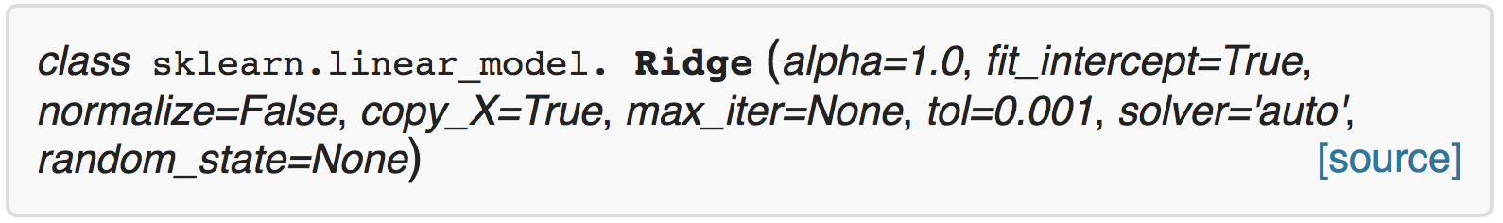
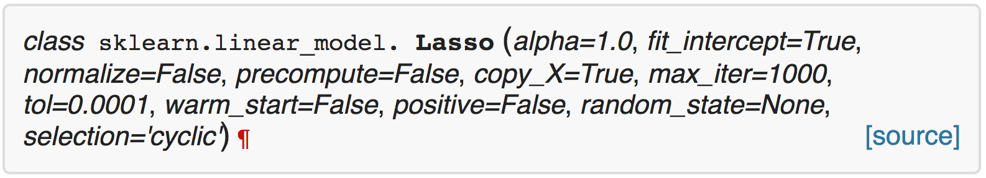
Parameter: $α$ (alpha)
You can control this parameter when using Ridge and Lasso in scikit-learn.
http://scikit-learn.org/stable/modules/generated/sklearn.linear_model.Ridge.html
http://scikit-learn.org/stable/modules/generated/sklearn.linear_model.Lasso.html

