Slide 1
Linear regression
고태훈 (thoon.koh@gmail.com)

Slide 2
Predictive modeling
Given data
X
Y
X
Y
Train data
X
Y
Test
data

Slide 3
Predictive modeling
Training/Learning /Estimating
X
Y
Supervised model
Train data
Test
data
X
Y

Slide 4


Predictive modeling
Calculating “train error” using Y and $\hat{Y}$ of training data
X
Y
$$\hat{Y}$$
Predicting Y values
Train data
Supervised model
Test
data
X
Y
$$\hat{Y}$$
Predicting Y values
Calculating “test error” using Y and $\hat{Y}$ of test data

Slide 5
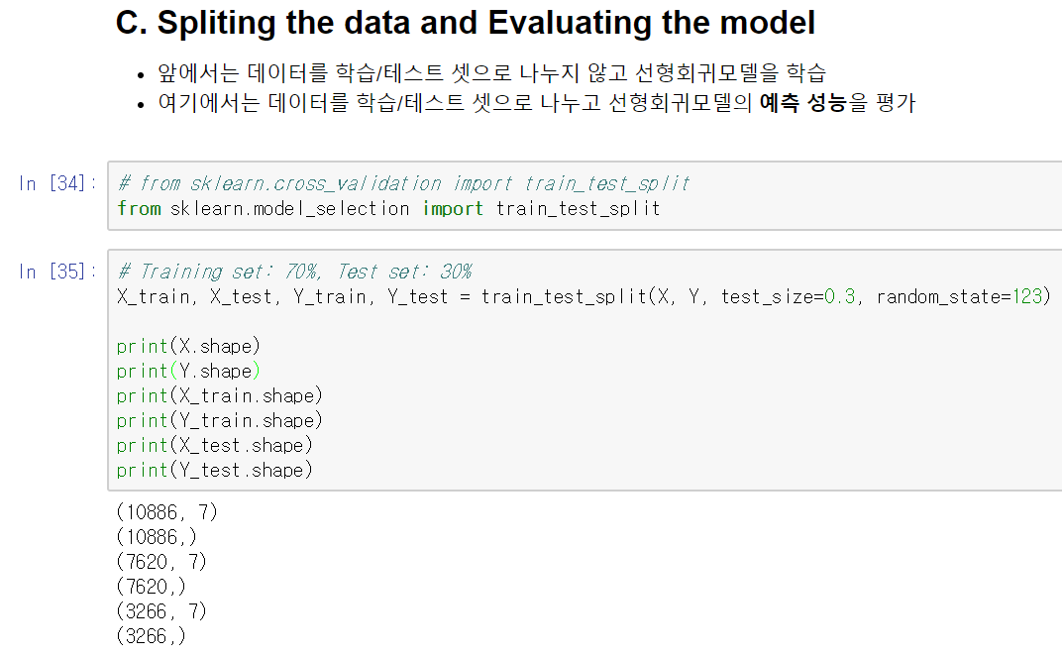
train_test_split

Slide 6
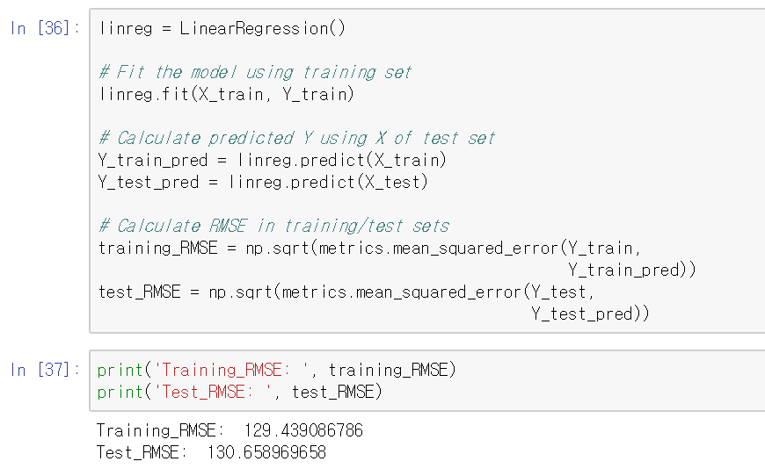
Calculate train_error and test_error

Slide 7

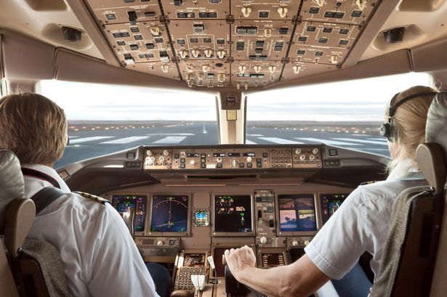
Control parameters of the estimator
Club DJ, pilot and data scientist
DJ set, airplane ➔ machine learning model
Buttons, dials ➔ parameters for model

Slide 8
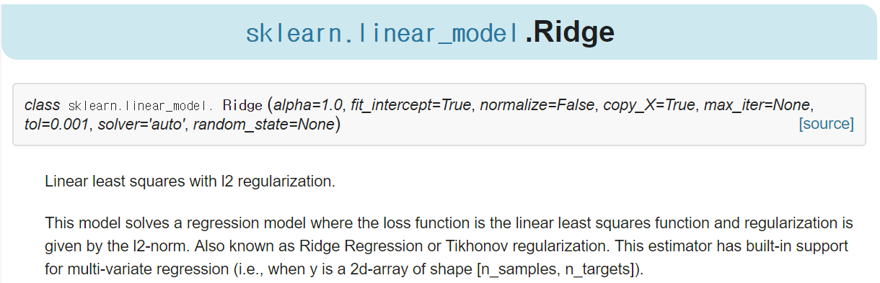
Control parameters of the estimator
Example: Ridge
Initial parameters
http://scikit-learn.org/stable/modules/generated/sklearn.linear_model.Ridge.html

Slide 9
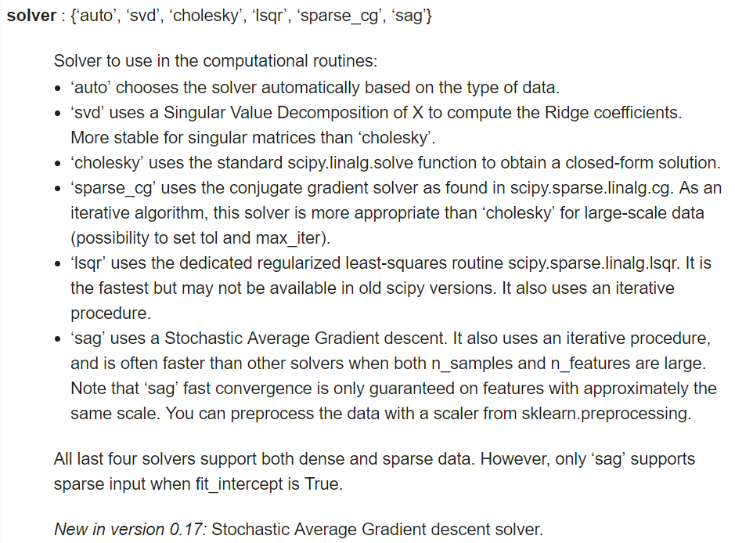
Control parameters of the estimator
Example: Ridge
You can see parameters and responding values
‘solver’ parameter for Ridge
http://scikit-learn.org/stable/modules/generated/sklearn.linear_model.Ridge.html

