Slide 1


TRADER: Trace Divergence Analysis and Embedding Regulation for Debugging Recurrent Neural Networks
Guanhong Tao, Shiqing Ma, Yingqi Liu, Qiuling Xu, Xiangyu Zhang

Slide 2
Introduction
Many software artifacts are in the form of text or sequences
Recurrent Neural Networks (RNNs): designed to deal with textual inputs and inputs in sequence
SentiStrength [1] predicts positive or negative sentiment for informal English text
Predicted sentiment is further used to extract problematic API features by work [2]
A recent study [3] showed that SentiStrength achieved recall and precision lower than 40% on negative sentences
[1] Thelwall et al. 2010. Sentiment strength detection in short informal text. Journal of the American Society for Information Science and Technology.
[2] Zhang et al. 2013. Extracting problematic API features from forum discussions. In 21st International Conference on Program Comprehension (ICPC).
[3] Lin et al. 2018. Sentiment Analysis for Software Engineering: How Far Can We Go?. In Proceedings of 40th International Conference on Software Engineering (ICSE).

Slide 3
Introduction
Text sequence → word embeddings → RNN model → prediction
Word embeddings are the dominating factor in model accuracy in RNN applications [4, 5, 6]
Same ML model using different word embeddings can have divergent accuracy ranging from 62.95% to 88.90% [5]
For a type of bugs in which problematic word embeddings lead to suboptimal model accuracy
[4] Baroni et al. 2014. Don’t count, predict! A systematic comparison of context-counting vs. context-predicting semantic vectors. In Proceedings of the 52nd Annual
Meeting of the Association for Computational Linguistics (ACL).
[5] Schnabel et al. 2015. Evaluation methods for unsupervised word embeddings. In Conference on Empirical Methods in Natural Language Processing (EMNLP).
[6] Yu et al. 2017. Refining word embeddings for sentiment analysis. In Conference on Empirical Methods in Natural Language Processing (EMNLP).

Slide 4
Introduction
Text sequence → word embeddings → RNN model → prediction
The quality of word embeddings can be measured using neighboring words
Target word
Original: original embeddings
Regulated: regulated embeddings (by our tool)
Nearest words measured by cosine similarity

Slide 5
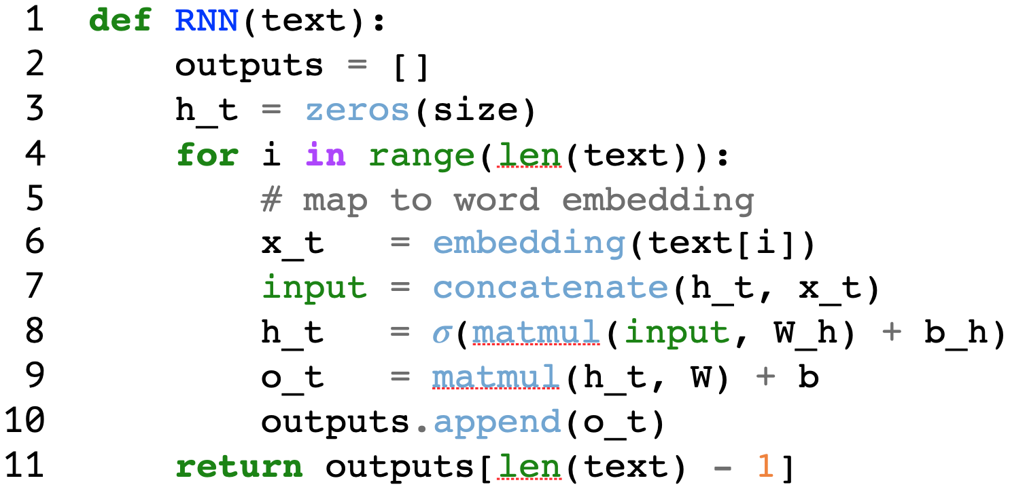

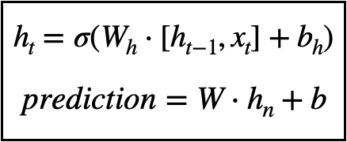
Debugging An RNN Model
o_{t}
o₀
o₁
o_{t}
h_{t}
Loop
h₀
h₁
h_{t}
C
C
C
C
x_{t}
x₀
x₁
x_{t}
Task: predict the label of an input sentence
Unrolled RNN structure
Each pair of [h_t, x_t] and o_t is a state, and all the states (looping over input text sequence) constitute a trace
Prediction is the last output

Slide 6
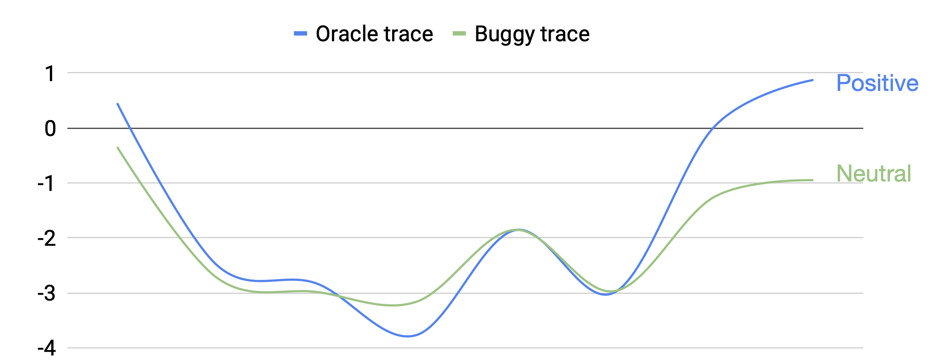
Trace Divergence Analysis
Trace divergence analysis
At each time step, use x_t and h_t as input, and o_t as output
Train classifiers on validation set to identify diverged steps
Please see paper for detailed analysis
A misclassification is caused by buggy states within a trace
“Also, JodaTime¹ makes calculations with time much simpler”²
o₀
o₁
o₆
o₇
h₀
h₁
h₆
h₇
Also
C
C
C
C
simpler
Output
much
x₀
x₁
x₆
x₇
with
makes
Trace divergence
JodaTime
JodaTime
time
simpler
Also
much
calculations
x₀
h₀
o₀
x₁
h₁
o₁
x₆
h₆
o₆
x₇
h₇
o₇
Time step
State vector
Trace
¹A data and time library for Java. https://www.joda.org/joda-time/
²A sample text from Stack overflow dataset predicted by a LSTM model

Slide 7
Defective Dimension Identification
Obtain state vector of diverged step
Multiply state vector with a pre-trained state importance element-wisely
Locate defective dimensions with large values
Aggregate defective dimensions from all the diverged steps using Algorithm 1 (details in paper)
The root cause of buggy states comes from problematic state dimensions
Also, JodaTime makes … much simpler.
[ ]
x_{t}
h_{t}
[ ··· 0.4 ··· -0.1 ··· -0.2 ··· ]
⊙
Pre-trained importance
[ ··· 0.1 ··· -4.0 ··· 0.3 ··· ]
=
Weighted state vector
[ ··· 0.04 ··· 0.4 ··· -0.06 ··· ]
Defective dimension

Slide 8





Embedding Regulation
Model is sensitive for defective dimensions
Regulating word embeddings to reduce impact from buggy dimensions
Apply perturbations on buggy (input and internal) dimensions
Freeze model parameters and update input embeddings by minimizing output difference
Retrain model with regulated word embeddings
Please see details in Algorithm 2
Also, JodaTime makes … much simpler.
$${[x}_{t}, h_{t}]$$
[ ··· 0.4 ··· -0.1 ··· -0.2 ··· ]
Weighted state vector
[ ··· 0.04 ··· 0.4 ··· -0.06 ··· ]
+
Error vector
[ ··· 0 ··· 𝜀 ··· 0 ··· ]
$${[\hat{x}}_{t}, {\hat{h}}_{t}]$$
o_{t}
diff
$${\hat{o}}_{t}$$
h_{t}
$${ \hat{h}}_{t}$$
C
C
x_{t}
$${ \hat{x}}_{t}$$

Slide 9

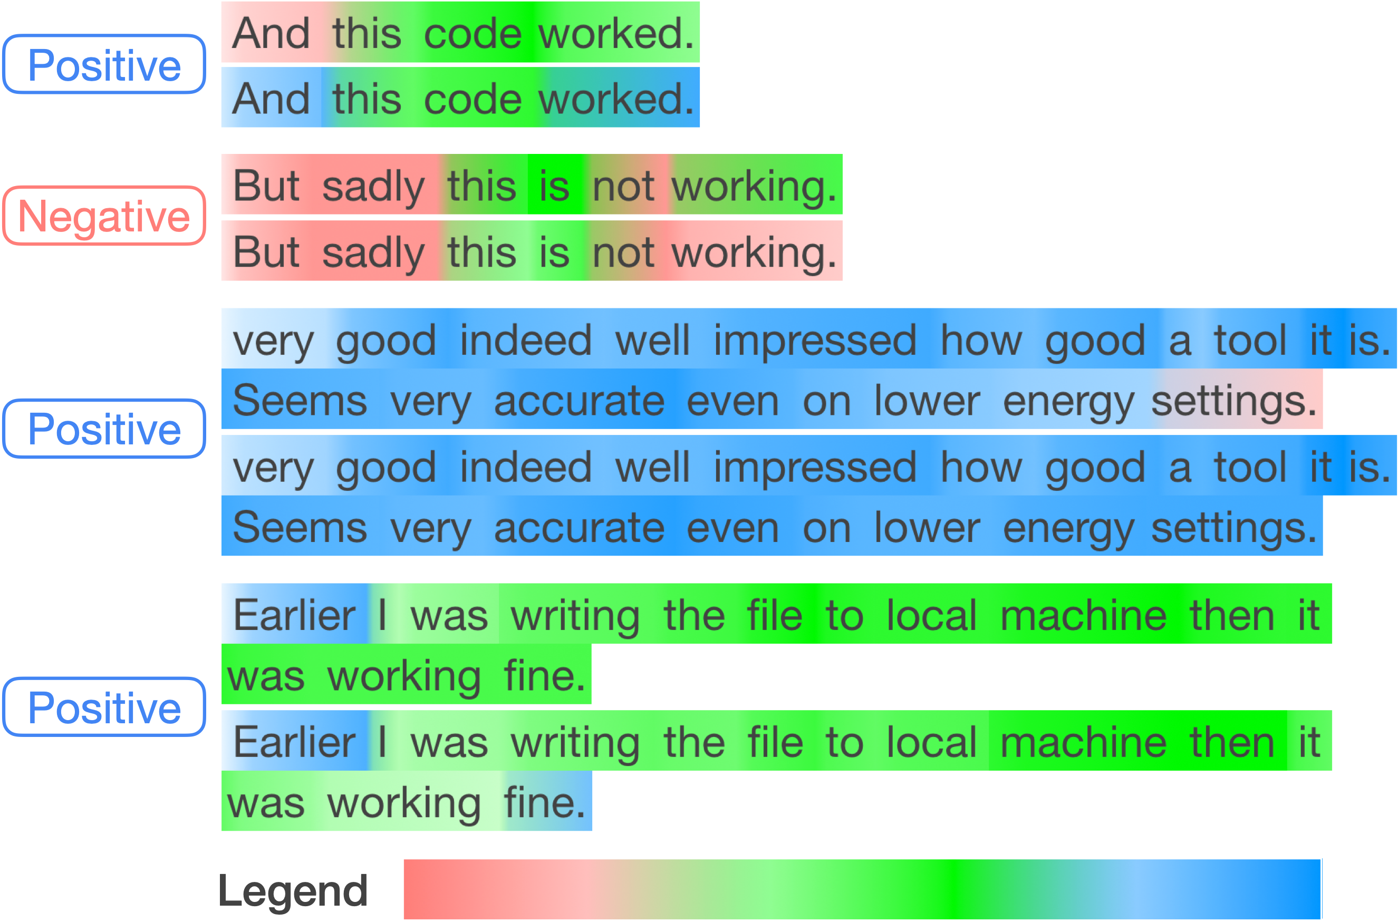
Experimental Results
5.37% improvement on 135 models (baseline 0.6%)
5 datasets, 3 word embeddings, 3 RNN model structures (each with 3 different settings)
Case study
Artifacts: https://github.com/trader-rnn/TRADER
Label
Input sentence
→Original model
→Fixed model
→Original model
→Fixed model
Negative Neutral Positive

Slide 10
Related Work
Existing works focus on debugging specific machine learning models or feed-forward Neural Networks and are not applicable to RNNs [7, 8, 9]
Work [10] aims at debugging NLP models by generating adversarial examples as training data
Researchers [11, 12] propose methods to debug models by cleaning up the wrongly labeled training data
These approaches debug RNN models by providing better training data and do not analyze model internals
[7] Cadamuro et al. 2016. Debugging machine learning models. In ICML Workshop on Reliable Machine Learning in the Wild.
[8] Chakarov et al. 2016. Debugging machine learning tasks. arXiv preprint arXiv:1603.07292 (2016).
[9] Ma et al. 2018. MODE: automated neural network model debugging via state differential analysis and input selection. In Proceedings of the 2018 26th ACM Joint
Meeting on European Software Engineering Conference and Symposium on the Foundations of Software Engineering (ESEC/FSE).
[10] Ribeiro et al. 2018. Semantically equivalent adversarial rules for debugging NLP models. In Association for Computational Linguistics (ACL).
[11] Jiang et al. 2004. Editing training data for kNN classifiers with neural network ensemble. In International Symposium on Neural Networks.
[12] Zhang et al. 2018. Training set debugging using trusted items. In Thirty-Second AAAI Conference on Artificial Intelligence.

Slide 11
Thank you!

Slide 12
Q&A

