Slide 1

Model Orthogonalization: Class Distance Hardening in Neural Networks for Better Security
Guanhong Tao, Yingqi Liu, Guangyu Shen, Qiuling Xu,
Shengwei An, Zhuo Zhang, Xiangyu Zhang
Email: {taog, liu1751, shen447, xu1230, an93, zhan3299, xyzhang}@cs.purdue.edu

Slide 2





Backdoor Attack
Backdoor attack is a prominent security threat to deep neural networks
+
Input
Injected Trigger
Input + Trigger
Poisoned Model
Target
Model
Output
Model Orthogonalization: Class Distance Hardening in Neural Networks for Better Security

Slide 3
Backdoor Defense
Backdoor scanning
Determine if a model has an injected backdoor
Backdoor input detection
Detect an input with a backdoor pattern on-the-fly
Backdoor elimination
Repair a model by removing an injected backdoor
Injected Backdoors
Model Orthogonalization: Class Distance Hardening in Neural Networks for Better Security

Slide 4

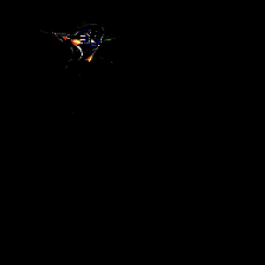
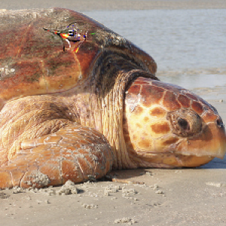


Injected Backdoor
+
Input
Injected Trigger
Input + Trigger
Poisoned Model
Target
Natural Backdoor
Downloaded from Model Zoo^{[1]}
+
Input
Generated Trigger
Input + Trigger
Benign Model
Target
[1] Keras Applications, https://keras.io/api/applications/
Model Orthogonalization: Class Distance Hardening in Neural Networks for Better Security

Slide 5

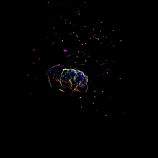
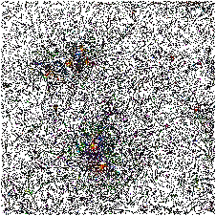
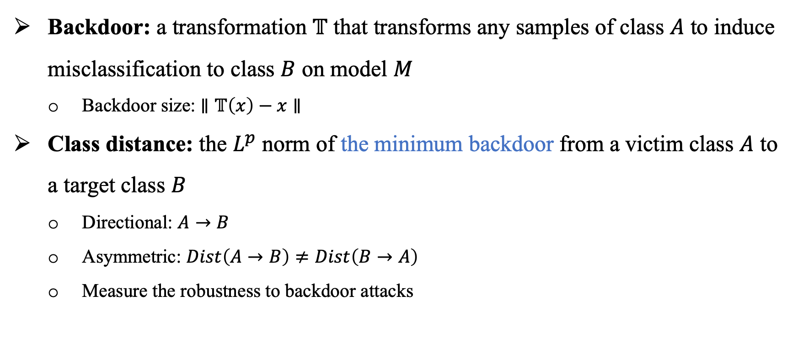
Class Distance
Backdoor: a transformation $𝕋$ that transforms any samples of class $A$ to induce misclassification to class $B$ on model $M$
Backdoor size: $∥𝕋\left(x\right)−x∥$
Class distance: the $L^{p}$ norm of the minimum backdoor from a victim class $A$ to a target class $B$
Directional: $A→B$
Asymmetric: $Dist\left(A→B\right)≠Dist\left(B→A\right)$
Measure the robustness to backdoor attacks
Turtle → Bird
Distance: 615
Bird → Turtle
Distance: 1399
Distance: 48004
Model Orthogonalization: Class Distance Hardening in Neural Networks for Better Security

Slide 6
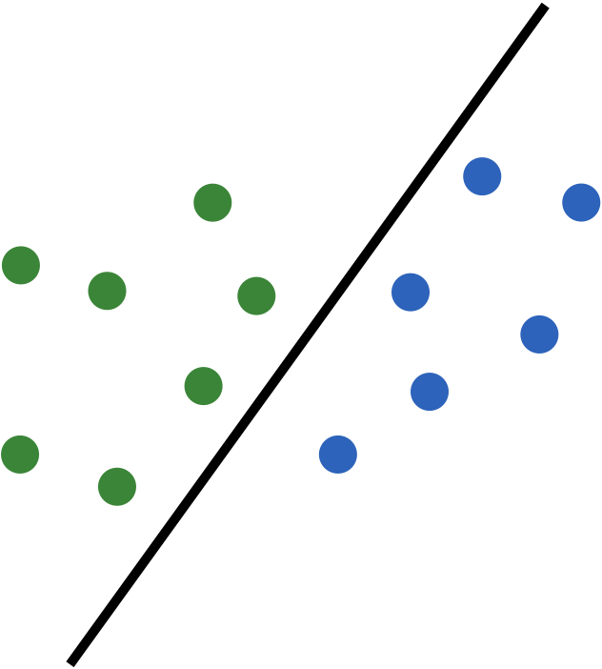










Intuition: How to Enlarge Class Distance
Backdoor flipping samples to the other side
Decision boundary after adv. training
Boundary perpendicular to the linking line
Not sufficient
Natural Training
Adversarial Training
Our Goal
Model Orthogonalization: Class Distance Hardening in Neural Networks for Better Security

Slide 7
Problem Definition
Goal
Improve model robustness against backdoors by enlarging pairwise class distances w/o sacrificing much accuracy
Knowledge: 5% of the original training dataset when removing injected backdoors
Scope
Static trigger: doesn’t change regarding the input, e.g. patch backdoors
Label-specific: flip samples from a victim class to a target class
Injected (poisoned model) or naturally present (clean model)
Model Orthogonalization: Class Distance Hardening in Neural Networks for Better Security

Slide 8
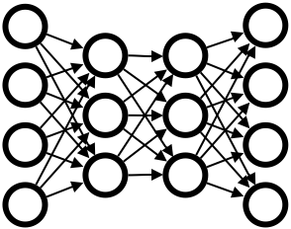

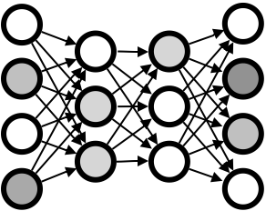




A Straightforward Idea
Select A Pair
Trigger Generation
Input Model & Data
Model Hardening
Output Model
Model Orthogonalization: Class Distance Hardening in Neural Networks for Better Security

Slide 9

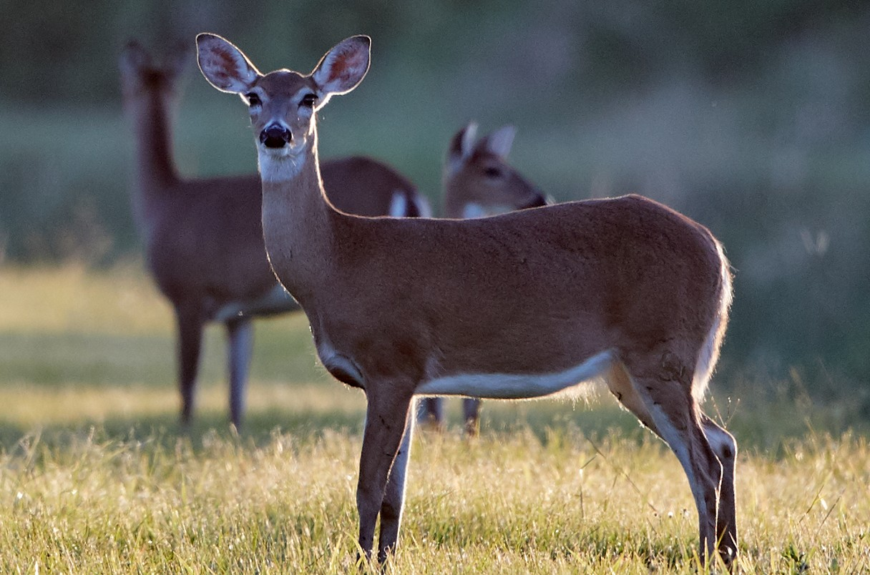
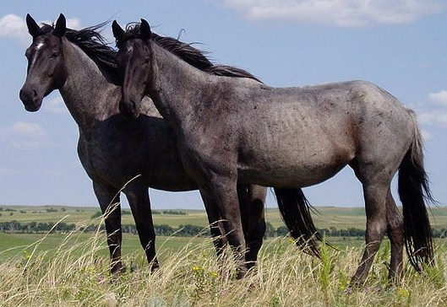
Problem 1: Different Potentials of Class Pairs
A close pair like deer and horse
Class distance does not grow much over time
A promising pair like bird and horse
Distance saturates after certain iterations
Train each pair to their maximum distance
Quadratic complexity
Random selection is suboptimal
Different pairs have various capacities
Deer
Bird
Horse
Model Orthogonalization: Class Distance Hardening in Neural Networks for Better Security

Slide 10


Solution to P1: Warm-up
Input Model & Data
Warm-up
Pair Selection & Hardening
Run a few rounds of optimization for every pair and use the distance for further improvement
Quadratic complexity
Our warm-up with linear complexity
Leverage one round of universal backdoor generation to probe the potential
Flip a small set of samples from all classes to a target class
Observe the loss change of each class to the target
Difficulty of flipping samples using the universal trigger
Model Orthogonalization: Class Distance Hardening in Neural Networks for Better Security

Slide 11

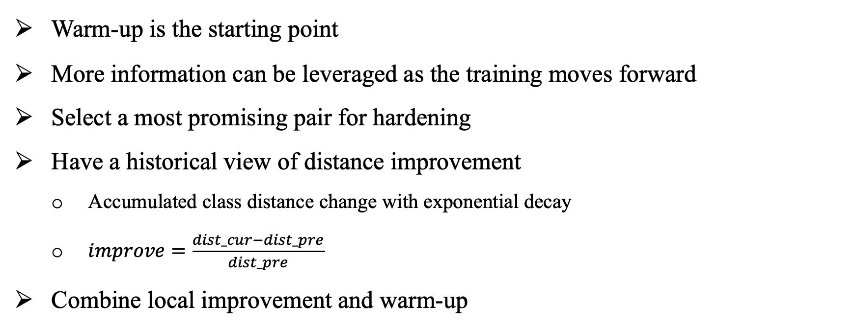
Solution to P1: Scheduling
Scheduler
Input Model & Data
Warm-up
Pair Selection & Hardening
Warm-up is the starting point
More information can be leveraged as the training moves forward
Select a most promising pair for hardening
Have a historical view of distance improvement
Accumulated class distance change with exponential decay
$improve=\frac{dist_cur−dist_pre}{dist_pre}$
Combine local improvement and warm-up
Model Orthogonalization: Class Distance Hardening in Neural Networks for Better Security

Slide 12
Problem 2: Training Along Two Directions Cancels Out
Boundary perpendicular to the linking line
Train Two Directions Separately
Train Two Directions Together
Model Orthogonalization: Class Distance Hardening in Neural Networks for Better Security

Slide 13
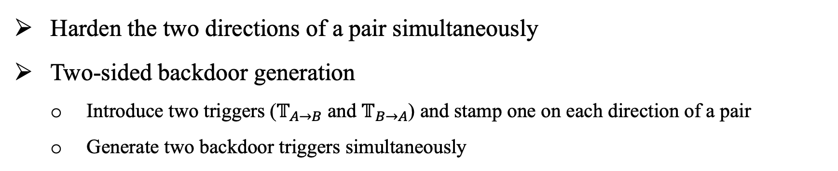
Solution to P2: Symmetric Hardening
Harden the two directions of a pair simultaneously
Two-sided backdoor generation
Introduce two triggers ($𝕋_{A→B}$ and $𝕋_{B→A}$) and stamp one on each direction of a pair
Generate two backdoor triggers simultaneously
Scheduler
Input Model & Data
Warm-up
Pair Selection & Hardening
Model Orthogonalization: Class Distance Hardening in Neural Networks for Better Security

Slide 14
Experiment Setup
Datasets and models
Datasets: CIFAR-10, SVHN, LISA, and GTSRB
Models: ResNet20, ResNet32 , ResNet50, Network in Network, CNN, VGG19
89 (downloaded) pre-trained models (30 benign and 59 poisoned)
Baselines
Use universal backdoors for hardening (Universal)
Universal adversarial perturbation (UAP)^{[2]}
Two backdoor-erasing approaches: NC^{[3]} and NAD^{[4]}
[2] Shafahi, Ali, et al. “Universal adversarial training.” AAAI 2020.
[3] Wang, Bolun, et al. “Neural cleanse: Identifying and mitigating backdoor attacks in neural networks.” IEEE S&P 2019.
[4] Li, Yige, et al. “Neural attention distillation: Erasing backdoor triggers from deep neural networks.” ICLR 2021.
Model Orthogonalization: Class Distance Hardening in Neural Networks for Better Security

Slide 15
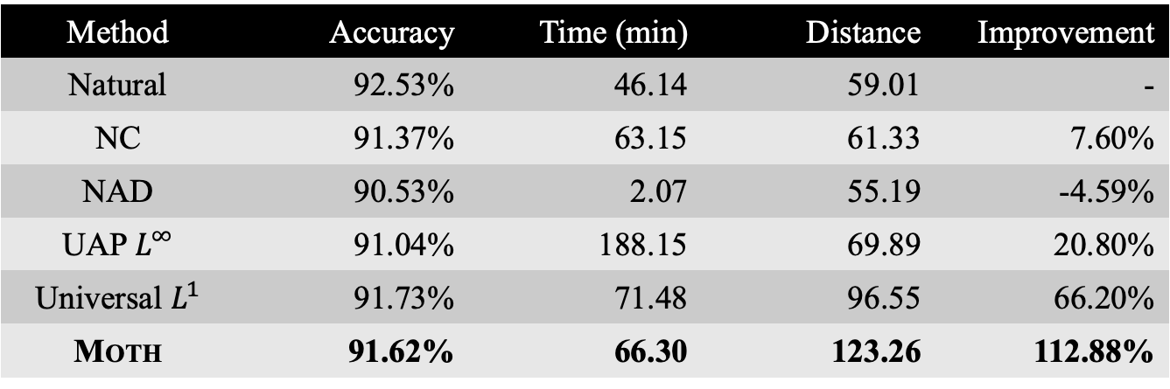
Enlarging Class Distance
Metric: relative improvement of pair-wise class distance for all pairs
Naturally trained models
MOTH has the largest distance improvement with reasonable time cost and accuracy drop
Method | Accuracy | Time (min) | Distance | Improvement
Natural | 92.53% | 46.14 | 59.01 | -
NC | 91.37% | 63.15 | 61.33 | 7.60%
NAD | 90.53% | 2.07 | 55.19 | -4.59%
UAP $L^{∞}$ | 91.04% | 188.15 | 69.89 | 20.80%
Universal $L^{1}$ | 91.73% | 71.48 | 96.55 | 66.20%
MOTH | 91.62% | 66.30 | 123.26 | 112.88%
Model Orthogonalization: Class Distance Hardening in Neural Networks for Better Security

Slide 16
Enlarging Class Distance (cont.)
Adversarially trained models
MOTH also has the largest distance improvement
Only 0.58% accuracy degradation
No robustness degradation on average
Model Orthogonalization: Class Distance Hardening in Neural Networks for Better Security

Slide 17
Application
Eliminate injected backdoors
MOTH reduces the attack success rate from almost 100% to 1% for 59 models on average
In comparison, SOTA methods (NC^{[3]}, NAD^{[4]}, etc.) can only reduce to 27% at most
Code: https://github.com/Gwinhen/MOTH
[3] Wang, Bolun, et al. “Neural cleanse: Identifying and mitigating backdoor attacks in neural networks.” IEEE S&P 2019.
[4] Li, Yige, et al. “Neural attention distillation: Erasing backdoor triggers from deep neural networks.” ICLR 2021.
Model Orthogonalization: Class Distance Hardening in Neural Networks for Better Security

Slide 18
Related Work
[1] Keras Applications, https://keras.io/api/applications/
[2] Shafahi, Ali, et al. “Universal adversarial training.” AAAI 2020.
[3] Wang, Bolun, et al. “Neural cleanse: Identifying and mitigating backdoor attacks in neural networks.” IEEE S&P 2019.
[4] Li, Yige, et al. “Neural attention distillation: Erasing backdoor triggers from deep neural networks.” ICLR 2021.
[5] Auer, Peter, et al. “Finite-time analysis of the multiarmed bandit problem.” Machine learning 47.2 (2002): 235-256.
[6] Watkins, Christopher John Cornish Hellaby. “Learning from delayed rewards.” (1989).
[7] Gu, Tianyu, et al. “Badnets: Evaluating backdooring attacks on deep neural networks.” IEEE Access 7 (2019).
[8] Liu, Yingqi, et al. “Trojaning attack on neural networks.” NDSS 2018.
[9] Liu, Yingqi, et al. “Abs: Scanning neural networks for back-doors by artificial brain stimulation.” CCS 2019.
[10] TrojAI Leaderboard, https://pages.nist.gov/trojai/
…
Model Orthogonalization: Class Distance Hardening in Neural Networks for Better Security

Slide 19
Conclusion
Propose a novel model hardening technique MOTH that can enlarge class distances, making models resilient to backdoor attacks
MOTH can improve class distances by 177.63% on average with only 1% accuracy loss for 48 models
MOTH reduces the attack success rate of injected backdoors by 99% on average, outperforming state-of-the-art backdoor removal techniques
Model Orthogonalization: Class Distance Hardening in Neural Networks for Better Security

Slide 20

MOTH Repo
Thank you!
Q&A

