Slide 1
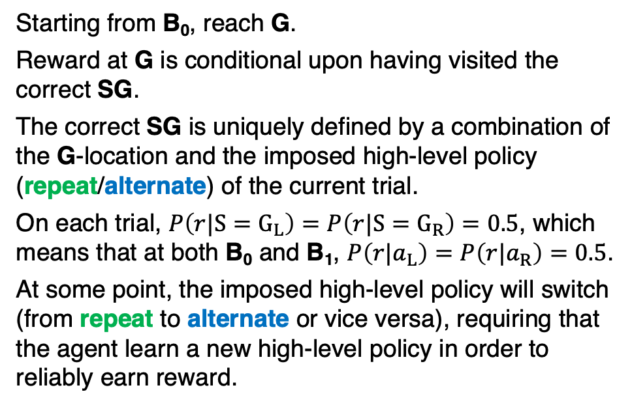
TASK DESIGN
G_{L}
G_{R}
Starting from B₀, reach G.
Reward at G is conditional upon having visited the correct SG.
The correct SG is uniquely defined by a combination of the G-location and the imposed high-level policy (repeat/alternate) of the current trial.
On each trial, $P\left(r|{S=G}_{L}\right)=P\left({r|S=G}_{R}\right)=0.5$, which means that at both B₀ and B₁, $P\left(r|a_{L}\right)=P\left(r|a_{R}\right)=0.5$.
At some point, the imposed high-level policy will switch (from repeat to alternate or vice versa), requiring that the agent learn a new high-level policy in order to reliably earn reward.
D_{L}
B₁
D_{R}
repeat
SG_{L}
SG_{R}
alternate
B
bottlenecks
SG
sub-goals
B₀
D
dead ends
G
goals
People are able to learn new high-level policies following only 1 trial under the new imposed regime, and are able to generalise immediately to the symmetrical, unexperienced path. What classes of reinforcement learning models are able to reproduce one-shot learning and zero-shot transfer learning?

Slide 2
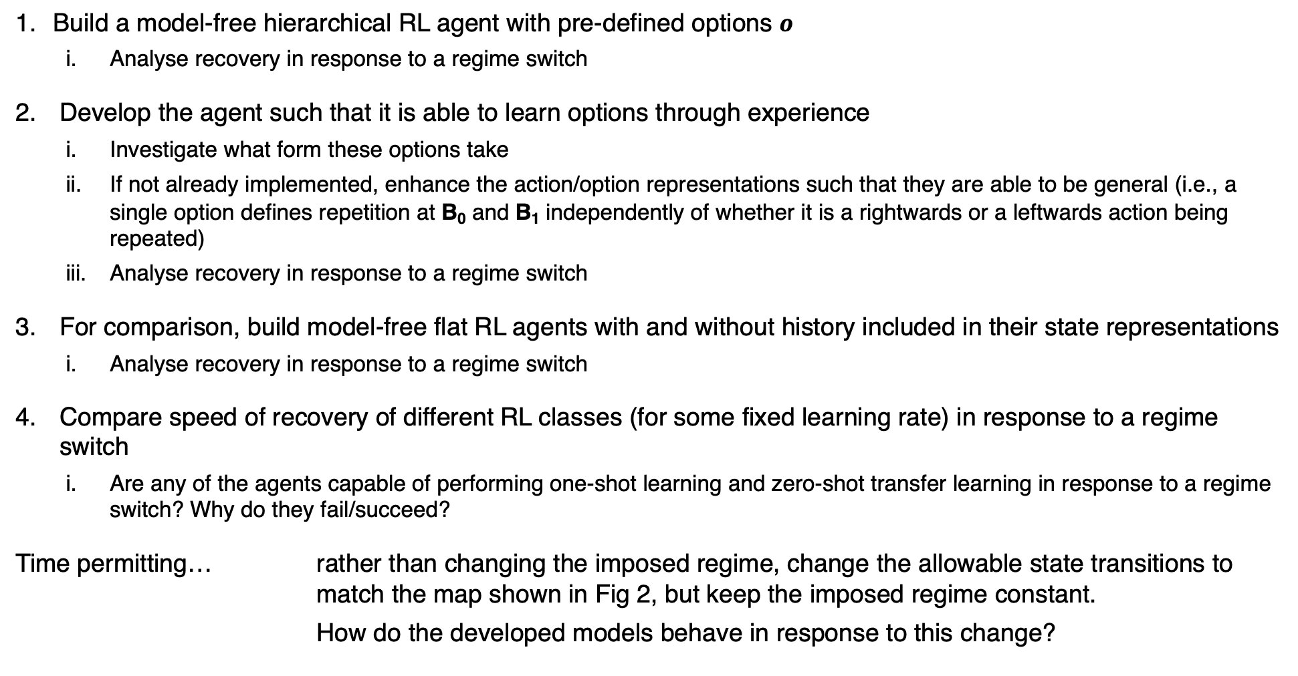
PROJECT STEPS
Build a model-free hierarchical RL agent with pre-defined options $o$
Analyse recovery in response to a regime switch
Develop the agent such that it is able to learn options through experience
Investigate what form these options take
If not already implemented, enhance the action/option representations such that they are able to be general (i.e., a single option defines repetition at B₀ and B₁ independently of whether it is a rightwards or a leftwards action being repeated)
Analyse recovery in response to a regime switch
For comparison, build model-free flat RL agents with and without history included in their state representations
Analyse recovery in response to a regime switch
Compare speed of recovery of different RL classes (for some fixed learning rate) in response to a regime switch
Are any of the agents capable of performing one-shot learning and zero-shot transfer learning in response to a regime switch? Why do they fail/succeed?
Time permitting… rather than changing the imposed regime, change the allowable state transitions to match the map shown in Fig 2, but keep the imposed regime constant.
How do the developed models behave in response to this change?

Slide 3
G_{L}
G_{R}
G_{L}
G_{R}
B₁
D
B₁
repeat
SG_{L}
SG_{R}
alternate
B
bottlenecks
SG
sub-goals
D
dead ends
B₀
G
goal

