Slide 1
What is the role of hierarchy in action control, how is it implemented, and does it help us generalise behaviours from one environment to another?
Gwydion Williams
PhD Student, UCL

Slide 2
What is the role of hierarchy in action control, how is it implemented, and does it help us generalise behaviours from one environment to another?
SOME MOTIVATION…
Hierarchical structures are pervasive in human behaviour

Slide 3
What is the role of hierarchy in action control, how is it implemented, and does it help us generalise behaviours from one environment to another?
SOME MOTIVATION…
Hierarchical structures are pervasive in human behaviour
The goal-directedness of human action is often explained in reinforcement learning (RL) terms, however…
RL is limited by the scaling problem
If the brain implements RL-like mechanisms, the scaling problem must pertain in the brain as it does in machine learning
Hierarchical action control presents one solution to the scaling problem

Slide 4
What is the role of hierarchy in action control, how is it implemented, and does it help us generalise behaviours from one environment to another?
SOME MOTIVATION…
Hierarchical structures are pervasive in human behaviour
The goal-directedness of human action is often explained in reinforcement learning (RL) terms, however…
RL is limited by the scaling problem
If the brain implements RL-like mechanisms, the scaling problem must pertain in the brain as it does in machine learning
Hierarchical action control presents one solution to the scaling problem
Hierarchical RL presents a framework which could be applied to study human behavioural hierarchy, its implementation, and its utility.

Slide 5
What is the role of hierarchy in action control, how is it implemented, and does it help us generalise behaviours from one environment to another?
SOME MOTIVATION…
Hierarchical structures are pervasive in human behaviour
The goal-directedness of human action is often explained in reinforcement learning (RL) terms, however…
RL is limited by the scaling problem
If the brain implements RL-like mechanisms, the scaling problem must pertain in the brain as it does in machine learning
Hierarchical action control presents one solution to the scaling problem
Hierarchical RL presents a framework which could be applied to study human behavioural hierarchy, its implementation, and its utility.
The options framework, which supplements the set of primitive actions found in flat RL with temporally abstract options, is one popular implementation of hierarchical RL.
Sutton, Precup & Singh (1999)

Slide 6
What is the role of hierarchy in action control, how is it implemented, and does it help us generalise behaviours from one environment to another?
A TASK…
G_{L}
G_{R}
For reward, the agent must navigate from B₀ to one of the two goal locations (G_{L} or G_{R}) via one of the two sub-goal locations (SG_{L} or SG_{R}).
D_{L}
B₁
D_{R}
repeat
SG_{L}
SG_{R}
alternate
B
bottlenecks
SG
sub-goals
B₀
D
dead ends
G
goals

Slide 7
What is the role of hierarchy in action control, how is it implemented, and does it help us generalise behaviours from one environment to another?
A TASK…
G_{L}
G_{R}
For reward, the agent must navigate from B₀ to one of the two goal locations (G_{L} or G_{R}) via one of the two sub-goal locations (SG_{L} or SG_{R}).
The correct sub-goal location on each trial is instructed, and the two sides are equiprobable.
D_{L}
B₁
D_{R}
repeat
SG_{L}
SG_{R}
alternate
B
bottlenecks
SG
sub-goals
B₀
D
dead ends
G
goals

Slide 8
What is the role of hierarchy in action control, how is it implemented, and does it help us generalise behaviours from one environment to another?
A TASK…
G_{L}
G_{R}
For reward, the agent must navigate from B₀ to one of the two goal locations (G_{L} or G_{R}) via one of the two sub-goal locations (SG_{L} or SG_{R}).
The correct sub-goal location on each trial is instructed, and the two sides are equiprobable.
The correct path is given by an imposed behavioural regime (repeat or alternate), which must be learned and applied on a trial-by-trial basis.
D_{L}
B₁
D_{R}
repeat
SG_{L}
SG_{R}
alternate
B
bottlenecks
SG
sub-goals
B₀
D
dead ends
G
goals

Slide 9
What is the role of hierarchy in action control, how is it implemented, and does it help us generalise behaviours from one environment to another?
A TASK…
G_{L}
G_{R}
For reward, the agent must navigate from B₀ to one of the two goal locations (G_{L} or G_{R}) via one of the two sub-goal locations (SG_{L} or SG_{R}).
The correct sub-goal location on each trial is instructed, and the two sides are equiprobable.
The correct path is given by an imposed behavioural regime (repeat or alternate), which must be learned and applied on a trial-by-trial basis.
The imposed behavioural regime will at some point switch (from repeat to alternate or vice versa).
D_{L}
B₁
D_{R}
repeat
SG_{L}
SG_{R}
alternate
B
bottlenecks
SG
sub-goals
B₀
D
dead ends
G
goals

Slide 10
What is the role of hierarchy in action control, how is it implemented, and does it help us generalise behaviours from one environment to another?
THE PROJECT…
People are able to learn new regimes following only 1 trial under a new imposed regime.
G_{L}
G_{R}
D_{L}
B₁
D_{R}
repeat
SG_{L}
SG_{R}
alternate
B
bottlenecks
SG
sub-goals
B₀
D
dead ends
G
goals

Slide 11
What is the role of hierarchy in action control, how is it implemented, and does it help us generalise behaviours from one environment to another?
THE PROJECT…
People are able to learn new regimes following only 1 trial under a new imposed regime.
What classes of reinforcement learning models are able to reproduce one-shot and zero-shot learning?
G_{L}
G_{R}
D_{L}
B₁
D_{R}
repeat
SG_{L}
SG_{R}
alternate
B
bottlenecks
SG
sub-goals
B₀
D
dead ends
G
goals

Slide 12
What is the role of hierarchy in action control, how is it implemented, and does it help us generalise behaviours from one environment to another?
THE PROJECT…
People are able to learn new regimes following only 1 trial under a new imposed regime.
What classes of reinforcement learning models are able to reproduce one-shot and zero-shot learning?
Flat (i.e., non-hierarchical)
Without history representation
With history representation
G_{L}
G_{R}
D_{L}
B₁
D_{R}
repeat
SG_{L}
SG_{R}
alternate
B
bottlenecks
SG
sub-goals
B₀
D
dead ends
G
goals

Slide 13
What is the role of hierarchy in action control, how is it implemented, and does it help us generalise behaviours from one environment to another?
THE PROJECT…
People are able to learn new regimes following only 1 trial under a new imposed regime.
What classes of reinforcement learning models are able to reproduce one-shot and zero-shot learning?
Flat (i.e., non-hierarchical)
Without history representation
With history representation
Hierarchical
Without generalisable action representation
With generalisable action representation
G_{L}
G_{R}
D_{L}
B₁
D_{R}
repeat
SG_{L}
SG_{R}
alternate
B
bottlenecks
SG
sub-goals
B₀
D
dead ends
G
goals

Slide 14
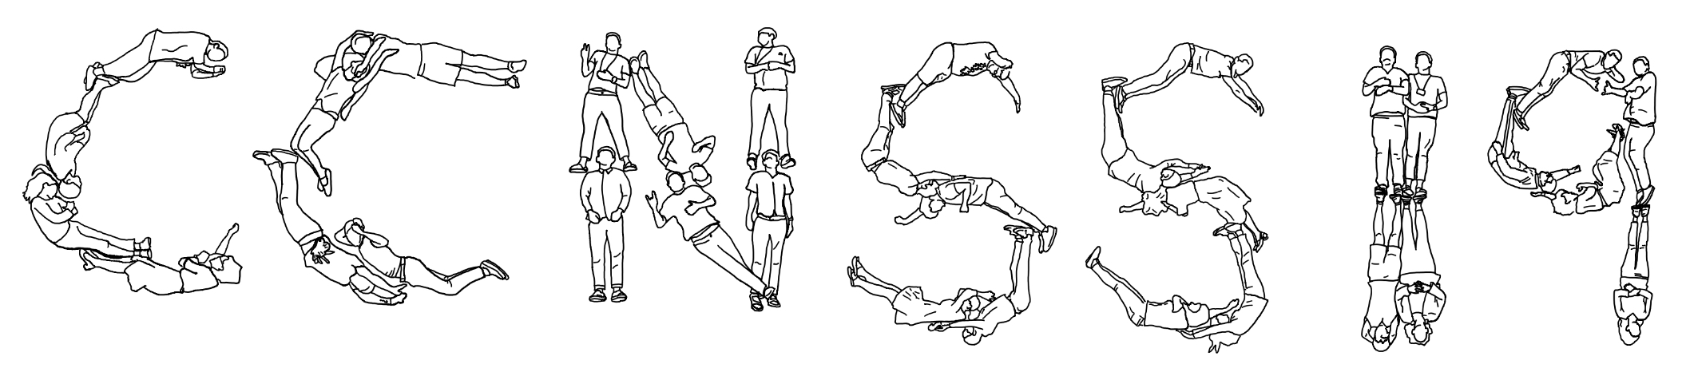

Slide 15
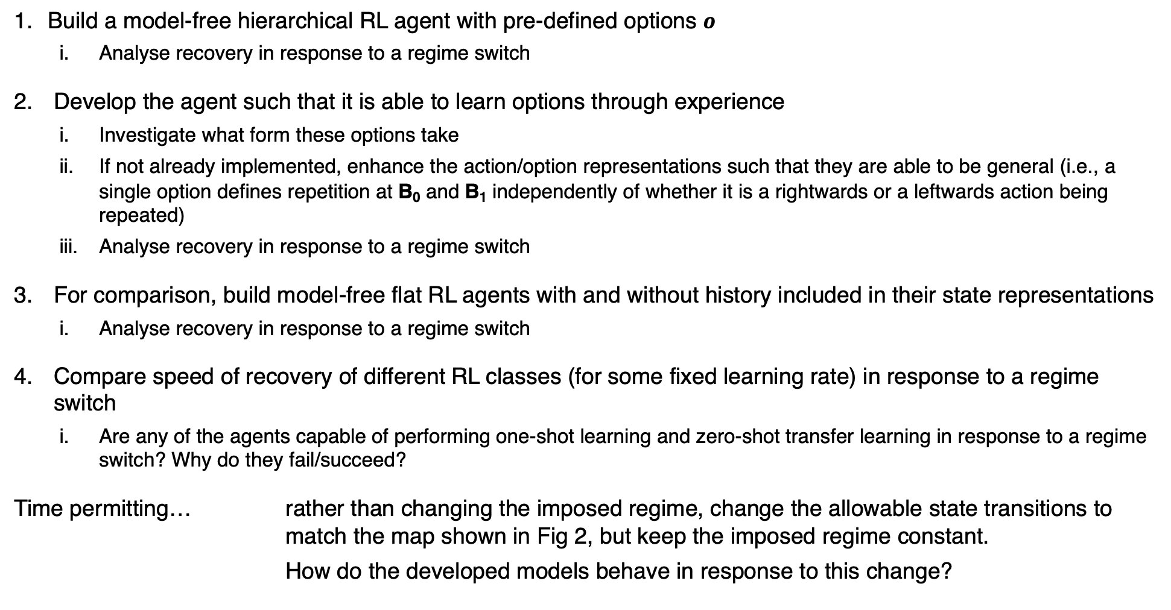
PROJECT STEPS
Build a model-free hierarchical RL agent with pre-defined options $o$
Analyse recovery in response to a regime switch
Develop the agent such that it is able to learn options through experience
Investigate what form these options take
If not already implemented, enhance the action/option representations such that they are able to be general (i.e., a single option defines repetition at B₀ and B₁ independently of whether it is a rightwards or a leftwards action being repeated)
Analyse recovery in response to a regime switch
For comparison, build model-free flat RL agents with and without history included in their state representations
Analyse recovery in response to a regime switch
Compare speed of recovery of different RL classes (for some fixed learning rate) in response to a regime switch
Are any of the agents capable of performing one-shot learning and zero-shot transfer learning in response to a regime switch? Why do they fail/succeed?
Time permitting… rather than changing the imposed regime, change the allowable state transitions to match the map shown in Fig 2, but keep the imposed regime constant.
How do the developed models behave in response to this change?

Slide 16
G_{L}
G_{R}
G_{L}
G_{R}
B₁
D
B₁
repeat
SG_{L}
SG_{R}
alternate
B
bottlenecks
SG
sub-goals
D
dead ends
B₀
G
goal

Slide 17
6
7
3
4
5
NW
NE
1
2
0
SW
SE

