Slide 1
CRCV REU 2022
Week 4
Gwyn Gras-Usry
Mentor: Dr. Navid Kardan

Slide 2
Recap
Continuing to read Neural Knitworks: Patched Neural Implicit Representation Networks
Implementing patch MLP and MLP reconstructor in Pytorch
Trained model on inpainting task
Trained with patches vs no patches

Slide 3
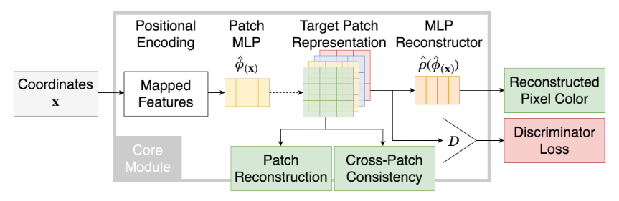
Neural Knitworks
Our Implementation:
Positional encoding/Fourier feature mapping
Patch MLP
Patch reconstruction loss
Multi-scale patch representation
MLP reconstructor
Reconstructed pixel loss

Slide 4
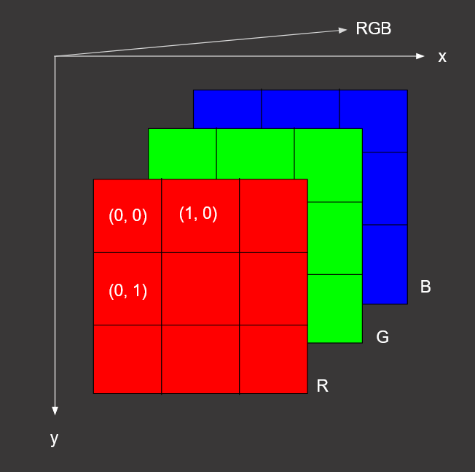
Patches
Each coordinate value is represented by a patch of 3x3 size
3 channels for RGB and a 3x3 grid of the surrounding pixels
Patches overlap

Slide 5
MLP Architecture
Patch MLP
5 linear layers, followed by ReLU activation function
Linear output layer is followed by sigmoid activation function
Takes positionally encoded pixel coordinates as input
Outputs 3x3 patches
MLP Reconstructor
5 linear layers, followed by ReLU activation function
Linear output layer is followed by sigmoid activation function
Takes patches as input, 27 (3x3x3) values per coordinate
Outputs RGB pixel

Slide 6
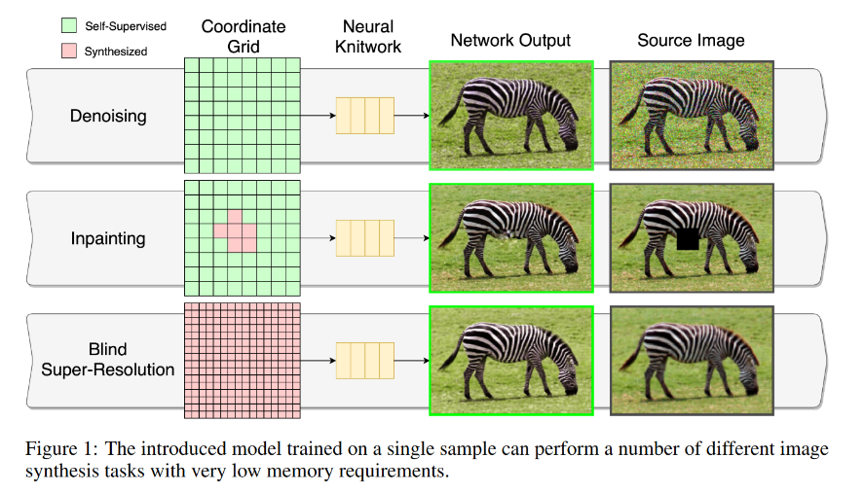
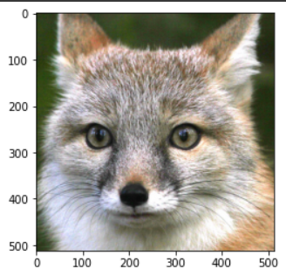
Inpainting
Removed all pixels from a rectangle of shape (250, 200) to (300, 250) in training data
Trains on every coordinate instead of every other coordinate (step size = 1), except for those in the removed block of pixels

Slide 7
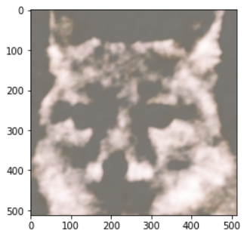
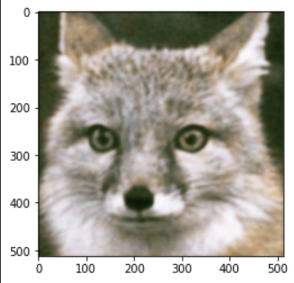
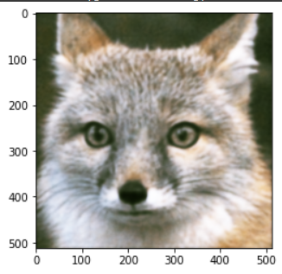
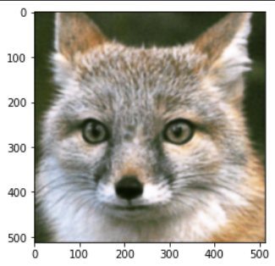
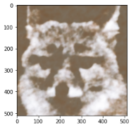
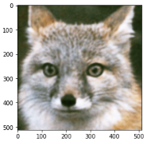
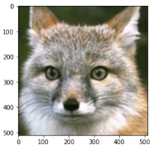
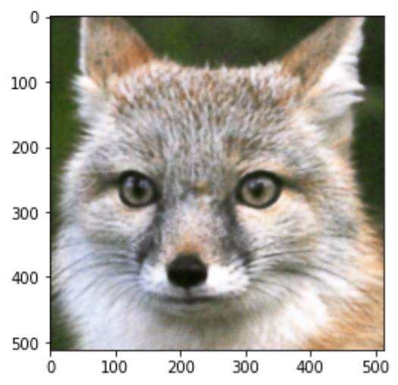
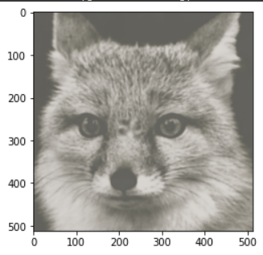
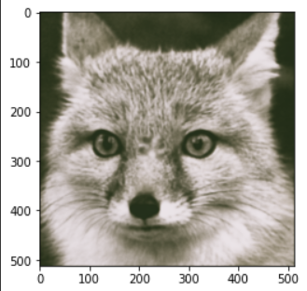
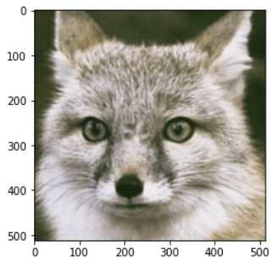
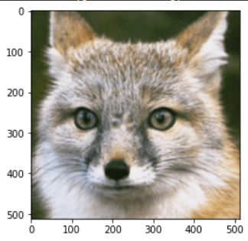
25 iterations
150 iterations
250 iterations
Ground truth
75 iterations
Patch MLP with 3x3 patchs
MLP with no patchs
MLP Reconstructor

Slide 8
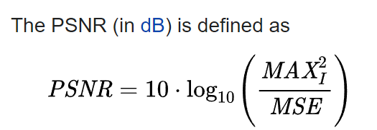
Results
 | Patch MLP (3x3 patches) | Patch MLP (no patches) | MLP Reconstructor
Start PSNR | 13.7909 | 13.7761 | 13.4821
Best PSNR | 15.9806 | 15.2884 | 16.2567
Iterations until best PSNR | 100 | 95 | 55

Slide 9
Future Work
Implement multi-scale patch representation
Goal: neural network compression and replacing CNN layers with neural fields

Slide 10
Thanks for watching!

