Slide 1



Waste Classification

Slide 2

Learning Objectives
Understand how AI can improve waste management.
Learn about image classification using deep learning.
Explore the tools and technologies used.
Understand the model training process and its deployment.
Understand and Implement Convolutional Neural Networks to classify images.
GOAL

Slide 3
Tools and Technology used:
Programming Language: Python
Libraries: TensorFlow, Keras, OpenCV, NumPy, Matplotlib
Dataset: Kaggle Waste Classification Dataset
Framework: Streamlit for deployment
Hardware: Trained using GPU for better efficiency

Slide 4
Methodology:
Data Collection: Kaggle dataset with labeled waste images.
Preprocessing: Image resizing, normalization, and augmentation.
Model Building: CNN architecture with multiple convolutional layers.
Training & Validation: Optimized with Adam optimizer and binary cross-entropy loss.
Evaluation: Achieved 96% accuracy on test data.
Deployment: Hosted the model using Streamlit for real-time classification.

Slide 5
Problem Statement:
Improper waste disposal leads to environmental pollution.
Manual waste sorting is inefficient and time-consuming.
Need for an automated solution to classify waste into Recyclable and Organic categories.

Slide 6
Solution:
Developed a Convolutional Neural Network (CNN) model.
Trained on labeled waste images from Kaggle.
Achieved 96% accuracy in classification.
Deployed as a web application using Streamlit.
Users can upload an image, and the model predicts whether it is Organic or Recyclable.

Slide 7
Results and Performance:
Model Accuracy: 96%
Loss Reduction: Significant decrease in training loss over epochs.
Performance: Robust classification of organic and recyclable waste.
Deployment Success: Fully functional Streamlit web app for real-time predictions.

Slide 8
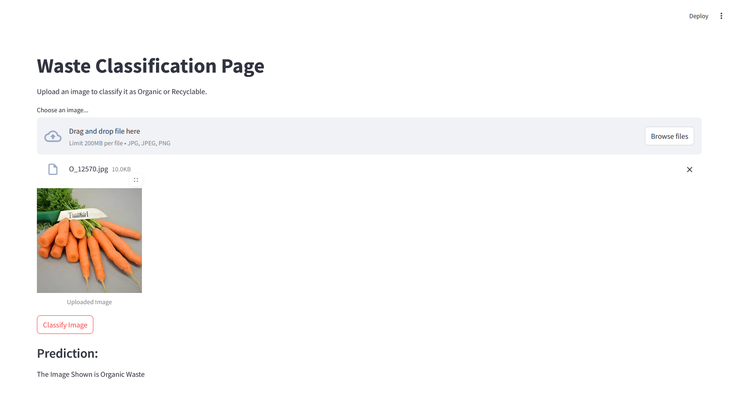
Screenshot of Output:

Slide 9
Conclusion:
AI-driven waste classification is fast, efficient, and scalable.
Helps in better waste management and recycling efforts.
Future Scope:
Expand dataset for improved accuracy.
Deploy as a mobile application.
Integrate with IoT-based smart waste bins.

