Slide 1
Popayán – Colombia 16 Diciembre 2019

Slide 2

Face identity
Popayán
Gabriel Eduardo Rengifo Rios
Asesor TI - Centro de desarrollo tecnológico CreaTIC

Slide 3
Face identity
Popayán
Azure Cognitive Services
IA como servicio
Congnitive Services y Python
Consumiendo servicios de IA desde Python

Slide 4











Slide 5
Azure Cognitive Services

Slide 6
Configurar un endpoint
https://azure.microsoft.com/es-mx/try/cognitive-services/
Notes:
https://docs.microsoft.com/en-us/azure/cognitive-services/cognitive-services-apis-create-account?tabs=multiservice%2Cwindows#configure-an-environment-variable-for-authentication

Slide 7
Configurar un endpoint
https://docs.microsoft.com/en-us/python/api/azure-cognitiveservices-vision-face/?view=azure-python
https://azure.microsoft.com/es-mx/try/cognitive-services/
Notes:
https://docs.microsoft.com/en-us/azure/cognitive-services/cognitive-services-apis-create-account?tabs=multiservice%2Cwindows#configure-an-environment-variable-for-authentication

Slide 9
Preguntas?

Slide 10
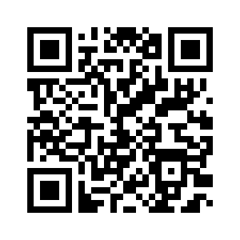




Face identity
Gabriel Eduardo Rengifo
Asesor TI – Centro de desarrollo Tecnológico CreaTIC

