Slide 1
Requirement of HuarongPath

Slide 2
Non-functional Requirements

Slide 3
Fuctional Requirements
There are 10 tiles in the board， the size and amounts of them are: 2×2：曹操：1， 1×2 or 2×1 关羽：1，张飞：1，赵云：1，马超：1 1×1: 卒：4
The board size is 5×4.
Before entering the game, players can choose different levels. All these levels of game must have solution(s).
The winning condition is that the 曹操 tile should be at the bottom and medium of the board.
When one tile is clicked, if there are more than one directions to move, the directions should be displayed, and clicking these directions will lead to the corresponding moving.If there is only one direction to move, clicking it will lead to the moving without displaying direction choices. If no direction available, nothing happens.
Only if there are enough room for the tile to stay in the direction can it move. There are four directions : UP, DOWN, LEFT, RIGHT.

Slide 4
Fuctional Requirements
Regret functionality should be enabled. Clicking it will lead to returning to the previous state.
During the game, player can exit and choose new level if they want.
Hint functionality should be enabled. Clicking the hind button will lead to an action to one possible solution. So the software should have at least one solution.

Slide 5
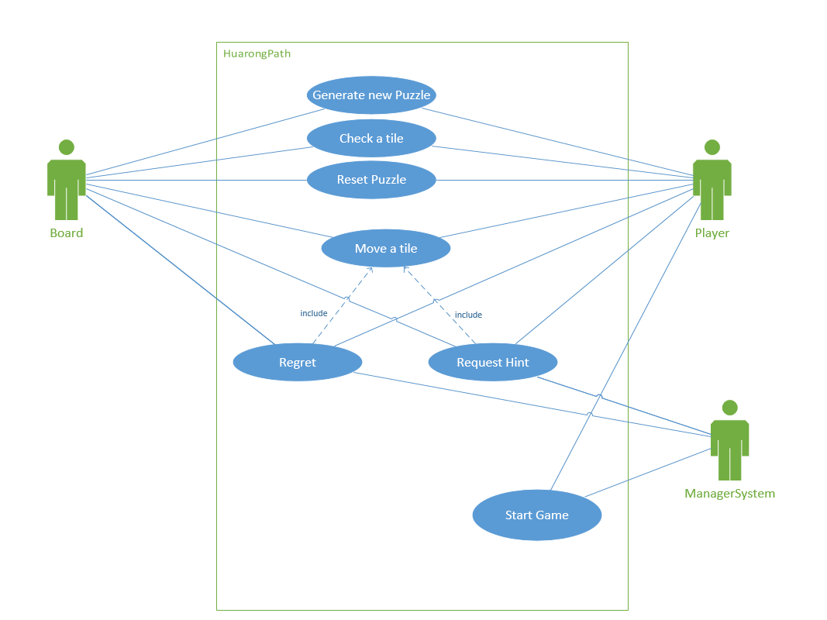
UML Diagrams
Use case diagram

Slide 6
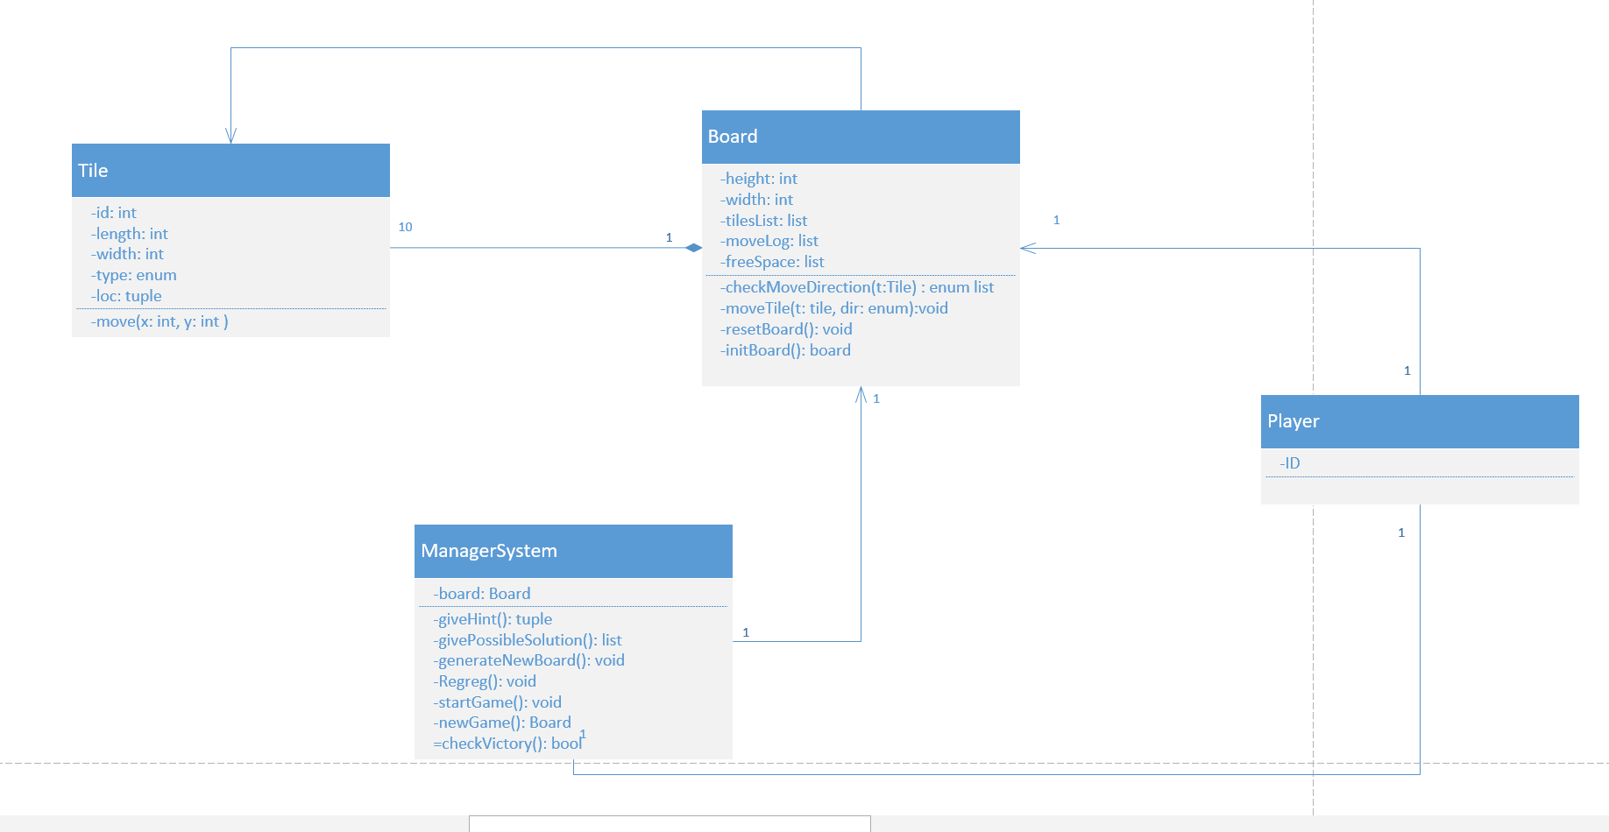
UML Diagrams
Class diagram

Slide 7
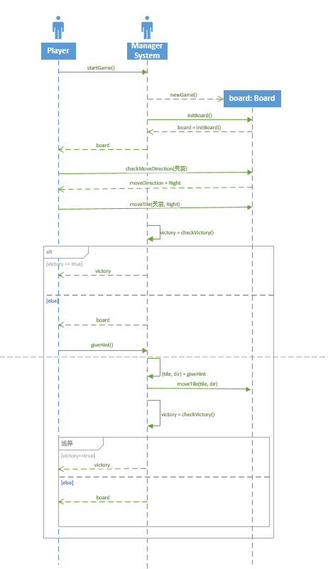
UML Diagrams
Sequence Diagram
There are many possible results of many actions. Here we choose two common actions: move a tile and hint. And there are two results: winning or continue the game.

Slide 8
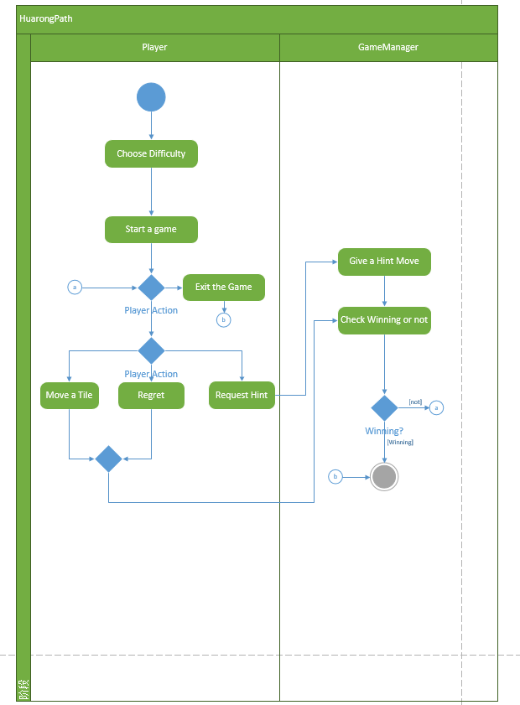
UML Diagrams
Activity Diagram

Slide 9
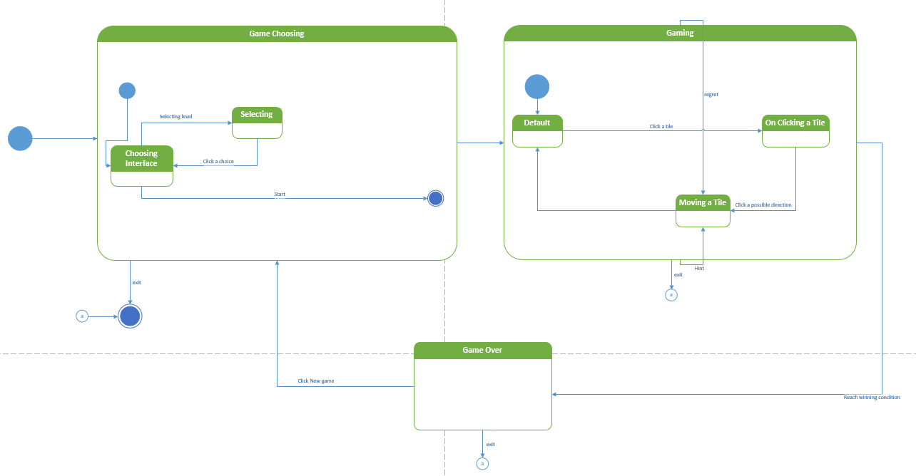
UML Diagram
Statemachine Diagram

Slide 10
Possible Non-functional Requirements
Performance - Tiles should respond in less than 100ms.
Sound effect - BGM, sound of moving a tile...
Timer - Record game duration.
......

