Slide 1

Image Classification Using Pre- Trained Cnn and Autoencoders
Presented by – Gyan Prakash Singh (1601024)
Supervised by - Dr. Moumita Roy
& Indrajit Kalita

Slide 2
Contents
Problem Overview
Literature Survey
Implementation
Result
Analysis
Application & Drawback
Proposed work
Reference

Slide 3
Problem Overview
Classifying land use into different categories like forest, agricultural without manual intervention
Knowing about land pattern of a particular area using remote sensed images and automatisation of the process
Using pre trained models and autoencoders as tools to Classify image data
Importance of deep Convolution neural network and Autoencoders and their use for optimisation
Data Set – UCMerced_LandUse
( It Contains 21 Classes of images having 100 images per class.)

Slide 4
Survey
Motivation behind shift from pixel based image classification (PBIC) to object
based image classification (OBIC).
OBIC is composed of three steps:
1) Image segmentation.
2) Feature extraction
3) Supervised classification
Autoencoder-
An AE reduces the dimension of the input data in an un supervised way, and consists of the following two parts :
Encoders: A function or map that transforms an input vector x to a hidden representation vector y, is regarded
as an encoder. To provide nonlinearity, an activation function is used after affine mapping. This process is delineated by the following equation:
y = f θ (x) = s (W x + b)

Slide 5
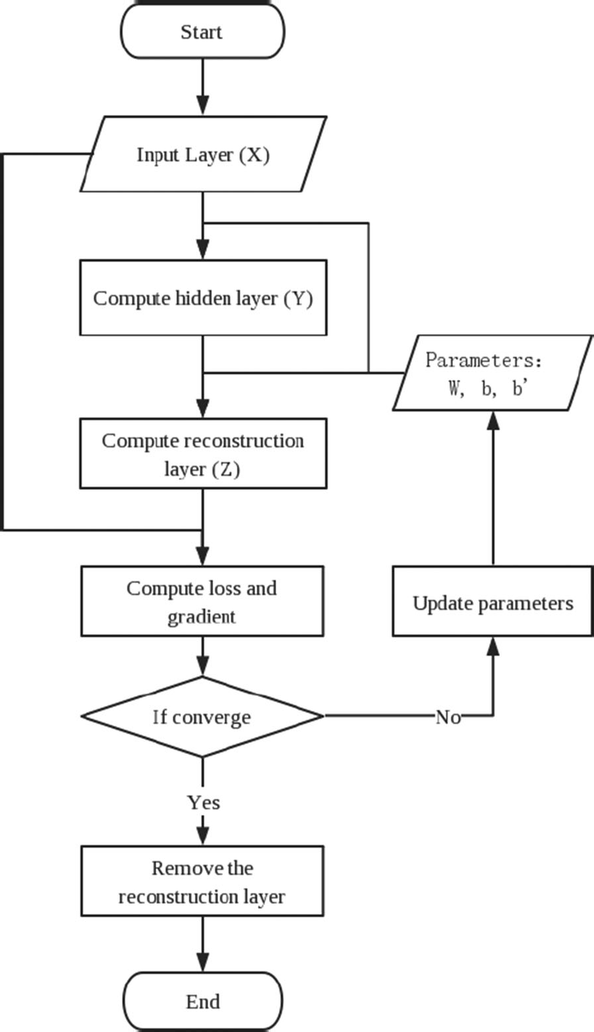
Decoder: A decoder is a map from the hidden
representation vector y to a reconstructed vector z.
same dimension as the input vector x. Like the encoder,
the decoder will apply the same activation function,
as the following equation shows:
z = g θ (y) = s (W y + b ) .
Denoising Autoencoder
ability to recover the corrupted (denoising)
input data robustly.
Overall accuracy of 95% is acheived using AH dataset.
X. Zhang, G. Chen, W. Wang, Q. Wang, F. Dai, Object Based Land Cover Supervised Classification or Very-High-Resolution UAV Images Using Stacked Denoising Autoencoders, IEEE Journal of Selected Topics in Applied Earth Observations and Remote Sensing,Vol. 10, Issue: 7, July 2017, PP(99):1-13

Slide 6
Survey
Motivation:
Classifying land use from remote sensing imagery for monitoring and managing human
development in a way that is not possible in scope and scale from a ground perspective with
human-centric methods.
Accelerated learning by applying transfer learning (TL) from pretrained DCNN models,
AlexNet,CaffeNet, GoogLeNet and ResNet and expanding the remote sensing image
training data set through augmentation strategies.
Transfer learning approaches-
Complete locking feature extraction phase
Refinement of convolution layers during training

Slide 7
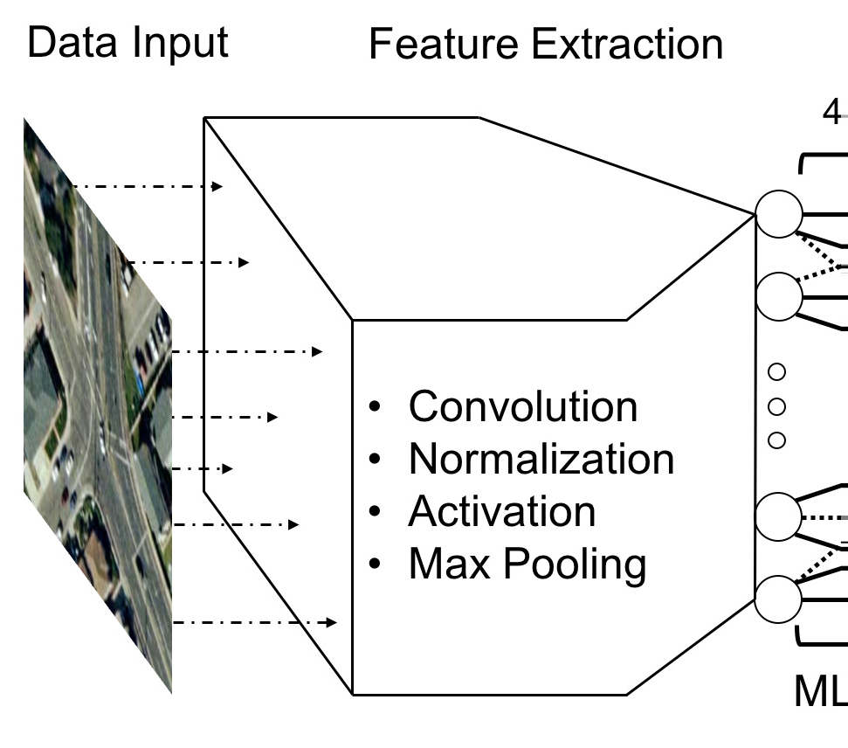
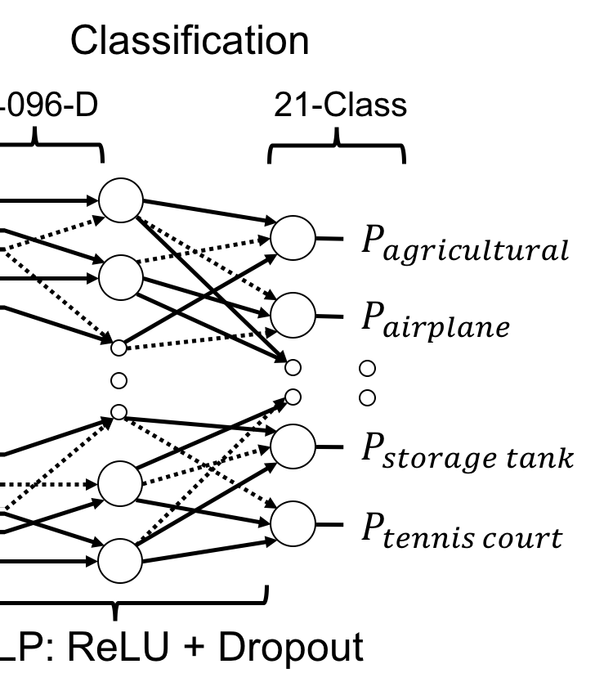
Need of data augmentation
Feature Extraction using Cnn network
Accuracy : 90 to 95 %
Figure:
G. J. Scott, M. R. England, W. A. Starms, R. A. Marcum, C. H. Davis, Training Deep Convolutional Neural Networks for Land–Cover Classification of High-Resolution Imagery, IEEE Geoscience and Remote Sensing Letters, Vol. 14, Issue: 4, April 2017, PP(99):1-5

Slide 8
Survey Continued..
In this paper , remote sensed image classification has been done using stack autoencoder.
Parameter classifier typically requires knowing beforehand the distribution of data, whereas it is often difficult to achieve in remote sensing image. Accordingly, nonparametric classifier gets more extensive.
SAE is composed of multilayer unsupervised autoencoder and a supervised layer of BP neural network.
Parameter of AE is fine tuned through back propagation to further improve
the convergence of the whole network. The training of BP neural network is
divided into forward conduction and back propagation.

Slide 9
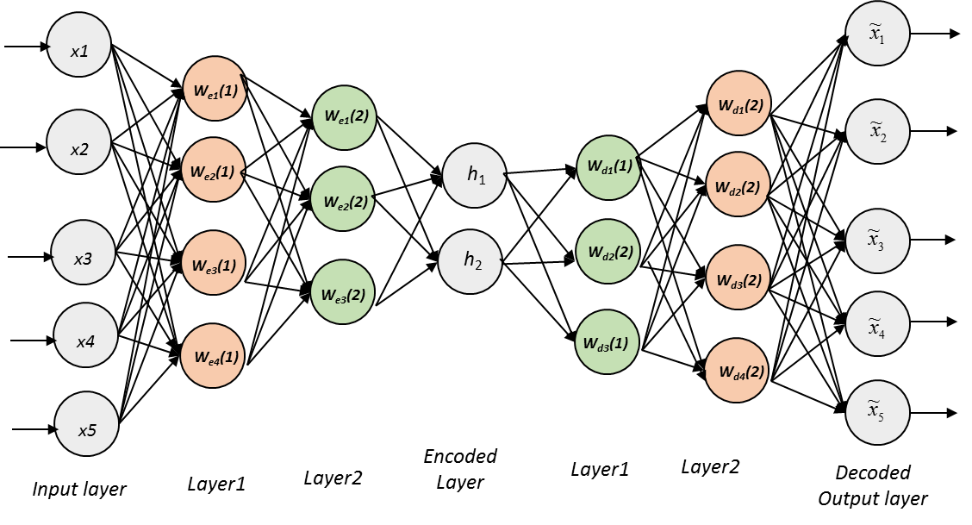
Continued..
Stack Autoencoder
A. Ding, X. Zhou, Land-Use Classification with Remote Sensing Image Based on Stacked Autoencoder, International Conference on Industrial Informatics - Computing Technology, Intelligent Technology, Industrial Information Integration, 3-4 Decemeber 2016

Slide 10
Survey
CNN consists of convolutional layers, each followed by optional subsampling and regularization layers, and ending in fully connected 1-D hidden layer
Use of pretrained CNN model and extract the features
These derived representations are then transferred into a supervised CNN classifier giving the accuracy 83.1% to 92.4%

Slide 11
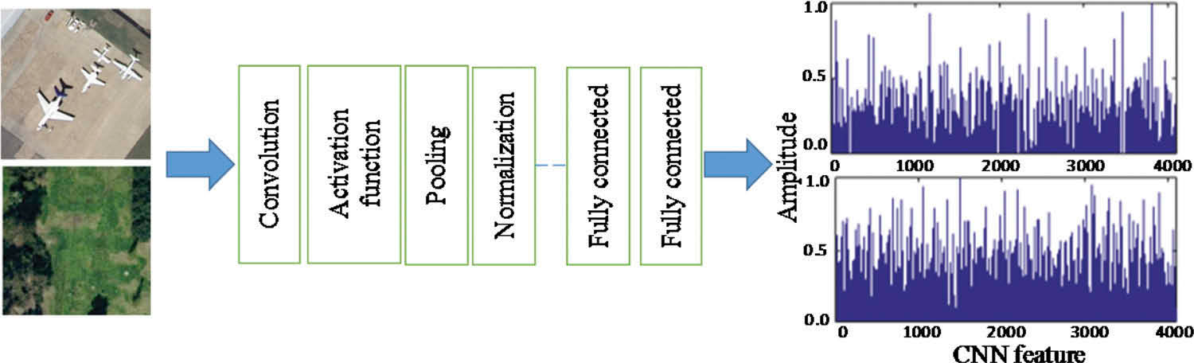
Implementation

Slide 12
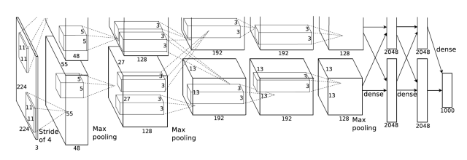
AlexNet
5 convolutional layers and 3 fully connected
Relu is applied after very convolutional and fully connected layer.
Dropout is applied before the first and the second fully connected year.

Slide 13
Implementation 1
Division of dataset into train, validate and test
Loading pretrained CNN MODEL(alex net)
Training data on this model
Calculate accuracy – 88% to 91%
Extract features from the last fully connected layer
Transeferring these features to a simple autoencoder
Calculating accuracy – 82 % to 87%

Slide 14
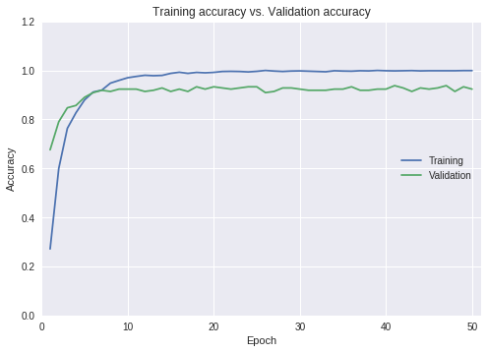
Results

Slide 15
GoogleNet
It contains 1×1 Convolution at the middle of the network. And global average pooling is used at the end of the network instead of using fully connected layer
GoogLeNet has 9 inception modules stacked linearly. It is 22 layers deep (27, including the pooling layers). It uses global average pooling at the end of the last inception module.
It performs convolution on an input, with 3 different sizes of filters. Additionally, max pooling is also performed. The outputs are concatenated and sent to the next inception module

Slide 16
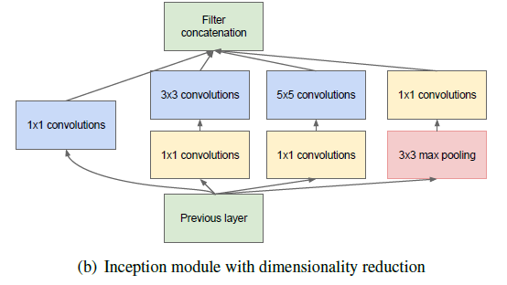
Now, 1×1 conv, 3×3 conv, 5×5 conv, and 3×3 max pooling are done altogether for the previous input, and stack together again at output.

Slide 17
Implementation 2
Division of dataset into train, validate and test
Loading google net (inception v3)
Training data on this model
Checking accuracy – 88% to 92%
Fine-tuning
Use of denoising autoencoder
Calculating accuracy – 87 % to 91%

Slide 18
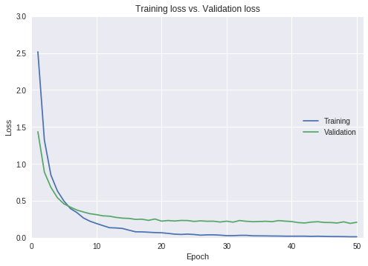
RESULTS

Slide 19
Two models
Performance
Time efficient
Use of inception module increase it’s performance
In GoogLeNet, global average pooling is used nearly at the end of network by averaging each feature map from 7×7 to 1×1
average pooling improved the top-1 accuracy by about 0.6%.
Drawbacks
Vanishing gradient problem
deep neural networks are computationally expensive
Solution
Different model like Resnet can be used for solving vanishing gradient problem

Slide 20
Applications & Drawbacks
Applications:
Image and Face Recognition on Social Networks.
Automated Image Organization – from Cloud Apps to Telecoms.
Visual search engines.
Remote Sensing
Infrared Thermal Imagery
Drawbacks:
Better accuracy from scratch training if less amount of data availability
Overfitting

Slide 21
Proposed Methodology
Using Data Augmentation techniques accuracy will be increased
Use of capsule network may result in increase in accuracy

Slide 22
References
X. Zhang, G. Chen, W. Wang, Q. Wang, F. Dai, Object Based Land Cover Supervised Classification or Very-High-Resolution UAV Images Using Stacked Denoising Autoencoders, IEEE Journal of Selected Topics in Applied Earth Observations and Remote Sensing, Vol. 10, Issue: 7, July 2017, PP(99):1-13
G. J. Scott, M. R. England, W. A. Starms, R. A. Marcum, C. H. Davis, Training Deep Convolutional Neural Networks for Land–Cover Classification of High-Resolution Imagery, IEEE Geoscience and Remote Sensing Letters, Vol. 14, Issue: 4, April 2017, PP(99):1-5
A. Ding, X. Zhou, Land-Use Classification with Remote Sensing Image Based on Stacked Autoencoder, International Conference on Industrial Informatics - Computing Technology, Intelligent Technology, Industrial Information Integration, 3-4 Decemeber 2016

Slide 23
(4) E. Othman, Y. Bazi, N. Alajlan, H. Alhichri, F. Melgani, Using convolutional features and a sparse autoencoder for land-use scene classification, Taylor & Francis, International Journal of Remote Sensing,Vol. 37 Issue : 10, May 2016, Pages 2149-2167
(5) F. P. S. Luus, B. P. Salmon, F. van den Bergh, and B. T. J. Maharaj,
Multiview deep learning for land-use classification,IEEE Geoscience
Remote Sensing Letters, vol. 12, no. 12, December 2015, pp. 2448–2452
(6) Dimitrios Marmanis, Mihai Datcu,Thomas Esch, Deep Learning Earth
Observation Classification Using ImageNet Pretrained Networks, IEEE
Geoscience Remote Sensing Letters, vol. 13, NO. 1, JANUARY 2016,
Pages 105-109

Slide 24


Slide 25


