Slide 1
SESSION-1
Sakshi Sinha
16BCE1123

Slide 2

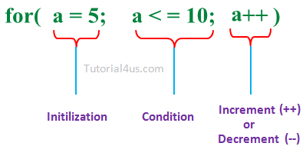
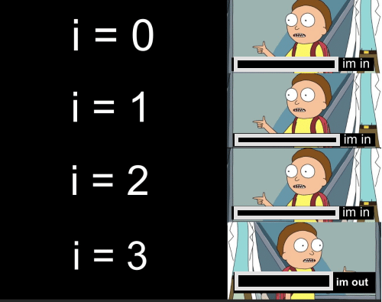
Looping statements in c++
FOR:
Notes:
Problem to give out:https://www.hackerrank.com/challenges/c-tutorial-for-loop/problem

Slide 3
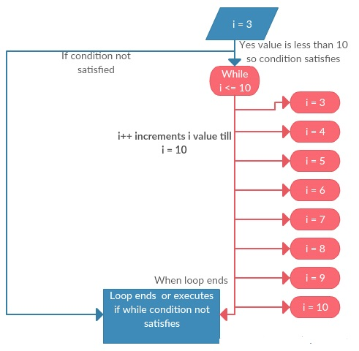
LOOPS CONTD..
WHILE:
int i=0;
while(i<=10)
{
i++;
cout<<i;
}

Slide 4

LET’S TALK ABOUT POINTERS-step by step
In a long lost kingdom was an integer
variable i assigned with value 3
As soon as the compilers would encounter i
They would reserve space in computer memory(4 bytes/32 bits) to hold an integer value(As our variable was an integer one)
Start associating the name i with the memory location
Store the value 3 at that location
65524

Slide 5
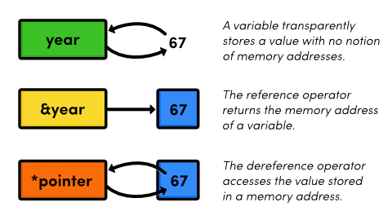
What to * and & mean?
&variable-Returns the address of the variable.It would return 65524 for i.
*a-Gives the value at address i.
int *a=&i means pointer a(As it points to/gives the value at) address of i
Notes:
A small challenge:https://www.hackerrank.com/challenges/c-tutorial-pointer/problem
More help:http://cslibrary.stanford.edu/102/?ref=hackr.io

Slide 6
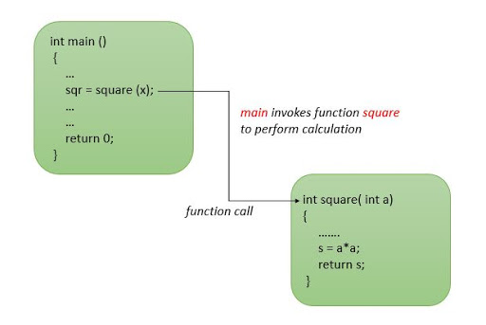
FUNCTIONS
Chottu is a mathematician and needs to calculate the square of numbers all the time.So,he writes a square function.
Now every time he calls the square function:
The control is passed on to the square function.The said value is computed and returned to the square variable and the code continues to execute.
Notes:
Challenge:https://www.hackerrank.com/challenges/c-tutorial-functions/problem
Some information on function call(How control transfer takes place):https://zhu45.org/posts/2017/Jul/30/understanding-how-function-call-works/

Slide 7
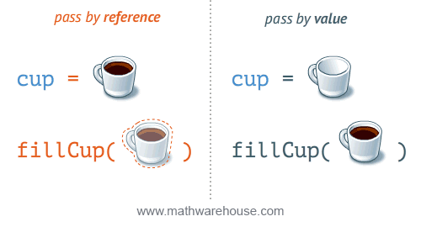
PASSING VALUE BY REFERENCE
#include<stdio.h>
void fillcup(int *c)
{
*c=5;
}
int main()
{
int cup=0;
fillcup(&cup);
printf("%d",cup);
return 0;
}
Notes:
int *c=&cup;

Slide 8
Differences between call by value and call by reference
int fillcup(int c)
{
c=5;
return c;
}
int main()
{
int r=0;
int cup=fillcup(r);
printf("%d\n",r);
printf("%d",*(&cup));
return 0;
}
CALL BY VALUE
The actual value that is passed as argument is not changed
changes the value of copy of passed variable
CALL BY REFERENCE
The actual value that is passed as argument is changed

Slide 9
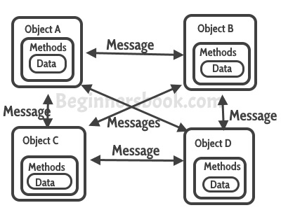
CLASSES AND OBJECTS
Class:
User defined
has data members and member functions.
Object
An instance of the class
Notes:
Small practice problem:https://tinyurl.com/uveuyu6
Print the average of three numbers entered by the user by creating a class named 'Average' having a function to calculate and print the average without creating any object of the Average class.

Slide 10
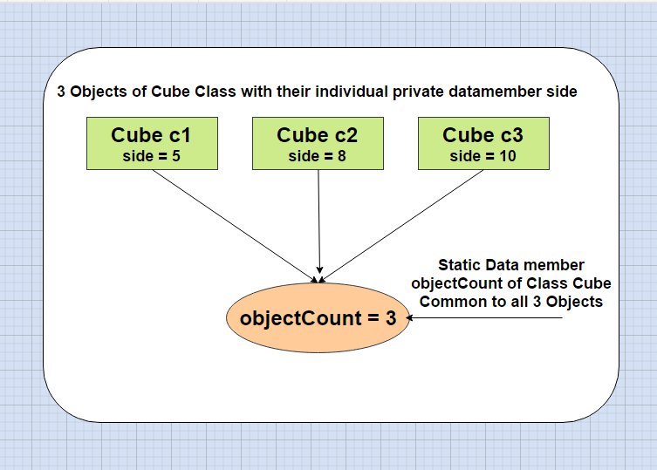
AN INTRO TO STATIC
Allocated storage only once in a program lifetime
Have a scope till the program lifetime
Static data members in class
Are shared by all objects.
Not initialized using constructor.
Must be initialized explicitly, always outside the class.
Static member functions
work for the class as whole
can be called using an object
Can be called by itself, using class name and scope resolution :: operator.
Notes:
More on static data members:https://www.tutorialspoint.com/cplusplus/cpp_static_members.htm

Slide 11
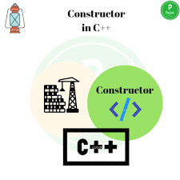
CONSTRUCTORS
initialises an object automatically on creation.
has the same name as that of the class
does not have any return type
always public

Slide 12
DEFAULT AND PARAMETERIZED CONSTRUCTORS
DEFAULT CONSTRUCTOR-doesn’t take any argument. Generated by C++ compiler on default for us with empty body.
class construct {
public:
int a, b;
// Default Constructor
construct()
{
a = 10;
b = 20;
}
};
PARAMETERIZED CONSTRUCTOR=Default constructor+Parameters.
class Point {
private:
int x, y;
public:
Point(int x1, int y1)
{
x = x1;
y = y1;
}
};

Slide 13
COPY-CONSTRUCTORS-Initialize an object using another object of the same class
class Okay
{
private:
int x, y;
public:
Okay(int x1, int y1) { x = x1; y = y1; }
Okay(const Okay &p2)
{x = p2.x; y = p2.y;}
int getX() { return x; }
int getY() { return y; }
};
int main()
{
Okay p1(10, 15); // Normal constructor
Okay p2 = p1; // Copy constructor
// Accessing values assigned
cout << "p1.x ="<< p1.getX()
<< "p1.y ="<< p1.getY();
cout <<"np2.x="<<p2.getX()
<<"p2.y ="<<p2.getY();
return 0;
}
OUTPUT:
Notes:
A copy constructor is used to initialize a newly declared variable from an existing variable. This makes a deep copy like assignment, but it is somewhat simpler:
There is no need to test to see if it is being initialized from itself.
There is no need to clean up (eg, delete) an existing value (there is none).
A reference to itself is not returned.

Slide 14
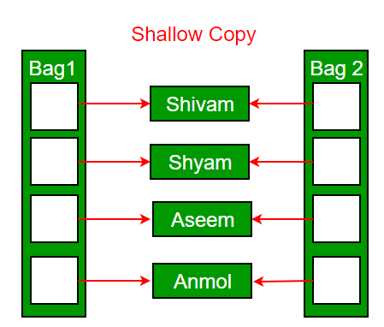
WHAT HAPPENS WHEN WE USE A COPY CONSTRUCTOR?
CODE:
class test
{public:
int p;
void print(){cout<<&p<<"\n";}
test(int r){p=r;}
test (test &c)
{
cout<<"Copy constructor called\n";}
};
int main()
{
test camera(5);
test snapshot=camera;
camera.print();
snapshot.print();
return 0;
}
Notes:
Output:Both the objects give out the same memory location:WHICH IS CALLED SHALLOW COPY

Slide 15
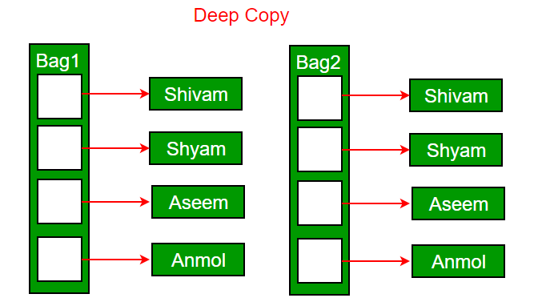
DEEP COPY
Deep copy allocates separate memory for copied information.
General requirements for deep copy:
A normal constructor.
A destructor to delete the dynamically allocated memory.
A copy constructor to make a copy of the dynamically allocated memory.
An overloaded assignment operator.

Slide 16
CODE FOR DEEP COPY
#include<iostream>
#include<cstring>
using namespace std;
class test
{
public:
char *p;
void print(){cout<<&p<<"\n";}
test(const char *r){
p=new char[20];//Dynamic Memory
strcpy(p,r);}
test (test &c)
{
cout<<"Copy constructor called\n";
}
~test()
{
cout<<"Destructor called\n";
delete[] p;
}
};
int main()
{
test camera("Hello");
test snapshot=camera;
camera.print();
snapshot.print();
return 0;
}

Slide 17

I WILL TELL YOU MORE ABOUT IT WHEN I SEE YOU AGAIN..

