Slide 1
Object Oriented Programming
Sakshi Sinha

Slide 2
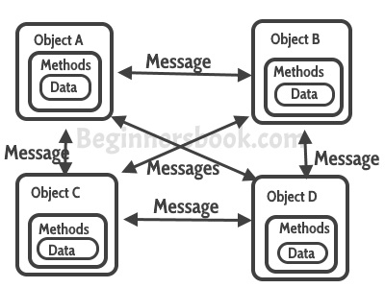
What is Object Oriented Programming?
A paradigm where the software operates as a bunch of objects talking to each other.
OBJECTIVE
To make software manageable
To increase understanding of software

Slide 3
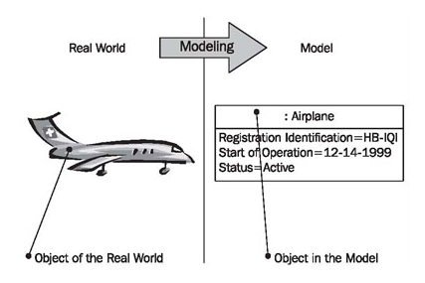
What is an Object?
A collection of data and methods that operate on it’s data.

Slide 4
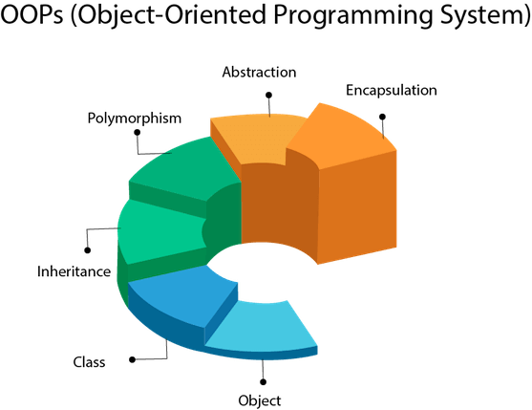
WHAT ARE THE MAIN FEATURES OF OOP?
ABSTRACTION
ENCAPSULATION
POLYMORPHISM

Slide 5

ABSTRACTION
Hiding the details to show only the necessary details
There are two ways to achieve this
Abstraction using classes
Abstraction using header files

Slide 6
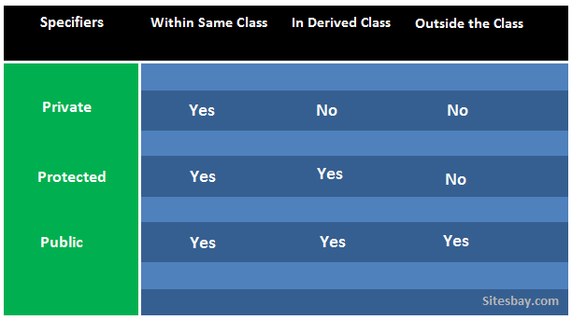
ABSTRACTION USING CLASS
Group data using data members and member function using available access specifiers.
Private
Public
Protected

Slide 7
EXAMPLE
class MyClass
{
public: //Access Modifier
int x;
};
int main()
{
MyClass myObj;
myObj.x = 15;
cout << myObj.x;
return 0;
}
Practice Problem:https://www.hackerrank.com/challenges/c-tutorial-class/problem
class MyClass
{
public:
int x; // Public
private:
int y; // Private
};
int main() {
MyClass myObj;
myObj.x = 25; // Allowed
myObj.y = 50; // Not allowed
return 0;
}

Slide 8
ABSTRACTION USING HEADER FILES
A header file in C/C++ contains:
Function definitions
Data type definitions
Macros
We make use of the functions defined in the header files.Ex-pow() method that helps us calculate the power without actually calculating power.

Slide 9
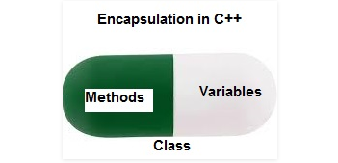
ENCAPSULATION
Wrapping information and data in a single unit.

Slide 10
EXAMPLE
class Encapsulation
{
Private:
int x;
Public:
void set(int a)
{
x =a;
}
int get()
{
return x;
}
};
Practice problem:https://www.hackerrank.com/challenges/classes-objects/problem
// main function
int main()
{
Encapsulation obj;
//Calling the setter function
obj.set(5);
//Calling the getter function
cout<<obj.get();
return 0;
}

Slide 11
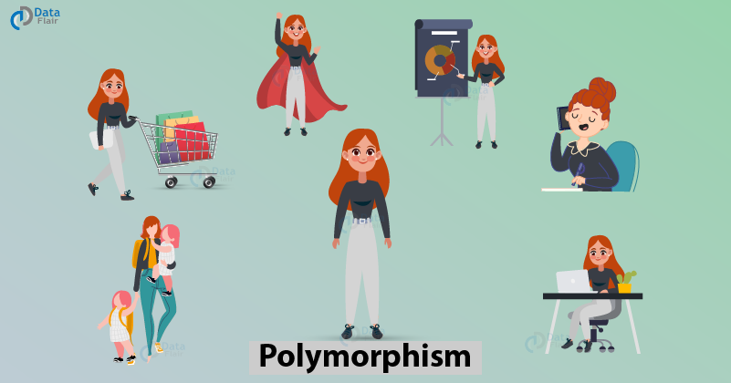
POLYMORPHISM
Polymorphism means having many forms. Polymorphism can be defined as the ability of a message to be displayed in more than one form.

Slide 12
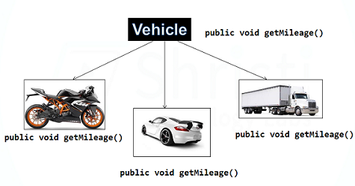
RUN-TIME POLYMORPHISM
Can be achieved by function overriding.
When a derived class has a definition for one of the member functions of the base class. That base function is said to be overridden.

Slide 13
EXAMPLE
FUNCTION OVERLOADING
void func(int x)
{
cout << "value of x is " << x << endl;
}
// function with same name
void func(double x)
{
cout << "value of x is " << x <<endl;
}
OPERATOR OVERLOADING
class Test
{
private:
int num;
public:
Test(): num(8){}
void operator ++() {
num = num+2;
}
};
int main()
{
Test tt;
++tt;
cout<<tt.num;
return 0;
}

Slide 14
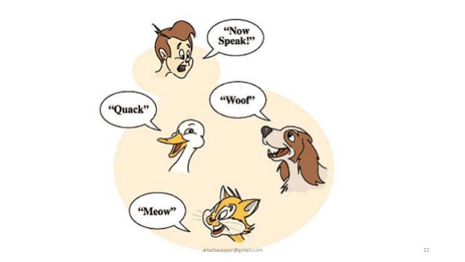
COMPILE-TIME POLYMORPHISM
When there are multiple functions with same name but different parameters
Functions can be overloaded by
change in number of arguments
change in type of arguments.

