Slide 1
TREES
16BCE1123
SAKSHI SINHA

Slide 2
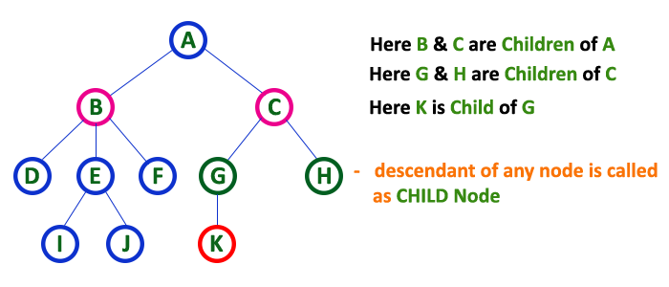
What ARE Trees?
Non linear data structures
Hierarchical
Have nodes connected by edges
Nodes can be of types
Root nodes- A special node through which the entire tree can be referenced.(Has no parent node)
Parent node-immediate predecessor of a node.
Child node-immediate successors of a node.

Slide 3
CREATING OUR TREE..
struct node
{
int data;
struct node *left;
Struct node *right;
}
//Code to insert a new node
struct node* insert(int data)
{
int ldata,rdata;
struct node* current=(struct node*) malloc(sizeof(struct node));
current->data=data;
printf(“Enter left-child’s & right child’s data -1 for none:”);
scanf(“%d”,&ldata)
//cont...
Notes:
Reference to struct in C:https://www.geeksforgeeks.org/structures-c/

Slide 4
mOVING ON TO TRAVERSE OUR TREE..
if(ldata!=-1)
current->left=insert(data);
else
current->left=NULL;
if(rdata!=-1)
current->right=insert(data);
else
current->right=NULL;
}
We can then appropriately traverse our tree which brings us to tree traversals

Slide 5
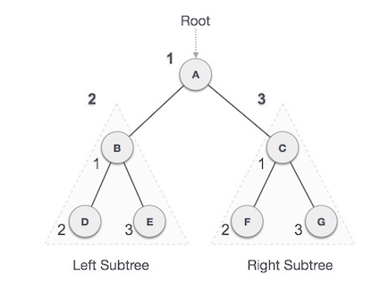
PREORDER TRAVERSAL
Root->Left->Right
A → B → D → E → C → F → G
CODE
void preorder(struct node* root)
{
printf(“%d”,root->data);
preorder(root->left);
preorder(root->right);
}
Check your learning @ https://www.hackerrank.com/challenges/tree-preorder-traversal/problem

Slide 6
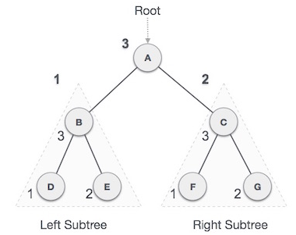
POST ORDER TRAVERSAL
Left->Right->Root
D → E → B → F → G → C → A
CODE
void postorder(struct node* root)
{
preorder(root->left);
preorder(root->right);
printf(“%d”,root->data);
}
Check your learning at:https://www.hackerrank.com/challenges/tree-postorder-traversal/problem

Slide 7
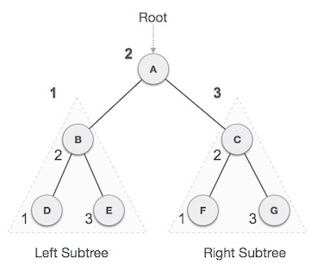
IN-ORDER TRAVERSAL
left->root->right
D → B → E → A → F → C → G
CODE
void inorder(struct node* root)
{
preorder(root->left);
printf(“%d”,root->data);
preorder(root->right);
}
Check your learning at:https://www.hackerrank.com/challenges/tree-inorder-traversal/problem

Slide 8
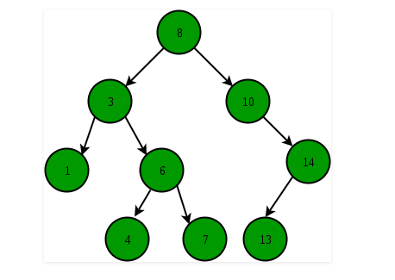
A FEW MORE TREE EXTENSIONS:
BINARY SEARCH TREE:
A type of tree where the
Node values follow:
Left child<Root<Right Child
Small practice problem:https://leetcode.com/problems/validate-binary-search-tree/

Slide 9
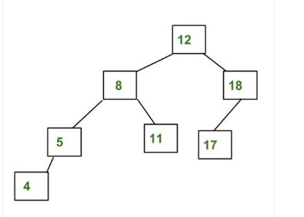
Some tree types cont...
AVL TREE
self-balancing Binary Search Tree (BST)
the difference between heights of left and right subtrees
cannot be more than one for all nodes
Small practice problem:https://leetcode.com/problems/balanced-binary-tree/

