Slide 1

Project Title :
Seasonal agriculture analysis
Student name :
Gyanendra
College name :
Beacon Institute of Technology
AICTE STU ID :
STU6a1b2153b7aad1780162899

Slide 2

PROBLEM STATEMENT
Agricultural profitability varies sharply across crops, seasons, and irrigation methods, with nearly half of the farms in this dataset operating at a loss. This project analyzes seasonal and crop-level performance data to identify the key factors driving yield and profit variation, in order to support more informed crop and season selection decisions.

Slide 3
Project Description
The dataset contains 4,000 records across 28 attributes — including rainfall, temperature, soil moisture, irrigation method, fertilizer and pesticide use, yield, revenue, cost, and profit — collected across 8 states, 8 crops, and 3 seasons (Kharif, Rabi, Zaid). The analysis begins with data cleaning (handling missing values in rainfall, soil moisture, and yield using group-wise medians, and verifying there were no duplicate records), followed by descriptive statistics and a careful outlier investigation that distinguishes genuine data errors from legitimate extreme values, such as Sugarcane's naturally high yield. The core of the project moves through univariate, bivariate, and multivariate analysis, a full correlation study, and season-by-season profitability comparisons, before closing with three original analyses — farm-size economics, disease/pest risk versus yield, and the best-performing state–crop–irrigation combinations.

Slide 4

WHO ARE THE END USERS?
Farmers / farm owners — to compare expected profitability across crop, season, and irrigation choices before committing land and input costs for a season.
Agricultural extension officers and state agriculture departments — to identify which crop-season combinations are underperforming in a region and target advisory support or subsidies accordingly.
Agri-lending and crop insurance providers — to get a data-backed view of which crop-season-irrigation combinations carry higher loss risk, relevant to loan or premium decisions.
Agri-tech/advisory platforms — as an underlying analysis layer for farmer-facing recommendation tools.

Slide 5

Technology Used
Python — core language for the entire analysis
Pandas — data loading, cleaning (missing value imputation, duplicate checks), grouping, and pivot-table style aggregation
NumPy — underlying numerical operations and array handling
Matplotlib & Seaborn — visualizations: histograms, boxplots, scatter plots, and correlation heatmaps
Jupyter Notebook — development environment, chosen so code, output, and explanation stay together in one document
CSV — source data format (seasonal_agriculture_performance_dataset.csv, 4,000 records)

Slide 6
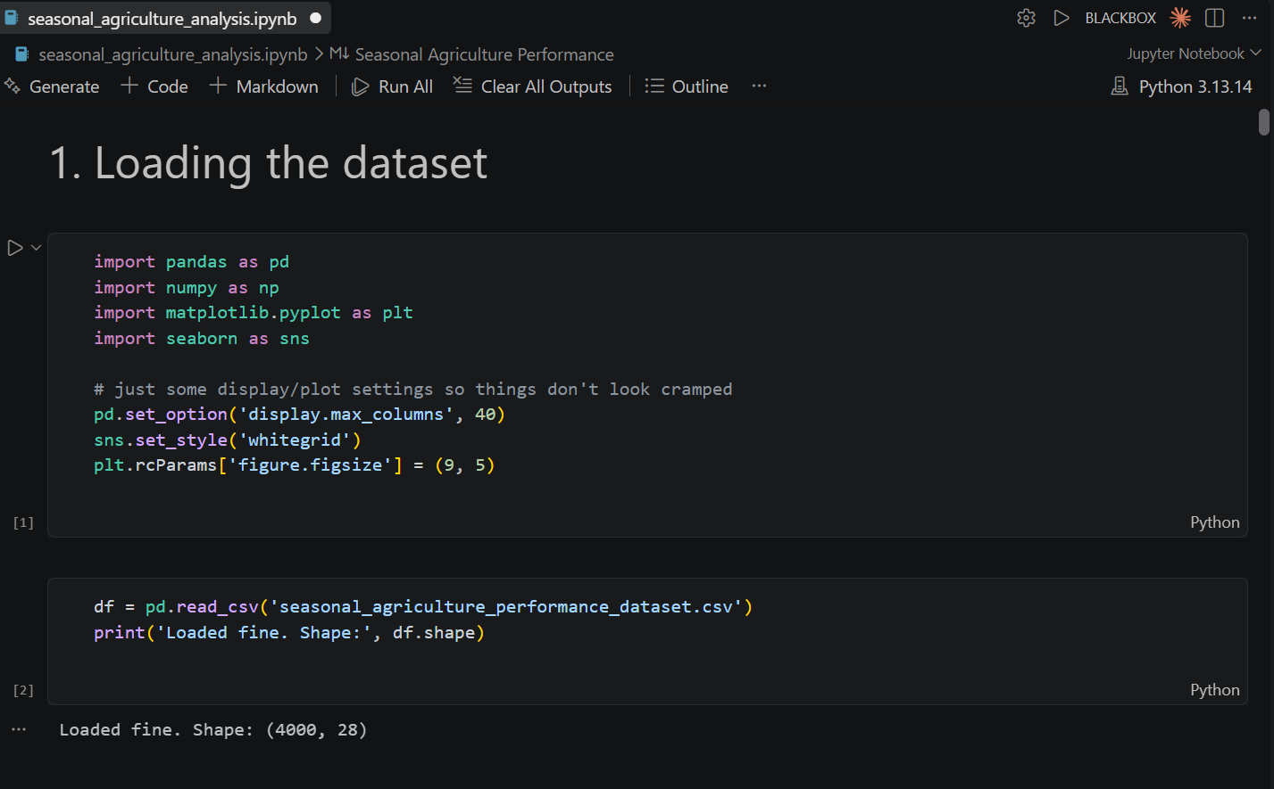
RESULTS
[Add screen shots of your code ]

Slide 7
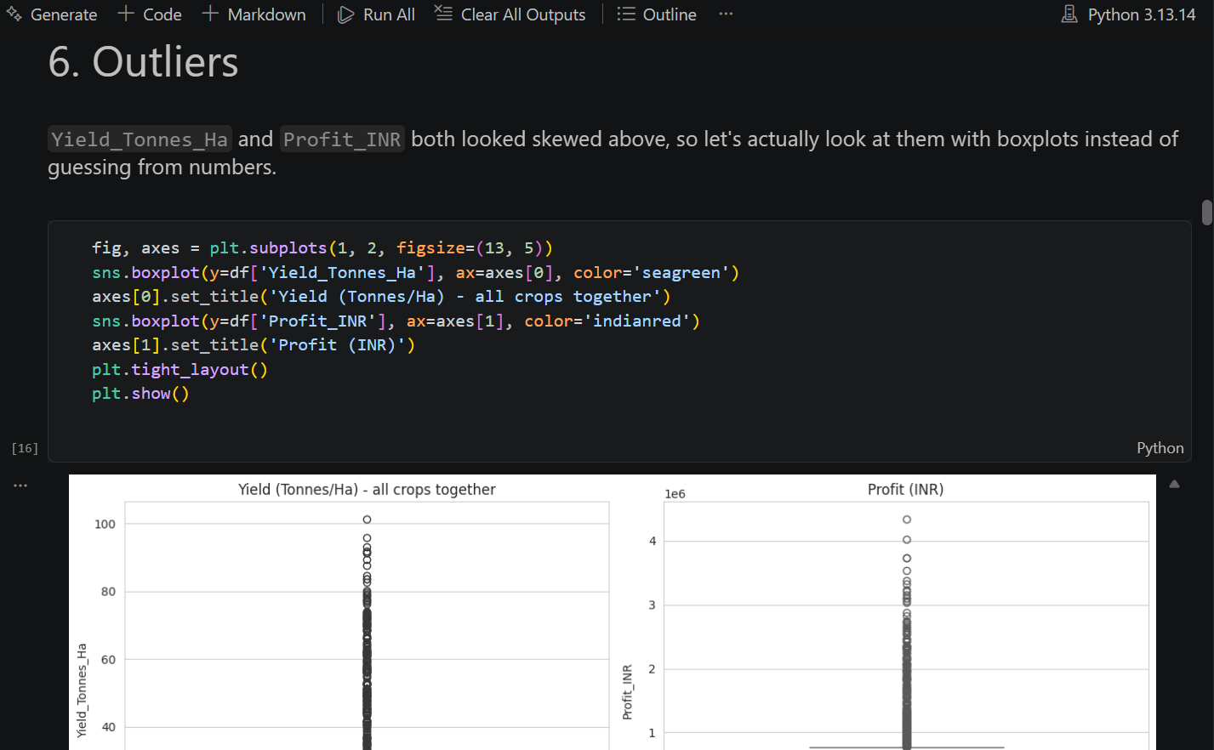
RESULTS
[Add screen shots of your code ]

Slide 8
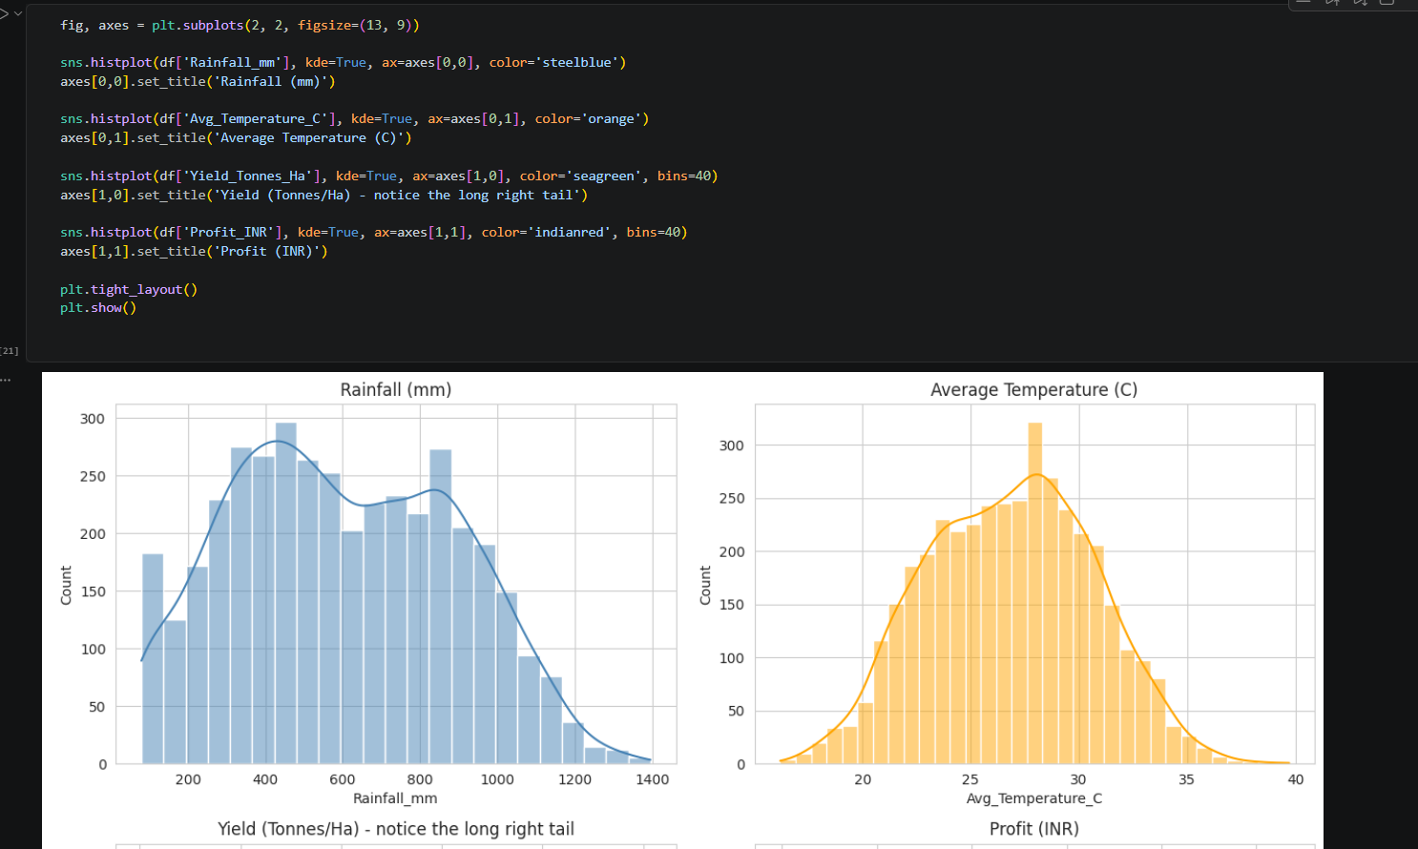
RESULTS
[Add screen shots of your code ]

Slide 9
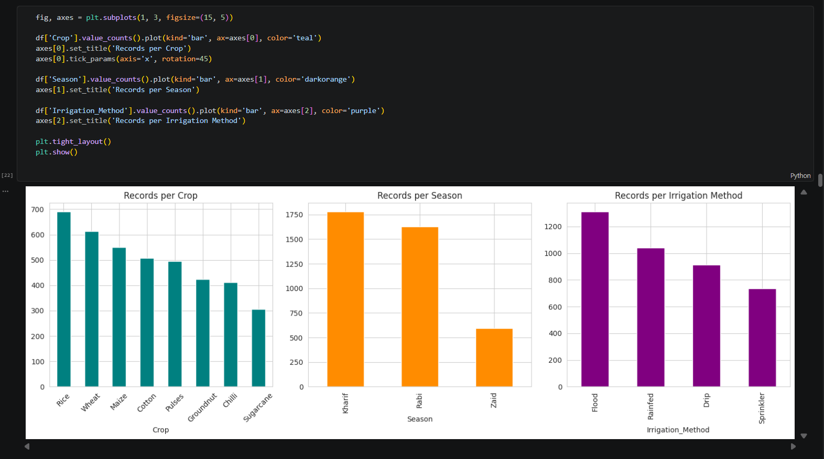
RESULTS
[Add screen shots of your code ]

Slide 10
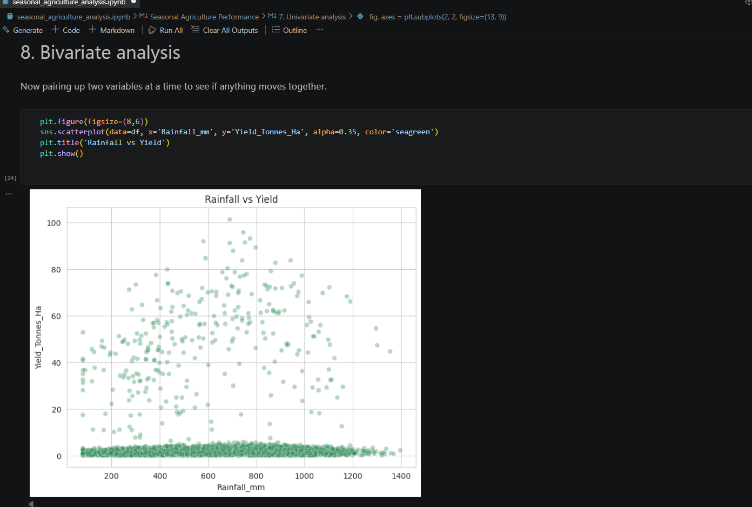
RESULTS
[Add screen shots of your code ]

Slide 11
Future scope
Multi-year, longitudinal data — this analysis is a single snapshot; tracking the same farms across multiple years would show whether a crop/season's performance is consistent or just one good/bad year.
Predictive modeling — moving from "what happened" (descriptive EDA) to "what will happen," using regression or tree-based models to predict yield or profit for a given crop-season-irrigation combination before it's planted.
Causal, controlled comparison for input use — this project found fertilizer/pesticide use barely correlates with yield, but correlation can't prove causation; a proper controlled study (same crop, same season, varying only input levels) would confirm whether that finding holds.
Better water-use measurement — specifically re-checking how "water used" is recorded for rainfed vs. pumped irrigation, since that metric was flagged as a likely measurement artifact rather than a true efficiency advantage.
Interactive dashboard deployment — turning the static notebook into a live dashboard (e.g. via Power BI or a simple web app) so farmers or officers can filter by their own state/crop instead of reading a fixed report.
Wider geographic and crop coverage — the current dataset covers 8 states and 8 crops; expanding this would make the recommendations generalizable beyond what's tested here.

Slide 12
GitHub Link
Click to open :
Major project

Slide 13
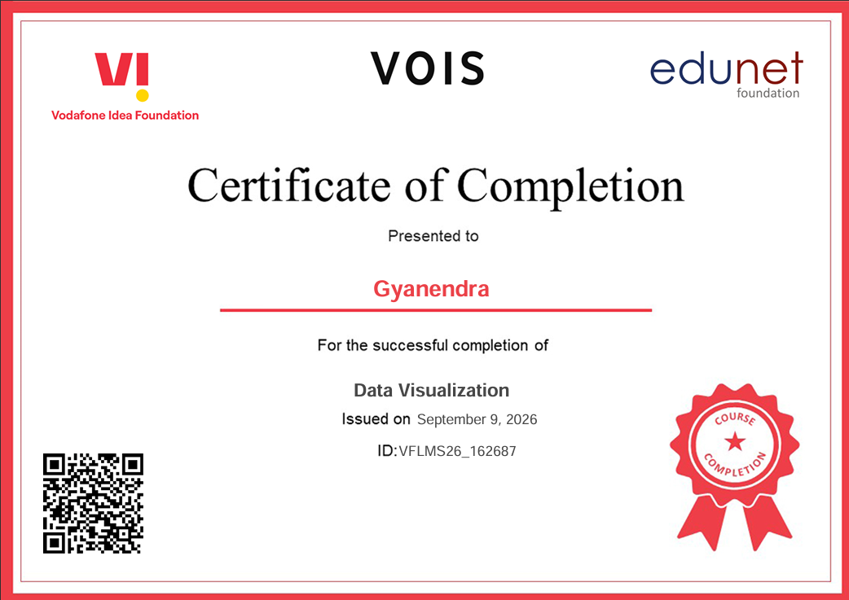
VOIS Course completion certificate -
Course name- Data Visualization

Slide 14
Thank You
Questions and feedback are welcome.
Gyanendra — BCA, BIT Meerut
gyanendra9117@gmail.com
| linkedin.com/in/gyanendra-
| github.com/gyanendra111
.
.

