Slide 1


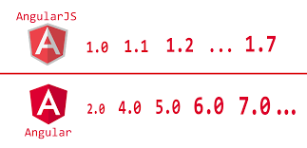

Angular Versions

Slide 2

AngularJS Vs Angular2
Released in the year of 2010. Officially named as AngularJS.
The Angular2 was released in September 2016. Angular 2 was a complete rewrite.
AngularJS was based on controllers and the View. Views and Controllers communicated using $scope. Angular2 introduced a component-based approach. The advantage of the Component-based approach is that it facilitates greater code reuse. As compared to AngularJS, in Angular2, the communication among components is very easy.
Angular2 applications are more testable.
From a performance standpoint, Angular2 is 5 times faster than AngularJS.
Angular2 has more language choices (TypeScript, JavaScript, Dart, PureScript and Elm etc.)
With Angular2 CLI came into being.

Slide 3
Improvements in Angular 4
It supported typescript 2.1 and 2.2
Animations module was separated from @angular/core.
Else block was supported in *ngIf
NgComponentOutlet was introduced to support dynamic components
<template> was changed to <ng-template>
With version 4.3 HttpClient was introduced

Slide 4
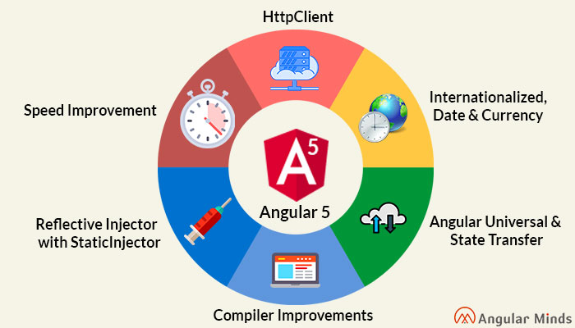
Improvements in Angular 5
Release in Nov 2017

Slide 5
Improvements in Angular 6
New CLI commands ng update and ng add
Build Optimizations
The Angular Elements package allows you to create an Angular component and publish it as a Web Component, which can be used in any HTML page.
TypeScript 2.7
RxJs, Router, ServiceWorker improvements
Release in May 2018

Slide 6
Improvements in Angular 7
Angular.json file
Build and Runtime Optimizations
material/CDKTypeScript 2.7
TypeScript 2.9 support
New Pipe KeyValuePipe
Ivy Rendering engine
Release in October 2018

