Slide 1
Linux Basics and Tools

Slide 2
Linux:-
Just like Windows, iOS, and Mac OS, Linux is an operating system.
Android, is powered by the Linux operating system.
Operating system :-
software that manages all of the hardware resources associated with your desktop or laptop.
The operating system manages the communication between your software and your hardware.
Distributions for Linux:-
1.Ubuntu – for average users
2.Kali - for security

Slide 3
Linux booting sequence:-
Power on :-
CPU searches for BIOS code stored at the predefined memory location and start executing BIOS code.
BIOS code:-
Perform hardware test if test fails then it stops.
Then, the BIOS searches for, loads, and executes the boot loader program, which can be found in the Master Boot Record (MBR).
Once the boot loader program is detected, it's then loaded into memory and the BIOS gives control of the system to it.
MBR:-
MBR stands for Master Boot Record, and is responsible for loading and executing the GRUB boot loader.

Slide 4
GRUB :-
GNU GRand Unified Bootloader, boot loader for most modern Linux systems.
The GRUB splash screen is often the first thing you see when you boot your computer.
The splash screen will wait a few seconds for you to select and option. If you don't, it will load the default kernel image.
Kernel :-
Linux kernel OS start executing in the RAM.
Linux kernel is the first software program, that is loaded in the RAM and executes until we shut down the system.
Kernel is the interface b/w Applications and Hardware.

Slide 5
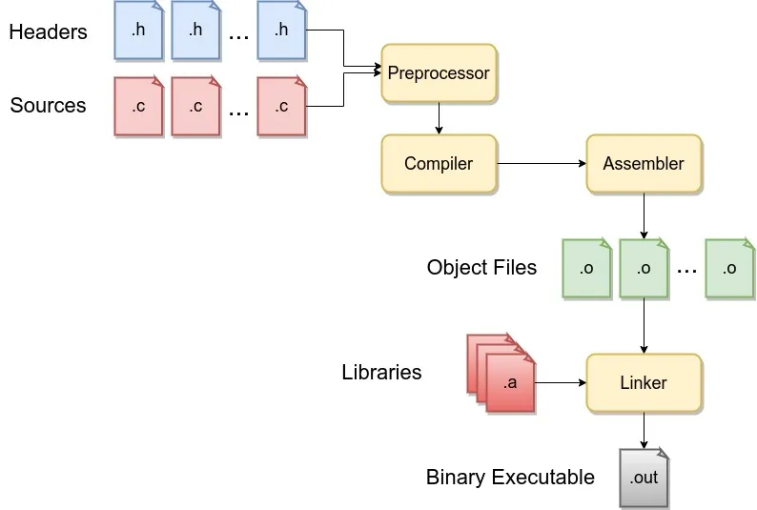
C compilation process:-
The compilation process in C involves four steps:-
pre-processing, compiling, assembling, and linking then,
we run the obtained executable file to get an output on the screen.
Cmd for compilation in Linux:- gcc prog.c –o output
To run output file :- ./output

Slide 6
Source code browsing Tool:-
Cscope:-
Cscope tool is used to examine the symbols of source code files,here symbols can be variable, function and macro.
Cmd to open cscope:- cscope -R
Once cscope is entered from terminal, it will take you to an interactive screen, with multiple options to examine your source code.
Ctags:-
Ctags is a programming tool used for software development process in large applications in Linux, and supports many programming languages along with c.
tags file generated contains the complete information about all the objects in the source and header file.
Cmd:- ctags *.c
Open:- vim tags

Slide 7
Compilation of multiple source files:-
How to compile all .c files and generate single executable file.
Compiling in single command.
$ gcc 1.c 2.c 3.c 4.c –o out
2. Compile only main file.
-> all the source code files are included in the main source code file.
#include<stdio.h>
#include”1.c”
#include”2.c”
#include”file.h”
-> then main file is compiled
$ gcc prog.c –o out
$ ./out

Slide 8
3. Using Makefile and make tool.
Make is a programming build development tool used in linux & unix operating systems.
Makefile contains set of commands that are similar to terminal commands, that uses variable names and files target names, to create objects.
Make executes shell commands.
Syntax:-
Target: dependencies . . .
commands …..
A target is usually the name of a file that is generated by a program;
A dependency is a file that is used as input to create the target.
A command is an actions that make carries out.
Use of variables-
Particular command or file extensions can be stored in a variable and can be dereferenced at the command lines.

Slide 9
GDB :-
GDB is powerful debugging tool used for c and c++ debugging in Linux and Unix operating systems.
GDB operates with the executable file, that is produced by the compiler.
GDB never works with .c file.
Cmd :-
gcc –g prog.c –o out
gdb –quiet ./out
breakpoint(b) – to set breakpoint
run(r) – to start execution
next(n) – to move next
step(s) – step into the child function
p –print the data
infolocals – value of variables
q – to stop execution

Slide 10
Command line argument:-
Parameters are passed to the program during execution from command line interface.
> cmd:- $ ./output this is parameter
> parameters:- “./output” “this” “is” “parameter”
We need to have modified version of main function, to accept CLA
Syntax of main function:-
int main( int argc, char *argv[] )
{
// program logic
}

Slide 11
Electric Fence:-
Electric fence is a memory debugger or memory profile library.
EF library has own implementation of malloc() and calloc()=0.
cmd:- gcc –g prog.c -o out -lefence
Issue with GDB:-
ptr = malloc(300) -> let malloc is requested for 300 bytes of memory, this request is done to MMU
In heap the memory is divided into slots of 32,64,128,256,512
If the request is for 300 bytes then MMU will allocate its nearest max byte that is 512
That means 512 – 300 -> 212 this amount of memory will be waste,
and if at ptr the data above 300 bytes is stored this will execute without any error in gcc and gdb.
but Electric fence will give segmentation error .

Slide 12
Valgrind:-
To identify error’s due to Heap memory.
Cmd:-
$ gcc –g prog.c –o output
$ valgrind ./output
-> valgrind runs without electric fence and use same standard c library and trying to identify/ fix program errors of Heap Memory.

Slide 13
Cross compilation:-
Cross compilation is a process of generating executable files for other architectures.
Executable files:- a file that contain binary encoded instructions that can be executed by an operating system.
On intel architecture, write a program and to generate executable file for ARM Architecture Cross compilers are needed.
Cmd:-
$ arm-linux-gnueabi-gcc prog.c –o out

Slide 14
Static tools analysis:-
Static tool analysis is the process of detecting error and bugs in the program source code before the program is being start.
Analysis and execution is done on stationary code therefore named as static code analysis.
Splint :- tool used to identify errors and bugs in the source code.
type of errors it detect:-
1.syntax error.
2.use of undefined variable functions.
cmd:- splint prog.c
2. Clang :- clang is a compiler like gcc, one diff is it is very fast in compare to gcc.
clang provides extremely clear diagnostic messages and warnings.
cmd:- clang –Wall prog.c –o out

Slide 15
Dynamic tools analysis:-
Dynamic analysis is done on the piece of software, that is executed or in execution.
gcov :- gcov tool is used along with gcc.
on analysis, gcov tool will determine untested or unexecuted part of code and also determines, number of times lines has executed.
two flags used:-
1. -ftest-coverage : causes gcc to add code coverage and statistics info to binary executable.
2. –fprofile-arcs : causes to create .gcda output profile file..
cmd:- $ gcc –fprofile-arcs –ftest-coverage pog.c –o out
$ ./out
$ gcov pog.gcda
$ vim pog.c.gcov

Slide 16
2. lcov :- lcov graphically represents gcc program coverage tool.
lcov tool genterates HTML file.
cmd:-
> first run gcov tool for the program.
> now to generate the html file we need lcov tool
1. $ lcov --capture --directory . --out pog.info
this will create pog.info file
2. $ genhtml pog.info --output--directory . -o
newfilethis will create newfile as html file

