Slide 1
Windows Server ADDS, IIS & Amazon Linux Setup
Detailed Tasks, Steps, Explanations & Theory

Slide 2
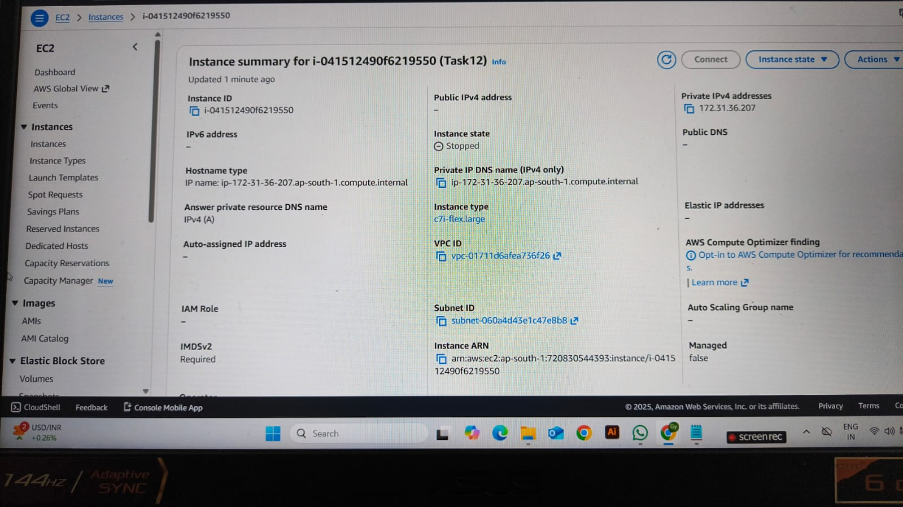
Task 1: Create Windows Server & Install ADDS(ACTIVE DIRECTORY DOMAIN SERVICES
- Create Windows instance in AWS
- Generate Key Pair for secure SSH/RDP access
- Launch instance

Slide 3
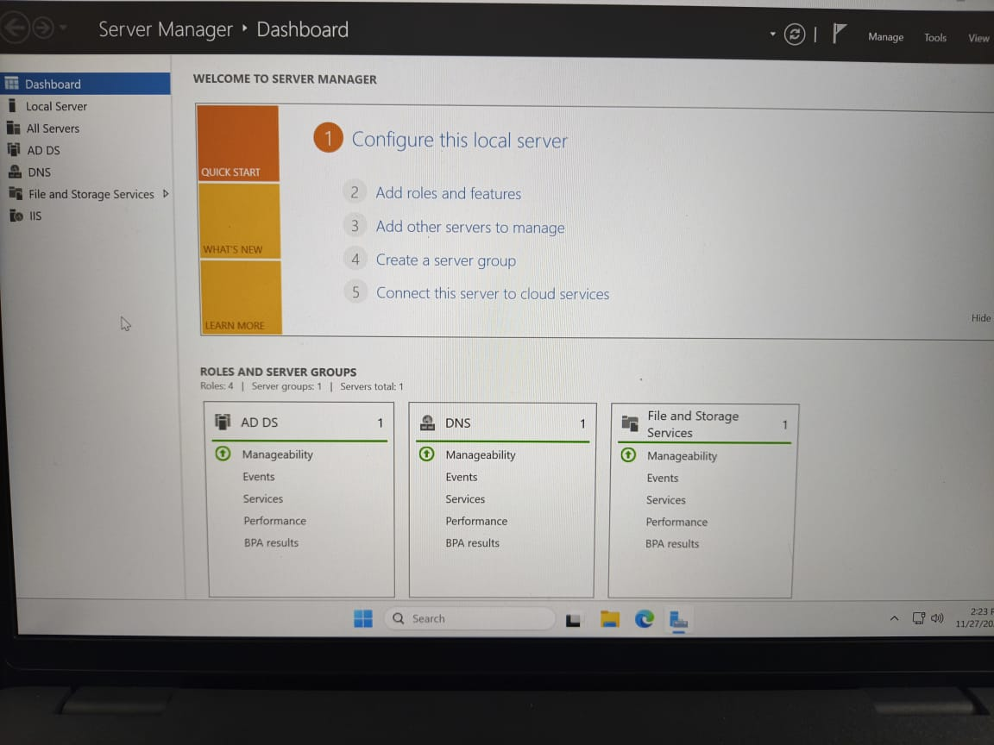
Installing ADDS
- Open Server Manager → Add Roles & Features
- Select Active Directory Domain Services
- Install ADDS
Reason: ADDS enables centralized authentication & identity management.

Slide 4
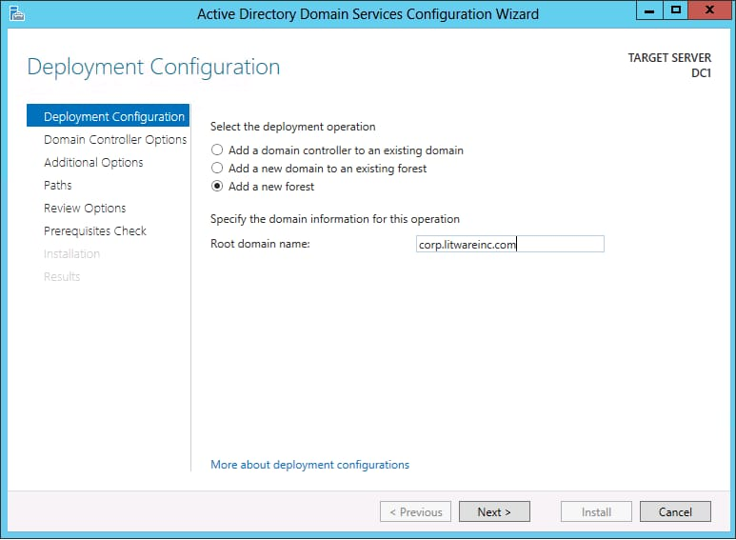
Promote Server to Domain Controller
- After ADDS installation → Promote this server to a Domain Controller
- Create a new forest
- Set Directory Services Restore Mode (DSRM) password
Why DC? Domain Controllers store and validate credentials for the domain.

Slide 5
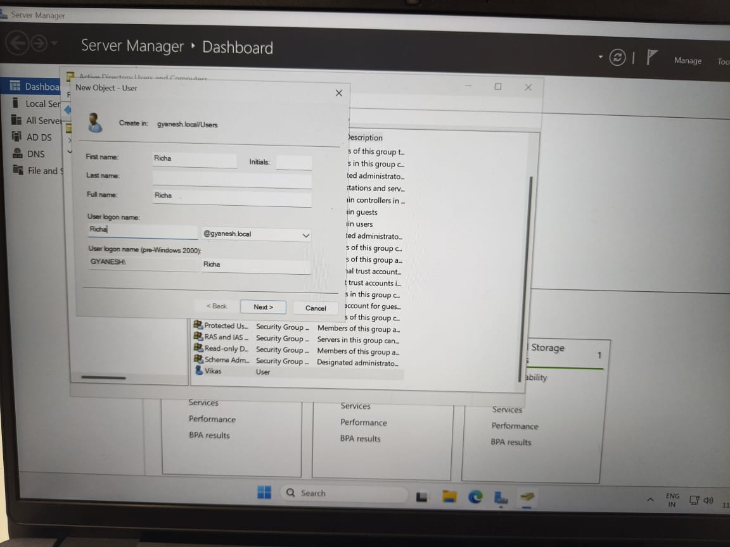
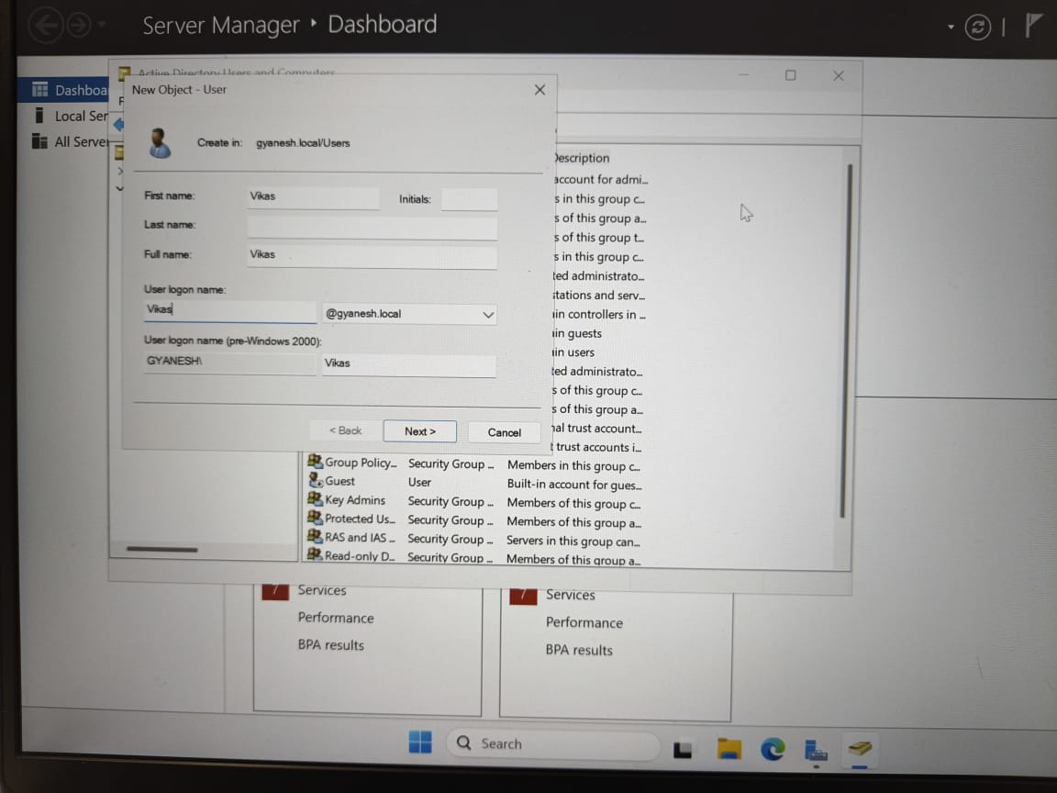
Create Users in ADDS
- Open ADUC (Active Directory Users and Computers)
- Create User: Vikas
- Create User: Richa
- Assign passwords to both users

Slide 6
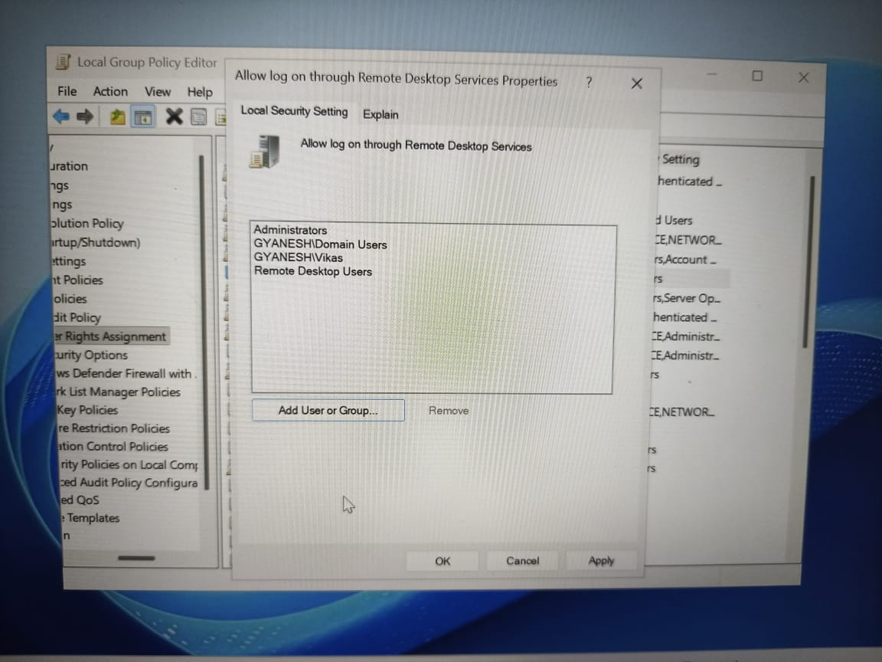
Configure RDP Permissions
- Go to: Computer Configuration → Windows Settings → Security Settings → Local Policies → User Rights Assignment
- Allow log on through Remote Desktop Services
Why? Allows non-admin domain users to login using RDP.
- Add: Vikas, Remote Desktop Users group
Why? RDP Users must be part of the Remote Desktop Users group.

Slide 7
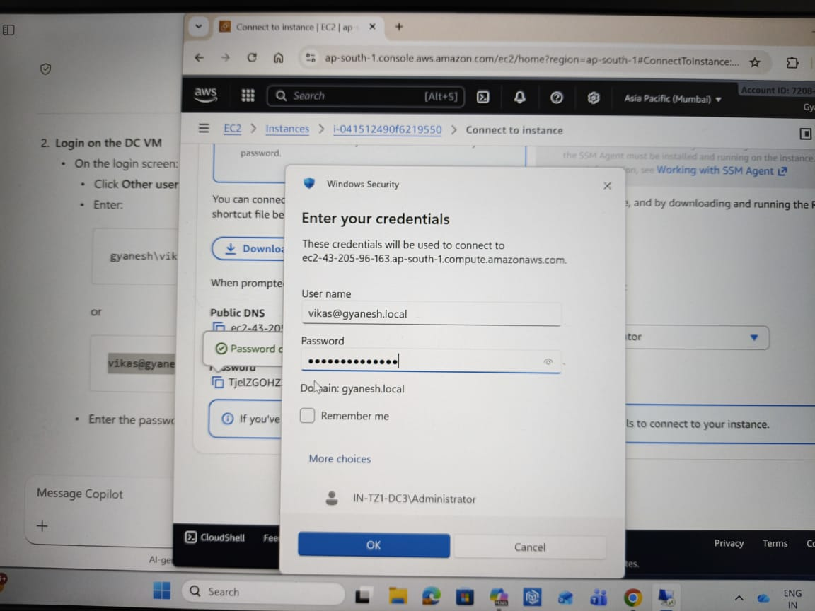
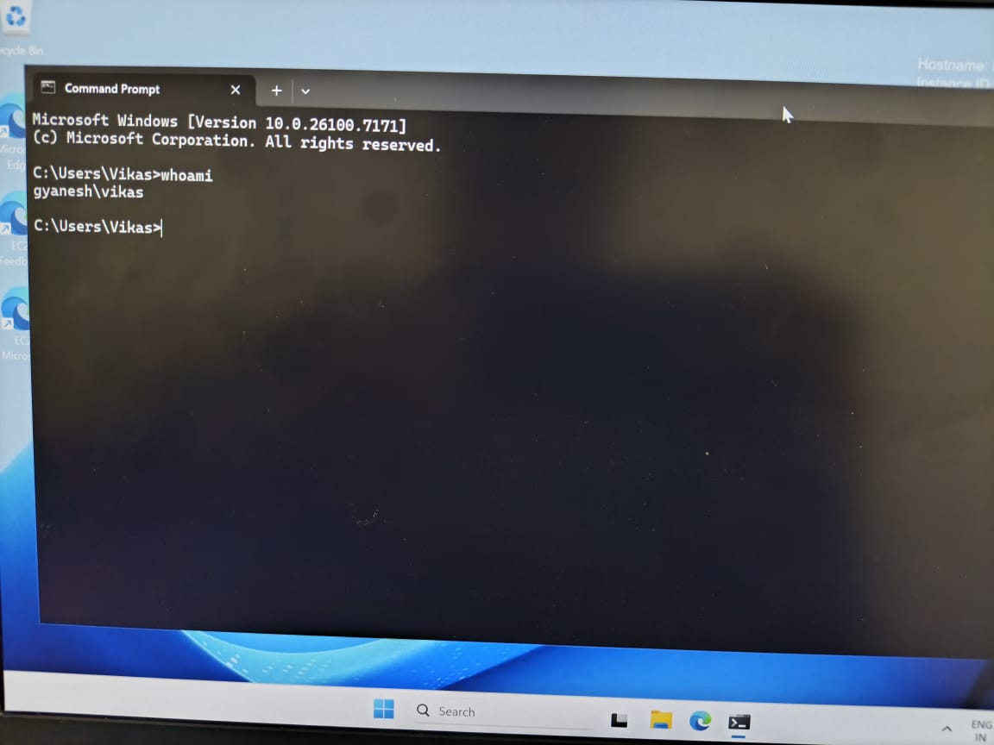
Login as Vikas
- Logout from Administrator
- Login using Vikas credentials
- Open CMD → Username should show 'VIKAS'

Slide 8
Task 2: Install IIS & Create Website
- Install IIS from Server Manager
IIS: Internet Information Services (Windows Web Server)

Slide 9
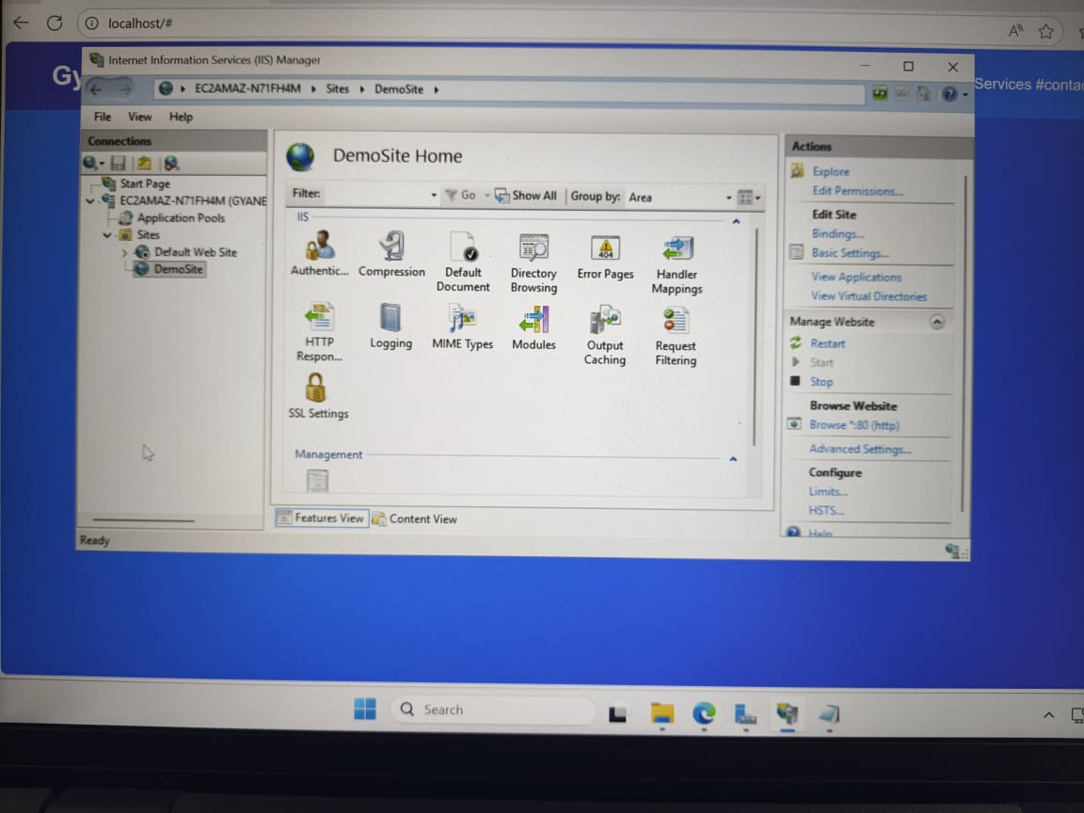
Host Website on IIS
- Open IIS Manager
WHY? IIS is Microsoft’s official web server built into Windows Server.
It is used to host websites, web applications, and APIs on Windows.
- Stop Default Web Site
- Create new site: Demosite

Slide 10
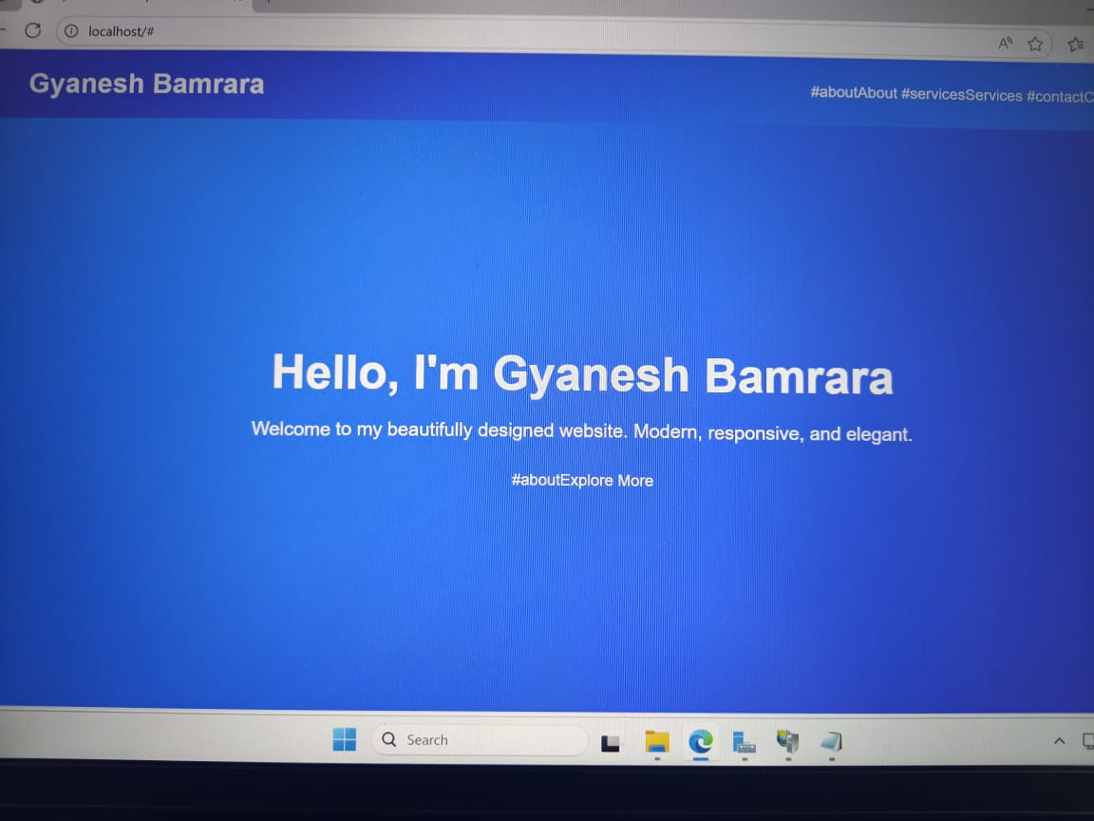
Host Website on IIS
- Add index.html in Default Document
- Restart site
- Copy public IP → http://<ip>

Slide 11
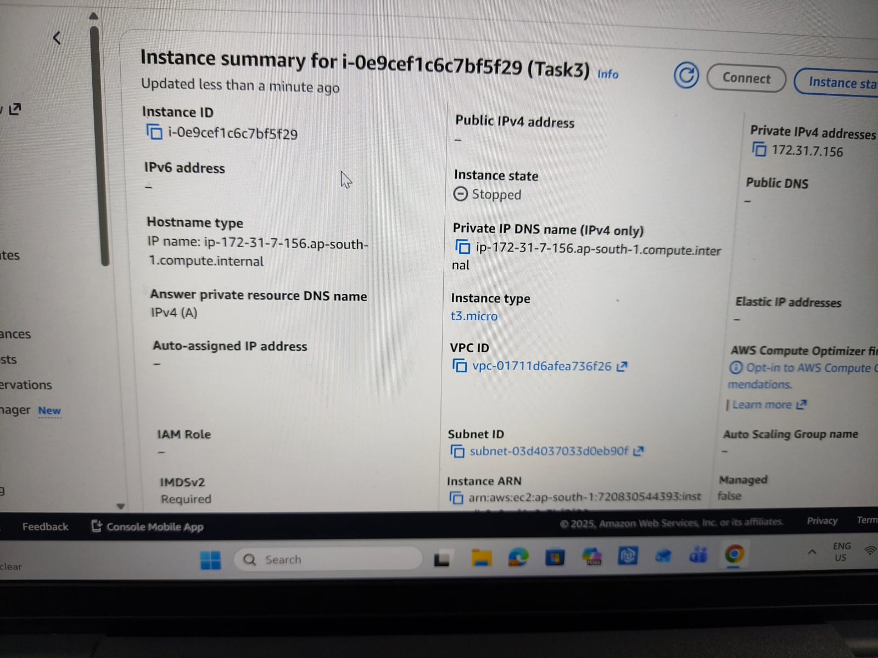
Task 3: Amazon Linux Server Setup
- Launch Amazon Linux instance
- Create Key Pair

Slide 12
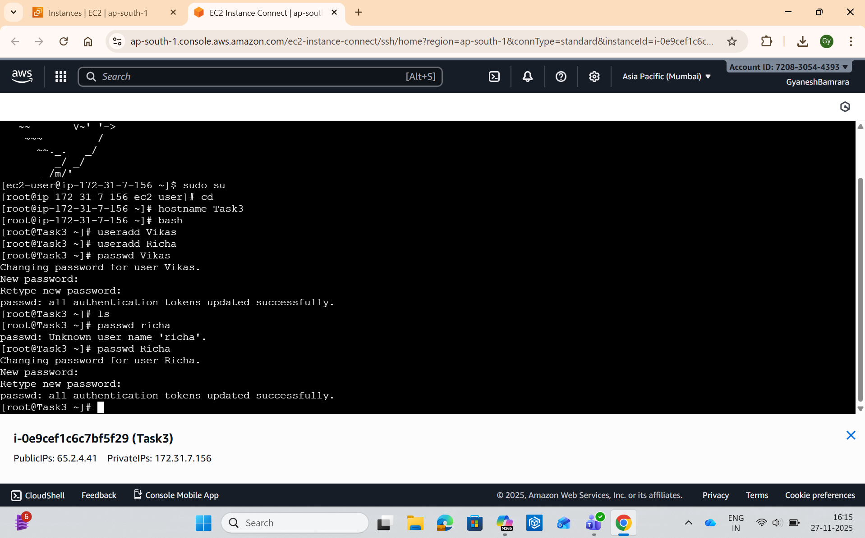
Task 3: Amazon Linux Server Setup
- Create users: Vikas, Richa
- Set passwords

Slide 13
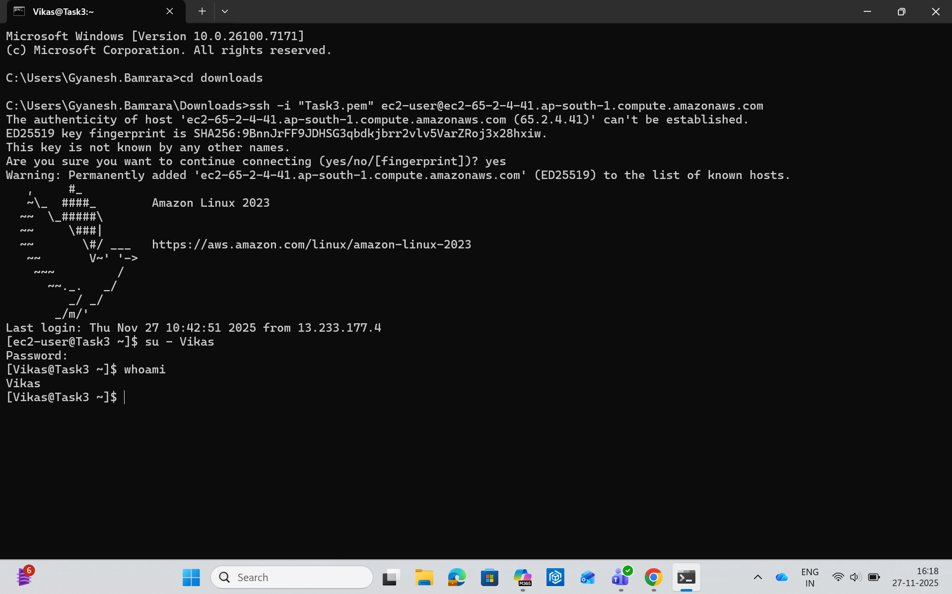
Amazon Linux User Login
- Login as Vikas
- Login as Richa

Slide 14
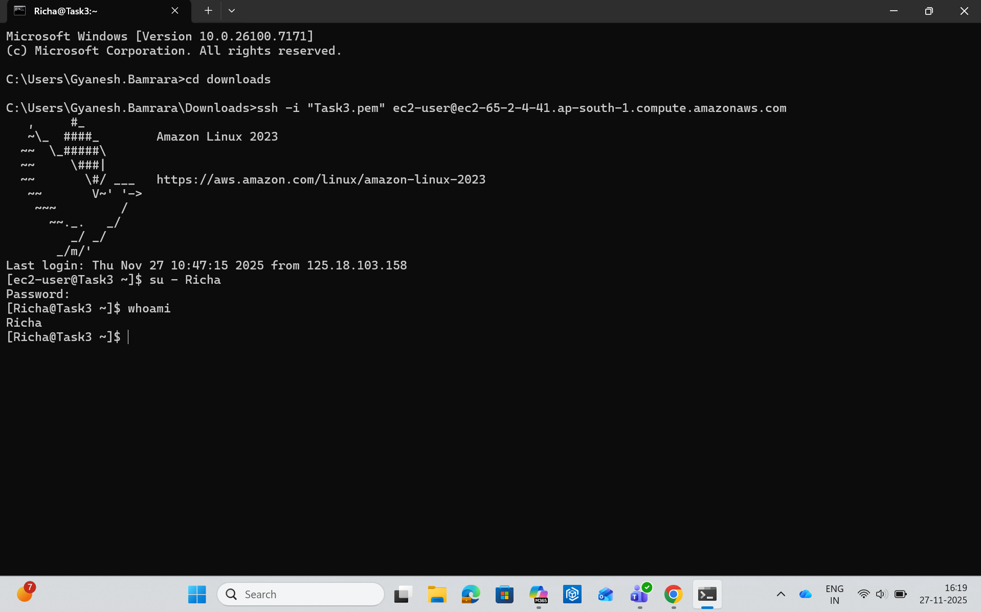
Amazon Linux User Login
- Login as Vikas
- Login as Richa

Slide 15
Install & Configure Apache (httpd)
- Install httpd: sudo yum install httpd
Why install httpd? Apache Web Server is required to host websites.
- Start service: sudo systemctl start httpd
- Navigate to /var/www/html
- Create index.html using vi editor

Slide 16
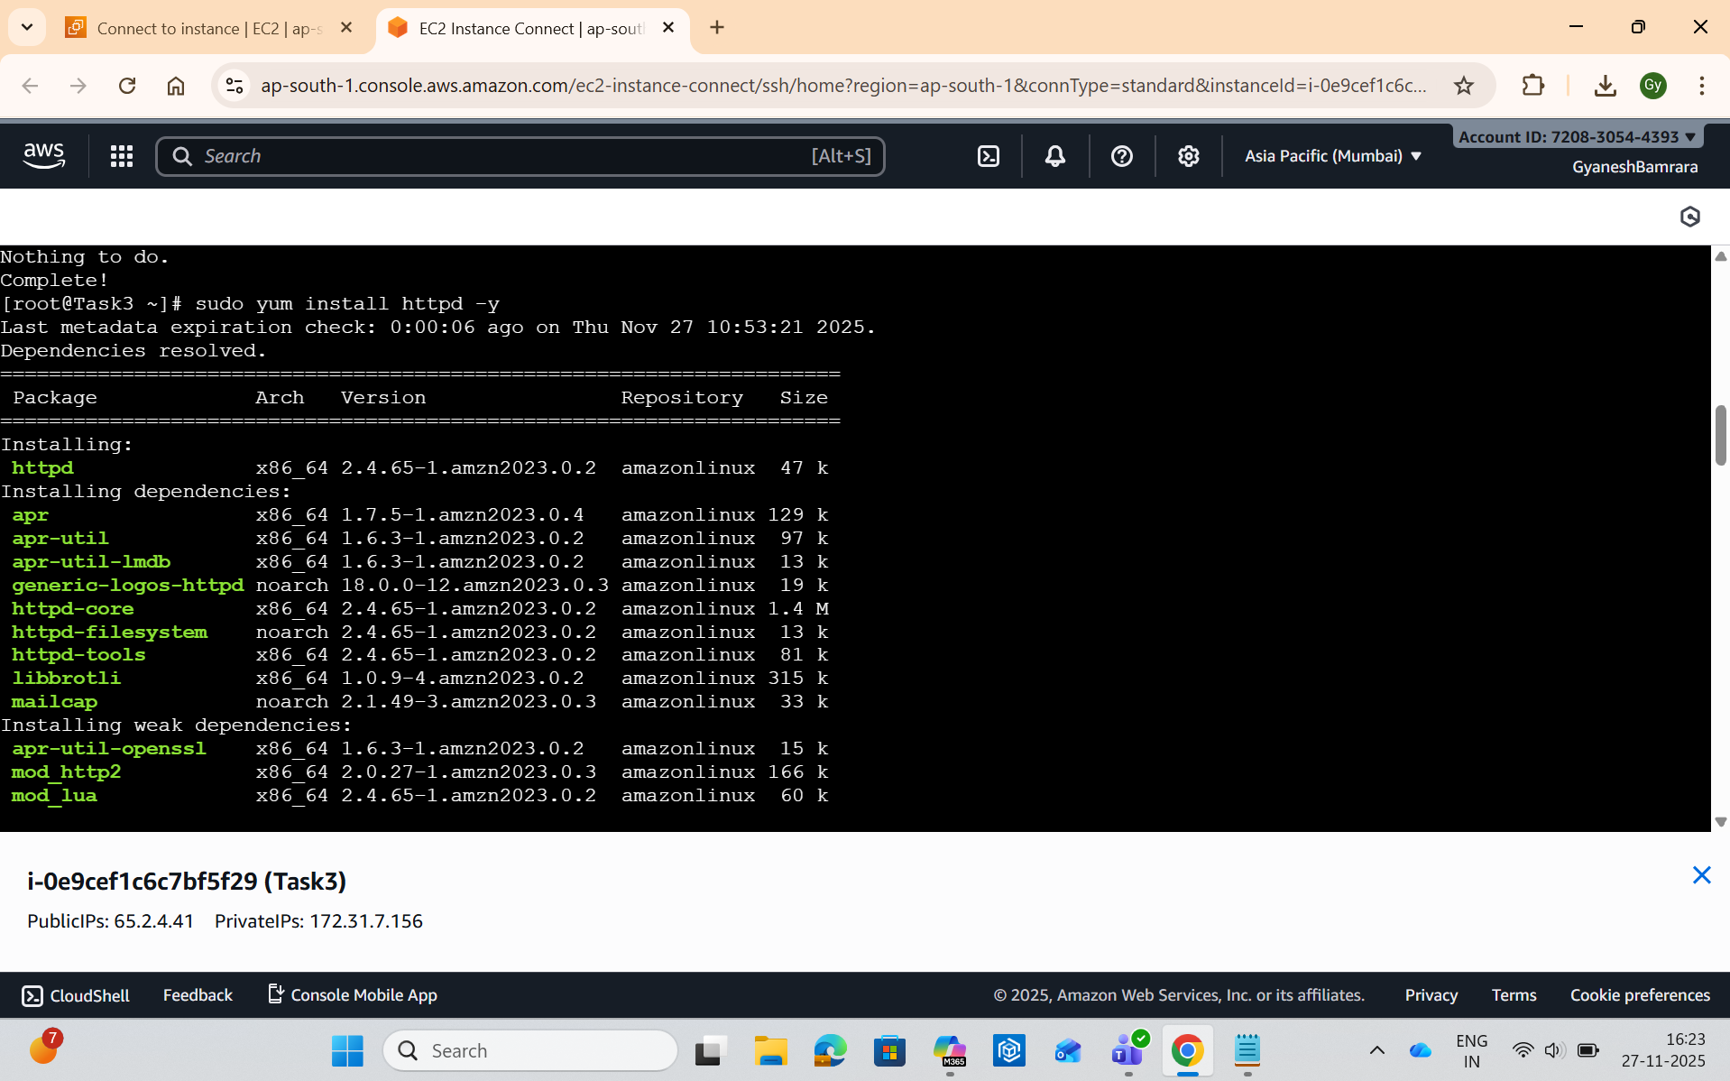
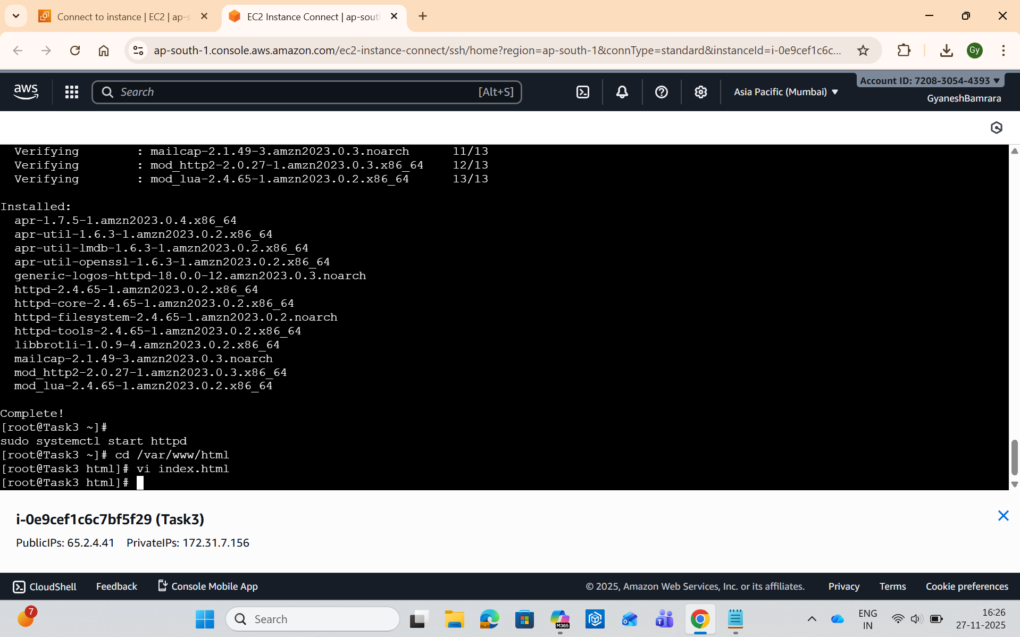

Slide 17
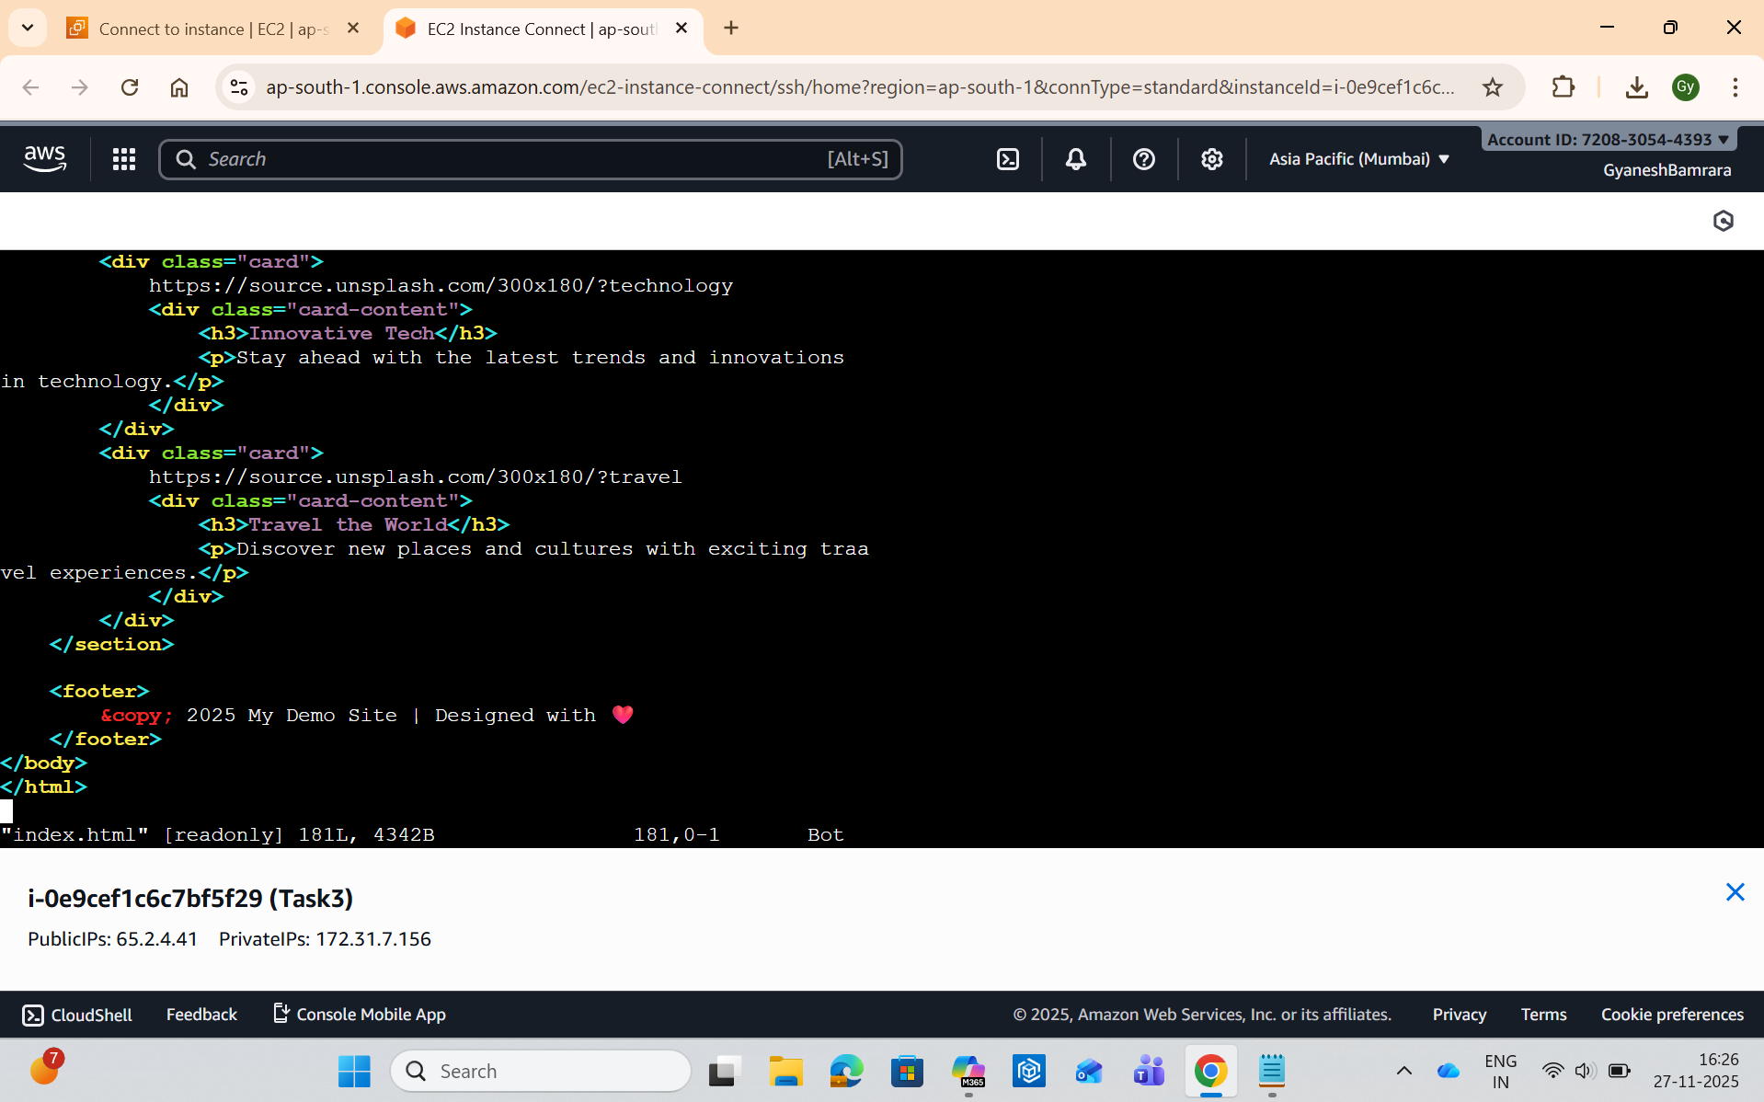

Slide 18
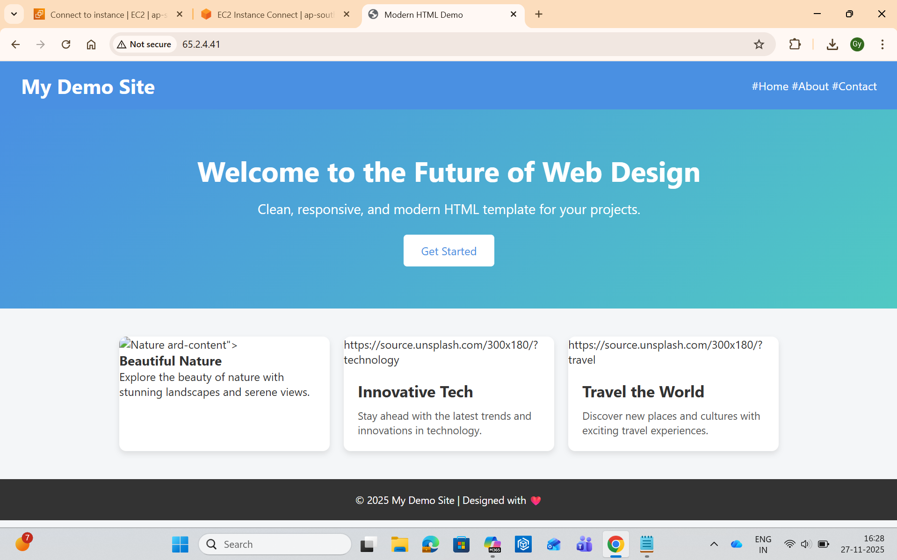
Host Website on Amazon Linux
- Insert HTML code into index.html
[IMAGE PLACEHOLDER]
- Open browser → http://<instance-ip>

