Slide 1
CS 5243: Analysis of Algorithms
Lecture 1: Introduction

Slide 2
The course
Purpose: a rigorous introduction to the design and analysis of algorithms
Textbook: Introduction to Algorithms, Cormen, Leiserson, Rivest, Stein 3ed
  An excellent reference you should own
  Do not sell this book at the end of the semester! Capice!?

Slide 3
Course Format
Two lectures /Week
  Mandatory
  MW 4:00-5:20 am @ BSH 320
  No recitation today
Homework most weeks
  Problem sets
  Occasional programming assignments
Four exams + final exam

Slide 4
Late homework submissions
10% penalty if submitted the same day after the instructor left classroom
15% penalty each additional day after the submission deadline
Email submission is acceptable in case of emergency

Slide 5
Exams
Exams cannot be made up, cannot be taken early, and must be taken in class at the scheduled time.
Proofs are needed for exceptions or true emergencies

Slide 6
Cheating
You are not allowed to read, copy, or rewrite the solutions written by others (in this or previous terms). Copying materials from websites, books or any other sources is considered equivalent to copying from another student.
If two people are caught sharing solutions, then both the copier and copiee will be held equally responsible, which will result in zero point in homework.
Cheating on an exam will result in failing the course.

Slide 7
Getting answers from the internet is
CHEATING
Getting answers from your friends is
CHEATING
However, teamwork is encouraged.
Group size at most 3.
Clearly acknowledge who you worked with.

Slide 8
Do NOT get answers
from other groups!
Do NOT do half the assignment
and your partner does the other half.
Each try all on your own.
Discuss ideas verbally at a high-level but write up on your own.

Slide 9
Attendance
Missing 3 or more classes (whenever attendance is checked) will result in a minimum of 5 points taken off your final grade

Slide 10
Introduction
Why should you study algorithms
What is an algorithm
What you can expect to learn from this course

Slide 11
Please feel free
to ask questions!
Help me know what people
are not understanding
We do have a lot of material
It’s your job to slow me down

Slide 12

So you want to be a computer scientist?

Slide 13

Is your goal to be a mundane programmer?

Slide 14

Or a great leader and thinker?

Slide 15


Boss assigns task:
  Given today’s prices of pork, grain, sawdust, …
  Given constraints on what constitutes a hotdog.
  Make the cheapest hotdog.
Everyday industry asks these questions.

Slide 16
Your answer:
Um? Tell me what to code.
With more sophisticated software engineering systems,
the demand for mundane programmers will diminish.

Slide 17

Your answer:
I learned this great algorithm that will work.
Soon all known algorithms
will be available in libraries.
Your boss might change his mind. He now wants to make the most profitable hotdogs.

Slide 18
Your answer:
I can develop a new algorithm for you.
Great thinkers
will always be needed.

Slide 19
How do I become a great thinker?
Maybe I’ll never be…

Slide 20
Learn from the classical problems

Slide 21

Shortest path
end
Start

Slide 22


Traveling salesman problem

Slide 23
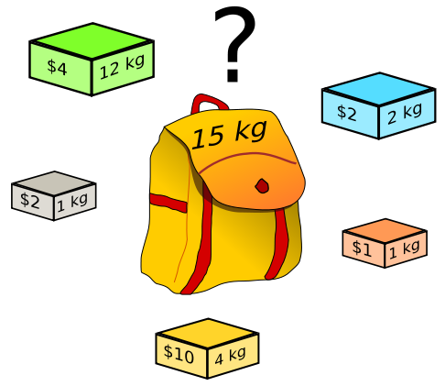
Knapsack problem

Slide 24
Useful learning techniques
Read Ahead. Read the textbook before the lectures. This will facilitate more productive discussion during class.
Explain the material over and over again out loud to yourself, to each other, and to your stuffed bear.
Be creative. Ask questions: Why is it done this way and not that way?
Practice. Try to solve as many exercises in the textbook as you can.

Slide 25
What will we study?
Expressing algorithms
  Define a problem precisely and abstractly
  Presenting algorithms using pseudocode
Algorithm validation
  Prove that an algorithm is correct
Algorithm analysis
  Time and space complexity
  What problems are so hard that efficient algorithms are unlikely to exist
Designing algorithms
  Algorithms for classical problems
  Meta algorithms (classes of algorithms) and when you should use which

Slide 26
What is an algorithm?
Algorithms are the ideas behind computer programs.
An algorithm is the thing that stays the same whether the program is in Pascal running on a Windows or is in JAVA running on a Macintosh!

Slide 27
What is an algorithm? (cont’)
An algorithm is a precise and unambiguous specification of a sequence of steps that can be carried out to solve a given problem or to achieve a given condition.
An algorithm accepts some value or set of values as input and produces a value or set of values as output.
Algorithms are closely intertwined with the nature of the data structure of the input and output values

Slide 28
How to express algorithms?
English
Pseudocode
Real programming languages
Increasing precision
Ease of expression
Describe the ideas of an algorithm in English.
Use pseudocode to clarify sufficiently tricky details of the algorithm.

Slide 29
How to express algorithms?
English
Pseudocode
Real programming languages
Increasing precision
Ease of expression
To understand / describe an algorithm:
Get the big idea first.
Use pseudocode to clarify sufficiently tricky details

Slide 30
Example: sorting
Input: A sequence of N numbers a₁…a_{n}
Output: the permutation (reordering) of the input sequence such that a₁ ≤ a₂ … ≤ a_{n}.
Possible algorithms you’ve learned so far
  Insertion, selection, bubble, quick, merge, …
  More in this course
We seek algorithms that are both correct and efficient

Slide 31
Insertion Sort
InsertionSort(A, n) {
for j = 2 to n {
}
}
▷ Pre condition: A[1..j-1] is sorted
1. Find position i in A[1..j-1] such that A[i] ≤ A[j] < A[i+1]
2. Insert A[j] between A[i] and A[i+1]
▷ Post condition: A[1..j] is sorted
1
j
sorted

Slide 32
Insertion Sort
InsertionSort(A, n) {
for j = 2 to n {
key = A[j];
i = j - 1;
while (i > 0) and (A[i] > key) {
A[i+1] = A[i];
i = i – 1;
}
A[i+1] = key
}
}
1
i
j
sorted
Key

Slide 33
Correctness
What makes a sorting algorithm correct?
  In the output sequence, the elements are ordered non-decreasingly
  Each element in the input sequence has a unique appearance in the output sequence
    [2 3 1] => [1 2 2] X
    [2 2 3 1] => [1 1 2 3] X

Slide 34
Correctness
For any algorithm, we must prove that it always returns the desired output for all legal instances of the problem.
For sorting, this means even if (1) the input is already sorted, or (2) it contains repeated elements.
Algorithm correctness is NOT obvious in some problems (e.g., optimization)

Slide 35
How to prove correctness?
Given a concrete input, eg. <4,2,6,1,7>
trace it and prove that it works.
Given an abstract input, eg. <a₁, … a_{n}>
trace it and prove that it works.
Sometimes it is easier to find a counterexample to show that an algorithm does NOT works.
  Think about all small examples
  Think about examples with extremes of big and small
  Think about examples with ties
  Failure to find a counterexample does NOT mean that the algorithm is correct

Slide 36
An Example: Insertion Sort
InsertionSort(A, n) {
for j = 2 to n {
key = A[j];
i = j - 1;
▷Insert A[j] into the sorted sequence A[1..j-1]
while (i > 0) and (A[i] > key) {
A[i+1] = A[i];
i = i – 1;
}
A[i+1] = key
}
}
1
i
j
sorted
Key

Slide 37
Example of insertion sort
5 | 2 | 4 | 6 | 1 | 3
2 | 5 | 4 | 6 | 1 | 3
2 | 4 | 5 | 6 | 1 | 3
2 | 4 | 5 | 6 | 1 | 3
1 | 2 | 4 | 5 | 6 | 3
1 | 2 | 3 | 4 | 5 | 6
Done!

Slide 38
Loop invariants and correctness of insertion sort
Claim: at the start of each iteration of the for loop, the subarray A[1..j-1] consists of the elements originally in A[1..j-1] but in sorted order.
Proof: by induction

Slide 39
Review: Proof By Induction
Claim:S(n) is true for all n >= 1
Basis:
  Show formula is true when n = 1
Inductive hypothesis:
  Assume formula is true for an arbitrary n = k
Step:
  Show that formula is then true for n = k+1

Slide 40
Prove correctness using loop invariants
Initialization (basis): the loop invariant is true prior to the first iteration of the loop
Maintenance:
  Assume that it is true before an iteration of the loop (Inductive hypothesis)
  Show that it remains true before the next iteration (Step)
Termination: show that when the loop terminates, the loop invariant gives us a useful property to show that the algorithm is correct

Slide 41
Prove correctness using loop invariants
InsertionSort(A, n) {
for j = 2 to n {
key = A[j];
i = j - 1;
▷Insert A[j] into the sorted sequence A[1..j-1]
while (i > 0) and (A[i] > key) {
A[i+1] = A[i];
i = i – 1;
}
A[i+1] = key
}
}
Loop invariant: at the start of each iteration of the for loop, the subarray A[1..j-1] consists of the elements originally in A[1..j-1] but in sorted order.

Slide 42
Initialization
InsertionSort(A, n) {
for j = 2 to n {
key = A[j];
i = j - 1;
▷Insert A[j] into the sorted sequence A[1..j-1]
while (i > 0) and (A[i] > key) {
A[i+1] = A[i];
i = i – 1;
}
A[i+1] = key
}
}
Subarray A[1] is sorted. So loop invariant is true before the loop starts.

Slide 43
Maintenance
InsertionSort(A, n) {
for j = 2 to n {
key = A[j];
i = j - 1;
▷Insert A[j] into the sorted sequence A[1..j-1]
while (i > 0) and (A[i] > key) {
A[i+1] = A[i];
i = i – 1;
}
A[i+1] = key
}
}
Assume loop variant is true prior to iteration j
Loop variant will be true before iteration j+1
1
i
j
sorted
Key

Slide 44
Termination
InsertionSort(A, n) {
for j = 2 to n {
key = A[j];
i = j - 1;
▷Insert A[j] into the sorted sequence A[1..j-1]
while (i > 0) and (A[i] > key) {
A[i+1] = A[i];
i = i – 1;
}
A[i+1] = key
}
}
The algorithm is correct!
Upon termination, A[1..n] contains all the original elements of A in sorted order.
1
n
j=n+1
Sorted

Slide 45
Efficiency
Correctness alone is not sufficient
Brute-force algorithms exist for most problems
To sort n numbers, we can enumerate all permutations of these numbers and test which permutation has the correct order
  Why cannot we do this?
  Too slow!
  By what standard?

Slide 46
How to measure complexity?
Accurate running time is not a good measure
It depends on input
It depends on the machine you used and who implemented the algorithm
It depends on the weather, maybe ☺
We would like to have an analysis that does not depend on those factors

Slide 47
Machine-independent
A generic uniprocessor random-access machine (RAM) model
  No concurrent operations
  Each simple operation (e.g. +, -, =, *, if, for) takes 1 step.
    Loops and subroutine calls are not simple operations.
  All memory equally expensive to access
    Constant word size
    Unless we are explicitly manipulating bits

Slide 48
Running Time
Number of primitive steps that are executed
  Except for time of executing a function call most statements roughly require the same amount of time
    y = m * x + b
    c = 5 / 9 * (t - 32 )
    z = f(x) + g(x)
We can be more exact if need be

Slide 49
Asymptotic Analysis
Running time depends on the size of the input
  Larger array takes more time to sort
  T(n): the time taken on input with size n
  Look at growth of T(n) as n→∞.
  “Asymptotic Analysis”
Size of input is generally defined as the number of input elements
  In some cases may be tricky

Slide 50
Running time of insertion sort
The running time depends on the input: an already sorted sequence is easier to sort.
Parameterize the running time by the size of the input, since short sequences are easier to sort than long ones.
Generally, we seek upper bounds on the running time, because everybody likes a guarantee.

Slide 51
Kinds of analyses
Worst case
  Provides an upper bound on running time
  An absolute guarantee
Best case – not very useful
Average case
  Provides the expected running time
  Very useful, but treat with care: what is “average”?
    Random (equally likely) inputs
    Real-life inputs

Slide 52
Analysis of insertion Sort
InsertionSort(A, n) {
for j = 2 to n {
key = A[j]
i = j - 1;
while (i > 0) and (A[i] > key) {
A[i+1] = A[i]
i = i - 1
}
A[i+1] = key
}
}
How many times will
this line execute?

Slide 53
Analysis of insertion Sort
InsertionSort(A, n) {
for j = 2 to n {
key = A[j]
i = j - 1;
while (i > 0) and (A[i] > key) {
A[i+1] = A[i]
i = i - 1
}
A[i+1] = key
}
}
How many times will
this line execute?

Slide 54
Analysis of insertion Sort
Statement cost time__
InsertionSort(A, n) {
for j = 2 to n { c₁ n
key = A[j] c₂ (n-1)
i = j - 1; c₃ (n-1)
while (i > 0) and (A[i] > key) { c₄ S
A[i+1] = A[i] c₅ (S-(n-1))
i = i - 1 c₆ (S-(n-1))
} 0
A[i+1] = key c₇ (n-1)
} 0
}
S = t₂ + t₃ + … + t_{n} where t_{j} is number of while expression evaluations for the j^{th} for loop iteration

Slide 55
Analyzing Insertion Sort
T(n) = c₁n + c₂(n-1) + c₃(n-1) + c₄S + c₅(S - (n-1)) + c₆(S - (n-1)) + c₇(n-1)
= c₈S + c₉n + c₁₀
What can S be?
  Best case -- inner loop body never executed
    t_{j} = 1 ➔ S = n - 1
    T(n) = an + b is a linear function
  Worst case -- inner loop body executed for all previous elements
    t_{j} = j ➔ S = 2 + 3 + … + n = n(n+1)/2 - 1
    T(n) = an² + bn + c is a quadratic function
  Average case
    Can assume that on average, we have to insert A[j] into the middle of A[1..j-1], so t_{j} = j/2
    S ≈ n(n+1)/4
    T(n) is still a quadratic function

Slide 56
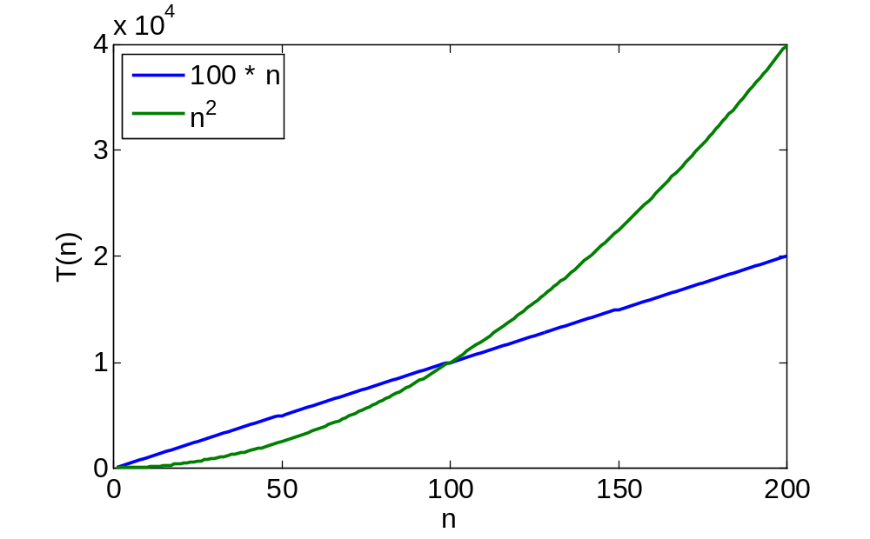
Asymptotic Analysis
Ignore actual and abstract statement costs
Order of growth is the interesting measure:
  Highest-order term is what counts
    As the input size grows larger it is the high order term that dominates

Slide 57
Comparison of functions
 | log₂n | n | nlog₂n | n² | n³ | 2^{n} | n!
10 | 3.3 | 10 | 33 | 10² | 10³ | 10³ | 10⁶
10² | 6.6 | 10² | 660 | 10⁴ | 10⁶ | 10³⁰ | 10¹⁵⁸
10³ | 10 | 10³ | 10⁴ | 10⁶ | 10⁹
10⁴ | 13 | 10⁴ | 10⁵ | 10⁸ | 10¹²
10⁵ | 17 | 10⁵ | 10⁶ | 10¹⁰ | 10¹⁵
10⁶ | 20 | 10⁶ | 10⁷ | 10¹² | 10¹⁸
For a super computer that does 1 trillion operations per second, it will be longer than 1 billion years

Slide 58
Order of growth
1 << log₂n << n << nlog₂n << n² << n³ << 2^{n} << n!
(We are slightly abusing of the “<<“ sign. It means a smaller order of growth).

Slide 59
Asymptotic notations
We say InsertionSort’s worst-case running time is Θ(n²)
  Properly we should say running time is in Θ(n²)
  It is also in O(n² )
  What’s the relationships between Θ and O?
Formal definition next time

