Slide 1
Math Converter
Members: 1. Gyaneshwar kale 2206022
2. Aryan Rajput 2206024

Slide 2
Introduction
Number System:
Number system is a form of expressing the numbers in Number System Conversion. A Number system is a system which convert a number of one base to a number of another base. There are a variety of number such as Binary Number, Decimal Number, Hexadecimal Number, Octal number.
Decimal Number -Base is 10.
Binary Number -Base is 2.
Octal Number- Base is 8.
Hexadecimal Number-Base is 16.

Slide 3
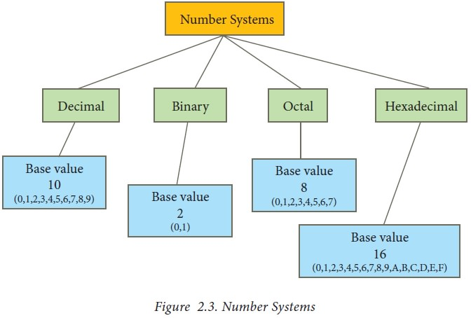
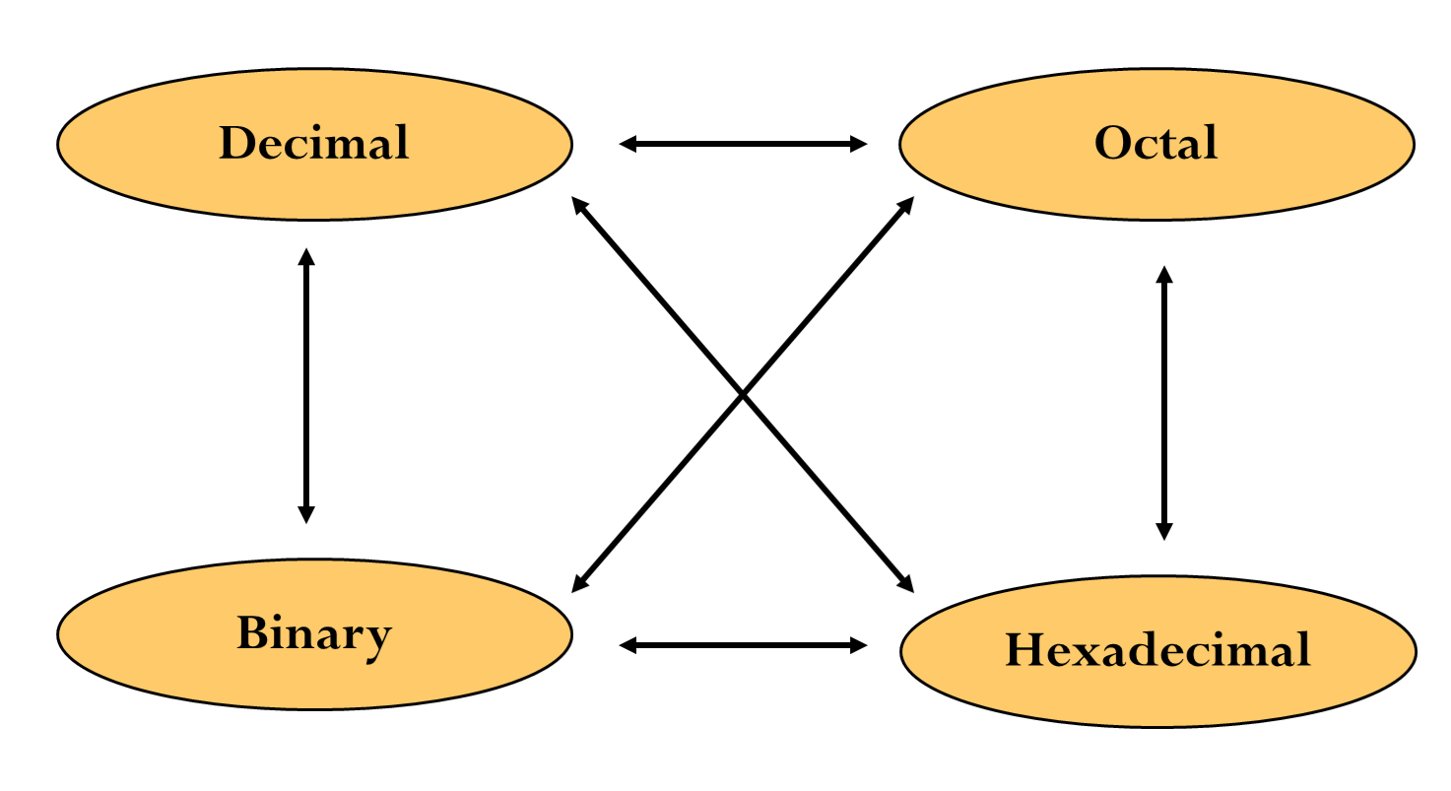
How a Number System conversion is carried out.

Slide 4
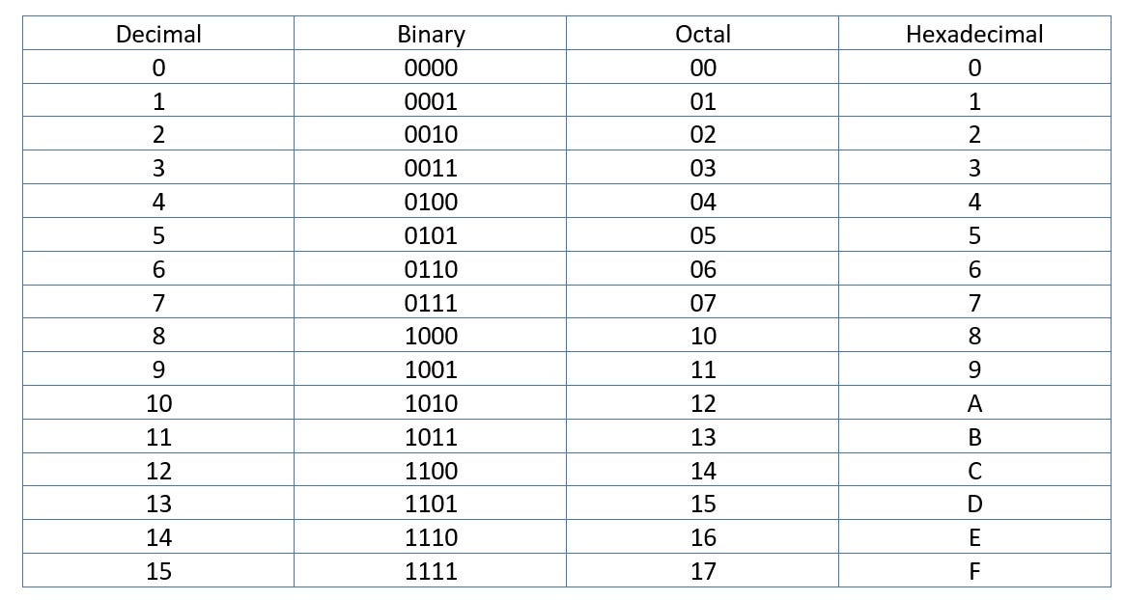
Number System Conversion Table

Slide 5
Methodology
The Number System converter, the tool uses inbuilt function of JavaScript to convert numbers between Binary, Decimal, Octal and Hexadecimal.

Slide 6
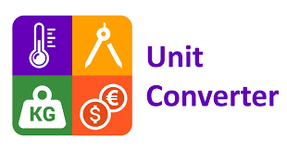
Unit Converter
Unit converter:
The use of unit depend on situation, such as the area of room expressed in meters, but the length of a pencil is expressed in centimeters and its thickness in mm
There are few things as the following that we measure :
Time.
Temperature.
Area.
Volume.
Mass.

Slide 7

Currency Converter
International currency converters are electronic programs, which permit users to determine the conversion values of one currency to another quickly. International currency converters generally make use of the latest market price for calculation purposes.

Slide 8
Thank you

