Slide 1
HOUSE PRICE PREDICTION WASHINGTON DC

Slide 2
Agenda
Problem Statement
About the dataset
Data Challenges
Data Preparation

Slide 3
Problem Statement
To build a prediction model to evaluate the price of a house with the given features.
Business Importance:
Traditional house price prediction is based on cost and sale price comparison, lacking of an accepted standard and a certification process. Therefore, the availability of a house price prediction model helps fill up an important information gap and improve the efficiency of the real estate market

Slide 4
About the dataset
This dataset contains house sale prices for the state of Washington, United States. It includes houses sold between May 2014 and May 2015.
There are 21613 records/rows with 23 columns/features of the houses.
The dataset is great for evaluating simple regression models.

Slide 5
Features
Dependent variable
Dependent variable
Dependent variable
Independent variable
Price
Continuous
Categorical
dayhour
living_measure
lot_measure
ceil_measure
basement_measure
yr_built
yr_renovated
lat
long
living_measure_15
lot_measure_15
total_area
room_bed
room_bath
ceil
coast
sight
condition
quality
zipcode
furnished

Slide 6
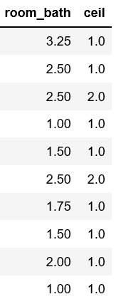
Data Interpretation
There were features like ‘room_bath’ and ‘ceil’ in our data where the values were unusual, as shown below
So, the bath_room column is interpreted as
0.25 bath- toilet, no sink, no shower, no tub.
0.5 bath- sink, toilet, no shower, no tub
0.75 bath- sink, toilet, shower, no tub Full bath- everything,
E.g. 1.25 means one bathroom having only toilet
Similarly with the feature ceil, where .5 means it is a partially built floor, i.e. a pent house in the top.

Slide 7
Data Challenges & Preparation
Data Challenges
Data Preparation
Data Cleaning :
Incorrect datatypes and formats.
Outliers :
5.87% of data has atleast one outlier in each row. The rows cannot be removed as the percentage is significant enough to cause data loss.
Multicollinearity :
Presence of collinearity between different independent features.
Area measures are correlated.
Data Transformation:
Updating the column dayhour to appropriate format
Changing the Datatype of Categorical columns to object.
Creating a new age of the house column
Outlier Treatment:
Replacing the outliers with null.
Imputing the null value using MICE (multiple imputation by chained equations).
Feature Elimination:
Feature elimination using VIF (Variance Inflation Factor)

Slide 8

Exploratory Data Analysis
Our EDA objective will be to understand how the variables in this dataset relate to the sale price of a house

Slide 9

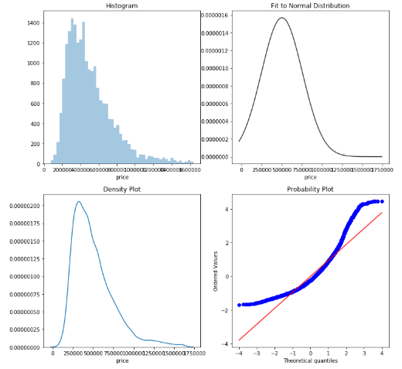
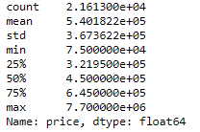
Checking the Skewness of Target Variable
Min Price: $75,000
Median Price:$450,000,
Max Price: $7,700,000
Notes:
The above histogram plot indicates that the distribution of the Price exhibits
a positive skewness (right skewed) and that the peakedness deviates from normal distribution.
The skewness can be visualized by a probability plot of the Price against the quantiles
of the normal distribution.

Slide 10
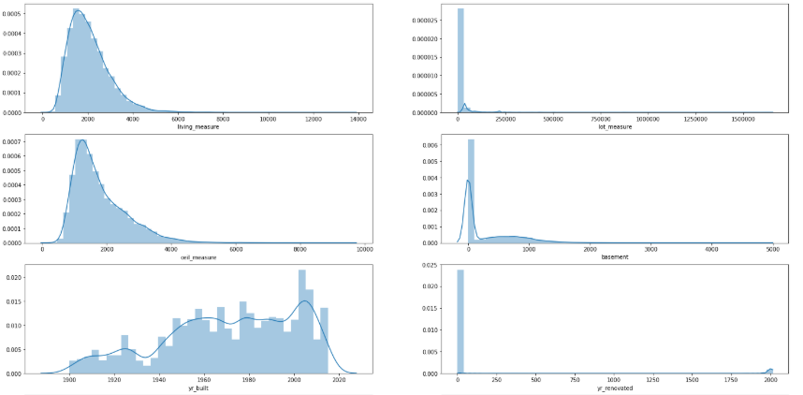
Univariate Analysis for Continuous Variables

Slide 11
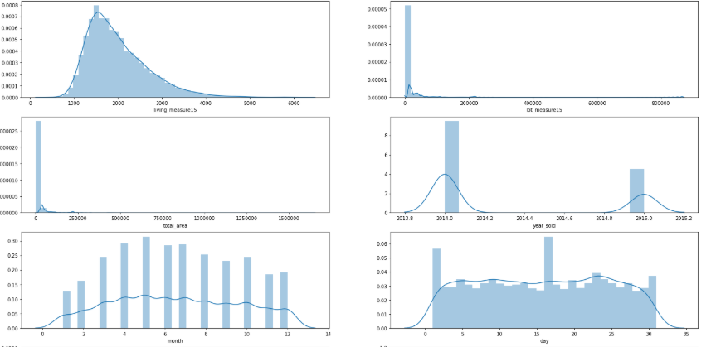
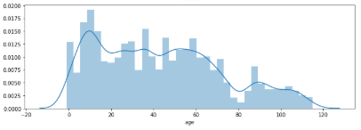
Univariate Analysis for Continuous Variables

Slide 12
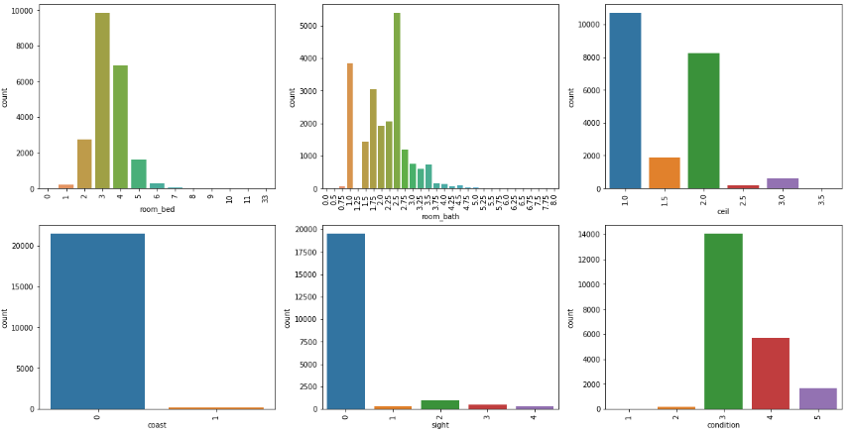
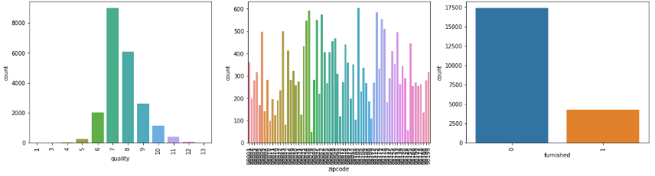
Univariate Analysis for Categorical
Categorical Description
room_bed:
Minimum Bed : 0
Median Bed : 3
Maximum Bed : 33

Slide 13
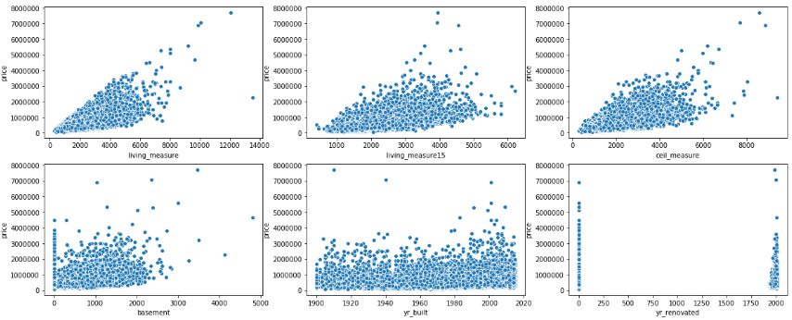
Bivariate Analysis
Price Vs Continuous
highly Correlated:
living_measure,
living_measure_15,
weakly Correlated:
ceil_measure,
Basement_measure,
Yr_renovated
Not Correlated:
lot_measure
lot_measure15

Slide 14
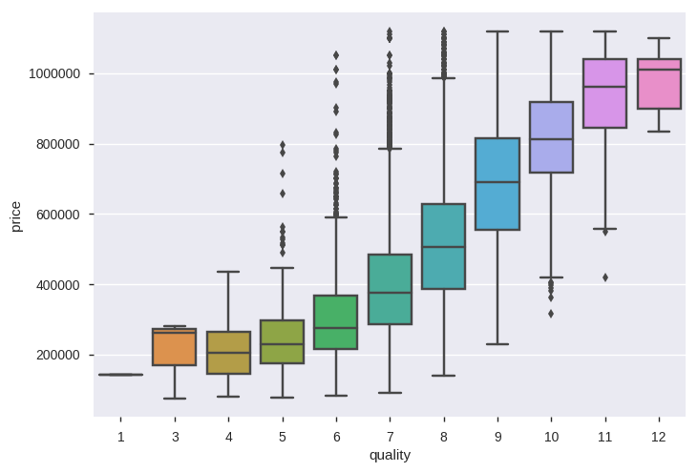
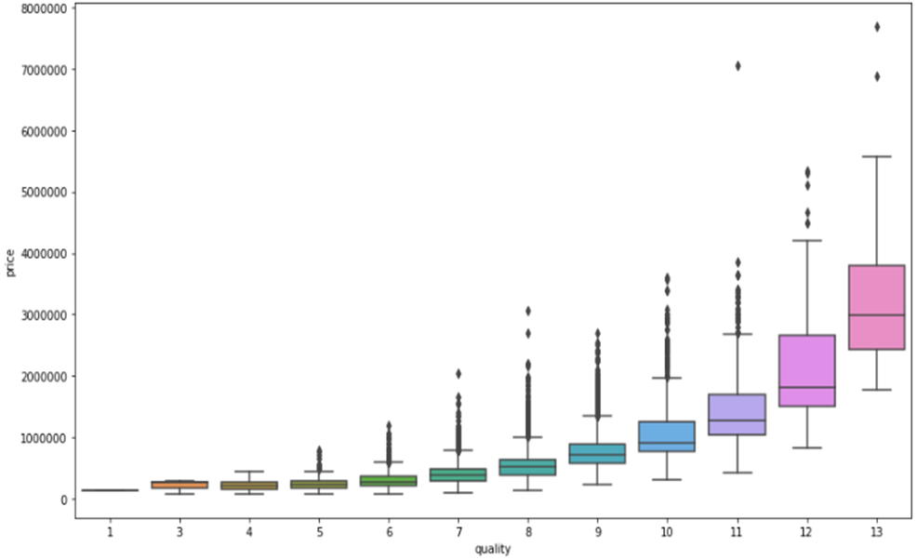
Bivariate Analysis
Price Vs Categorical
Highly Correlated:
zipcode
quality
coast
room_bath
furnished
Weakly Correlated:
room_bed
sight
condition
ceil

Slide 15
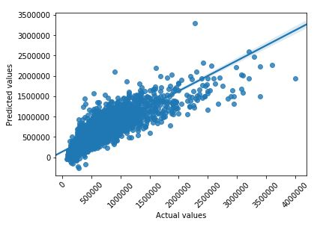
Baseline Model
Linear Regression Algorithm
R-square : 0.709

Slide 16
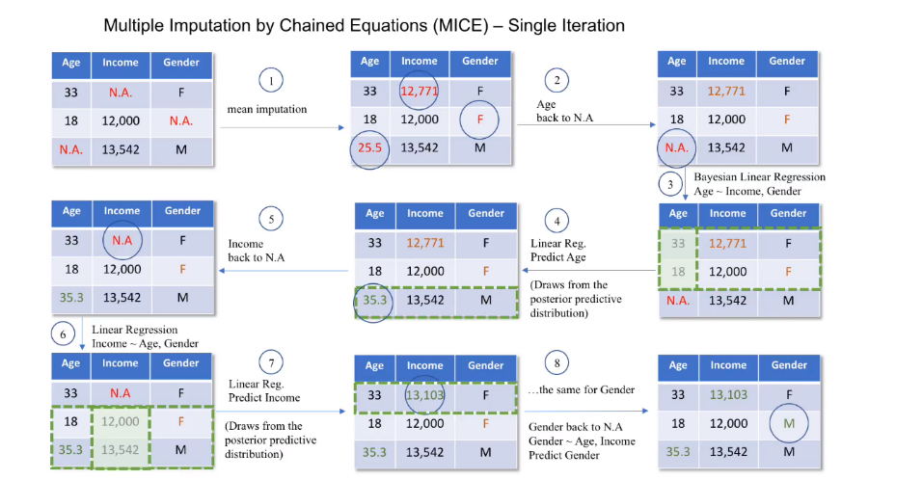
Outlier Treatment

Slide 17
Action Plan
Selection of Features After applying RFE.
Applying statistical techniques.
Use of regional features instead of zip code.
Applying some other imputation techniques other than MICE.
Applying different algorithms to get the better the accuracy

