Slide 1
Fundamentals of Computational Thinking
mulualem teku
Aug 5, 2019 / gcit

Slide 2
…Previously in itp101
Computing basics
Information Technology, Computers (definition, generation, types…)
The Number system (binary, decimal, Octal, Hexadecimal), conversion
Human computation (brain) vs Computer computation
The Computer system: Hardware and Software

Slide 3
Brainstorm
What are some milestones in the evolution of computers?
The whats, whys and hows of computation?
Computational Thinking? (from last week’s homework)
What do you think are the steps involved in solving a problem?

Slide 4
Computation
(dictionary) the act or process of computing/calculating. The procedure of calculating; determining something by mathematical or logical methods.
Recall our last discussion on evolution of computers from simple calculating machines. Computation is not just about numbers. Goes beyond.
(Wikipedia) any type of calculation that includes both arithmetical and non-arithmetical steps and follows a well-defined model (e.g. algorithm).

Slide 5
Computational Thinking (CT)
computational thinking = process of problem solving.
It is The process of approaching a problem in a systematic manner, developing and expressing its solution. It’s a thinking process.
IS Not just programming/coding & It not just for computer science/IT people.
Could be done with/without computers.
CT is thinking algorithmically (more on this later).

Slide 6
Some Quotes
“CT is a fundamental skill for everyone, not just computer scientists. To reading, writing and arithmetic, we should add computational thinking to every child’s analytical ability” (J. M. Wing , CMU)
“Computers are extremely talented at performing menial tasks quickly; computational thinkers can leverage that power to find solutions to previously impossible problems.”

Slide 7
Video time ☺
https://www.youtube.com/watch?v=GJKzkVZcozc

Slide 8
Applications
Computational biology/chemistry/physics
Computational music/photography
Computational advertising
Computer-aided design/manufacturing (CAD/CAM)
Computational social science
Computational journalism
Computational […]

Slide 9
Example problems
The Tower of Hanoi problem
The man, the cabbage, the goat and the wolf problem
Finding a name/contact number in a telephone directory.
Sorting a list of numbers in ascending/descending order.
The Traveling salesman problem (Tsp)
The 8-queens problem

Slide 10
CT techniques
Computers are good at computing. They Can be used for problem solving. Some of their characteristics Are: speed, accuracy, storage capacity, diligence, versatility, …
However, we must first understand the problem and know the how-to of solving the problem.
The Garbage-in, Garbage-out (GIGO) principle of computers.

Slide 11
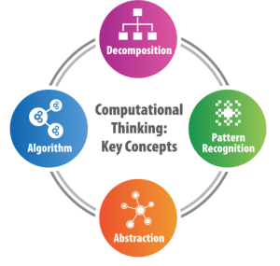
CT techniques (2)
4 key techniques to CT
Decomposition
Pattern Recognition
Abstraction
Algorithm

Slide 12
1. Decomposition
Breaking down complex problem into smaller/more manageable problems.
“If you can’t solve a problem, then there is an easier problem you can solve: find it.” (George Pólya, math proF)
Complex problem
Subproblem 1
Subproblem 3
Subproblem 2

Slide 13
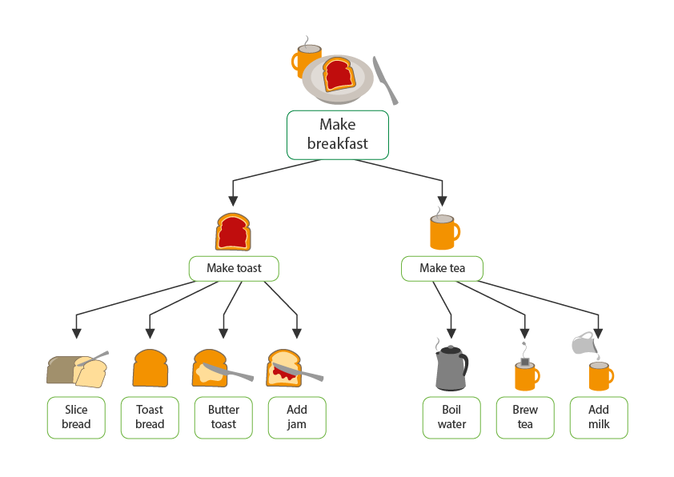
Examples
Make breakfast
Divide and conquer problems (e.g. binary search)

Slide 14
2. Pattern Recognition
Knowledge of previous similar problems.
The goal is to find common similarities and differences among them.
Helps us not to reinvent the wheel when finding solution to a problem.
This way, diverse problems can be solved by a single solution/approach.

Slide 15

Examples
Spot the pattern in the following numbers: a. { 2, 7, 12, 17, 22, 27, 32 …} b. {1, 3, 5, ,7, 9, 11, …}
Pattern recognition systems (image, iris, fingerprint…recognition)
Putting together (assembling) new furniture, jigsaw puzzles
Playing new computer game of familiar pattern.

Slide 16
3. Abstraction
Abstraction = Process of filtering out (ignoring) unnecessary information and extracting only the relevant ones.
Helps us to focus on important information needed to solve a problem.
Useful to create a general idea of the problem and how to solve it (i.e. representation/modeling).

Slide 17
Examples
The man, the cabbage, the goat and the wolf problem
you focus on what is relevant to solve the problem.
E.g. physical attributes of the man, the kind of cabbage, the age of the goat … relevant or irrelevant?
Representation/modeling the problem useful.
Google maps/Transit maps (irrelevant data omitted)

Slide 18
4. algorithms
Algorithm = a precise step-by-step procedure/instruction followed to solve a problem. It can be seen like a recipe.
The word is derived from the 9th century Mathematician Muhammad ibn musa Al-Khwarizmi (“Algoritmi” in latin), known for his work on algebra.
Algorithms are central to computational problem solving. They can be expressed in various forms such as Pseudocode and flowchart.

Slide 19
Examples
Making Ema Datsi
Direction to a particular destination
Determine if a given number is even or odd.
Find the maximum number in a list of numbers.

Slide 20
Characteristics
Some characteristics of A good algorithm:
Finiteness: terminates after finite number of steps
Input and Output
Uniqueness: each step gives definite result.
Unambiguity: steps are precisely defined.
Generality: applies to set of defined inputs

Slide 21
More Examples
Write an algorithm that achieves the following:
find the area of a circle/rectangle

Slide 22
find the maximum of two numbers.
How about for three numbers?

Slide 23
4) find the roots of a quadratic equation.

Slide 24
Search a particular number from a list/set of numbers.
Case 1: unsorteD list
Case 2: sorteD list

Slide 25
Flowcharts: graphical algorithms

Slide 26
Flowchart
(dictionary) a schematic representation of a sequence of operations.
It is A pictorial/graphical representation of the problem solving process
Gives step-by-step procedure for solution of a problem.
Uses various geometric shapes/symbols to represent the steps.

Slide 27
The Symbols

Slide 28
Start/end
Ellipse/oval symbol is used to indicate the start and end of a flowchart.
Start written in it denotes beginning of the flowchart.
End/exit/stop written in it denotes the end.

Slide 29
data
Parallelogram can be used to get data (input).
It can also be used to display data (output).
Recall the input/output characteristics of algorithms.

Slide 30
process
Rectangle denotes processing/calculation in the flowchart.
e.g. arithmetic operations (+, -, X, / )

Slide 31
decision
Diamond symbol shows a decision/conditional (if…else) operation in the flowchart.
A decision question is specified in the diamond.
next step of the flowchart depends on the answer: “yes” or “no”.

Slide 32
connector
Arrows indicate the correct flow of the problem solving process.
The connector symbol ( ) can be used to connect
breaks in the flowchart (e.g. multi-page flowcharts). A letter inside often used.

Slide 33
Example
Draw a Flowchart to find the average of two numbers.

Slide 34
More Examples
Draw A flowchart for each of the previous 5 problems.

Slide 35
Next …
More on the problem-solving process
Pseudocode
I/o determination
trace table / dry running algorithms
building blocks of problem solving
programming paradigms.

Slide 36
Pseudocode
Pseudo = artificial, imitation, false, fake, quasi …
Why is it called pseudocode?
An informal (non-standard), high-level description of steps of a process.
Algorithm in common/colloquial language.
It is logic of solution to a problem without syntax.

Slide 37
Examples
Write a pseudocode for each of the following:
Wear a gho/kira.
Drive a car / ride a bike.
Multiply two numbers using Napier’s technique
Display numbers 1 to 50.
Encrypt (conceal) a given message using caesar’s encryption method.

Slide 38
Algorithms vs flowchart vs pseudocode ?

Slide 39
Input output (I/o) determination
Given a problem description, filtering out the required inputs and expected outputs is very useful in computational thinking.
Consider the following word problem:
“The sum of three numbers is 20. The second number is twice the first and the third number is 5 more than the second. Find the square root of each numbers.” What are the inputs and outputs ?

Slide 40
More examples
Imagine an Atm machine for a moment. Ponder on and identify all inputs and outputs in the system.
(next, draw the flowchart for the process)
2. Now, Consider a bus/flight reservation system and do the same for this system.

Slide 41
Testing Algorithms
Recall the GIGO principle
Programmers often encounter errors (logic, syntax, runtime) in their algorithm/program.
Flawed algorithms result in flawed programs.
Good practice to check our algorithms for accuracy.
One technique of testing algorithms is using trace tables.

Slide 42
Trace table
also known as “dry running code”.
It is a technique to test the accuracy of algorithms by tracing the execution flow of the algorithms.
appears as a table of rows and columns.
helps to track the values of variables used in an algorithm.
variable is simply a symbol that represents a given value or set of values (e.g. x, y, num1, sum, etc).

Slide 43
Example 1
Consider the following pseudocode. What is the final value of x?
Set x to 1
Print x
Repeat the following two operations for y from 1 to 4
x = x + y
print x

Slide 44
Track the flow of the pseudocode using this trace table:
Line number | X | Y | Output (print)
1
2
3
4
etc

Slide 45
Example 2
Develop a trace table for the following pseudocode?
Set N to 5
As long as N < 400, do the following one computation
N = N * 2
afterwards, print N

Slide 46
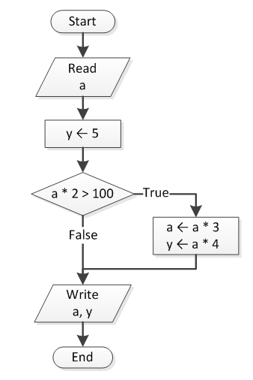
Example 3
Develop a trace table for
The following flowchart.

Slide 47
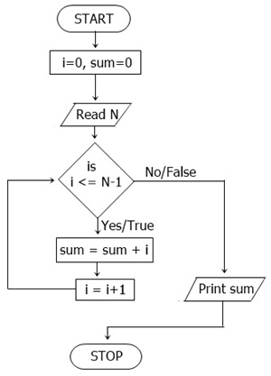
Example 4
Develop a trace table for
The following flowchart.

Slide 48
Building blocks of problem solving
Sequence
decision / Branching
Iteration/ looping
Functions / subroutine

Slide 49
Algorithm-computer Relation
Analogy:
Suppose you have written the recipe for a delicious Ema Datsi in English.
You want to tell a person in Thailand (who doesn’t speak English) how to make it.
Solution: translate your recipe into thai. You recipe can now be “run” in Thailand.
{ you = programmer, Algorithm = recipe, the thai person = computer }
Compilers and Interpreters (more on these later)

Slide 50
Next…
Python programming
Reading task: programming paradigms
structured programming
procedural programming
Object-oriented programming
Functional programming

