Slide 1
Introduction to Flowcharting

Slide 2
The Flowchart
(Dictionary) A schematic representation of a sequence of operations, as in a manufacturing process or computer program.
(Technical) A graphical representation of the sequence of operations in an information system or program. Information system flowcharts show how data flows from source documents through the computer to final distribution to users. Program flowcharts show the sequence of instructions in a single program or subroutine. Different symbols are used to draw each type of flowchart.

Slide 3
The Flowchart
A Flowchart
  shows logic of an algorithm
  emphasizes individual steps and their interconnections
  e.g. control flow from one action to the next

Slide 4
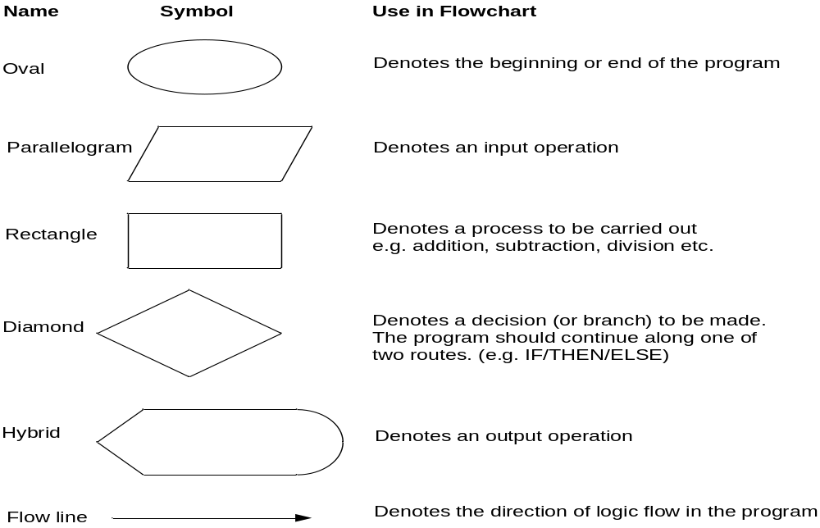
Flowchart Symbols
Basic

Slide 5
Basic Flowchart Symbols
Rounded Rectangle
START
Display message “How many hours did you work?”
Notice there are three types of symbols in this flowchart:
  rounded rectangles
  parallelograms
  a rectangle
Each symbol represents a different type of operation.
Read Hours
Display message “How much do you get paid per hour?”
Parallelogram
Read Pay Rate
Multiply Hours by Pay Rate. Store result in Gross Pay.
Rectangle
Display Gross Pay
Rounded Rectangle
END

Slide 6
Basic Flowchart Symbols
START
Terminal
Display message “How many hours did you work?”
Terminals
  represented by rounded rectangles
  indicate a starting or ending point
Read Hours
Display message “How much do you get paid per hour?”
Read Pay Rate
Multiply Hours by Pay Rate. Store result in Gross Pay.
START
Display Gross Pay
END
Terminal
END

Slide 7
Basic Flowchart Symbols
START
Display message “How many hours did you work?”
Input/Output Operations
  represented by parallelograms
  indicate an input or output operation
Read Hours
Display message “How much do you get paid per hour?”
Input/Output Operation
Read Pay Rate
Multiply Hours by Pay Rate. Store result in Gross Pay.
Display message “How many hours did you work?”
Read Hours
Display Gross Pay
END

Slide 8
Basic Flowchart Symbols
START
Display message “How many hours did you work?”
Processes
  represented by rectangles
  indicates a process such as a mathematical computation or variable assignment
Read Hours
Display message “How much do you get paid per hour?”
Read Pay Rate
Multiply Hours by Pay Rate. Store result in Gross Pay.
Multiply Hours by Pay Rate. Store result in Gross Pay.
Process
Display Gross Pay
END

Slide 9
Stepping Through the Flowchart
Stepping Through the Flowchart
START
Output Operation
Display message “How many hours did you work?”
Read Hours
Display message “How much do you get paid per hour?”
Read Pay Rate
Multiply Hours by Pay Rate. Store result in Gross Pay.
Variable Contents:
Hours: ?
Pay Rate: ?
Gross Pay: ?
Display Gross Pay
END

Slide 10
Stepping Through the Flowchart
Stepping Through the Flowchart
START
Display message “How many hours did you work?”
Input Operation
(User types 40)
Read Hours
Display message “How much do you get paid per hour?”
Read Pay Rate
Multiply Hours by Pay Rate. Store result in Gross Pay.
Variable Contents:
Hours: 40
Pay Rate: ?
Gross Pay: ?
Display Gross Pay
END

Slide 11
Stepping Through the Flowchart
Stepping Through the Flowchart
START
Display message “How many hours did you work?”
Read Hours
Display message “How much do you get paid per hour?”
Output Operation
Read Pay Rate
Multiply Hours by Pay Rate. Store result in Gross Pay.
Variable Contents:
Hours: 40
Pay Rate: ?
Gross Pay: ?
Display Gross Pay
END

Slide 12

Stepping Through the Flowchart
Stepping Through the Flowchart
START
Display message “How many hours did you work?”
How much do you get paid per hour? 20
Read Hours
Display message “How much do you get paid per hour?”
Input Operation
(User types 20)
Read Pay Rate
Multiply Hours by Pay Rate. Store result in Gross Pay.
Variable Contents:
Hours: 40
Pay Rate: 20
Gross Pay: ?
Display Gross Pay
END

Slide 13
Stepping Through the Flowchart
START
Display message “How many hours did you work?”
Read Hours
Display message “How much do you get paid per hour?”
Read Pay Rate
Multiply Hours by Pay Rate. Store result in Gross Pay.
Process: The product of 40 times 20 is stored in Gross Pay
Variable Contents:
Hours: 40
Pay Rate: 20
Gross Pay: 800
Display Gross Pay
END

Slide 14
Stepping Through the Flowchart
START
Display message “How many hours did you work?”
Read Hours
Display message “How much do you get paid per hour?”
Read Pay Rate
Multiply Hours by Pay Rate. Store result in Gross Pay.
Variable Contents:
Hours: 40
Pay Rate: 20
Gross Pay: 800
Output Operation
Display Gross Pay
END

Slide 15
Four Flowchart Structures
Sequence
Decision
Repetition
Case

Slide 16
Sequence Structure
a series of actions are performed in sequence
The pay-calculating example was a sequence flowchart.

Slide 17
Decision Structure
One of two possible actions is taken, depending on a condition.

Slide 18
Decision Structure
A new symbol, the diamond, indicates a yes/no question. If the answer to the question is yes, the flow follows one path. If the answer is no, the flow follows another path
NO
YES

Slide 19
Decision Structure
In the flowchart segment below, the question “is x < y?” is asked. If the answer is no, then process A is performed. If the answer is yes, then process B is performed.
NO
YES
x < y?
Process A
Process B

Slide 20
Decision Structure
The flowchart segment below shows how a decision structure is expressed in C++ as an if/else statement.
Flowchart
C++ Code
NO
YES
if (x < y)
a = x * 2;
else
a = x + y;
x < y?
Calculate a as x plus y.
Calculate a as x times 2.

Slide 21
Decision Structure
The flowchart segment below shows a decision structure with only one action to perform. It is expressed as an if statement in C++ code.
Flowchart
C++ Code
NO
YES
if (x < y)
a = x * 2;
x < y?
Calculate a as x times 2.

Slide 22
Repetition Structure
A repetition structure represents part of the program that repeats. This type of structure is commonly known as a loop.

Slide 23
Repetition Structure
Notice the use of the diamond symbol. A loop tests a condition, and if the condition exists, it performs an action. Then it tests the condition again. If the condition still exists, the action is repeated. This continues until the condition no longer exists.

Slide 24
Repetition Structure
In the flowchart segment, the question “is x < y?” is asked. If the answer is yes, then Process A is performed. The question “is x < y?” is asked again. Process A is repeated as long as x is less than y. When x is no longer less than y, the repetition stops and the structure is exited.
YES
x < y?
Process A

Slide 25
Repetition Structure
The flowchart segment below shows a repetition structure expressed in C++ as a while loop.
Flowchart
C++ Code
while (x < y)
x++;
YES
x < y?
Add 1 to x

Slide 26
Controlling a Repetition Structure
The action performed by a repetition structure must eventually cause the loop to terminate. Otherwise, an infinite loop is created.
In this flowchart segment, x is never changed. Once the loop starts, it will never end.
QUESTION: How can this
flowchart be modified so
it is no longer an infinite
loop?
YES
x < y?
Display x

Slide 27
Controlling a Repetition Structure
ANSWER: By adding an action within the repetition that changes the value of x.
YES
x < y?
Display x
Add 1 to x

Slide 28
A Pre-Test Repetition Structure
This type of structure is known as a pre-test repetition structure. The condition is tested BEFORE any actions are performed.
YES
x < y?
Display x
Add 1 to x

Slide 29
A Pre-Test Repetition Structure
In a pre-test repetition structure, if the condition does not exist, the loop will never begin.
YES
x < y?
Display x
Add 1 to x

Slide 30
A Post-Test Repetition Structure
This flowchart segment shows a post-test
repetition structure.
The condition is tested AFTER the actions
are performed.
A post-test repetition structure always
performs its actions at least once.
Display x
Add 1 to x
YES
x < y?

Slide 31
A Post-Test Repetition Structure
The flowchart segment below shows a post-test repetition structure expressed in C++ as a do-while loop.
C++ Code
Display x
do
{
cout << x << endl;
x++;
} while (x < y);
Flowchart
Add 1 to x
YES
x < y?

Slide 32
Case Structure
One of several possible actions is taken, depending on the contents of a variable.

Slide 33
Case Structure
The structure below indicates actions to perform depending on the value in years_employed.
CASE
years_employed
1
2
3
Other
bonus = 100
bonus = 200
bonus = 400
bonus = 800

Slide 34
Case Structure
If years_employed = 2, bonus is set to 200
If years_employed = 3, bonus is set to 400
If years_employed = 1, bonus is set to 100
If years_employed is any other value, bonus is set to 800
CASE
years_employed
1
2
3
Other
bonus = 100
bonus = 200
bonus = 400
bonus = 800

Slide 35
Connectors
Sometimes a flowchart will not fit on one page.
A connector (represented by a small circle) allows you to connect two flowchart segments.
A

Slide 36
Connectors
The “A” connector indicates that the second flowchart segment begins where the first segment ends.
START
A
END
A

Slide 37
Example
START
Step 1: Input M1,M2,M3,M4
Step 2: GRADE ← (M1+M2+M3+M4)/4
Step 3: if (GRADE <50) then
Print “FAIL”
else
Print “PASS”
endif
Input
M1,M2,M3,M4
GRADE←(M1+M2+M3+M4)/4
IS
GRADE<50
N
Y
PRINT
“PASS”
PRINT
“FAIL”
STOP

Slide 38
Example 2
Write an algorithm and draw a flowchart to convert the length in feet to centimeter.
Pseudocode:
Input the length in feet (Lft)
Calculate the length in cm (Lcm) by multiplying LFT with 30
Print length in cm (LCM)

Slide 39
Example 2
Flowchart
Algorithm
Step 1: Input Lft
Step 2: Lcm ← Lft x 30
Step 3: Print Lcm
START
Input
Lft
Lcm ← Lft x 30
Print
Lcm
STOP

Slide 40
Example 3
Write an algorithm and draw a flowchart that will read the two sides of a rectangle and calculate its area.
Pseudocode
Input the width (W) and Length (L) of a rectangle
Calculate the area (A) by multiplying L with W
Print A

Slide 41
Example 3
Algorithm
Step 1: Input W,L
Step 2: A ← L x W
Step 3: Print A
START
Input
W, L
A ← L x W
Print
A
STOP

Slide 42
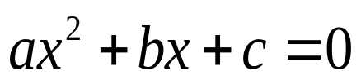
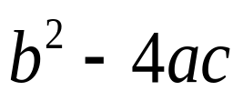
Example 4
Write an algorithm and draw a flowchart that will calculate the roots of a quadratic equation
Hint: d = sqrt ( ), and the roots are: x1 = (–b + d)/2a and x2 = (–b – d)/2a

Slide 43
Example 4
Pseudocode:
Input the coefficients (a, b, c) of the quadratic equation
Calculate d
Calculate x1
Calculate x2
Print x1 and x2

Slide 44

Example 4
START
Algorithm:
Step 1: Input a, b, c
Step 2: d ← sqrt ( )
Step 3: x1 ← (–b + d) / (2 x a)
Step 4: x2 ← (–b – d) / (2 x a)
Step 5: Print x1, x2
Input
a, b, c
d ← sqrt(b x b – 4 x a x c)
x₁ ←(–b + d) / (2 x a)
X₂ ← (–b – d) / (2 x a)
Print
x₁ ,x₂
STOP

Slide 45
DECISION STRUCTURES
The expression A>B is a logical expression
it describes a condition we want to test
if A>B is true (if A is greater than B) we take the action on left
print the value of A
if A>B is false (if A is not greater than B) we take the action on right
print the value of B

Slide 46
DECISION STRUCTURES
is
A>B
Y
N
Print A
Print B

Slide 47
IF–THEN–ELSE STRUCTURE
The structure is as follows
If condition then
true alternative
else
false alternative
endif

Slide 48
IF–THEN–ELSE STRUCTURE
The algorithm for the flowchart is as follows:
If A>B then
print A
else
print B
endif
is
A>B
Y
N
Print A
Print B

Slide 49
Relational Operators
Relational Operators
Operator | Description
> | Greater than
< | Less than
= | Equal to
≥ | Greater than or equal to
≤ | Less than or equal to
≠ | Not equal to

Slide 50
Example 5
Write an algorithm that reads two values, determines the largest value and prints the largest value with an identifying message.
ALGORITHM
Step 1: Input VALUE1, VALUE2
Step 2: if (VALUE1 > VALUE2) then
MAX ← VALUE1
else
MAX ← VALUE2
endif
Step 3: Print “The largest value is”, MAX

Slide 51
Example 5
START
Input
VALUE1,VALUE2
Y
is
VALUE1>VALUE2
N
MAX ← VALUE1
MAX ← VALUE2
Print
“The largest value is”, MAX
STOP

Slide 52
NESTED IFS
One of the alternatives within an IF–THEN–ELSE statement
  may involve further IF–THEN–ELSE statement

Slide 53
Example 6
Write an algorithm that reads three numbers and prints the value of the largest number.

Slide 54
Example 6
Step 1: Input N1, N2, N3
Step 2: if (N1>N2) then
if (N1>N3) then
MAX ← N1 [N1>N2, N1>N3]
else
MAX ← N3 [N3>N1>N2]
endif
else
if (N2>N3) then
MAX ← N2 [N2>N1, N2>N3]
else
MAX ← N3 [N3>N2>N1]
endif
endif
Step 3: Print “The largest number is”, MAX

Slide 55
Example 6
Flowchart: Draw the flowchart of the above Algorithm.

Slide 56
Example 7
Write and algorithm and draw a flowchart to
read an employee name (NAME), overtime hours worked (OVERTIME), hours absent (ABSENT) and
determine the bonus payment (PAYMENT).

Slide 57
Example 7
Bonus Schedule
OVERTIME – (2/3)*ABSENT | Bonus Paid
>40 hours >30 but ≤ 40 hours >20 but ≤ 30 hours >10 but ≤ 20 hours ≤ 10 hours | $50 $40 $30 $20 $10

Slide 58
Modules
A program module (such as a function in C++) is represented by a special symbol.

Slide 59
Modules
The position of the module symbol indicates the point the module is executed.
A separate flowchart can be constructed for the module.
START
Read Input.
Call calc_pay function.
Display results.
END

Slide 60
Combining Structures
Structures are commonly combined to create more complex algorithms.
The flowchart segment below combines a decision structure with a sequence structure.
YES
x < y?
Display x
Add 1 to x

Slide 61
Combining Structures
This flowchart segment
shows two decision
structures combined.
NO
YES
x > min?
Display “x is outside the limits.”
NO
YES
x < max?
Display “x is outside the limits.”
Display “x is within limits.”

Slide 62
Review
What do each of the following symbols represent?
(Answer on next slide)

Slide 63
Answer
What do each of the following symbols represent?
Decision
Terminal
Input/Output Operation
Connector
Process
Module

Slide 64
Review
Name the four flowchart structures.
(Answer on next slide)

Slide 65
Answer
Sequence
Decision
Repetition
Case

Slide 66
Review
What type of structure is this?
(Answer on next slide)

Slide 67
Answer
Repetition

Slide 68
Review
What type of structure is this?
(Answer on next slide)

Slide 69
Answer
Sequence

Slide 70
Review
What type of structure is this?
(Answer on next slide)

Slide 71
Answer
Case

Slide 72
Review
What type of structure is this?
(Answer on next slide)

Slide 73
Answer
Decision

