Slide 1
Programming for Engineering II
Week 9 Project : Export csv spreadsheet using Pandas
Team B2
2018046999 강경돈
2018047083 김정훈
2020010300 김민주
9018920227 Nhat Dong Tran

Slide 2
Contents
Last week
Feedback
Mission
Solutions
Result
Discussion

Slide 3
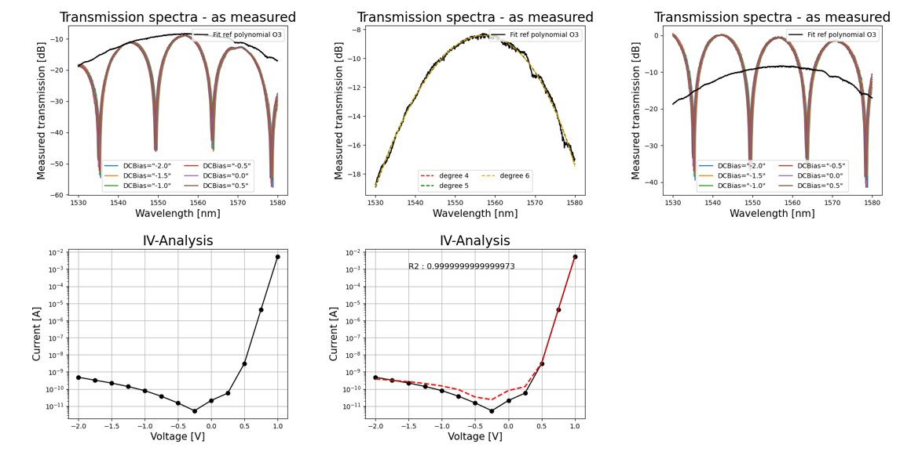
Last week - Data fitting

Slide 4
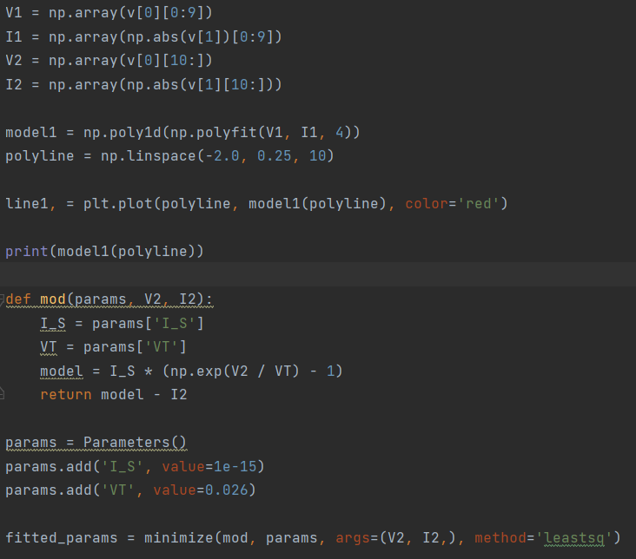

Feedback
I-V graph fitting

Slide 5
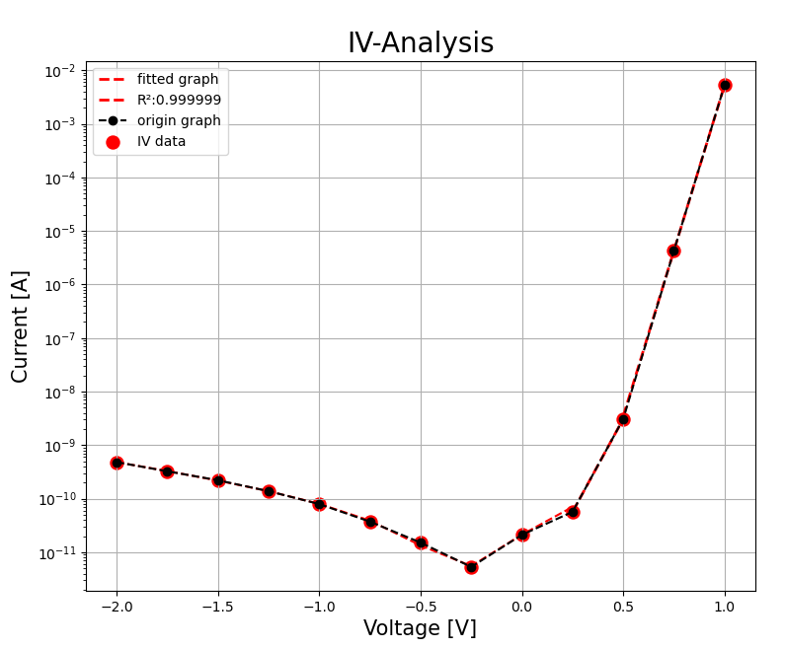
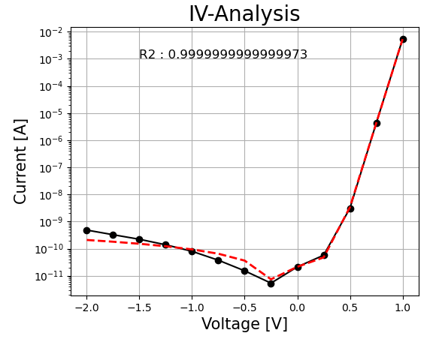
- Data fitting

Slide 6
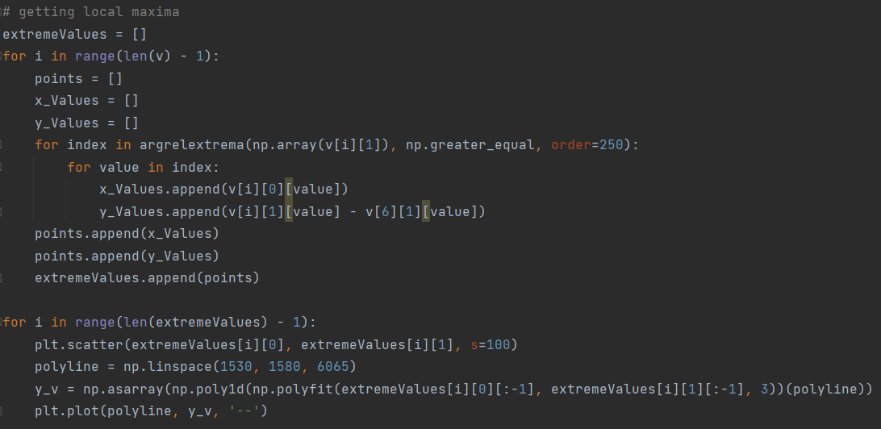
Feedback
Spectra graph fitting

Slide 7
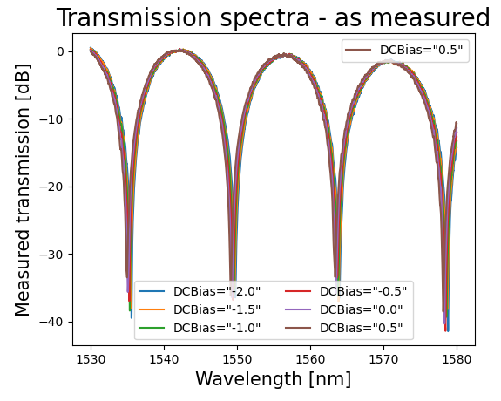
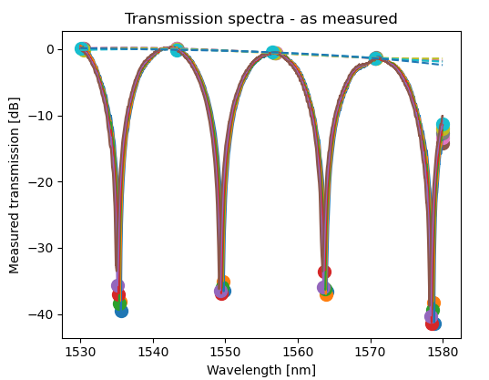

Slide 8
Mission
Save data analysis figure file using plt.savefig
Make a result table including analyzed data
Save the result as a csv format using Pandas

Slide 9
Solutions
Save the graph as png file by plt.savefig
Extract the data that we need
Create a DataFrame with extracted data
Save created DataFrames as csv files

Slide 10
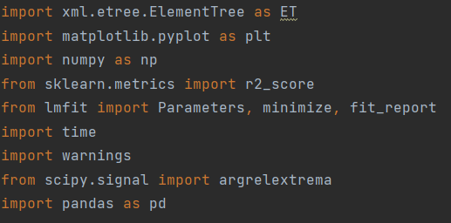
Result
Import libraries

Slide 11
Result
Save our figure as png file

Slide 12
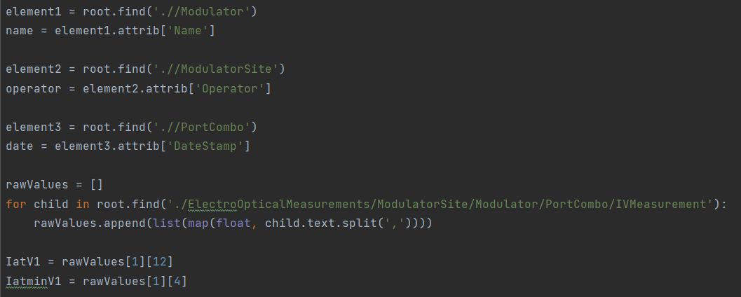
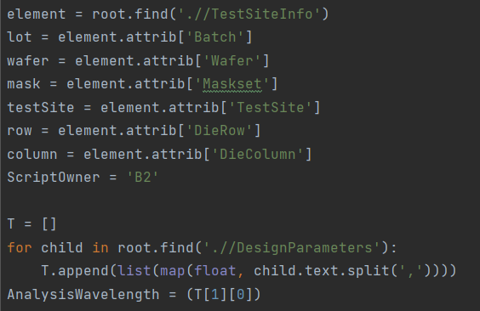
Result
Extract the data

Slide 13
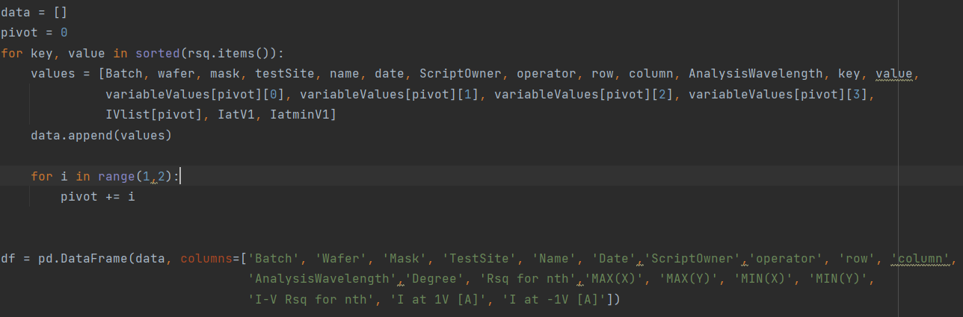
Result
Create a dataFrame

Slide 14

Result
Save as csv file

Slide 15
Result
AnalysisResult_B2.csv

Slide 16
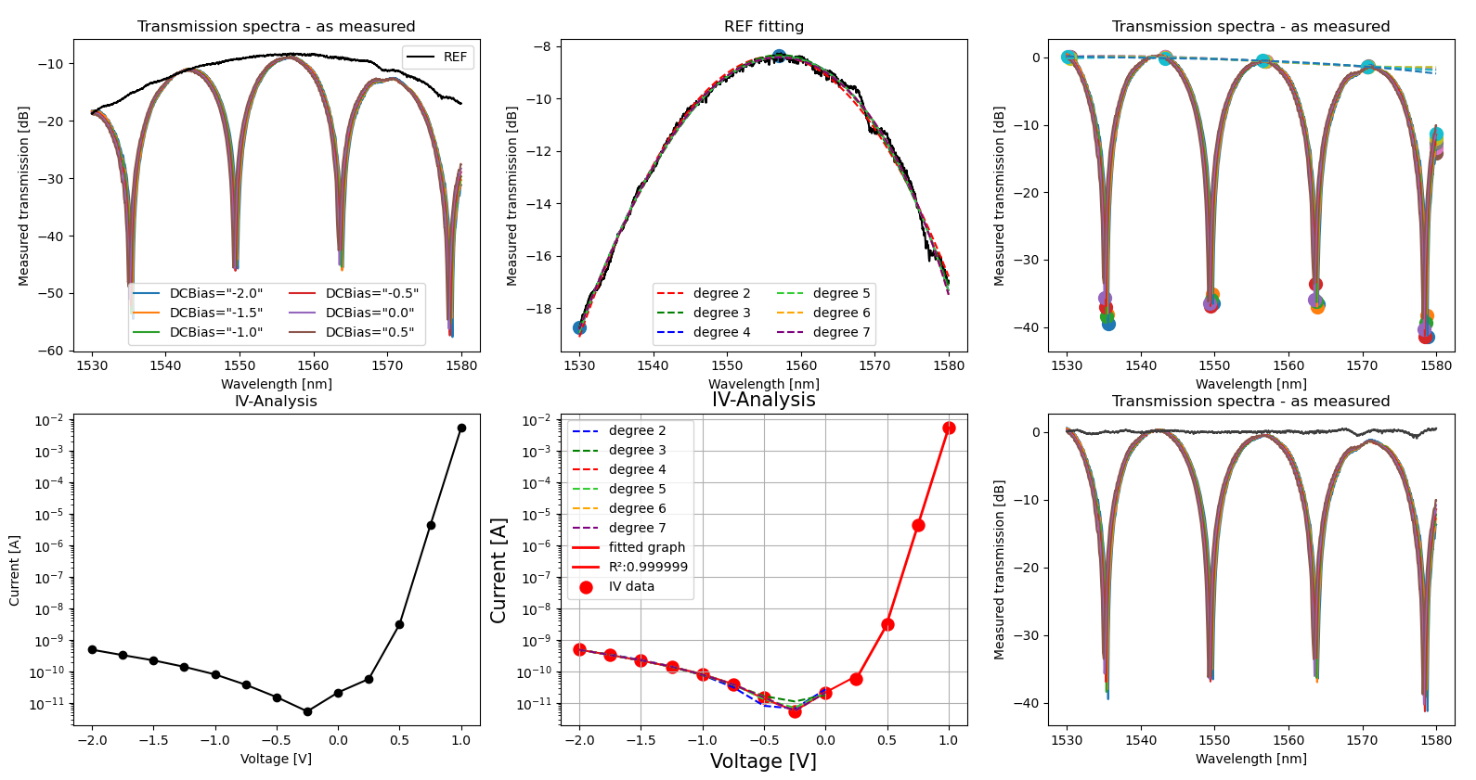
Discussion

Slide 17

Q & A

