Slide 1
Team Project Group B2
2018046999 강경돈
2018047083 김정훈
2020010300 김민주
9018920227 Nhat Dong Tran

Slide 2
Contents
- Introduction
- Process
- Result
- Conclusion

Slide 3
Introduction - What was the mission?
The mission was to develop a software which helps customers analyzing their wafer measurement data in XML file.
The software should include data, doc, ppt, res, src, .gitignore, README.md, requirements.txt, and run.py.

Slide 4
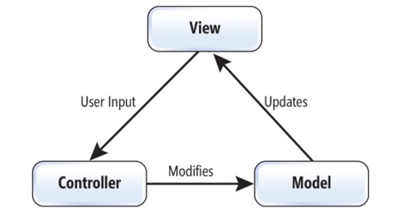
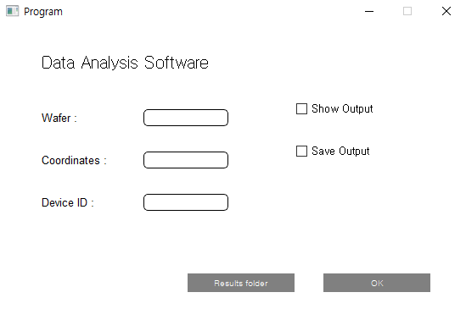
Process
The structure of this software was created by referring to the MVC model.
We also decided to make gui, so it makes it easier for users to use this software.

Slide 5
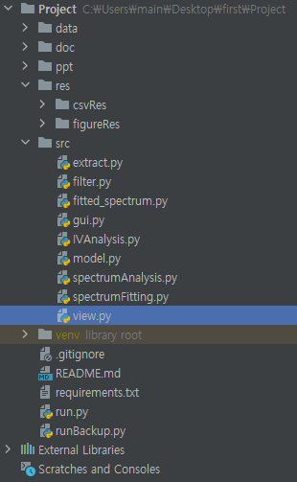
Process
The structure of this software is configured as shown in the figure.
Team members carried out the project by taking charge of each part and writing the code for the part they were responsible for.

Slide 6
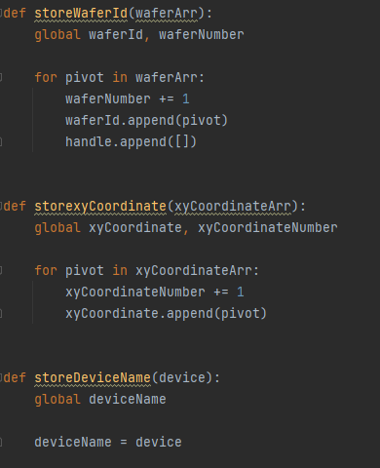
Process -src
1. model
It stores the input data and the stored data can be used by other modules.

Slide 7
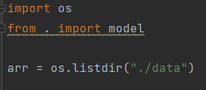
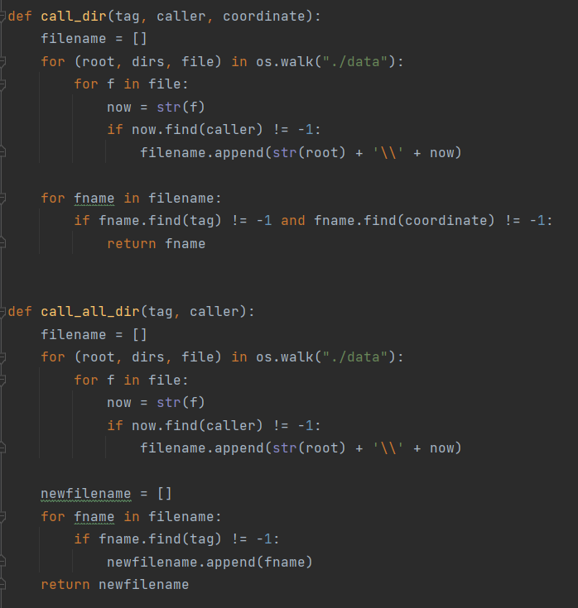
Process -src
2. filter
This program only provides analysis of LMZ files.
It filters files that cannot be analyzed from the data file list.

Slide 8
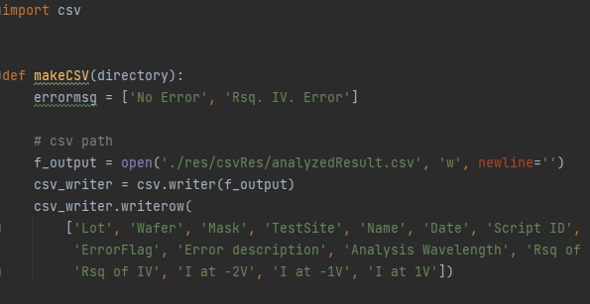
Process -src
2. extract
It extract the contents to be stored in the csv file such as the name, wafer ID, operator, date, etc.

Slide 9
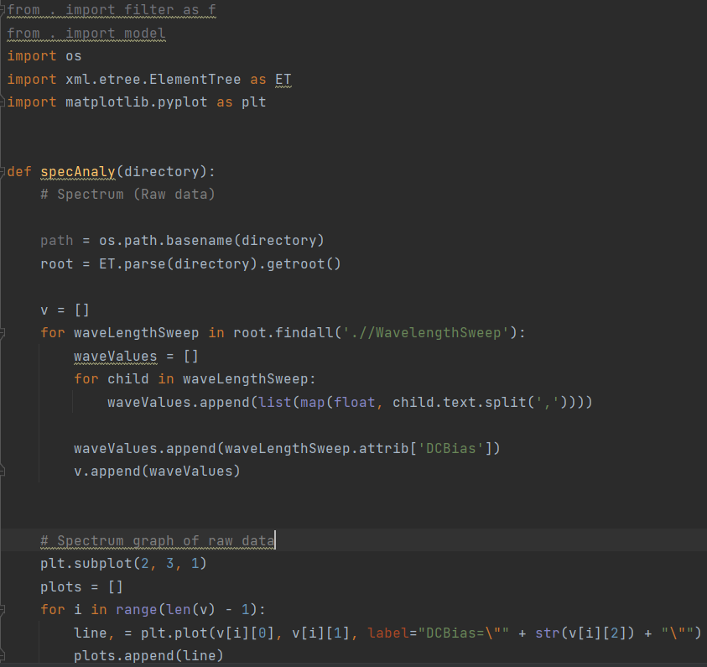
Process -src
2. spectrum analysis

Slide 10
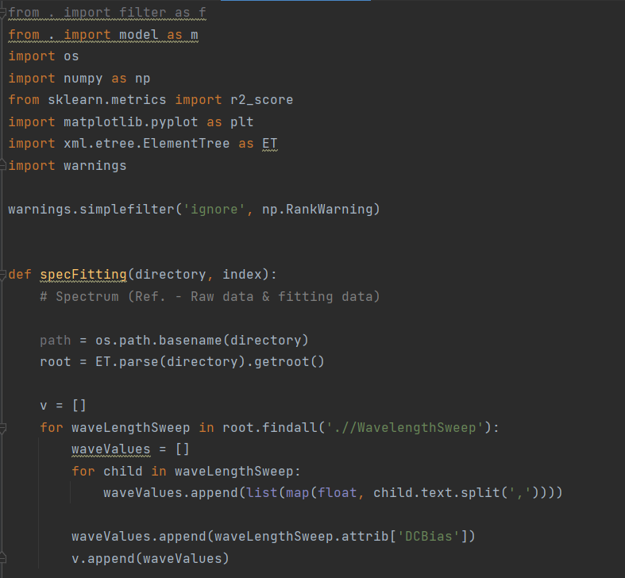
Process -src
2. spectrum fitting

Slide 11
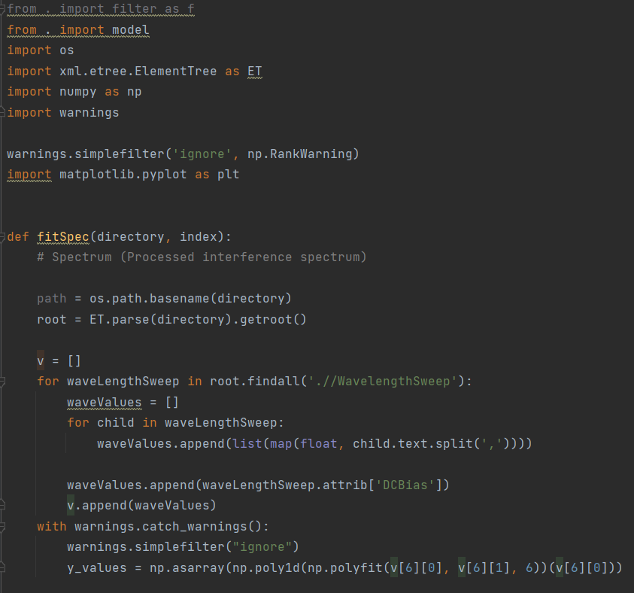
Process -src
2.fitted_spectrum

Slide 12
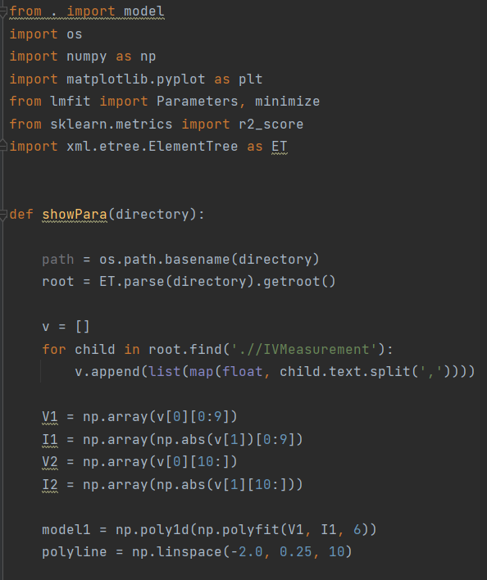
Process -src
2. IV graph

Slide 13
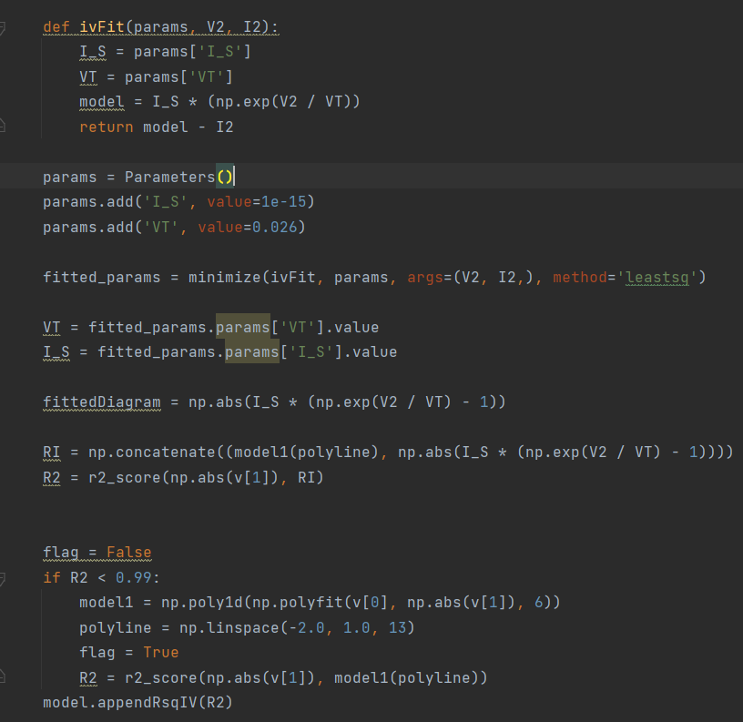
Process -src
2. IV graph

Slide 14
Process -src
5. gui
It makes it easier for users to use this program.

Slide 15
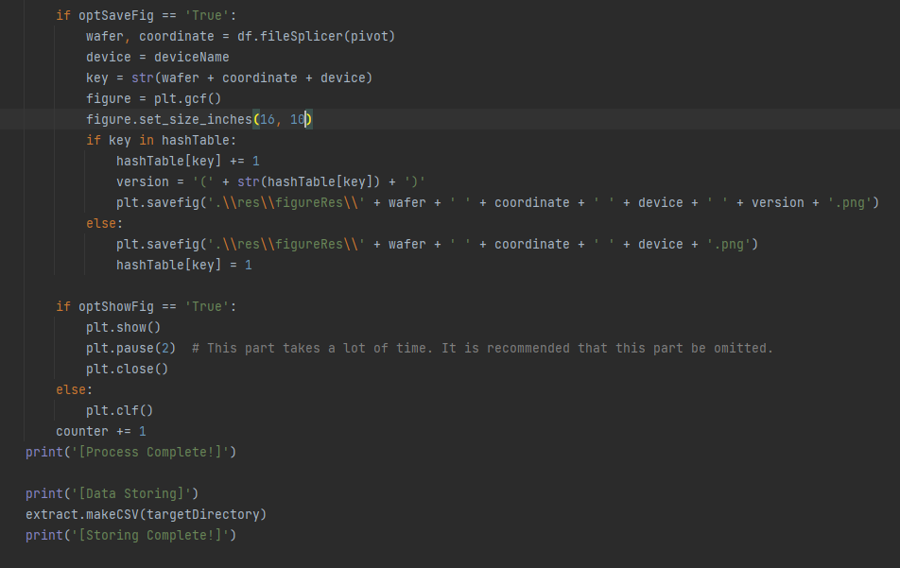
Process -src
6. view
It receives input through interaction with the user. Show, save, button, gui are processed in view.

Slide 16
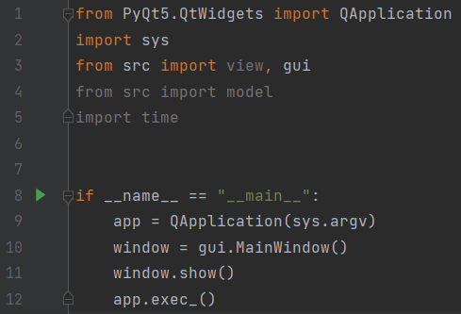
Process -run.py
Execution python file of this software

Slide 17
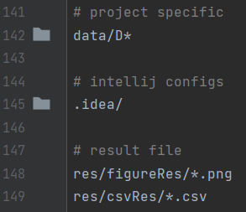
Process -.gitignore
Data is confidential, so it should not be uploaded and published. Gitignore prevents data from being uploaded to GitHub.

Slide 18
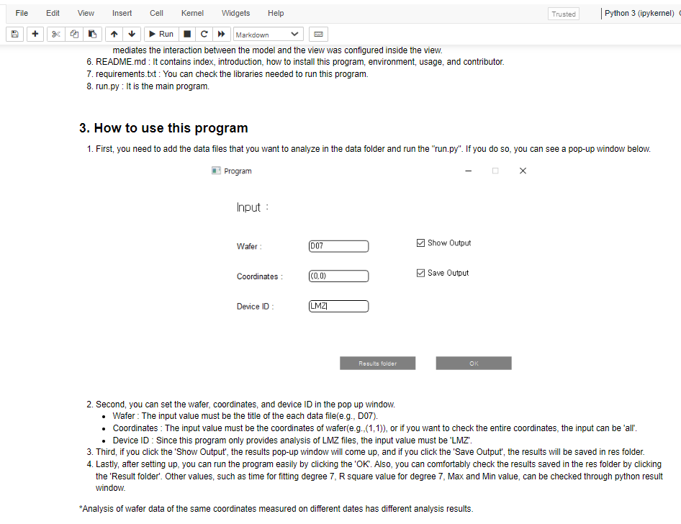
Process -doc
A documentation folder contains a jupyter notebook file describing data analysis results
manual_report - Jupyter Notebook

Slide 19
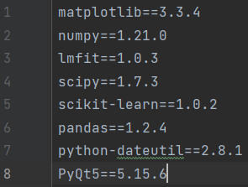

Process -requirements.txt
List python packages so that it can be installed by a line

Slide 20
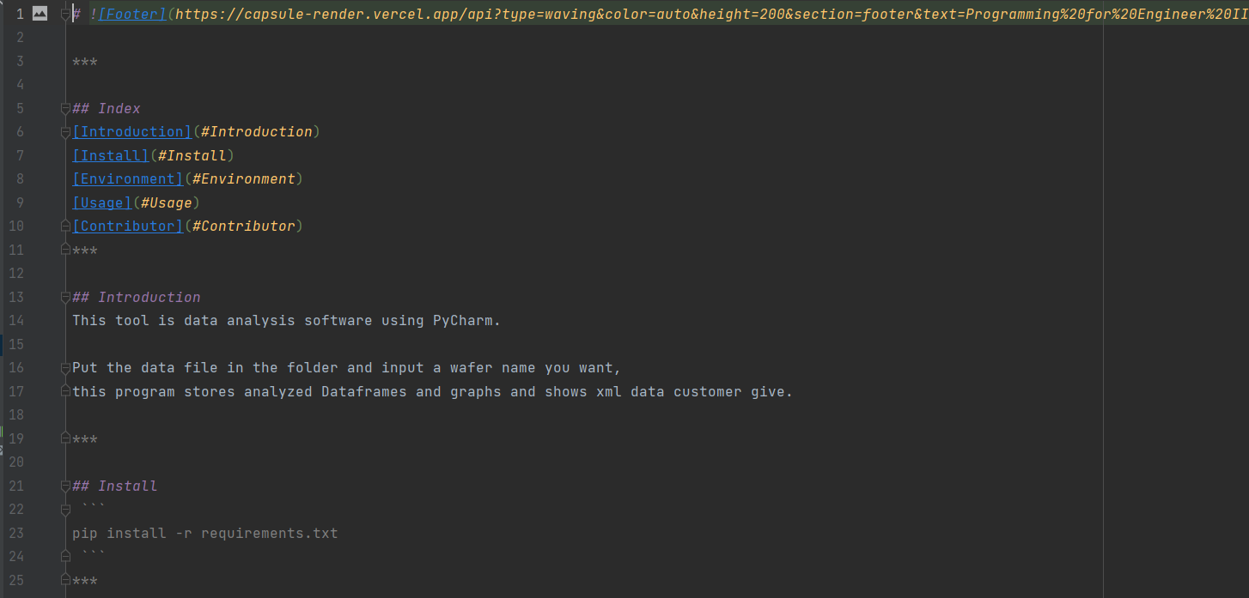
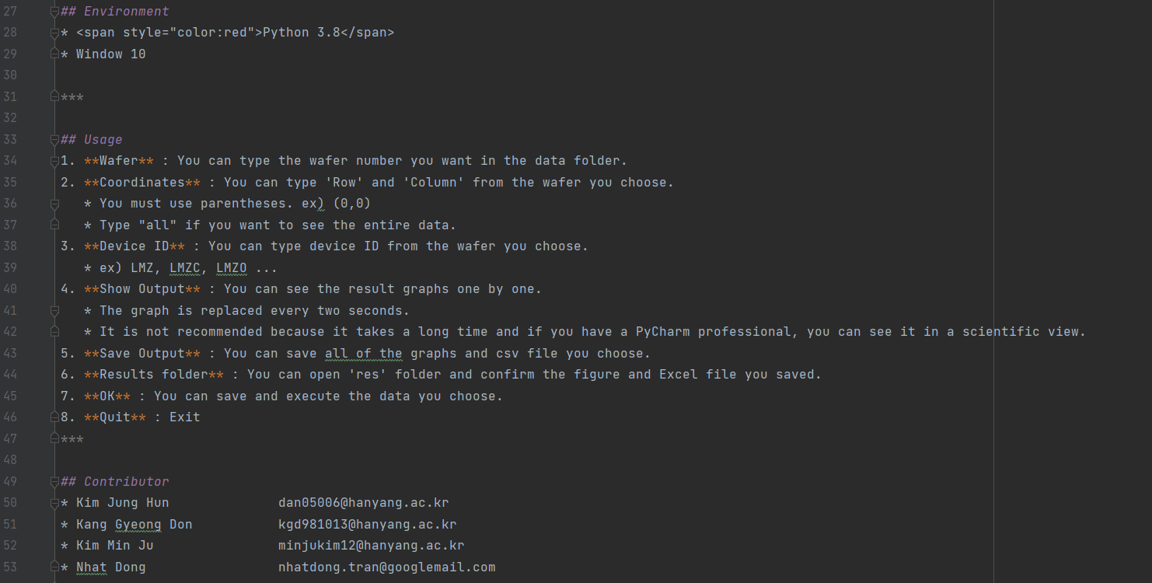
Process -README.md
Brief introduction of this software repository
https://github.com/PE2-B2/Project

Slide 21
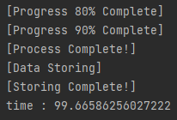
Result
Running time and video of our project.

Slide 22
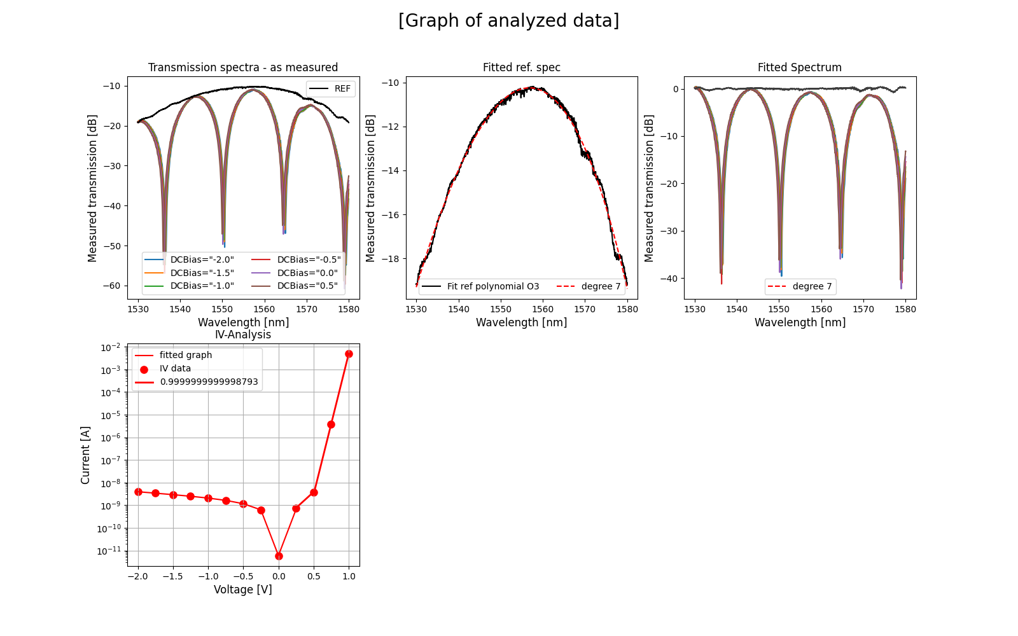
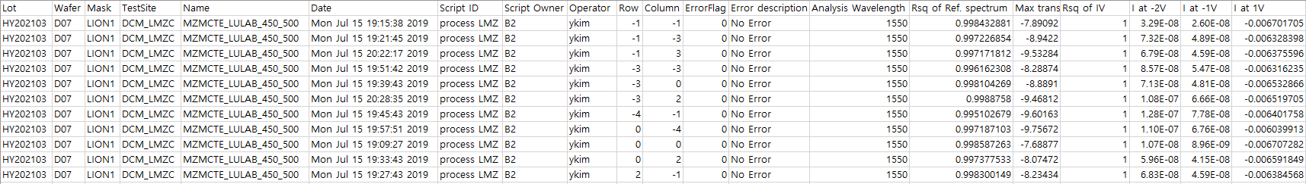
Result

Slide 23
Conclusion
We have created a software that can automatically analyze XML files containing measured wafer data.
It was hard to detect code errors while using gui. It would be better to add gui after the software development is complete.

Slide 24
Future work
It will be possible to analyze not only LMZ but also other data through some code modification.
Furthermore, it will be possible to add the function which compares the current level of the wafer to this software.

Slide 25
Thank you

