Slide 1
Building your own Internet router
EE323 assignment 4
Suho Shin
shinas327@lanada.kaist.ac.kr

Slide 2
Router
Forward packets to appropriate paths
Receive a raw Ethernet frame that has an IP packet inside it
Look up the forwarding table (static) with the destination IP address
Forward the packet to the right output port
In the assignment, you will be writing a simple router with a static routing table

Slide 3
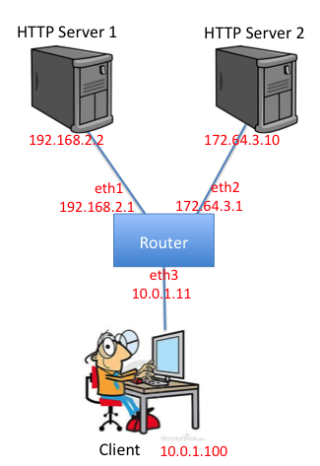
Example functionality
Router should allow these functionalities
Client->router
Ping
Traceroute
Client->server
Ping
Traceroute
Downloading a file

Slide 4
Important Stuff
You need to know
Where to forward the received packet
What is the MAC address of the receiver
General Forwarding Logic
IP forwarding (with forwarding table)
We are not dealing with the routing algorithms or routing table. We only focus on the forwarding logic.
ARP handling (with arp table)

Slide 5
What to study
Protocols to understand
Ethernet
http://www.networksorcery.com/enp/protocol/IEEE8023.htm
IP (Internet Protocol)
http://www.networksorcery.com/enp/protocol/ip.htm
ICMP (Internet Control Message Protocol)
http://www.networksorcery.com/enp/protocol/icmp.htm
ARP (Address Resolution Protocol)
http://www.networksorcery.com/enp/protocol/arp.htm

Slide 6
Remember
Forwarding table lookup
If you want to find the output interface of a packet to forward
ARP table lookup
When you want to know the destination MAC address of a packet with the destination IP address
http://www.netmanias.com/ko/post/blog/5502/arp-bridging-ip-routing-network-protocol/switching-and-routing-part-2-ip-routing
Packet
Forwarding table
Output interface
IP address
ARP table
MAC address

Slide 7
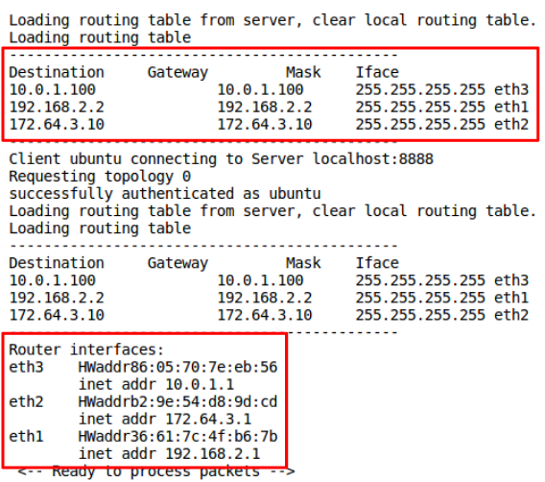
Example
$ cd ~/your/source/path/router/
$ make
$ ./sr
(Try sr_solution)

Slide 8
Code Overview
sr_handlepacket()
When there is an incoming packet, the function is automatically called.
sr_send_packet()
When you want to send a packet, call the function.
sr_arpcache_sweepreqs()
Called every second, try sending ARP request until a reply comes.

Slide 9
Example Scenario (ICMP)
Incoming packet
sr_handlepacket()
sr_handle_ip()
sr_handle_icmp()
sr_send_packet()
Check the packet is IP packet.
Check the packet is ICMP packet.
Check whether the packet is destined to me or not.
Send ICMP reply or forward ICMP packet through this.
The sr_handlepacket() is automatically called.
Your part

Slide 10
Data structures
General structures for router (sr_router.h)
Interfaces (sr_if.c/h)
Routing table (sr_rt.c/h)
ARP cache and request queue (sr_arpcache.c/h)
Protocol headers (sr_protocol.h)
Debugging functions (sr_utils.c/h)

Slide 11
Coding tips
Start from the sr_handlepacket() in sr_router.c
Callback for an incoming packet
Then, sr_router.c & sr_arpcache.c
Type conversion
Packet is given as uint8_t *packet
It can be converted to an Ethernet frame by
ethh = (sr_ethernet_hdr_t *)packet;
Also can be converted to an IP struct by
iph = (sr_ip_hdr_t *) (ethh + 1);
See sr_protocol.h

Slide 12
Coding tips
Use the debugging functions
print_hdrs(): prints all possible headers included in the packet.
print_hdr_eth(), print_hdr_ip(), print_hdr_icmp()
There are more valuable utilities in sr_util.c/h. Feel free to use them.
Coding style
Do not put all the codes in a function.

Slide 13
Caution
Be careful on the endianness
Network byte order and host byte order is different.
Be familiar with ntohs(), ntohl(), htons() or htonl().
Be careful on the memory management
You should not free the memory for structures commented as /* lent */.
Ex) in sr_handlepacket, you should not free *packet, *interface (see sr_vns_comm.c)

Slide 14
Caution
Be careful on the packet sanity check
If it is an Ethernet packet, its length should be larger than sizeof(sr_ethernet_hdr_t)
Validate the checksum (e.g. IP checksum)

Slide 15
Example Implementation
void sr_handlepacket(uint8_t *packet, unsigned int len, …) {
…
/* sanity check */
minlength = sizeof(sr_ethernet_hdr_t);
if (len < minlength) {
fprintf(stderr, “Not a valid packet: invalid length.\n”);
break;
}
…
/* Ethernet header lookup */
ethh = (sr_ethernet_hdr_t *)packet;
ether_type = ntohs(ethh->ether_type);
if (ether_type == ethertype_ip) {
sr_handle_ip(ethh, len, …);
}
…
}

Slide 16
Testing
Check your router is answering to ICMP
mininet> client ping –c 3 192.168.2.1
Check your router is forwarding ICMP well
mininet> client ping –c 3 192.168.2.2
Check your router is forwarding well
mininet> client wget http://192.168.2.2
Think about more cases to test your router’s functionality.

Slide 17
Environment
Mininet: a virtual network emulator
(You don’t need to know about it.)
All environments are set up on the virtual machine image file that we provide.
Set on your own machine with environment.html
Check out the baseline code and get started!

Slide 18
Tips
Start early. You are given lots of readings.
Read the assignment guideline and references on the website carefully.
Don’t hesitate to ask questions on the KLMS site
Read manual carefully, google it first, then ask!
Enjoy building your “own” Internet router.

