Slide 1
CCA from scratch
Alana Darcher
MLCoLearn Pitch
28 Feb 24

Slide 2
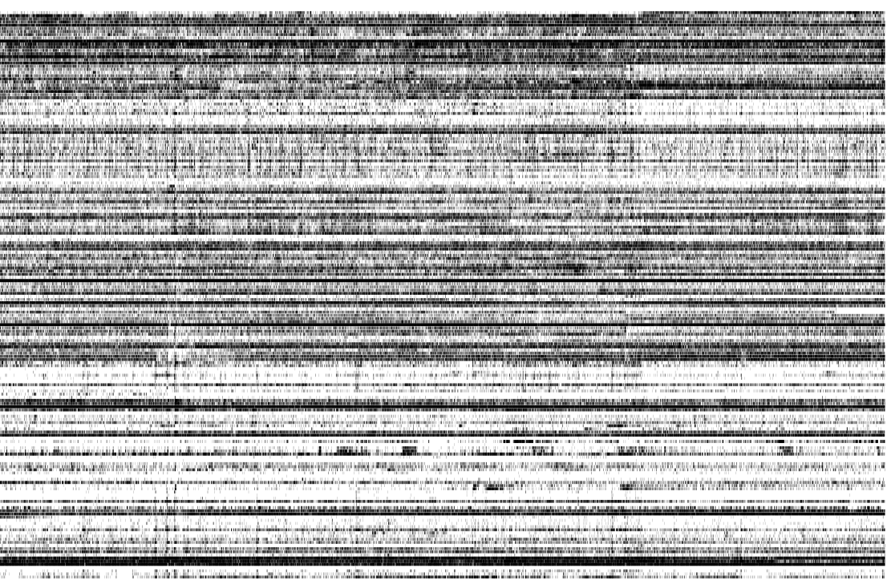
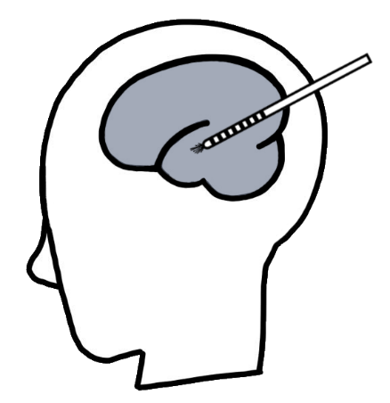

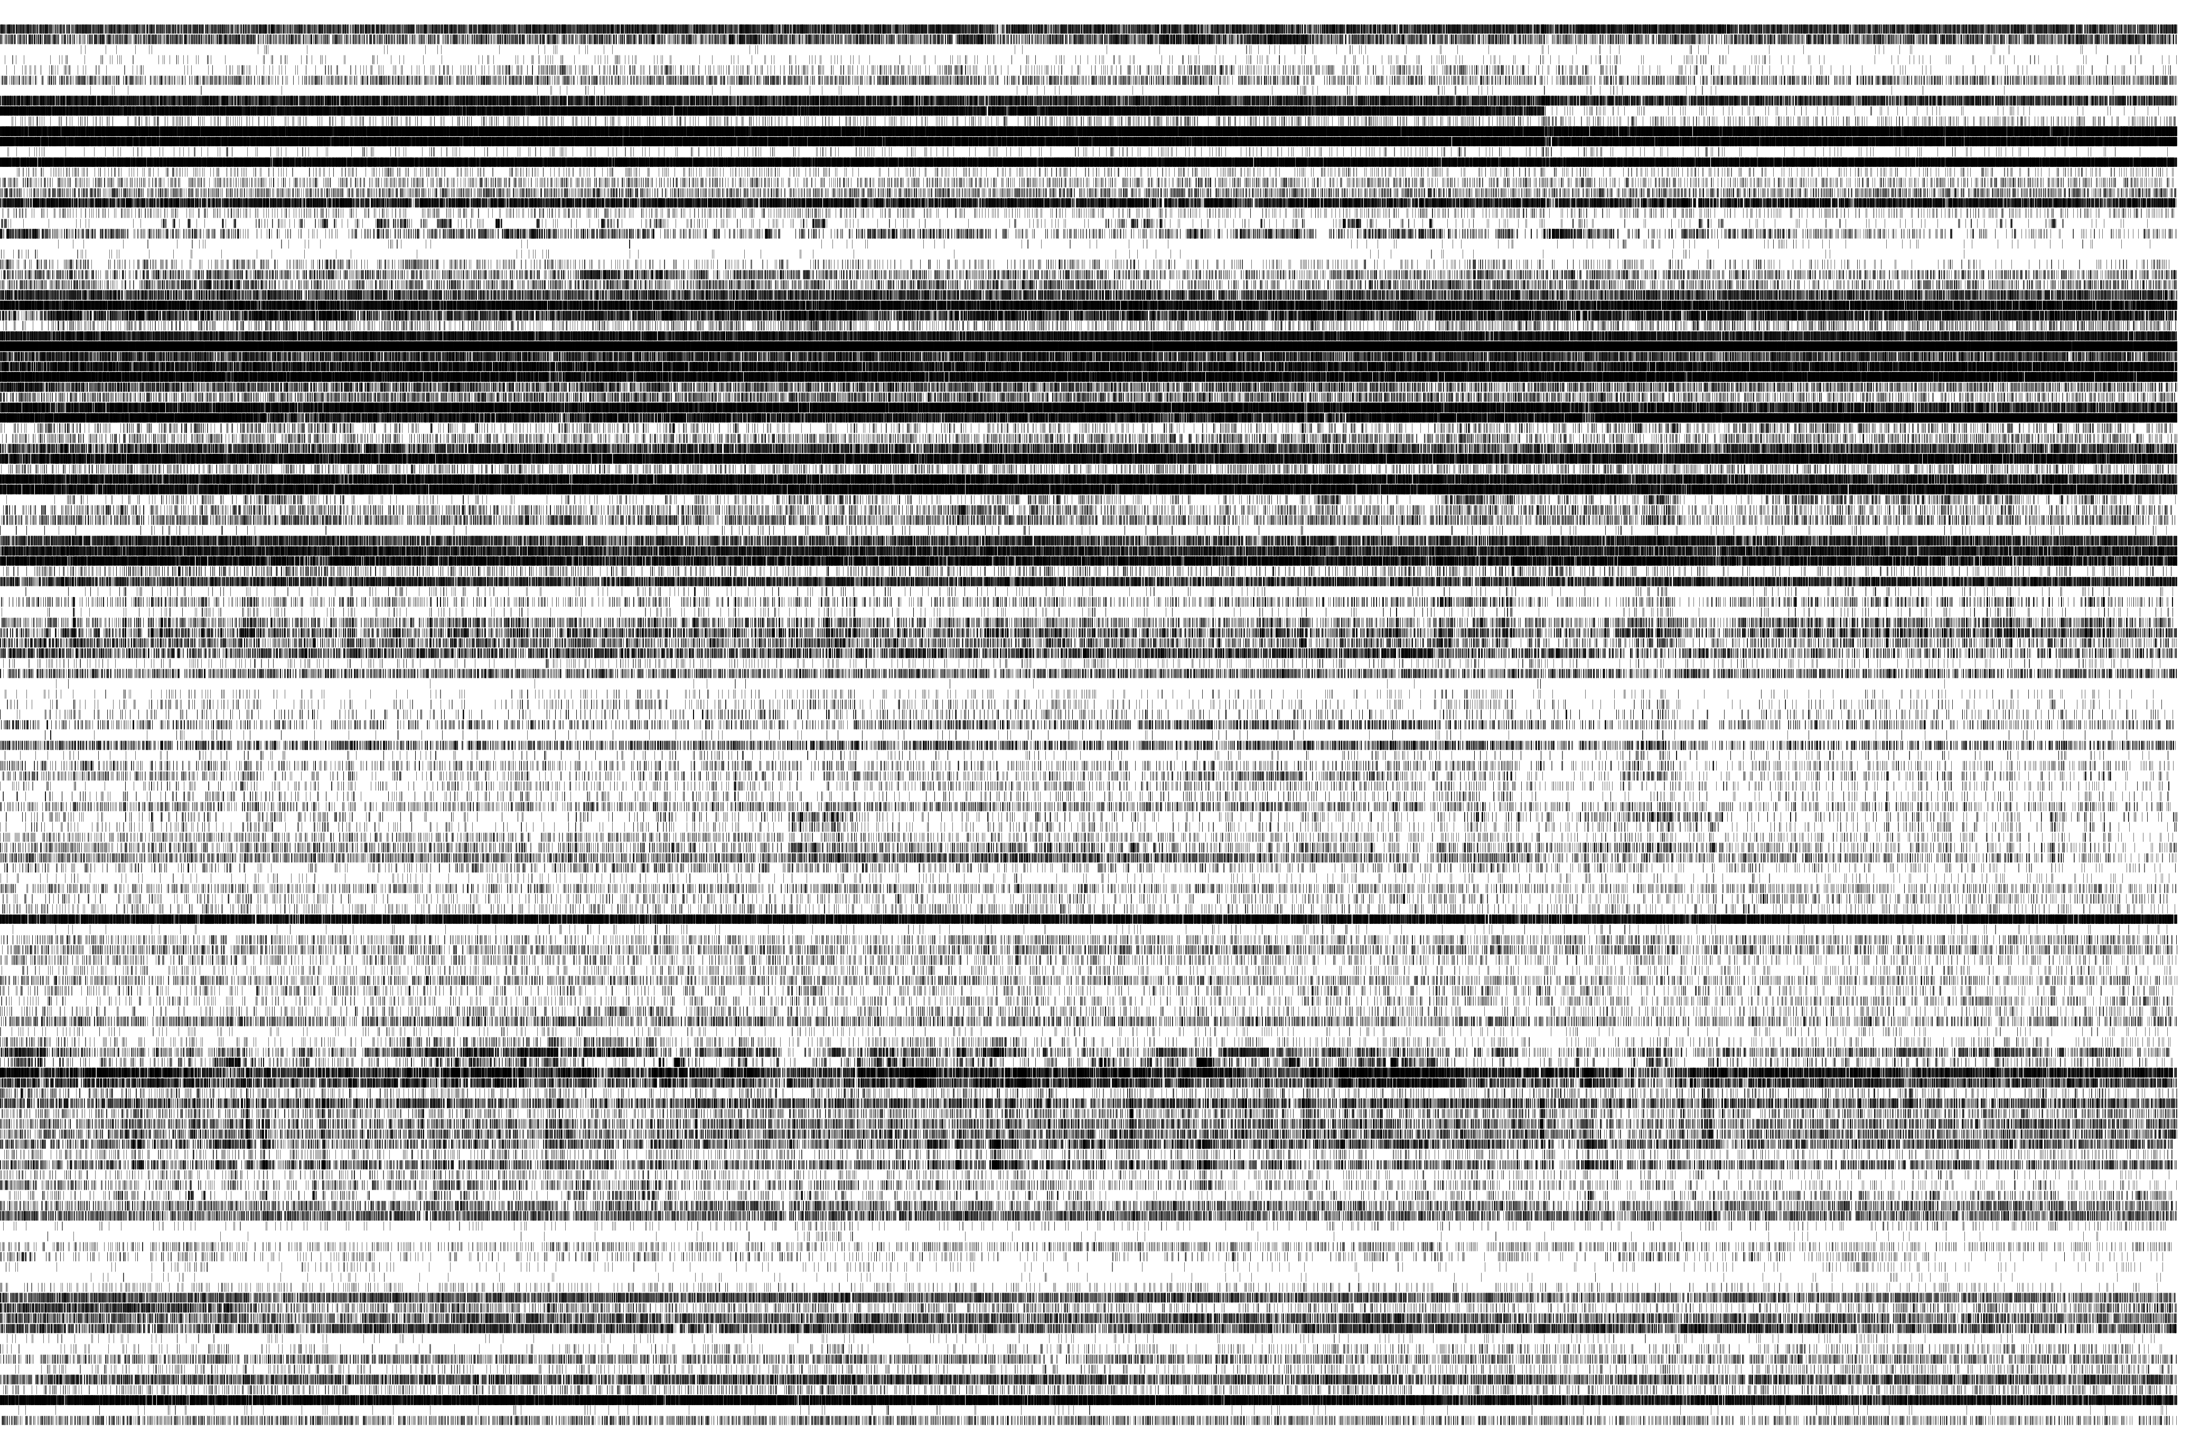
A
B

Slide 3
A
B
Can you tell that these two people watched the same movie, based on the neural activity?

Slide 4
Canonical Correlation Analysis (CCA)
Relations Between Two Sets of Variates, Harold Hotelling, 1936
multivariate statistical method used to analyze correlations between 2 datasets
identifies the sources of common variation in two high-dimensional sets of variables, from two measurement domains
makes no assumptions about directionality/flow of information
Variable sets could be:
neural activity X behavioral measure
region A X region B
patient 1 X patient 2
spikes X calcium imaging
....

Slide 5
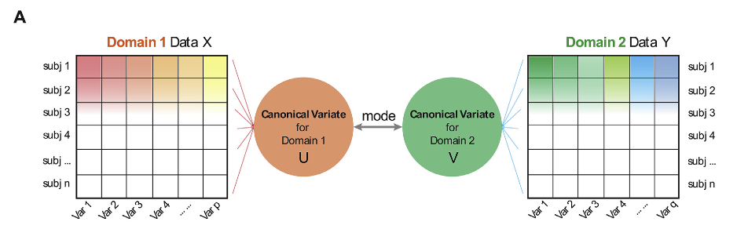
2 datasets, different measurement domains.
Goal:
re-express the datasets as multiple pairs
of highly-correlated latent embeddings.
Wang et al. 2020

Slide 6
2 datasets, different measurement domains.
Goal:
re-express the datasets as multiple pairs
of highly-correlated latent embeddings.
(i.e., common decomposition of 2 matrices)
Wang et al. 2020

Slide 7
Canonical Variate (U,V):
a linear combination of a set of variables from 1 of the domains.
Canonical Vector (a,b):
coefficients of the above linear combination
mode:
a pair of latent embeddings between each canonical variate
Wang et al. 2020

Slide 8
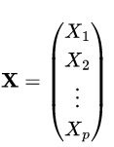
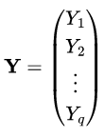
Canonical Variate (U,V):
a linear combination of a set of variables from 1 of the domains.
Canonical Vector (a,b):
coefficients of the above linear combination
mode:
a pair of latent embeddings between each canonical variate
X, Y chosen such that
Wang et al. 2020

Slide 9
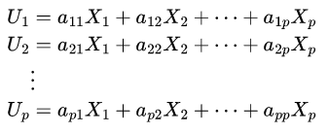
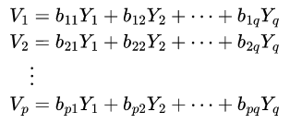

Canonical Variate (U,V):
a linear combination of a set of variables from 1 of the domains.
Canonical Vector (a,b):
coefficients of the above linear combination
mode:
a pair of latent embeddings between each canonical variate
Wang et al. 2020
https://online.stat.psu.edu/stat505/book/export/html/682

Slide 10
Canonical Variate (U,V):
a linear combination of a set of variables from 1 of the domains.
Canonical Vector (a,b):
coefficients of the above linear combination
mode:
a pair of latent embeddings between each canonical variate
Want to find linear combinations that maximize the correlations between a given U_i and V_i.
Wang et al. 2020
https://online.stat.psu.edu/stat505/book/export/html/682

Slide 11




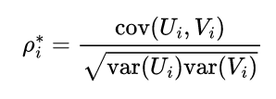
Canonical Variate (U,V):
a linear combination of a set of variables from 1 of the domains.
Canonical Vector (a,b):
coefficients of the above linear combination
mode:
a pair of latent embeddings between each canonical variate
Specific Goal: to find linear combinations that maximize the correlations between a given U_i and V_i.
For a given i, compute the variance of U_i , V_i:
For a given i, j, compute the covariance of U_i , V_j:
Maximize the correlation between pairs of canonical variates:
Wang et al. 2020
https://online.stat.psu.edu/stat505/book/export/html/682

Slide 12
Canonical Variate (U,V):
a linear combination of a set of variables from 1 of the domains.
Canonical Vector (a,b):
coefficients of the above linear combination
mode:
a pair of latent embeddings between each canonical variate
Specific Goal: to find linear combinations that maximize the correlations between a given U_i and V_i.
For a given i, compute the variance of U_i , V_i:
For a given i, j, compute the covariance of U_i , V_j:
Maximize the correlation between pairs of canonical variates:
Wang et al. 2020
https://online.stat.psu.edu/stat505/book/export/html/682

Slide 13
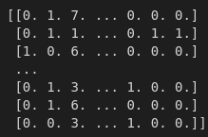
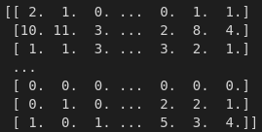
Goal today:
Implement CCA from scratch in Python.
Test out the implementation with simulated data to see how reliably modes are recovered.
Apply to human single-neurons recorded during a naturalistic stimulus.
Binned spiking data:
bin_size = 1 s
p x n = 30 x 4726
q x n = 109 x 4726

Slide 14
Resources:
sklearn Implementations:
https://scikit-learn.org/stable/modules/generated/sklearn.cross_decomposition.CCA.html
https://scikit-learn.org/stable/modules/cross_decomposition.html#cross-decomposition
background:
https://online.stat.psu.edu/stat505/book/export/html/682
https://www.sciencedirect.com/science/article/pii/S1053811920302329
solution:
https://gregorygundersen.com/blog/2018/07/17/cca/

