Slide 1

GymRatTrax Personal Fitness Scheduler Mobile Application
Group #8
Wesley Ford
Justin Krynicki
Christopher Stone
Aly Wright

Slide 2
PROJECT SCOPE
Create an exercise scheduling and tracking application
Exclusively developed for the Android mobile operating system using the Android Studio IDE
Allows users to:
Schedule unique workout routines
Document the completion of the routines
Monitor progress of the routines as well as overall personal body metrics
Accurately calculate calories burned (with implementation of either the Katch & McArdle or Harris Benedict Method)

Slide 3
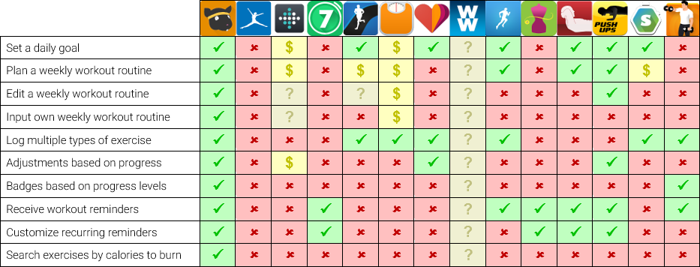
LITERATURE REVIEW
Android marketplace is saturated with fitness applications
Scope will focus on unique features

Slide 4
BASE OBJECTIVES
User-created schedules serve as a workout checklist with the freedom to input many different exercises in specific dates and times
Track progress towards personal goals as time progresses
Daily overview of planned workouts
Customized reminders for individual exercises
Fitness assessment that will analyze user’s fitness level at first launch and calculate calories as accurately as possible

Slide 5
EXPECTED OBJECTIVES
Suggestions based on previous workouts that offer to intensify or ease routine depending on exercise completion rates
Google Calendar synchronization
Search exercise by ‘calories burned’ to burn off specific snack
Option for persistent reminders that continuously appear until exercise is logged
New user tutorial to explain best use of the application and all its features
Progress reports and graphs that display clear measurements of success on a week-to-week basis

Slide 6
BONUS OBJECTIVES
Before and after pictures stored privately for the user to see personal success for themselves
Initial schedule suggestions in the form of templates for those who need a starting point
Individual exercise tutorials provided in the form of YouTube links for users who need a reminder of proper workout form
Google Fit integration allows users to include GymRatTrax activities in Google Fit reports
Achievements with Google Play Games integration to share workout goal completion badges with friends

Slide 7
SOCIAL & ETHICAL CONSIDERATIONS
User privacy is essential
No data sent back to developers
No data stored outside local device (with the exception of cloud backup tied to Google account if user opts in)
No data shared with a third-party or other applications unless user chooses to integrate app with Google Calendar, Google Fit, and/or Google Play Games services
All exercise suggestions are based upon previous workout data and user-defined fitness metrics; they are not made with consideration of the user’s medical history or any current health conditions
Exercises will be manually logged by the user under the assumption they know how to plan safe workouts and will consult their doctor prior to beginning an exercise routine

Slide 8
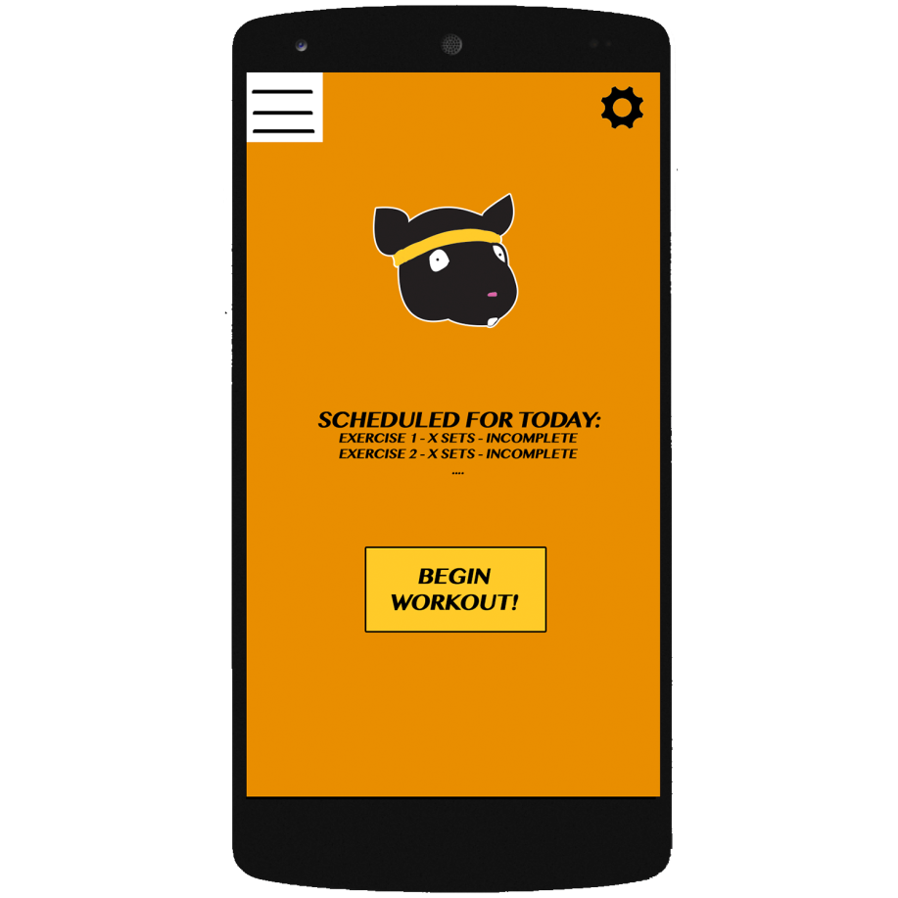
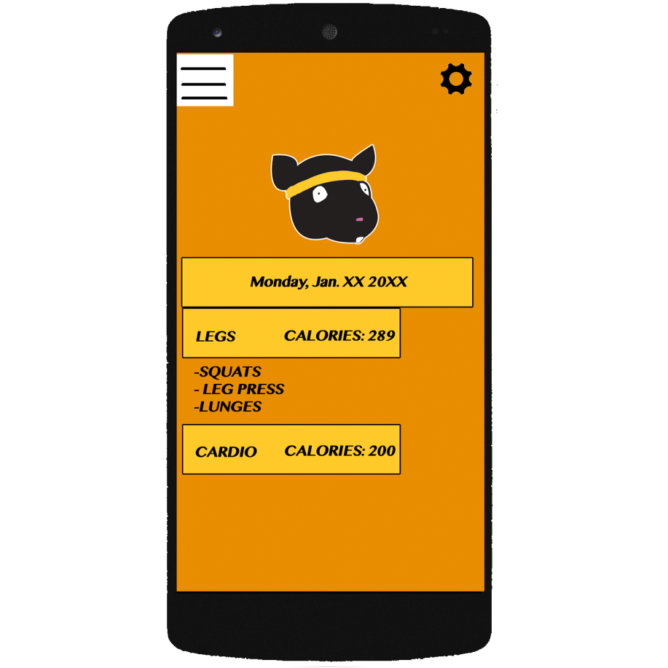
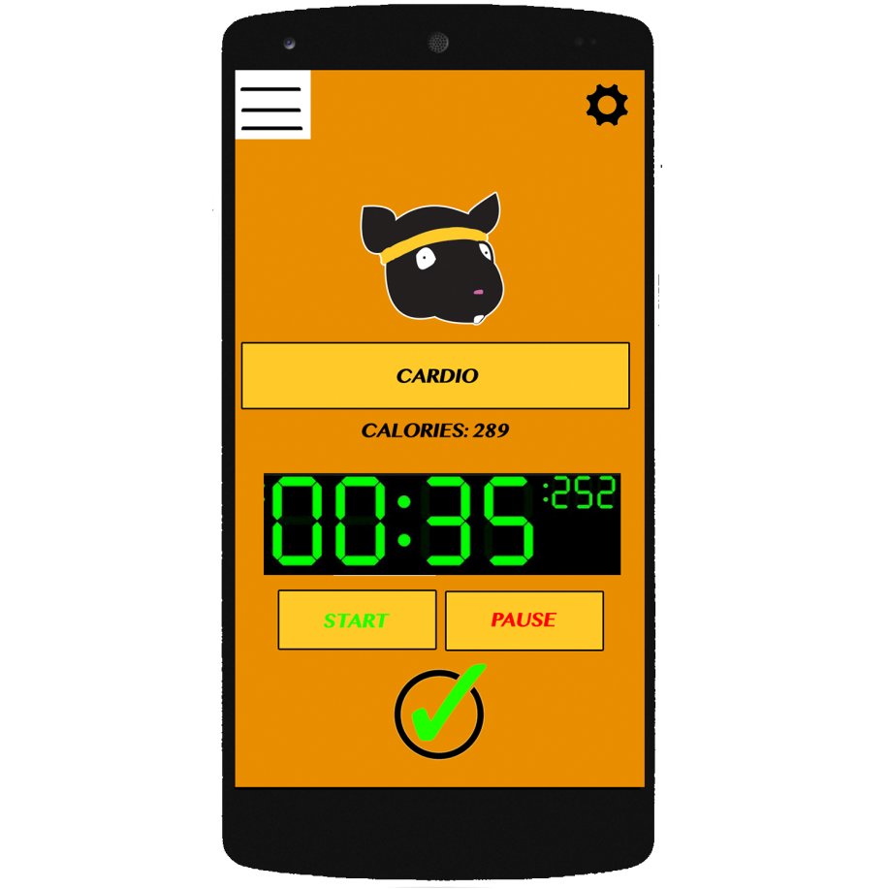
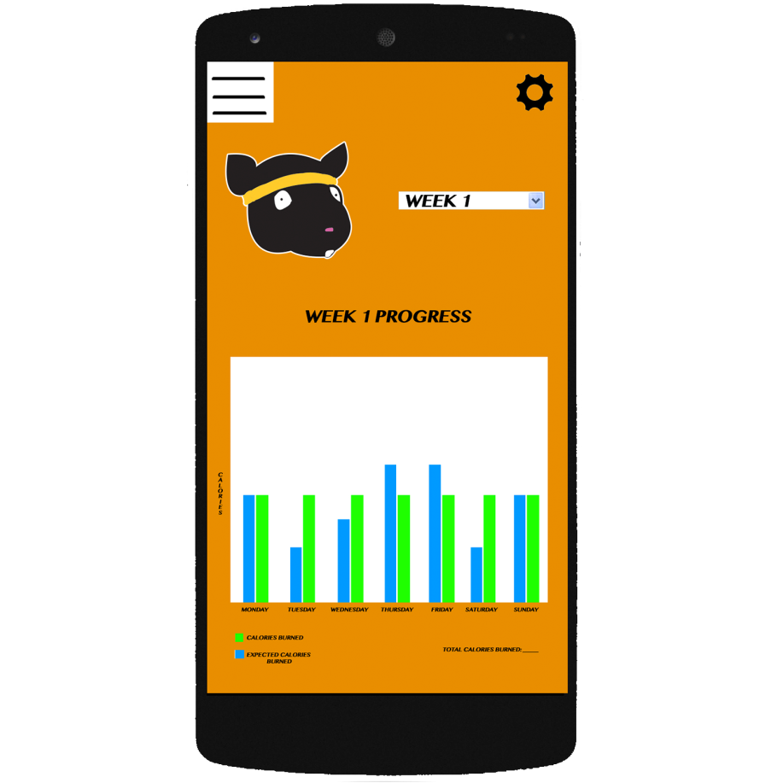
USER INTERFACE MOCKUPS
Home
Screen
Today’s
Routine
Cardio
Exercise
Progress
Report

Slide 9
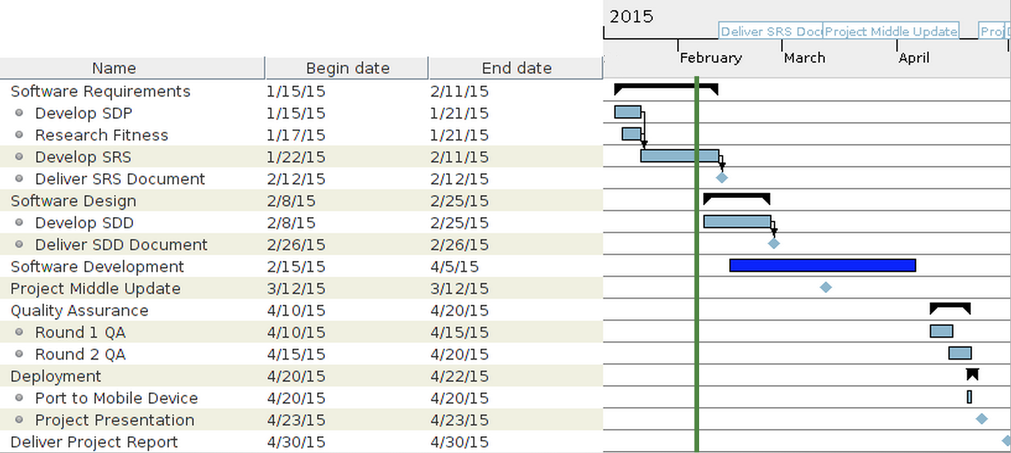
PROJECT PLAN/SCHEDULE
Notes:
NEED TO UPDATE WITH MORE COMPLETE VERSION. REPLACE ‘task_30’ and so forth.

Slide 10
CURRENT STATUS
Software Requirements Specification nearing completion and to be published next week
Software Design Document set to begin in next several days
Early development set to begin by next week upon results of research into APIs and database systems

Slide 11
SUMMARY
GymRatTrax – Personal Fitness Scheduler is the ideal solution for people who wish to stay on track with a balanced workout routine
Accurate calorie calculations across various types of exercise
Customized and persistent notifications to help stay focused and on track
Measurable progress over time to monitor health and fitness improvement

