Slide 1

GymRatTrax
Middle Update
Presentation
Group #8
Wesley Ford
Justin Krynicki
Christopher Stone
Aly Wright

Slide 2
DEVELOPMENT PROGRESS
Exhaustive documentation has benefits, but caused late start to development
Overcoming busy lives and unforeseen circumstances also delayed process
Existing twice-a-week meeting schedule has been working and will continue
Division of responsibilities
  Christopher – Database maintenance
  Aly – Back-end Java coding
  Wesley – Front-end layout coding
  Justin – API implementation research and documentation

Slide 3
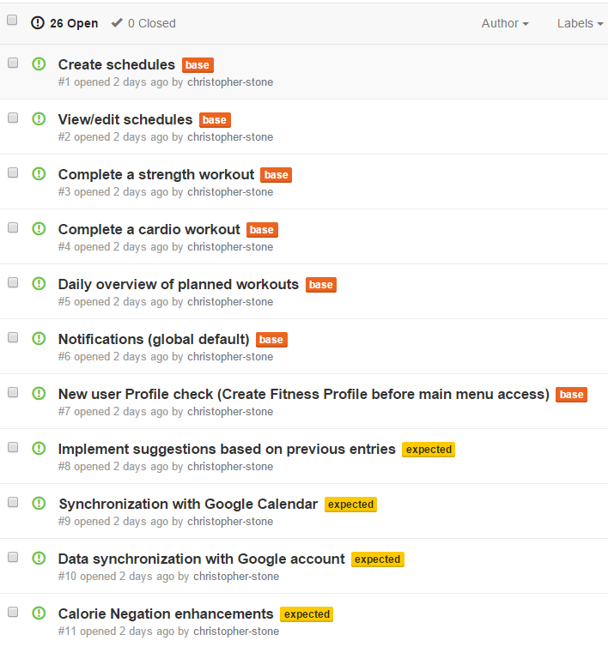
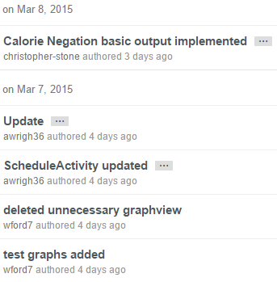
DEVELOPMENT PROGRESS
GitHub being used as shared code repository and issue tracking system
Ongoing development will incorporate a Kanban-based Agile schedule with weekly sprints

Slide 4
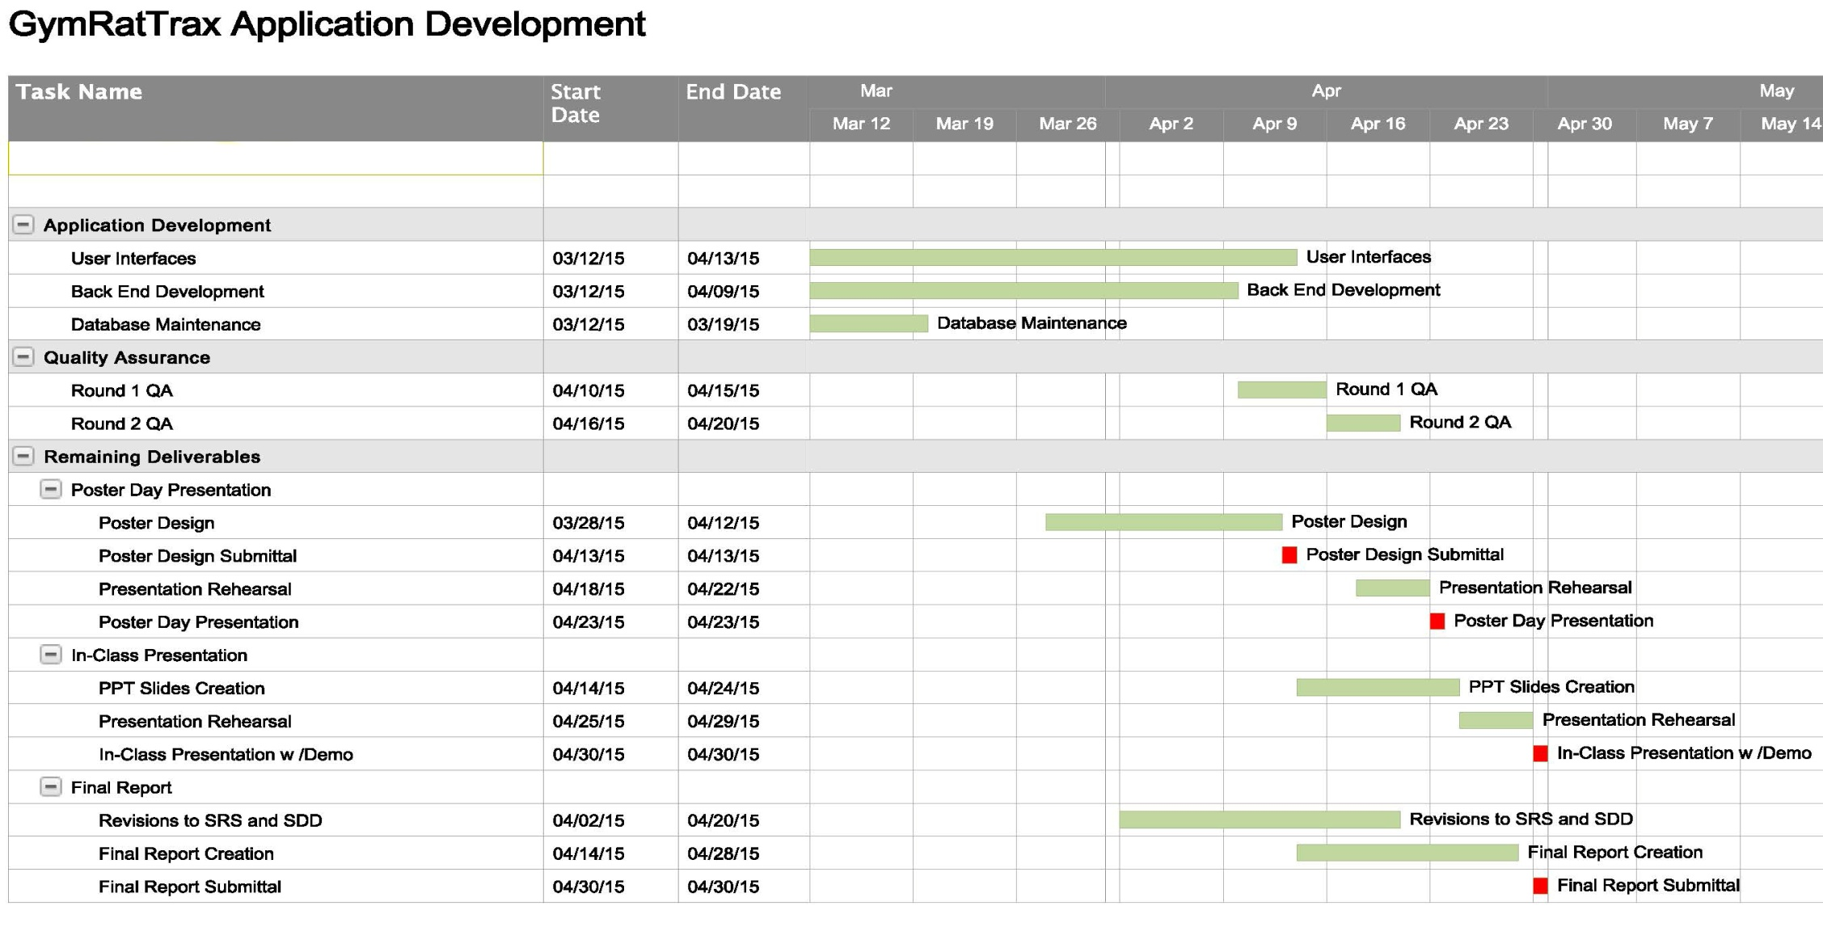
REMAINING SCHEDULE

Slide 5
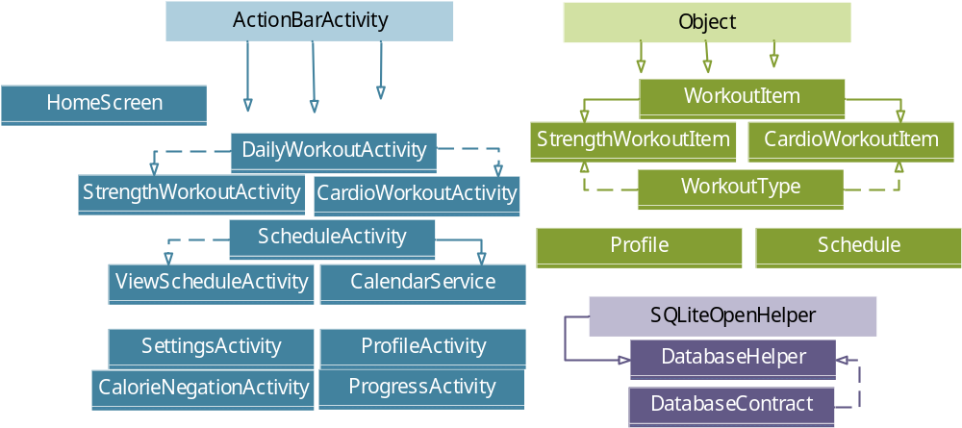
TECHNICAL IMPLEMENTATION

Slide 6
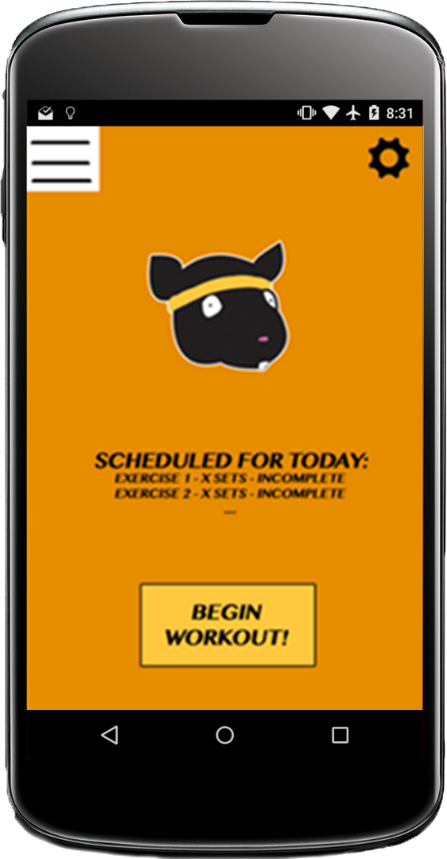
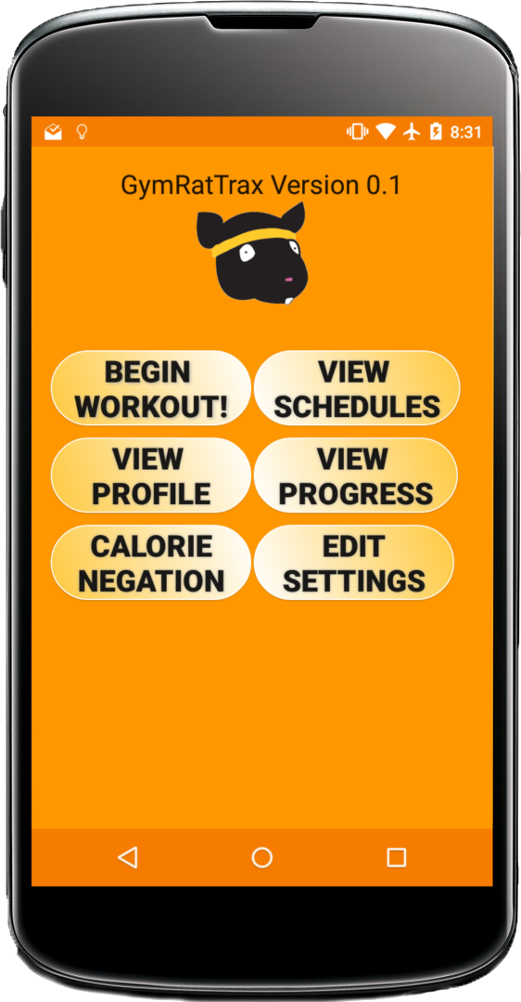
DESIGN UPDATES

Slide 7
FEATURES DEMONSTRATED TODAY
View and edit user’s profile
View user’s weight loss progress
View day’s scheduled workouts
Use Calorie Negation to find a suggested workout

Slide 8
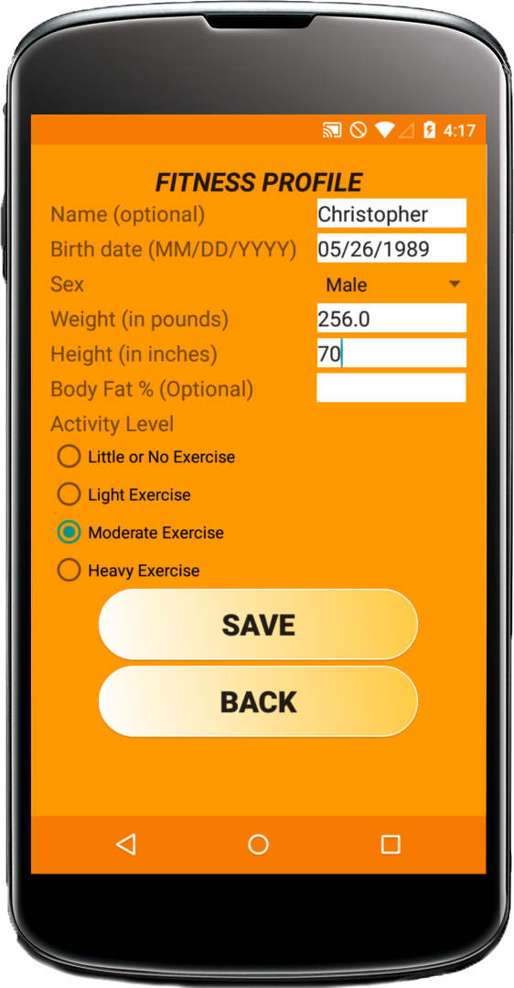
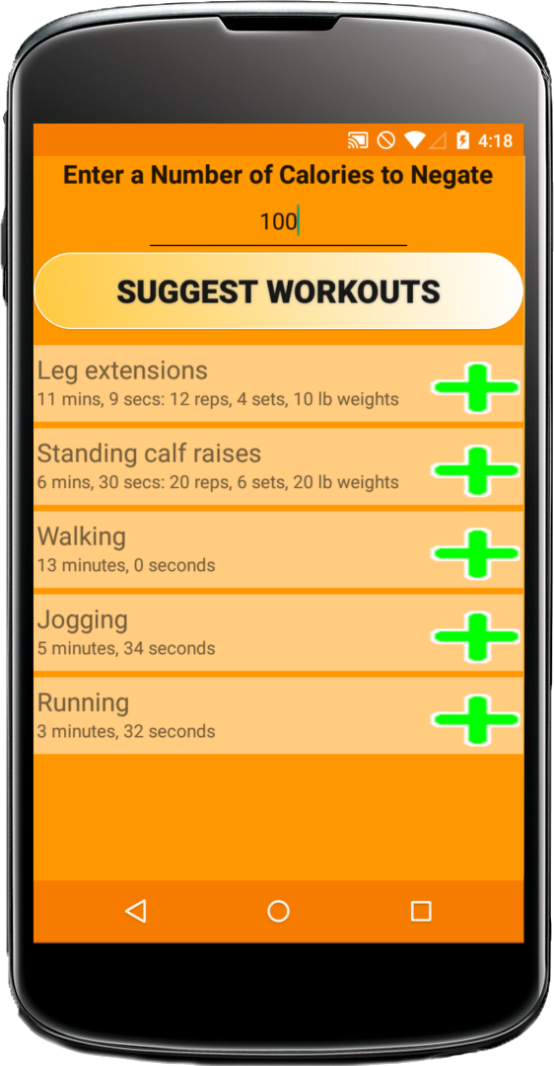
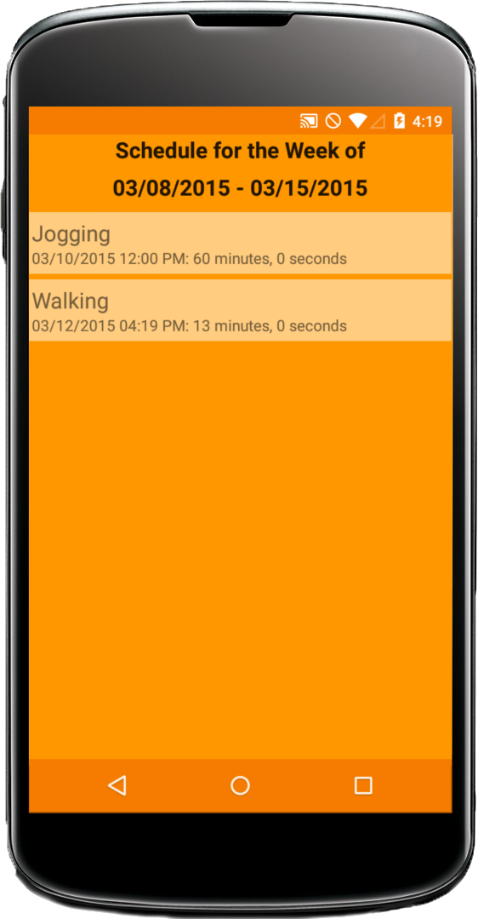
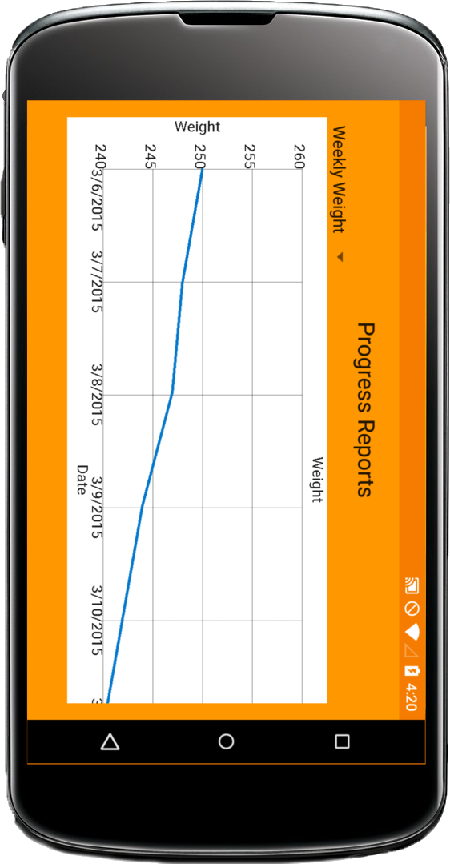
FEATURES DEMONSTRATED TODAY
View Profile
Calorie Negation
View Schedule
View Progress

