Slide 1
Fuel Consumption Optimization
Using AI-Based Tools
Indian Coast Guard — Problem Statement 77
Quantum-Inspired Optimization for Maritime Fuel Efficiency
By Amitanshu Lal

Slide 2
The Problem
Cubic Speed-Power Law
Operational Constraint
Environmental Impact
A ship's fuel burn rate grows with the cube of speed. Doubling speed increases fuel rate ~8×. Even small speed reductions yield large savings.
Ships must arrive by a deadline (mission schedule). The captain cannot just go as slow as possible — there is a minimum feasible speed.
Waves, wind, and currents change fuel burn significantly. A storm can increase fuel consumption by 30-50%. Route matters, not just speed.
fuel_rate ∝ displacement²ᐟ³ × speed³
2

Slide 3
Objectives
01
Predict Fuel Burn
Build an ML model that learns the cubic speed-power law from ship voyage data and predicts fuel rate (tonnes/day) for any condition.
02
Optimize Speed
Find the fuel-minimizing speed that still meets the arrival deadline — data-driven slow steaming with CO₂ reporting.
03
Optimize Route
Find the minimum-fuel path through a weather field, detouring around storms when the fuel savings outweigh the extra distance.
04
Quantum-Inspired QUBO
Formulate both problems as QUBOs — the binary optimization form quantum annealers solve natively — portable to D-Wave hardware.
3

Slide 4
Approach — Phased Development
Phase 1
Phase 2
Phase 3
Data + ML + Classical Optimization
Quantum-Inspired QUBO
Synthetic data from physics
Train ML fuel-rate model (R² ≈ 0.99)
Simulated annealing speed optimizer
Grid search validation + CO₂ reporting
Speed optimization as QUBO (proof)
Weather routing as QUBO (headline)
Solve with neal (D-Wave sampler)
Validate against exact DP solver
→
4

Slide 5
Ship Classes Modeled
Three Indian Coast Guard ship classes spanning small interceptors to large patrol vessels
Parameter | Interceptor | Fast Patrol | Offshore Patrol
Displacement | ~60 t | ~550 t | ~2000 t
Engine Power | 4,000 kW | 8,000 kW | 12,000 kW
Hull Coefficient | 0.42 | 0.50 | 0.55
Max Speed | 35 kn | 28 kn | 25 kn
Service Speed | 28 kn | 22 kn | 18 kn
Fuel Types | MGO | MGO / VLSFO | VLSFO / HFO
5

Slide 6
Data Generation — Physics Model
Core Physics (Admiralty Law)
10,000 Synthetic Records
propulsion = 5×10⁻⁵ × disp²ᐟ³ × (speed − current)³
× hull_coeff × (1 + 0.06 × waves)
× (1 + 0.005 × wind) × laden_factor
hotel_load = 0.02 × displacement²ᐟ³
fuel_rate = (propulsion + hotel) / fuel_energy
× (1 + 6% noise)
Sample ship class + parameters from Gaussian distributions
Wave height: Gamma(2,1) distribution
Wind: correlated with waves (5 + 6×waves + noise)
Current: Normal(0, 1.2 kn)
Load: Laden (1.15×) or Ballast (0.85×)
6% multiplicative noise simulates real-world measurement uncertainty
6

Slide 7
Feature Engineering
Static Features (ship design)
Dynamic Features (voyage conditions)
displacement_tonnes — ship's total mass
engine_power_kw — installed engine power
hull_coefficient — hull shape (drag factor)
ship_type — Interceptor / Fast / Offshore
fuel_type — MGO / VLSFO / HFO
speed_knots — the decision variable
wave_height_m — sea state
wind_speed_kn — wind conditions
current_speed_kn — ocean current
load_condition — Laden / Ballast
Target: fuel_rate_tpd (tonnes per day)
7

Slide 8
ML Pipeline
Raw Data
10,000 rows
→
Column
Transformer
→
Train/Test
80/20 Split
→
3 Models
Compared
→
5-Fold
Cross-Val
ColumnTransformer
Three Models Compared
Numeric features: pass through unchanged
Categorical features: OneHotEncoder
Pipeline bundles preprocessing + model
Single call for prediction
Linear Regression (baseline)
Random Forest (200 trees)
HistGradientBoosting (best)
8

Slide 9
Model Comparison — Results
Model | CV R² | Test R² | MAE | RMSE | MAPE
Linear Regression | 0.641 | 0.648 | 9.10 | 12.97 | 354%
Random Forest | 0.977 | 0.980 | 1.52 | 3.06 | 9.3%
Gradient Boosting | 0.987 | 0.987 | 1.30 | 2.45 | 11.3%
Key Insight
Linear regression fails badly (R² = 0.65, MAPE = 354%) because it cannot capture the cubic speed-power law across ships spanning 5–90 t/day. This demonstrates WHY nonlinear ML models are essential for this problem. Gradient Boosting achieves R² ≈ 0.99 — the model has effectively rediscovered the physics from noisy data.
9

Slide 10
Speed Optimization — The U-Shaped Curve
total_fuel = rate(speed) × distance / (24 × speed)
Going Faster
Going Slower
Higher fuel rate (cubic law)
Rate grows as speed³
More fuel per hour at sea
Longer voyage time
Hotel load accumulates (generators,
electronics run regardless of speed)
The Result: A U-Shaped Curve
The bottom of the U is the "economic speed." Under a tight deadline, the minimum feasible speed may be above it. Under a relaxed deadline, the optimizer reaches the true economic speed — going even slower would waste fuel.
11

Slide 11
Simulated Annealing (SA)
Start at a random solution with high temperature T
Propose a small random change (adjust speed / flip a bit)
If change improves objective → always accept
If change worsens by ΔE → accept with probability exp(−ΔE / T)
Reduce temperature: T → T × 0.995 (cooling schedule)
Repeat for 2,000 iterations until T ≈ 0
Metropolis Rule
P(accept) = exp(−ΔE / T)
High T → explore freely
Low T → only accept improvements
Why not Gradient Descent?
Gradient descent needs continuous, differentiable functions — it computes slopes and slides downhill. Our QUBO variables are binary (0 or 1): there is no gradient. SA works by evaluating the function at random neighbors (no derivatives needed) and can escape local minima via the Metropolis rule.
12

Slide 12
Speed Optimization — Results
Offshore Patrol Vessel, 600 nm leg, baseline = 18 kn service speed
Scenario | Optimal Speed | Fuel (t) | vs Baseline | CO₂ Saved
Tight schedule (40 h) | 15.0 kn | 39.9 | −29% | 52.5 t
Relaxed schedule (90 h) | 8.4 kn | 18.3 | −68% | 121.8 t
−29%
−68%
fuel saved (tight deadline)
fuel saved (relaxed deadline)
SA matches brute-force grid optimum to within 0.01 kn — confirmed true optimum.
13

Slide 13
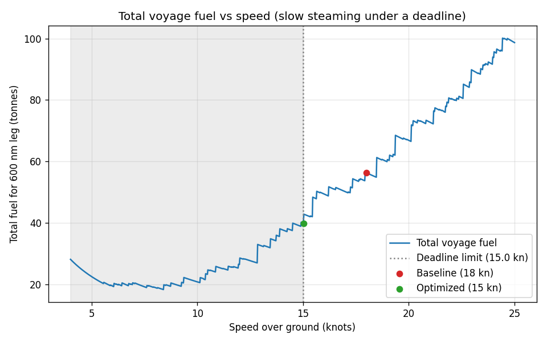
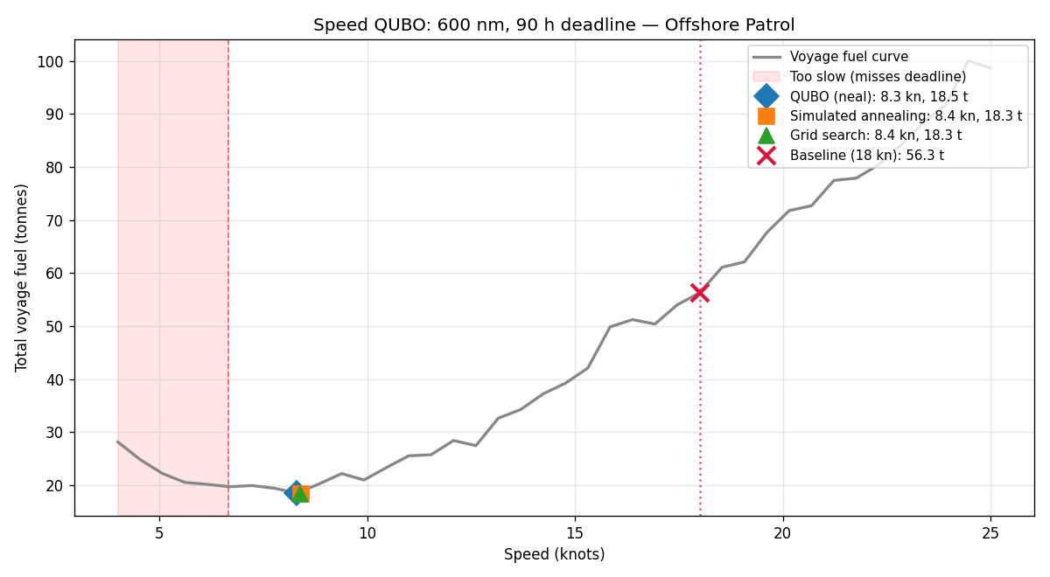
Speed Optimization — Plots
[ Insert voyage_fuel_vs_speed.png and speed_qubo plots here ]
14

Slide 14
QUBO — Quadratic Unconstrained Binary Optimization
minimize H = Σᵢ qᵢ·xᵢ + Σᵢⱼ qᵢⱼ·xᵢ·xⱼ where xᵢ ∈ {0, 1}
Ising Model Equivalence
QUBO (0/1 variables) is mathematically identical to the Ising model (±1 spins) from 1920s physics — the substitution sᵢ = 2xᵢ − 1 converts between them.
Constraints as Penalties
No "subject to" section. Constraints become penalty terms: e.g., pick exactly one option → P × (Σxᵢ − 1)². Violating adds huge energy.
Hardware Portable
D-Wave quantum annealers solve QUBO/Ising natively. The same QUBO dict we pass to neal (classical) can go to DWaveSampler() — one line change.
Reference: Lucas (2014), "Ising formulations of many NP problems"
15

Slide 15
QUBO Speed Optimization (Phase 2a)
QUBO Encoding (One-Hot Discretization)
H = Σᵢ fuelᵢ · xᵢ (minimize fuel)
+ P × (Σᵢ xᵢ − 1)² (pick exactly one speed)
+ P × Σ (infeasible xᵢ) (meet the deadline)
Results — 40 candidate speeds, 600 nm, 40 h deadline
Method | Speed (kn) | Fuel (t)
QUBO (neal) | 15.31 | 42.07
Simulated Annealing | 15.03 | 39.90
Brute-force Grid | 15.02 | 39.92
QUBO matches grid within the 0.54 kn discretization step — QUBO machinery is correct ✓
16

Slide 16
Weather Routing — The Problem
Grid Discretization
Ocean region becomes an n_rows × n_cols grid. Ship starts at the west port, must reach the east port, advancing one column per stage.
Movement Rules
At each stage, the ship can stay in the same row or move ±1 row (north/south). No teleporting across multiple rows.
ML-Driven Cell Costs
Each cell's fuel cost is computed by the Phase 1 Gradient Boosting model using that cell's wave height and corresponding wind.
Combinatorial Explosion
Total possible paths = rows^cols. For an 11×25 grid: 11²⁵ ≈ 10²⁶ paths. Brute force is impossible — we need QUBO.
17

Slide 17
Weather Routing — QUBO Formulation
Binary variable x[c, r] = 1 ⟺ "ship is in row r at column c"
Energy Hamiltonian
H = Σ cost[r,c] · x[c,r] (fuel objective)
+ surcharge × cost[r',c+1] · x[c,r] · x[c+1,r'] (diagonal penalty)
+ P × Σc (Σr x[c,r] − 1)² (one row per column)
+ P × (wrong rows at first / last col) (fixed endpoints)
+ P × Σ x[c,r] · x[c+1,r'] for |r−r'| ≥ 2 (no teleporting)
Penalty P = 10 × max(cell_cost) — large enough to prevent violations, small enough for fine optimization
Solved with neal.SimulatedAnnealingSampler() — same API as DWaveSampler()
18

Slide 18
Exact Validation — Dynamic Programming
dp[c][r] = min( dp[c-1][r-1], dp[c-1][r], dp[c-1][r+1] ) + cost[r][c]
Exploits optimal substructure: best path to (c, r) must arrive from best path to a neighbor at c−1
Complexity: O(rows × cols) — runs instantly on any grid size (replaces exponential brute force)
Traces back through pointers to recover the exact optimal path
Used to validate QUBO: if QUBO fuel is within ~1% of DP, the QUBO formulation is working
Why not just use DP instead of QUBO?
DP works for this specific grid structure. But QUBO generalizes to problems where DP doesn't apply (joint speed+route, multi-objective, non-monotone paths). And QUBO is portable to quantum hardware — DP is not.
19

Slide 19
Weather Routing — Results
Grid | Storms | QUBO Vars | Naive (t) | QUBO (t) | Exact (t) | Gap | Fuel Saved
5 × 7 | 1 (centre) | 35 | 58.3 | 52.7 | 52.7 | 0.00% | 9.6%
7 × 15 | 3 | 105 | — | — | — | 0.00% | ~8%
9 × 19 | 4 | 171 | — | — | — | 0.97% | ~7%
11 × 25 | 6 | 275 | 53.76 | 49.94 | 49.35 | 1.18% | 7.1%
7–10%
< 1.2%
fuel saved by routing around storms
gap from exact optimum (QUBO is near-optimal)
20

Slide 20
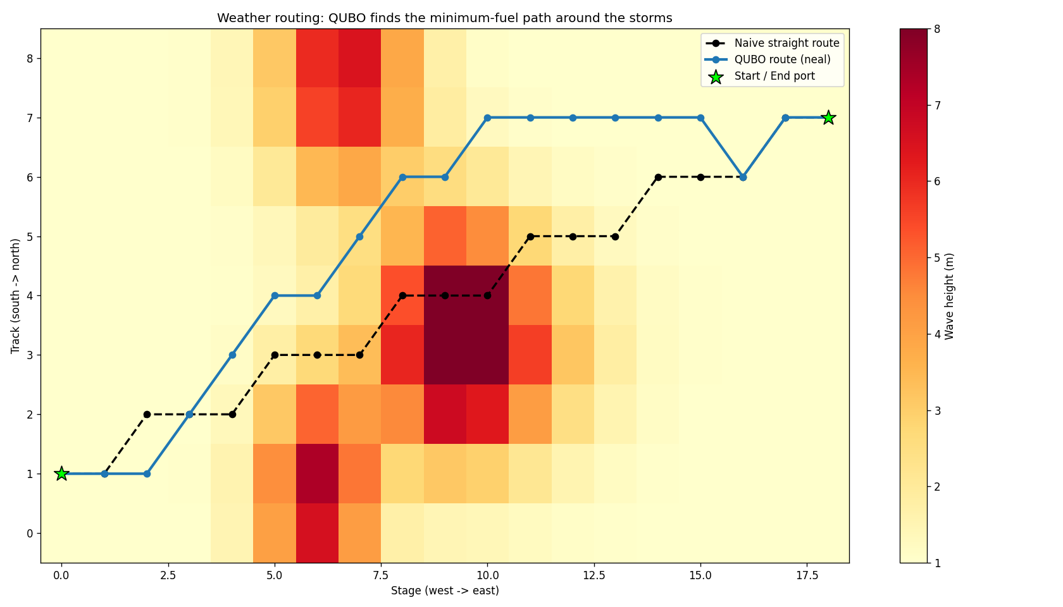
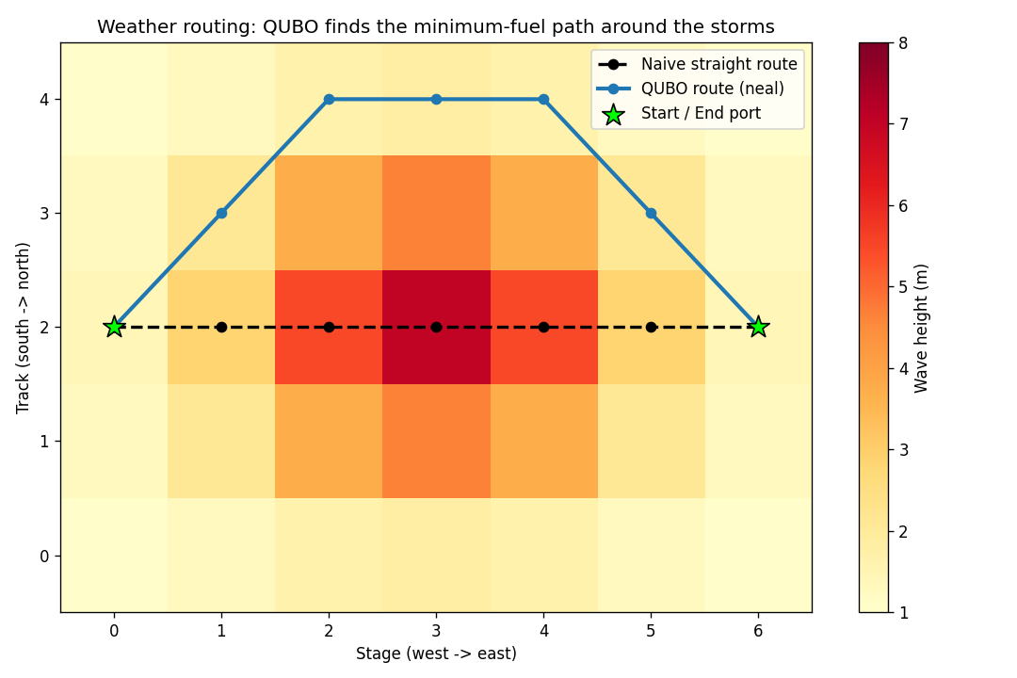
Weather Routing — Visual Results
21

Slide 21
IMO Compliance — CO₂ Reporting
Fuel Type | CO₂ Factor (t CO₂ / t fuel)
MGO (Marine Gas Oil) | 3.206
VLSFO (Very Low Sulphur) | 3.151
HFO (Heavy Fuel Oil) | 3.114
Example
29% fuel saving on tight schedule
= 16.4 t fuel saved
= 52.5 t CO₂ saved per leg
68% fuel saving on relaxed
= 37.9 t fuel saved
= 121.8 t CO₂ saved per leg
Official IMO values used in Carbon Intensity Indicator (CII) calculations
Why CO₂ Reporting Matters
The IMO requires ships to report Carbon Intensity Indicator (CII) ratings annually. Ships with poor CII ratings face operational restrictions. Our system automatically converts fuel savings into CO₂ reductions using official IMO emission factors, providing the data needed for compliance reporting.
22

Slide 22
Key References
Lucas, A. (2014) "Ising formulations of many NP problems"
Frontiers in Physics — The recipe book for encoding optimization problems as QUBOs
Feld, S. et al. (2019) "A Hybrid Solution Method for the Capacitated Vehicle Routing Problem Using a Quantum Annealer"
Frontiers in ICT — D-Wave applied to fleet routing — same problem structure as ours
Stollenwerk, T. et al. (2020) "Flight Gate Assignment with a Quantum Annealer"
Quantum Science and Technology — QUBO for transport/trajectory optimization
Ajagekar, A. & You, F. (2019) "Quantum computing for energy systems optimization"
Energy — QUBO formulations for energy-related scheduling
D-Wave Systems Ocean SDK Documentation
docs.ocean.dwavesys.com — PyQUBO + neal + DWaveSampler toolchain
23

Slide 23
Honest Caveats
Transparency strengthens the presentation — state limitations before the audience asks
Synthetic Data
Physics coefficients are plausible but not calibrated to specific ICG vessels. The model proves the approach works — real ship data would improve accuracy.
Classical Solver
QUBO is solved with neal (classical simulated annealing), not real quantum hardware. But the formulation is hardware-portable — one line change to run on D-Wave.
Independent Optimization
Speed and route are optimized separately. In reality they are interdependent. A joint QUBO is planned as a Phase 2+ extension.
Grid Approximation
The ocean is continuous; our grid discretization is an approximation. Finer grids improve accuracy but increase QUBO size.
24

Slide 24
Thank You
Maritime Fuel Consumption Optimization
Indian Coast Guard — Problem Statement 77

