Slide 1

Build, Run, and Manage your AI Models
While I’m talking, do prereqs and environment setup here:
github.com/ericmartens/openscale_app
Link to recording will be posted in repo

Slide 2
While I’m talking, do prereqs and environment setup here:
github.com/ericmartens/openscale_app
Eric Martens
Watson OpenScale
Not an app developer
Jacques Roy
Watson Machine Learning
YouTube: Byte Size Data Science
Nerav Doshi
Decision Optimization
Link to recording will be posted in repo
Notes:
Which means, only 25% (it’s actually less than 25%) have adopted AI

Slide 3
While I’m talking, do prereqs and environment setup here:
github.com/ericmartens/openscale_app
In an MIT & BCG survey of more than 3,000 executives, managers, and analysts across industries…
39%
Of all companies have an AI strategy in place
1/5
Has incorporated AI in some offerings or products
1/20
Has extensively incorporated AI in offerings or process
Link to recording will be posted in repo
Notes:
Which means, only 25% (it’s actually less than 25%) have adopted AI

Slide 4
While I’m talking, do prereqs and environment setup here:
github.com/ericmartens/openscale_app
Business stakeholders do not trust AI
60%
Without expensive Data Science resources handholding multiple AI models in a production application:
No way to validate if AI models are compliant with regulations and will achieve expected business outcomes before deploying
Difficult to track and measure indicators of business success in production
Resource intensive and unreliable processes for ongoing business monitoring and compliance
of companies see regulatory constraints as a barrier to implementing AI.
IBM IBV AI 2018
63%
cite availability of technical skills as a challenge to implementation.
- IBM IBV AI 2018
Link to recording will be posted in repo

Slide 5



While I’m talking, do prereqs and environment setup here:
github.com/ericmartens/openscale_app
Watson OpenScale
Validate and monitor AI models, deployed anywhere, to help comply with regulations, address internal safeguards, and mitigate business risk
Monitoring for compliance and safeguards
Mitigate biased model behavior
Explain model decisions
Validate and control risk
Ensure that models are resilient to changing situations
Detect drift during runtime
Generate specific model retraining inputs
Align model performance with business outcomes
Correlate model metrics and business KPIs
Actionable metrics and alerts
Link to recording will be posted in repo
Notes:
Align model performance with business outcomes – “if you are thinking about launching an AI model into production, this is a no-brainer”
Ensure that models are resilient to changing situations – “if you are using AI to impact revenue, identify problems with business models or transform operations, you have to track changes in business inputs. Models need to keep up with it much faster than manual review/retrain recommendations”
Prove regulatory compliance and safeguards – “if you are in a regulated industry, there are existing regulations that automated decisions have to meet”; “new controls could get added to GDPR or new regulations being proposed may become a reality in the Digital age”. This will need to be done both during production and before deploying

Slide 6
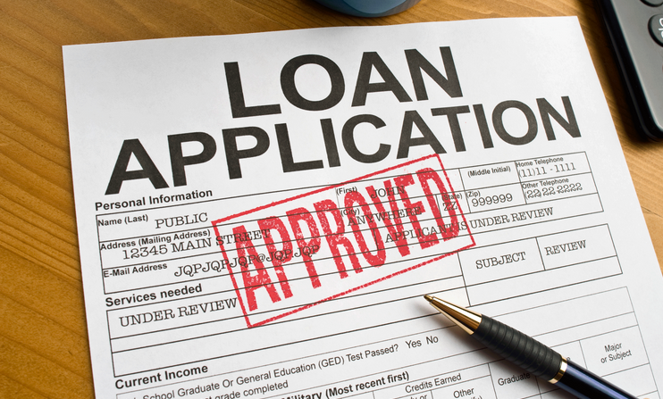
Demo
While I’m talking, do prereqs and environment setup here:
github.com/ericmartens/openscale_app
Use case
Build and monitor a mortgage approval model
Deployed classification model
Link to recording will be posted in repo

Slide 7
While I’m talking, do prereqs and environment setup here:
github.com/ericmartens/openscale_app
Watson Machine Learning
Watson OpenScale
World’s Ugliest App
Link to recording will be posted in repo
Notes:
Align model performance with business outcomes – “if you are thinking about launching an AI model into production, this is a no-brainer”
Ensure that models are resilient to changing situations – “if you are using AI to impact revenue, identify problems with business models or transform operations, you have to track changes in business inputs. Models need to keep up with it much faster than manual review/retrain recommendations”
Prove regulatory compliance and safeguards – “if you are in a regulated industry, there are existing regulations that automated decisions have to meet”; “new controls could get added to GDPR or new regulations being proposed may become a reality in the Digital age”. This will need to be done both during production and before deploying

