Slide 1


Attention with RNNs
Notes:
Today we’ll see how attention augments RNNs by letting the model selectively focus on the most relevant parts of a sequence. This tackles the problem of long sequences overwhelming a fixed memory and sets us up for clearer, more accurate decisions on sequential data.”

Slide 2
Attention + RNNs: The big picture
RNNs carry memory, but long sequences dilute key information.
Attention adds a selective focus: dynamically weights time steps.
Result: better long-term dependency capture and clearer model decisions across forecasting, language tasks, and sequential behaviors
Notes:
RNNs carry memory, but on long sequences important details get diluted. Attention adds a dynamic weighting over time steps, so the model emphasizes what matters most. The payoff is better long-term dependency capture and clearer decisions across forecasting, language tasks, and other sequential behaviors.”

Slide 3
Fundamentals of Attention
What it is: a mechanism that highlights the most relevant parts of an input sequence.
Key terms:
Attention weights (importance per time step)
Alignment score (relevance measure driving weights)
Context vector (weighted sum of sequence representations)
Types: additive vs. multiplicative (dot-product) attention
Notes:
“Think of attention as a mechanism that highlights the most relevant parts of an input sequence. Three terms to anchor: alignment score (how relevant each position is), attention weights (softmax-normalized importances per time step), and the context vector (the weighted sum of sequence representations). You’ll see two scoring styles: additive and multiplicative (dot-product) attention.

Slide 4
How attention works
For each output step: compute alignment scores between current state and each input position.
Apply softmax → attention weights that sum to 1.
Form context vector = weighted sum of hidden states.
Feed context (optionally with current state) to produce the output.
Effect: a dynamic spotlight on the most pertinent inputs
Notes:
“For each output step, we score the current state against every input position, apply a softmax to get attention weights that sum to one, and build a context vector as the weighted sum of hidden states. Feeding this context (optionally with the current state) to the decoder yields the output—a dynamic spotlight that moves to the most pertinent inputs as we decode.

Slide 5
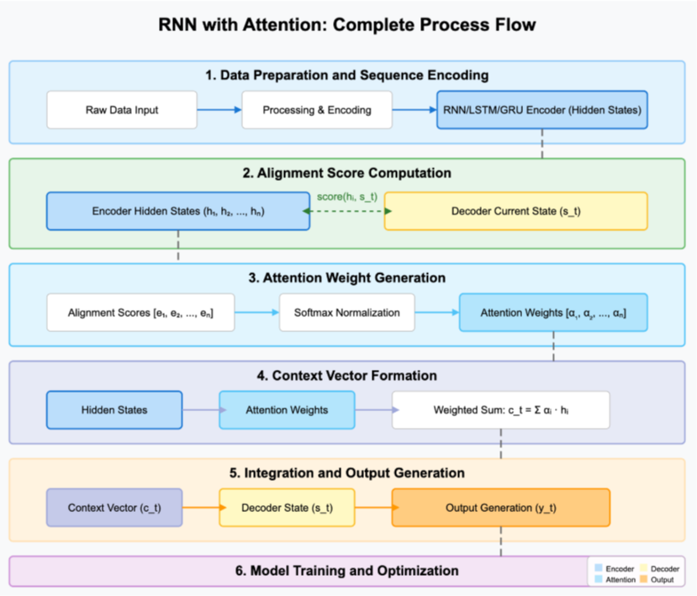
Notes:
“Use the diagram here to track the full pipeline end-to-end:
Data prep & encoding into RNN/LSTM/GRU hidden states,
Alignment score computation vs. the decoder’s current state,
Attention weight generation via softmax,
Context vector formation as a weighted sum,
Integration & output generation, and
Model training & optimization.
Notice how the diagram (page 5) makes the encoder states, scoring, and softmax normalization explicit.”
Input sequence: x1,…,xnx_1, \dots, x_nx1​,…,xn​
Encoder hidden states: h1,…,hnh_1, \dots, h_nh1​,…,hn​
Attention layer: scores → α₁…αₙ, softmax-normalized.
Context vector: c=∑αi⋅hic = \sum \alpha_i \cdot h_ic=∑αi​⋅hi​
Decoder/output: uses ccc (and state) to generate predictions.
Addresses fixed-vector bottlenecks; allows direct access to any time step

Slide 6
Integrating attention with RNNs
Add attention to simple RNNs, LSTMs, or GRUs.
Choose scoring: additive (small feedforward net) or multiplicative (dot product).
Improves sequence modeling where context varies over time
Notes:
“We can attach attention to SimpleRNNs, LSTMs, or GRUs. Choose a scoring function—additive or multiplicative—and let the model shift focus as context changes over time. The result is improved sequence modeling when relevance isn’t uniform across the timeline.” Long short term memory
gated recurrent unit (GRU)

Slide 7
Industry examples
Financial forecasting: focus on influential historical steps → better asset/volatility predictions.
Patient monitoring: highlight critical changes in vitals → earlier intervention, fewer false alarms.
Retail demand: emphasize recent/contextually significant sales periods → improved inventory planning.
Notes:
“In practice: financial forecasting benefits when attention highlights influential historical steps; patient monitoring improves by focusing on critical vital-sign changes, reducing false alarms; retail demand modeling emphasizes recent or contextually significant sales periods to improve planning. The common thread is that attention surfaces the right time steps at the right moment.”

Slide 8
Case study: Churn prediction with attention
Standard RNN treated all past actions equally → missed signals.
Attention-enhanced RNN assigns higher weights to key interactions (e.g., engagement drops).
Produces stronger predictions and interpretable insights (which time steps mattered)
Notes:
“A standard RNN tends to treat all past actions equally, which can miss signals. Adding attention lets the network assign higher weights to key interactions—like drops in engagement—yielding stronger predictions and interpretable insights into which time steps drove the decision.”

Slide 9
RNN Process
Prepare sequences (clean, normalize, encode; build base RNN).
Compute alignment scores vs. encoded inputs.
Generate attention weights (softmax).
Form context vector (weighted sum).
Integrate & output (combine context with state).
Train & optimize (metrics, overfitting checks, comparisons)
Notes:
“Here’s the working recipe:
Prepare sequences—clean, normalize, encode; build a base RNN.
Compute alignment scores against the encoded inputs.
Generate attention weights with softmax.
Form the context vector as a weighted sum.
Integrate & output—combine context with state.
Train & optimize—watch metrics, check overfitting, compare variants.”

Slide 10
Foreshadow: Attention for Language Models
Because attention assigns weights across a sequence, it naturally extends to language tasks where the model must focus on the most relevant positions at each step.
The same mechanics—alignment scores → attention weights → context vector—carry over to language modeling, helping retain long-range dependencies and making model focus interpretable.
Notes:
“Because attention assigns weights across a sequence, it naturally extends to language: at each step, the model can focus on the most relevant positions. The same mechanics—alignment scores → attention weights → context vector—carry over, helping retain long-range dependencies while keeping model focus interpretable.”

