Slide 1


Deep Learning with Normalization & Regularization

Slide 2
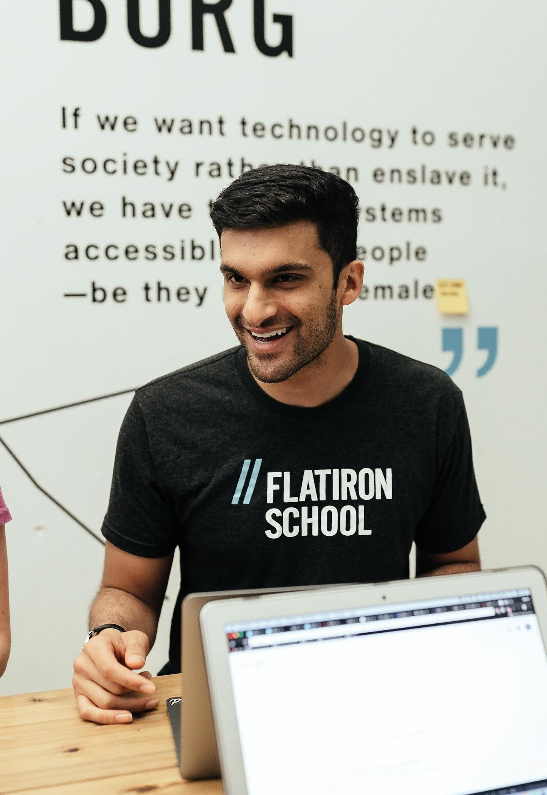
Agenda
Code

Slide 3


Code

Slide 4
Code
Jupyter Notebook
You’ll need a way to run a Jupyter notebook
  E.g., Anaconda, Colab, CodeRunner, VS Code
Data
Data is from the scikit-learn library

