Slide 1


Deep Learning with Normalization & Regularization
Notes:
“Deep learning powers image recognition, NLP, recommendations, and forecasting. But as networks get deeper, two problems creep in: unstable gradients and overfitting. In this lesson, we’ll see how normalization keeps learning stable and fast, and how regularization keeps models honest—generalizing beyond the training set. By the end, you’ll know when and how to apply each so your models train smoothly and make reliable predictions.

Slide 2
Why this matters
Deep learning drives image recognition, NLP, recommendations, forecasting
As models deepen, risk of vanishing/exploding gradients and overfitting rises
Normalization + Regularization = essential tools to
  Stabilize training
  Prevent memorizing noise
  Improve predictive reliability
Notes:
“When features come in on wildly different scales or activations drift layer to layer, training can stall or blow up. Normalization tackles that by keeping inputs and activations in friendly ranges, which smooths gradient flow and speeds convergence. Regularization fights the other battle—overfitting—so models don’t memorize noise. The combination is what turns a high-variance science project into a stable system you can ship.”

Slide 3
Normalization - Core Idea
Goal: Keep inputs & layer activations on stable scales
Benefits:
  Smooth gradient flow
  Faster convergence
  Balanced feature influence
Examples
  Feature scaling: standardization or min-max
  Batch normalization: normalizes activations between layers
Notes:
“Normalization means ‘put everything on a comparable scale.’ At the input level, that’s standardization or min–max scaling so no feature dominates. Inside the network, batch normalization keeps layer outputs well-behaved as they pass forward. The payoff: more predictable updates, fewer training headaches, and often fewer epochs to reach the same—or better—performance.”

Slide 4
Regularization - Core Idea
Goal: Constrain model complexity and improve generalization
Techniques
  L1/L2 weight decay: penalize large weights
  Dropout: randomly deactivate neurons turning training
  Early stopping: stop before overfitting begins
OUtcome: robust models that avoid memorizing training data
Notes:
“Regularization trims excess complexity so your network learns patterns, not noise. L1/L2 weight penalties keep weights from ballooning. Dropout randomly disables neurons during training, forcing the network to develop redundant, robust representations. And early stopping cuts training once the validation signal stops improving. Together, these techniques reduce variance and boost generalization.”

Slide 5
Putting it together - workflow
Data Exploration & Scaling — clean, analyze distributions
Model Architecture Design — plan normalization layers
Apply Regularization — L1/L2, dropout, early stopping
Training & Validation Loop — monitor loss & accuracy
Evaluation & Fine-tuning — adjust hyperparameters for stability & performance
Notes:
“Here’s a practical recipe you can reuse. One: explore and scale your data. Two: design the architecture and decide where normalization layers fit. Three: choose a regularization strategy—L1/L2, dropout, maybe early stopping. Four: run a training/validation loop, watching loss and accuracy curves. Five: fine-tune hyperparameters like learning rate, dropout rate, and weight decay for stability and performance. That’s the day-to-day loop of reliable deep learning.”

Slide 6
Industry Impact
Healthcare: MRI models more accurate with batch norm and dropout
Finance: credit risk models stable after scaling income, loans, scores
E-commerce: better recommendations across new and loyal customers via normalization + dropout
Notes:
“These ideas show up everywhere. In healthcare, medical imaging systems benefit from batch norm and dropout for steadier training on variable scans. In finance, scaling inputs like income and balances plus L2 regularization stabilizes credit risk models. In e-commerce, normalization balances heavy and light users, while dropout helps recommendations generalize to new customers. Same playbook, different data.”

Slide 7
Practical Tips
Always scale training data and apply the same transform to validation/test sets
Use batch normalization in deeper architectures to speed up training
Tune dropout and regularization strength– too much can underfit
Watch validation curves for early stopping clues
Notes:
“A few ground rules. Always fit your scaler on the training split and apply it to validation and test—no peeking. Use batch norm when your network is deeper or activations drift; it’s not mandatory for every tabular MLP. Start light with regularization and increase only if you see overfitting. And watch your validation curves—early stopping is an easy win that saves time and prevents regressions.”

Slide 8
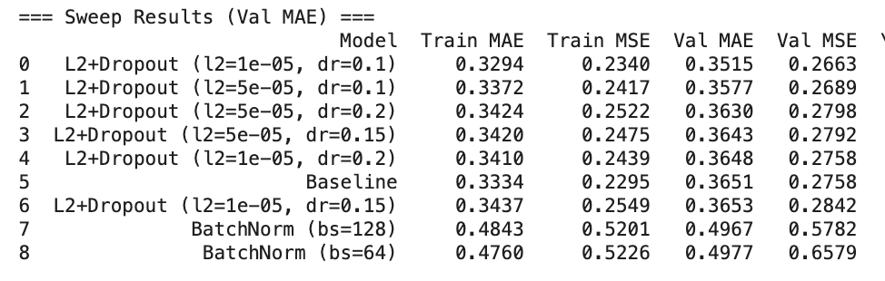
Sample Model Results
Notes:
“Here’s what this looks like in practice. On a standardized tabular task, a simple MLP can be tough to beat. In our runs, light L2 plus small dropout edged out the baseline, shrinking validation and test error a bit—exactly what you want from regularization. But batch norm underperformed here, which can happen with shallow MLPs and small-ish batches. The lesson: tune to the data. Normalization and regularization are tools, not defaults—use validation metrics to decide.”
Here’s the story your numbers tell:
hyperparameter sweep—you ran multiple model variants while “sweeping” over settings (e.g., L2 ∈ {1e-5, 5e-5}, dropout ∈ {0.1, 0.15, 0.2}, BN batch_size ∈ {64, 128}) and then compared them by validation MAE. “Sweep results” = summary of those trials.
1) Light regularization > baseline (small but real wins)
Best: L2+Dropout (l2=1e-05, dr=0.1)
Val MAE 0.3515 vs Baseline 0.3651 → ~3.7% lower ((0.3651−0.3515)/0.3651).
Test MAE 0.3510 vs Baseline 0.3591 → ~2.3% lower.
MSE drops similarly (Val: 0.2663 vs 0.2758; Test: 0.2646 vs 0.2716).
Interpretation: a light touch of L2 + modest dropout finds a sweet spot that reduces overfitting without adding much bias—exactly what regularization aims to do.
2) Heavier regularization starts to underfit
As dropout rises (0.15–0.20) and/or L2 increases (5e-05), Val/Test MAE creep up (rows 2–6).
Interpretation: push regularization too hard and you lose signal → higher bias.
3) BatchNorm underperforms here
BN variants are much worse (Val MAE ≈ 0.497).
Why this can happen on tabular MLPs:
You already standardized features; shallow MLP + small-ish batches can make BN’s batch stats noisy and volatile, hurting validation performance.
BN shines more in deeper conv/sequence models or when activations drift; here, it’s not needed.
Slide-ready takeaway (what to say)
“On standardized tabular data, light L2 + small dropout beat the plain MLP by ~3–4% on validation and ~2% on test. BatchNorm hurt in this shallow, small-batch setting—consistent with the idea that BN’s batch statistics can be volatile. Moral: tune regularization to the dataset; don’t assume BN helps by default.”
Why this matches the module’s guidance
Regularization (L1/L2, dropout) curbs overfitting and improves generalization when calibrated.
BN: helpful for stabilizing activations, but batch size matters; small batches can lead to unstable estimates and poorer validation results.
Process mindset: iterate with validation data, watch the curves/metrics, and adjust hyperparameters to balance stability vs. capacity.

Slide 9
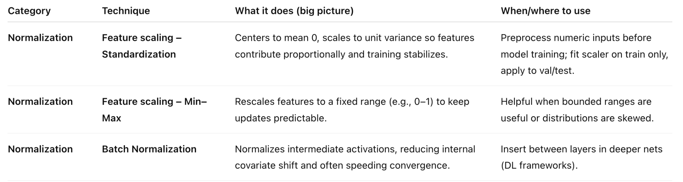
Common normalization techniques
Notes:
“Here’s what this looks like in practice. On a standardized tabular task, a simple MLP can be tough to beat. In our runs, light L2 plus small dropout edged out the baseline, shrinking validation and test error a bit—exactly what you want from regularization. But batch norm underperformed here, which can happen with shallow MLPs and small-ish batches. The lesson: tune to the data. Normalization and regularization are tools, not defaults—use validation metrics to decide.”
Here’s the story your numbers tell:
hyperparameter sweep—you ran multiple model variants while “sweeping” over settings (e.g., L2 ∈ {1e-5, 5e-5}, dropout ∈ {0.1, 0.15, 0.2}, BN batch_size ∈ {64, 128}) and then compared them by validation MAE. “Sweep results” = summary of those trials.
1) Light regularization > baseline (small but real wins)
Best: L2+Dropout (l2=1e-05, dr=0.1)
Val MAE 0.3515 vs Baseline 0.3651 → ~3.7% lower ((0.3651−0.3515)/0.3651).
Test MAE 0.3510 vs Baseline 0.3591 → ~2.3% lower.
MSE drops similarly (Val: 0.2663 vs 0.2758; Test: 0.2646 vs 0.2716).
Interpretation: a light touch of L2 + modest dropout finds a sweet spot that reduces overfitting without adding much bias—exactly what regularization aims to do.
2) Heavier regularization starts to underfit
As dropout rises (0.15–0.20) and/or L2 increases (5e-05), Val/Test MAE creep up (rows 2–6).
Interpretation: push regularization too hard and you lose signal → higher bias.
3) BatchNorm underperforms here
BN variants are much worse (Val MAE ≈ 0.497).
Why this can happen on tabular MLPs:
You already standardized features; shallow MLP + small-ish batches can make BN’s batch stats noisy and volatile, hurting validation performance.
BN shines more in deeper conv/sequence models or when activations drift; here, it’s not needed.
Slide-ready takeaway (what to say)
“On standardized tabular data, light L2 + small dropout beat the plain MLP by ~3–4% on validation and ~2% on test. BatchNorm hurt in this shallow, small-batch setting—consistent with the idea that BN’s batch statistics can be volatile. Moral: tune regularization to the dataset; don’t assume BN helps by default.”
Why this matches the module’s guidance
Regularization (L1/L2, dropout) curbs overfitting and improves generalization when calibrated.
BN: helpful for stabilizing activations, but batch size matters; small batches can lead to unstable estimates and poorer validation results.
Process mindset: iterate with validation data, watch the curves/metrics, and adjust hyperparameters to balance stability vs. capacity.

Slide 10
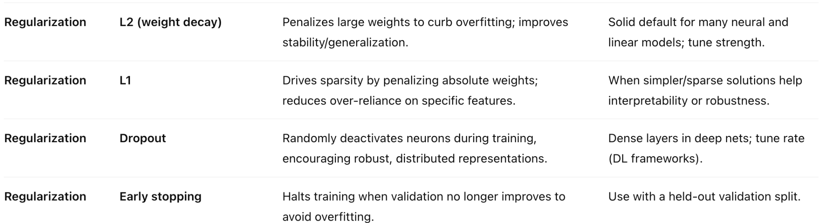
Common regularization techniques
Notes:
“Here’s what this looks like in practice. On a standardized tabular task, a simple MLP can be tough to beat. In our runs, light L2 plus small dropout edged out the baseline, shrinking validation and test error a bit—exactly what you want from regularization. But batch norm underperformed here, which can happen with shallow MLPs and small-ish batches. The lesson: tune to the data. Normalization and regularization are tools, not defaults—use validation metrics to decide.”
Here’s the story your numbers tell:
hyperparameter sweep—you ran multiple model variants while “sweeping” over settings (e.g., L2 ∈ {1e-5, 5e-5}, dropout ∈ {0.1, 0.15, 0.2}, BN batch_size ∈ {64, 128}) and then compared them by validation MAE. “Sweep results” = summary of those trials.
1) Light regularization > baseline (small but real wins)
Best: L2+Dropout (l2=1e-05, dr=0.1)
Val MAE 0.3515 vs Baseline 0.3651 → ~3.7% lower ((0.3651−0.3515)/0.3651).
Test MAE 0.3510 vs Baseline 0.3591 → ~2.3% lower.
MSE drops similarly (Val: 0.2663 vs 0.2758; Test: 0.2646 vs 0.2716).
Interpretation: a light touch of L2 + modest dropout finds a sweet spot that reduces overfitting without adding much bias—exactly what regularization aims to do.
2) Heavier regularization starts to underfit
As dropout rises (0.15–0.20) and/or L2 increases (5e-05), Val/Test MAE creep up (rows 2–6).
Interpretation: push regularization too hard and you lose signal → higher bias.
3) BatchNorm underperforms here
BN variants are much worse (Val MAE ≈ 0.497).
Why this can happen on tabular MLPs:
You already standardized features; shallow MLP + small-ish batches can make BN’s batch stats noisy and volatile, hurting validation performance.
BN shines more in deeper conv/sequence models or when activations drift; here, it’s not needed.
Slide-ready takeaway (what to say)
“On standardized tabular data, light L2 + small dropout beat the plain MLP by ~3–4% on validation and ~2% on test. BatchNorm hurt in this shallow, small-batch setting—consistent with the idea that BN’s batch statistics can be volatile. Moral: tune regularization to the dataset; don’t assume BN helps by default.”
Why this matches the module’s guidance
Regularization (L1/L2, dropout) curbs overfitting and improves generalization when calibrated.
BN: helpful for stabilizing activations, but batch size matters; small batches can lead to unstable estimates and poorer validation results.
Process mindset: iterate with validation data, watch the curves/metrics, and adjust hyperparameters to balance stability vs. capacity.

Slide 11
Key Takeaways
Normalization stabilizes training
Regularization builds generalizable models
Combined, they enable scalable, production-ready deep learning
Notes:
“Normalization stabilizes training and speeds learning. Regularization controls complexity so models generalize. Use a simple workflow: scale → design → regularize → validate → fine-tune. Let your validation results guide when to add batch norm and how much regularization to use. Mastering these fundamentals turns deep learning from fragile to production-ready

