Slide 1


RNNs & Time Series Data

Slide 2
RNNs & Time Series: The big picture
Recurrent Neural Networks (RNNs) handle sequences by keeping memory (hidden state) across time.
Ideal when order & context matter: text, time series, signals.
Used across finance, supply chain, healthcare, etc
Notes:
“Recurrent Neural Networks are built for sequences. They carry a hidden state forward, so each new prediction is informed by what came before. That’s why RNNs shine when order and context matter—think text, time series, and sensor signals—and why they show up in areas like finance, supply chain, and healthcare.”

Slide 3
Core building blocks & terms
Recurrent neuron / hidden state / time step
Weight sharing across time steps
Backpropagation Through Time (BPTT)
Vanishing gradients challenge in standard RNNs
Notes:
“Let’s align on vocabulary. A recurrent neuron processes one time step at a time while updating a hidden state. Parameters are shared across time, which keeps the model compact. Training uses Backpropagation Through Time, and a classic pitfall of vanilla RNNs is vanishing gradients on long sequences.”

Slide 4
Architectures that tackle long-term dependencies
LSTM: memory cell with input / output / forget gates
GRU: simplified gating with similar performance, fewer params
Bidirectional RNNs: process forward & backward
Seq2Seq: encoder–decoder for sequence inputs/outputs of different lengths
Notes:
“At each step we receive input, update the hidden state, and produce an output. That rolling hidden state is what gives RNNs their contextual memory. This simple loop is powerful for NLP, time-series forecasting, and sensor/signal applications where temporal dependence matters.”

Slide 5
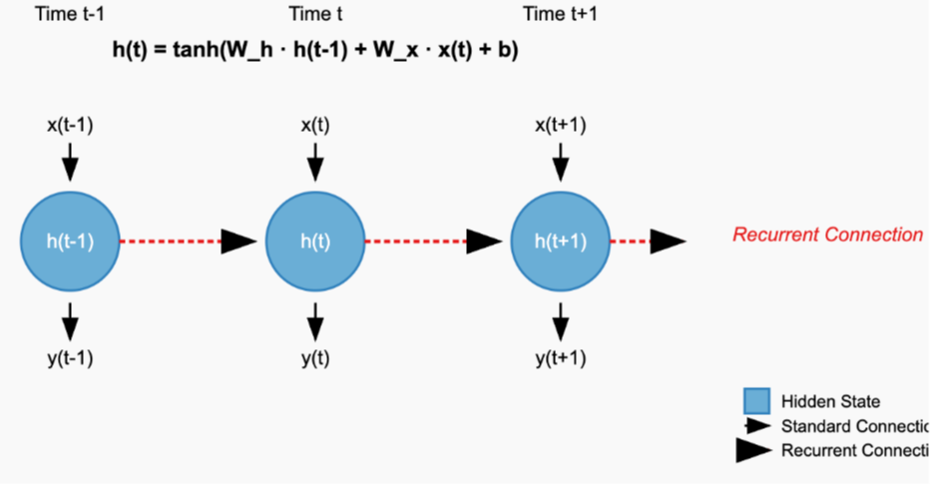
RNN Architecture
Notes:
“Use the architecture diagram to visualize time unfolding left-to-right: the same cell repeats at each step, passing its hidden state forward. Inputs stream in stepwise; outputs can be read stepwise as well. The key takeaways here are state propagation and weight sharing over time.”
Let’s break down the key components:
Time Dimension: The diagram shows three consecutive time steps - , , and , demonstrating how information flows through the network over time.
Hidden State (): The blue circles represent the hidden state at each time step. The hidden state is a key feature of RNNs that allows them to maintain information from previous time steps.
Equation: The top of the image shows the mathematical formula for computing the hidden state:
: Weight matrix for the previous hidden state
: Weight matrix for the current input
: Bias term
: Activation function that squashes values between -1 and 1
Connections:
Standard Connection (black arrows): From input to hidden state , and from hidden state to output
Recurrent Connection (red dotted arrows): From previous hidden state to current hidden state, allowing information to persist across time steps
Inputs and Outputs:
x(t) : Input at the current time step
y(t) : Output at the current time step
https://bletchley.instructure.com/courses/419/pages/what-are-recurrent-neural-networks?module_item_id=37552

Slide 6
How RNNs works: mechanism & significance
At each step: receive input → update hidden state → produce output
Internal state creates contextual memory over time
Powerful for NLP, time-series forecasting, sensor/signal tasks

Slide 7
RNN Process
Sequence Data Preparation (windows, normalization, lengths)
Architecture Design (choose RNN type; units/layers)
Configuration & Training (loss/optimizer; BPTT)
Evaluation & Validation (metrics; predicted vs actual)
Refinement & Deployment (iterate; real-world readiness)
Key considerations: sequence integrity, gradient management, generalization, reliability

Slide 8
Industry examples
JPMorgan Chase: LSTM forecasts → +23% accuracy; $38M annual savings
Walmart: multi-layer RNN → –30% out-of-stocks, –15% inventory costs
Mayo Clinic: RNN monitoring → detects 6 hours earlier, –65% false alarms
Notes:
“Real-world outcomes underscore the impact. JPMorgan Chase: LSTM forecasts delivered +23% accuracy and about $38M in annual savings. Walmart: a multi-layer RNN cut out-of-stocks by 30% and inventory costs by 15%. Mayo Clinic: RNN-based monitoring detected issues 6 hours earlier with 65% fewer false alarms.”

Slide 9
Case study: wind power forecasting
Data: turbine signals (wind speed, direction, temp, RPM, power)
Prep: sliding time windows, normalization, padding/truncation
Model: LSTM stack + dense layers; tune units to avoid under/overfit
Training: MSE loss, Adam; early stopping & checkpointing
Outcome: improved forecasts; deployment pipeline & continuous updates
Notes:
“In the wind-power example, inputs include turbine signals like wind speed, direction, temperature, RPM, and power. We build sliding time windows, normalize, and pad or truncate as needed. The model uses a stacked LSTM with dense layers—tuning units to avoid under- or overfitting—and trains with MSE, Adam, plus early stopping and checkpointing. Outcome: improved forecasts and a deployment pipeline with continuous updates.”

Slide 10
Common Challenges & Decision Points
Data prep: missing values, normalization, correct sequence windows
Architecture choice: LSTM vs GRU; sequence length; units/layers
Training issues: vanishing/exploding gradients; consider activation/clip; monitor loss
Overfitting: use proper splits, early stopping; evaluate on unseen data
Decisions: sequence length, train/test ratio, batch size trade-off
Notes:
“Watch for missing values and get normalization right; choose sensible window lengths. Decide between LSTM vs. GRU, number of layers, and units. Manage vanishing/exploding gradients—monitor loss and consider clipping when needed. Prevent overfitting with strong splits and early stopping. And weigh sequence length, train/test ratio, and batch size as deliberate trade-offs.”

