Slide 1


Multi-layer Perceptrons

Slide 2
Multi-Layer Perceptrons
Multi-layer perceptrons (MLP)
Foundational deep learning architecture
Handles both classification and regression tasks
We will use TensorFlow/Keras and PyTorch for implementation

Slide 3
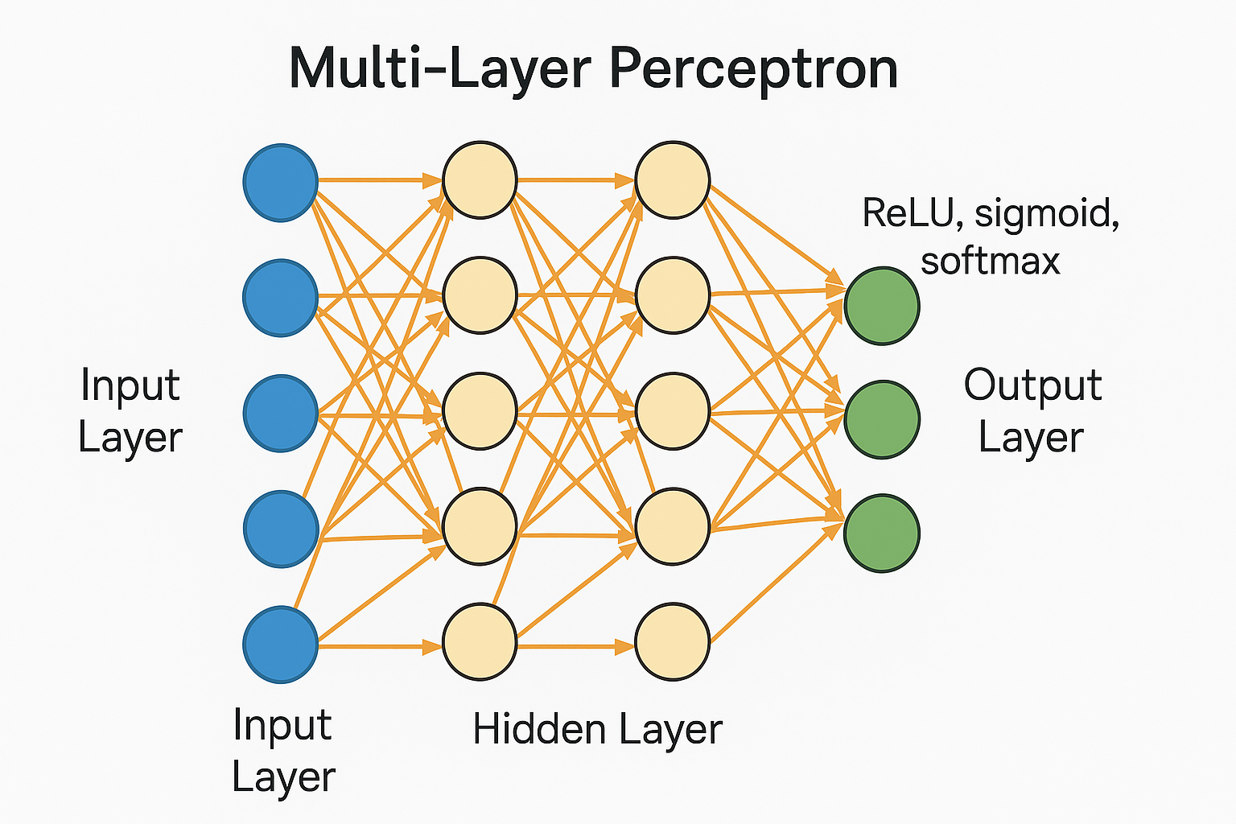
Notes:
1. Sigmoid
Formula: σ(x)=11+e−x\sigma(x) = \frac{1}{1 + e^{-x}}σ(x)=1+e−x1​
Output range: (0, 1)
Pros: Good for probabilities.
Cons: Saturates (gradients vanish for large |x|), not centered at zero.
2. Hyperbolic Tangent (tanh)
Formula: tanh⁡(x)=ex−e−xex+e−x\tanh(x) = \frac{e^x - e^{-x}}{e^x + e^{-x}}tanh(x)=ex+e−xex−e−x​
Output range: (-1, 1)
Pros: Zero-centered, stronger gradients than sigmoid.
Cons: Still suffers from vanishing gradients at extremes.
3. ReLU (Rectified Linear Unit)
Formula: f(x)=max⁡(0,x)f(x) = \max(0, x)f(x)=max(0,x)
Output range: [0, ∞)
Pros: Simple, efficient, reduces vanishing gradient issues, widely used in hidden layers.
Cons: Can cause “dying ReLU” problem (neurons stuck at 0).
4. Leaky ReLU
Formula: f(x)=max⁡(αx,x)f(x) = \max(\alpha x, x)f(x)=max(αx,x), with small α (e.g., 0.01)
Pros: Fixes dying ReLU problem by allowing small negative values.
Cons: Slightly more complex, α is a hyperparameter.
5. Softmax
Formula: softmax(zi)=ezi∑jezj\text{softmax}(z_i) = \frac{e^{z_i}}{\sum_j e^{z_j}}softmax(zi​)=∑j​ezj​ezi​​
Output range: (0, 1), sums to 1 across classes
Pros: Standard for multi-class classification in the output layer.
Cons: Computationally heavier, sensitive to large input values.
6. ELU (Exponential Linear Unit)
Formula: f(x)={xif x>0α(ex−1)if x≤0f(x) = \begin{cases} x & \text{if } x > 0 \\ \alpha(e^x - 1) & \text{if } x \leq 0 \end{cases}f(x)={xα(ex−1)​if x>0if x≤0​
Pros: Smooth, reduces bias shift, can outperform ReLU.
Cons: More computationally expensive.

Slide 4
Why MLPs matter?
Versatile: solve both classification & regression problems
Industry relevance: finance, healthcare, e-commerce
Framework diversity: exposure to PyTorch complements TensorFlow/Keras

Slide 5
Industry Applications
Healthcare (Mayo Clinic): disease prediction with patient data
Finance (JPMorgan Chase): credit risk assessment
E-commerce (Amazon): demand forecasting
Impact: improved diagnosis, better risk management, optimized supply chains

Slide 6
Defining MLPs
Input Layer → Hidden Layers → Output Layer
Classification: softmax/sigmoid activations for probabilities
Regression: linear activation for continuous outputs
Activation functions (ReLU, sigmoid, softmax) enable non-linear modeling

Slide 7
How MLPs work
Forward Propagation: input flows through weighted layers with activations
Backpropagation: weights updated via gradient descent to minimize error
Classification → categories (spam detection, medical diagnosis)
Regression → continuous predictions (housing prices, energy demand)

Slide 8
Process of building MLPs
Define dataset & preprocess features
Build architecture (layers, activations)
Choose loss function & optimizer
Train model with forward/backpropagation
Evaluate accuracy/error on validation data
Optimize hyperparameters for deployment

Slide 9
Deep Neural Networks vs. Multi-Layer Perceptrons: Similarities
Both consist of layers of neurons (input, hidden, output)
Use forward propagation and backpropagation for training
Rely on activation functions (ReLU, sigmoid, softmax) to capture non-linear patterns
Both can be applied to classification and regression tasks

Slide 10
Deep Neural Networks vs. Multi-Layer Perceptrons: Differences
MLPs are the simplest form of deep neural networks, typically fully connected with dense layers
Deep NNs can include specialized architectures (CNNs for images, RNNs for sequences, Transformers for NLP)
MLPs handle structured/tabular data well, while deep NNs often excel in complex, high-dimensional data (e.g., images, text, audio)
Deep NNs can be much deeper and more complex, requiring advanced techniques for stability (batch norm, residual connections)

Slide 11
Example – E-commerce
Predict purchase likelihood (classification)
Predict purchase amount (regression)
Implemented with PyTorch:
Insights inform marketing strategy & personalized offers

Slide 12
Comparing frameworks
TensorFlow/Keras
  Concise, high-level APIs (Sequential, fit())
  Great for rapid prototyping
PyTorch
  More explicit training loops (manual forward/backward passes)
  Provides flexibility and granular control
Performance: Both frameworks yield comparable results on regression & classification tasks

Slide 13
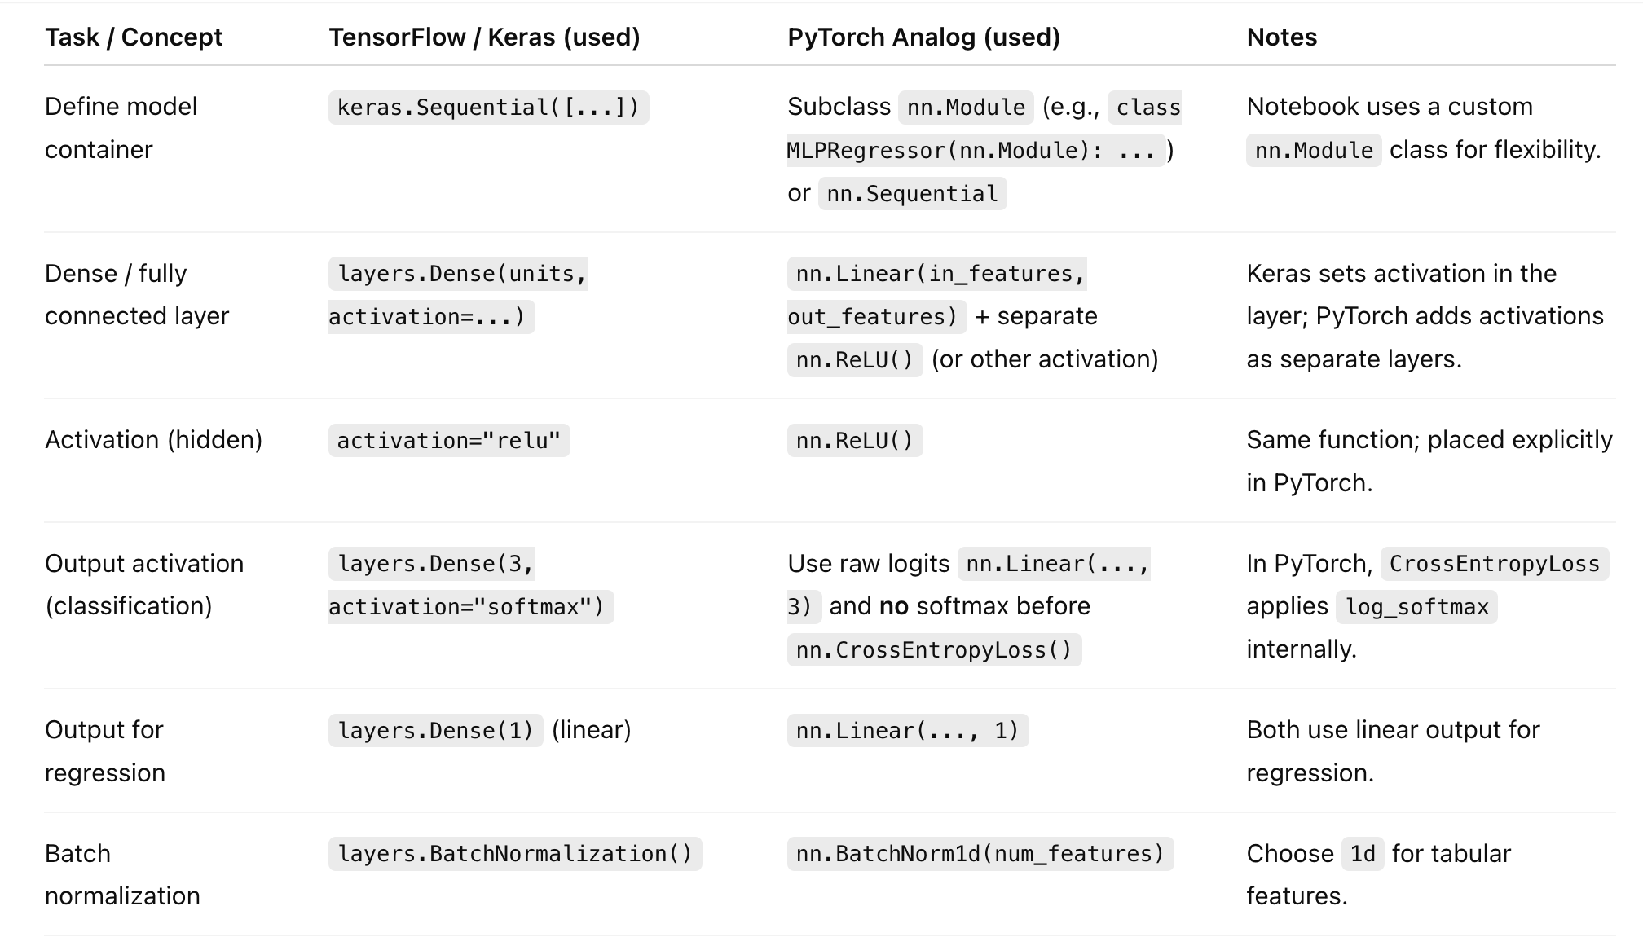
Some comparisons between frameworks

Slide 14
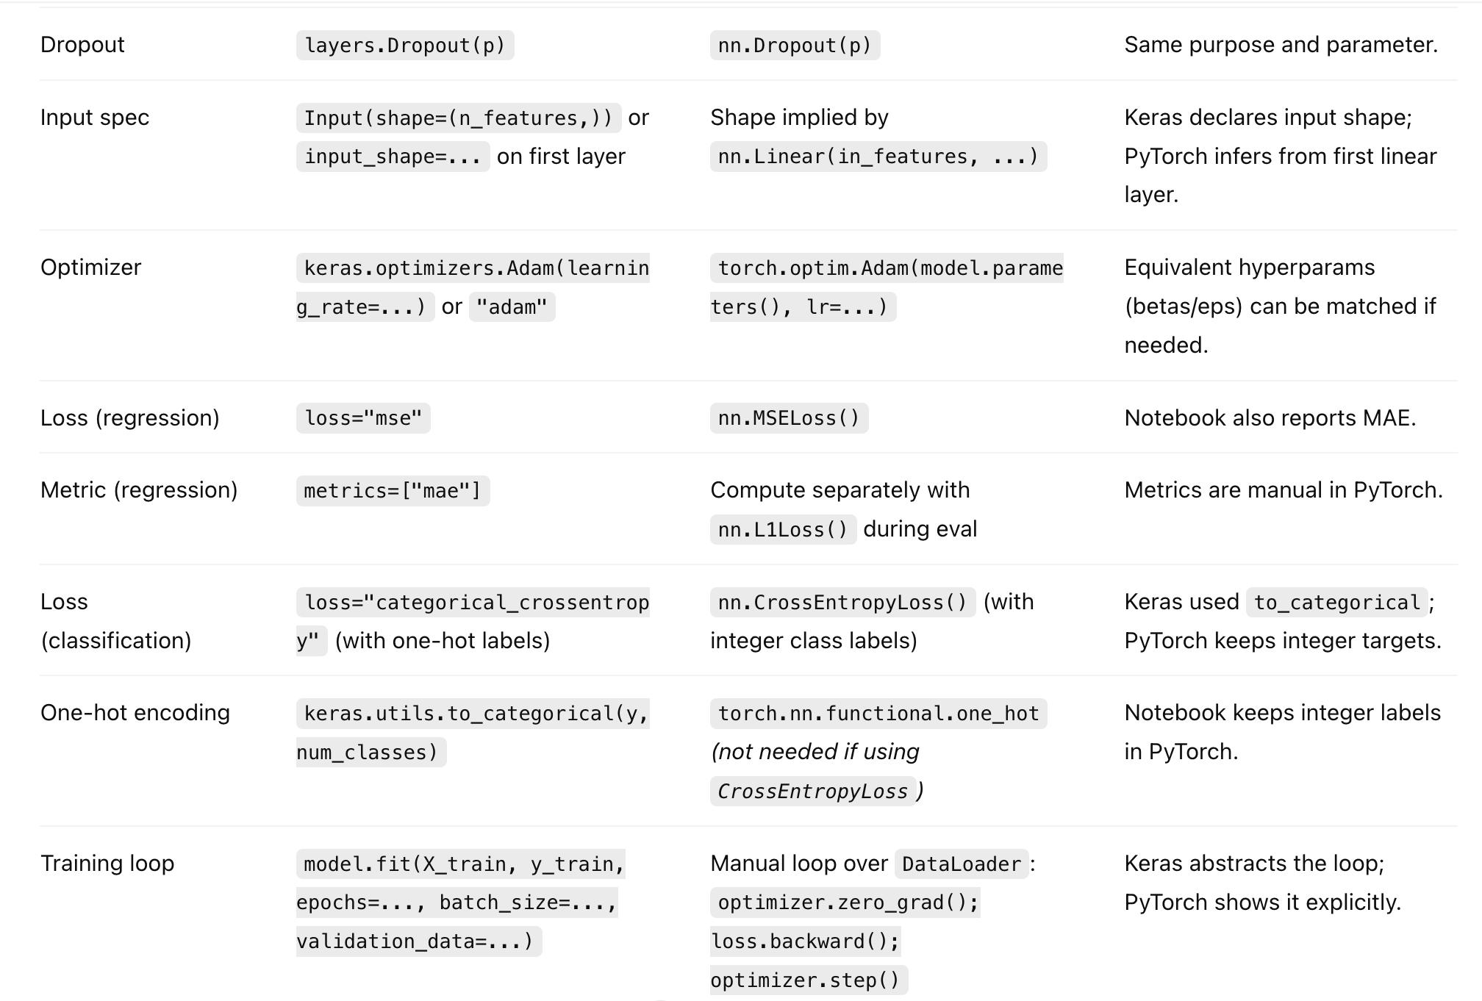
Some comparisons between frameworks

Slide 15
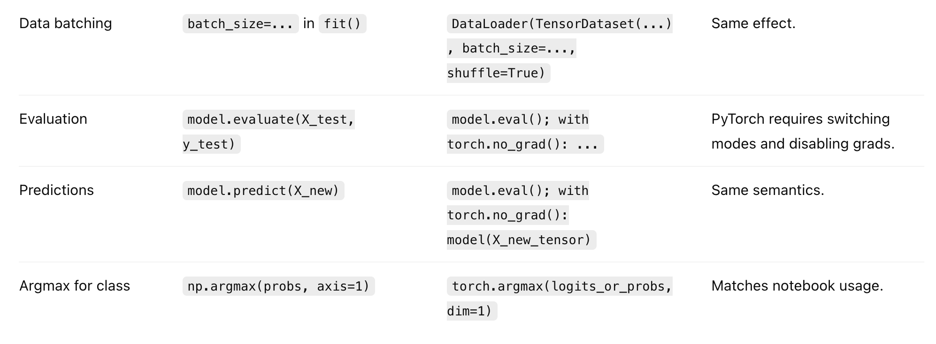
Some comparisons between frameworks

Slide 16
Key Takeaways
MLPs are core deep learning models for structured data
Both TensorFlow/Keras and PyTorch are valuable tools
Industry examples show wide applicability
Hands-on skills: architecture design, training, evaluation, tuning
Next steps: normalization & regularization to improve models

