Slide 1
ML PROJECT
E-Commerce Purchase Prediction
Predicting transaction value from customer, cart and delivery signals
D. Gourisankar Mohanty | Regression · Python · Scikit-learn
Notes:
Introduce the project: a regression model estimating how much a customer spends on a given e-commerce order, built end to end from a deliberately messy raw dataset.

Slide 2
Why predict transaction value?
Dynamic discounting
TARGET VARIABLE
1
Size the discount to the expected basket value instead of applying one flat rate to every customer.
Transaction_Amount
Continuous value, in currency units — making this a regression problem rather than classification.
Logistics cost forecasting
2
Anticipate delivery cost exposure by pairing predicted order value with delivery distance.
11 predictive features
5,055 raw transactions
Customer, cart, delivery and seasonal context
Inventory planning
3
Understand which categories and customer segments carry the highest spend.
Notes:
Frame this as the retailer's problem, not an academic exercise. Accurate spend prediction feeds discount strategy and logistics forecasting directly.

Slide 3
The dataset at a glance
A deliberately messy extract — data quality work is part of the brief
5,055
12
680
19
Raw transactions
Columns (11 + target)
Missing cells across 6 columns
Features after engineering
Numerical features
Categorical features
Customer_Age · Membership_Years
Items_In_Cart · Discount_Pct
Delivery_Distance_KM
Product_Category · Payment_Method
Season · Day_Of_Week
Is_Premium_Member (binary)
Notes:
5,055 rows, 12 columns. The dataset was supplied intentionally dirty, so cleaning decisions are a graded part of the work rather than a preamble to it.

Slide 4
What the raw data was actually hiding
16 → 4
10 → 2
46
payment method variants
membership flag variants
negative delivery distances
'UPI', 'upi', ' Debit card ', 'CREDIT CARD' — case and whitespace collapsed to four real categories.
Beyond case, 'Y' and 'N' shorthand sat alongside 'Yes' and 'No' — a separate encoding, not a case fix.
Physically impossible. Magnitudes matched the legitimate range, so treated as a sign-flip error.
101
25
55
discounts stored as text
rows missing the target
duplicate OrderIDs
Values like '4.8%' mixed with plain numbers, forcing the column to load as a string, not a number.
Dropped rather than imputed — imputing a label fabricates ground truth and biases the model.
Same identifier, different row data — flagged and investigated rather than blindly de-duplicated.
Notes:
This is the slide that separates this from a textbook exercise. Sixteen spellings of four payment methods and a percent sign hiding inside a numeric column are the kind of thing only hands-on work surfaces.

Slide 5
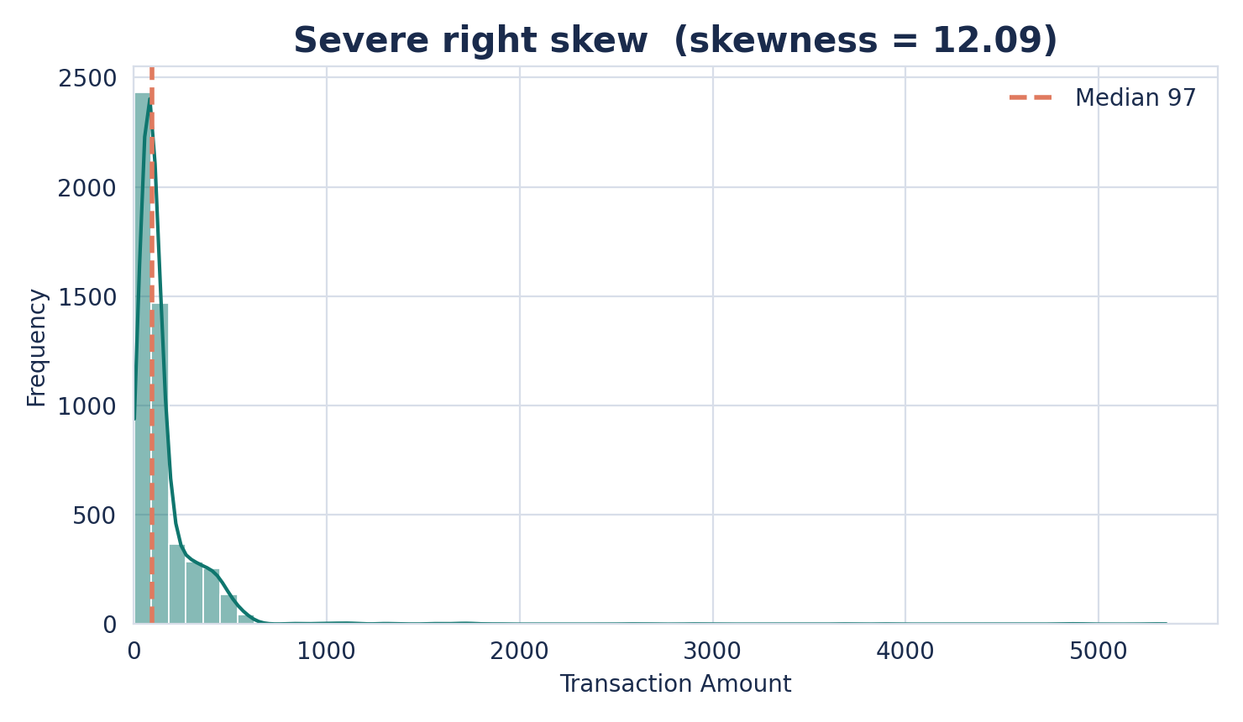
The target is severely right-skewed
Skewness
12.09
Anything above 1 counts as highly skewed; above 3 is considered extreme.
Median
97
Mean
155
Maximum
5,349
Notes:
Mean sits well above median — the classic right-skew signature. A handful of very large orders stretch the tail to 5,349 while the typical order is under 100.

Slide 6
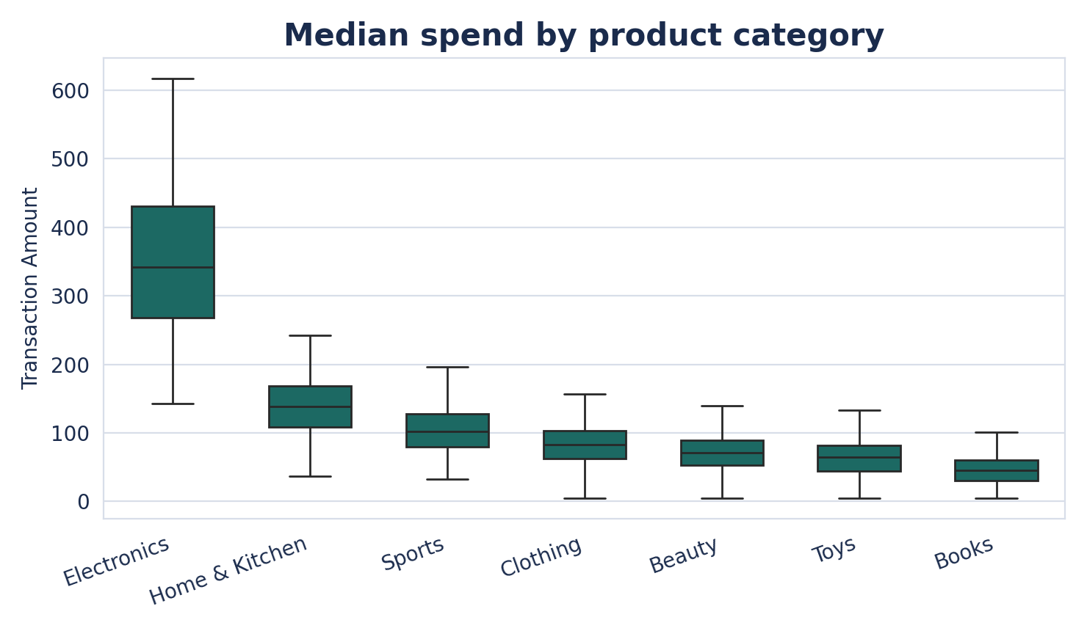
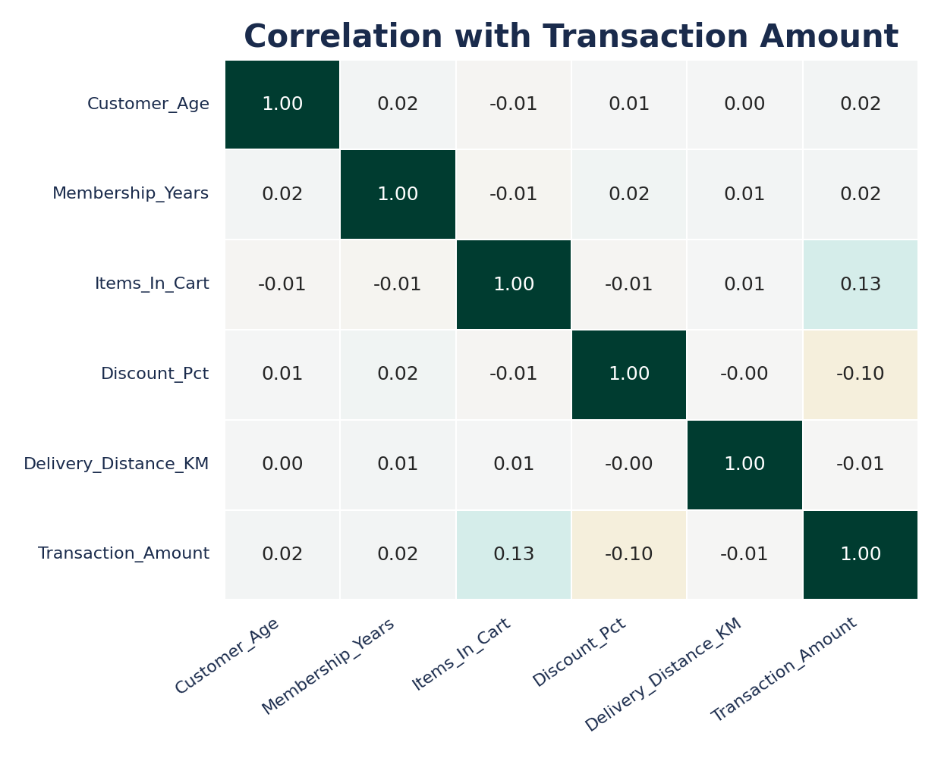
Where the spend concentrates
Electronics carries the highest median spend and the widest spread. Among numeric features, Items_In_Cart correlates most strongly with transaction value (r = 0.13) - weak in isolation, which is an early hint that the relationship is non-linear and interaction-driven.
Notes:
No single feature shows a strong linear correlation with the target. That matters later: it foreshadows why a linear model underperforms here.

Slide 7
From raw file to model-ready matrix
Each decision documented, with the reasoning behind it
Cleaning decisions
Engineered features
Lowercased and stripped categorical text, then mapped Y/N to Yes/No
Stripped '%' from Discount_Pct and cast to numeric
Flipped negative distances to positive after confirming magnitudes were plausible
Dropped 25 rows with a missing target
Mean for numeric gaps, mode for categorical gaps
spend_per_item
Transaction value divided by cart size
is_weekend
Binary flag for Saturday and Sunday orders
loyalty_segment
New / Regular / Loyal, label-encoded to preserve order
One-hot encoding
Category, payment and season — no clear ranking implied
Notes:
Ordinal versus nominal is the key distinction: loyalty_segment is label-encoded because New to Loyal has a real order; payment method and category are one-hot encoded because they do not.

Slide 8
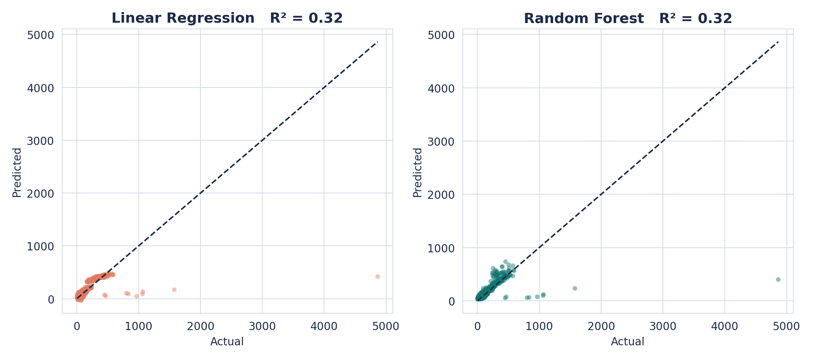
Random Forest edges ahead
Error reduction
Random Forest has a lower average error (MAE) than Linear Regression.
Overfitting check
For both the models, train-test gap is not high, a healthy, small gap.
R² and RMSE are essentially tied between the two models; MAE is where Random Forest pulls ahead.
Model | Train R² | Test R² | MAE | RMSE
Linear Regression | 0.277 | 0.322 | 44.16 | 166.32
Random Forest (tuned) | 0.378 | 0.316 | 39.19 | 167.07
Notes:
Be precise in the room: R2 and RMSE are a virtual tie, within noise of each other. The real, defensible edge for Random Forest is the lower MAE — about 11% lower average error on a typical prediction.

Slide 9
Recommendation
Deploy Random Forest Regressor
Why
As we can see, both models have almost the same R² value and almost the same RMSE value, this is because both metrics are sensitive to outliers, and we have some very extreme outliers in this dataset. The noticeable difference shows up in MAE (Mean Absolute Error), where Random Forest gives a lower error. This is because MAE is less dominated by extreme outliers, so it gives a more reliable measure of how the model performs on a typical transaction. This is why we should go with the Random Forest Regressor for this dataset.
Notes:
Close by being precise about what the tuned model earns you: MAE is the metric that genuinely favours Random Forest, R2 and RMSE are a virtual tie. Then leave the room with concrete next steps for both models, not just the winner.

