Slide 1


Breakout game with controller using Matter over Thread
By Bart Gysen

Slide 2
Goals
Knowledge
Demo

Slide 3
Contents
Project overview
Matter
OpenThread
Game controller
Matter controller
Breakout game
Q&A

Slide 4
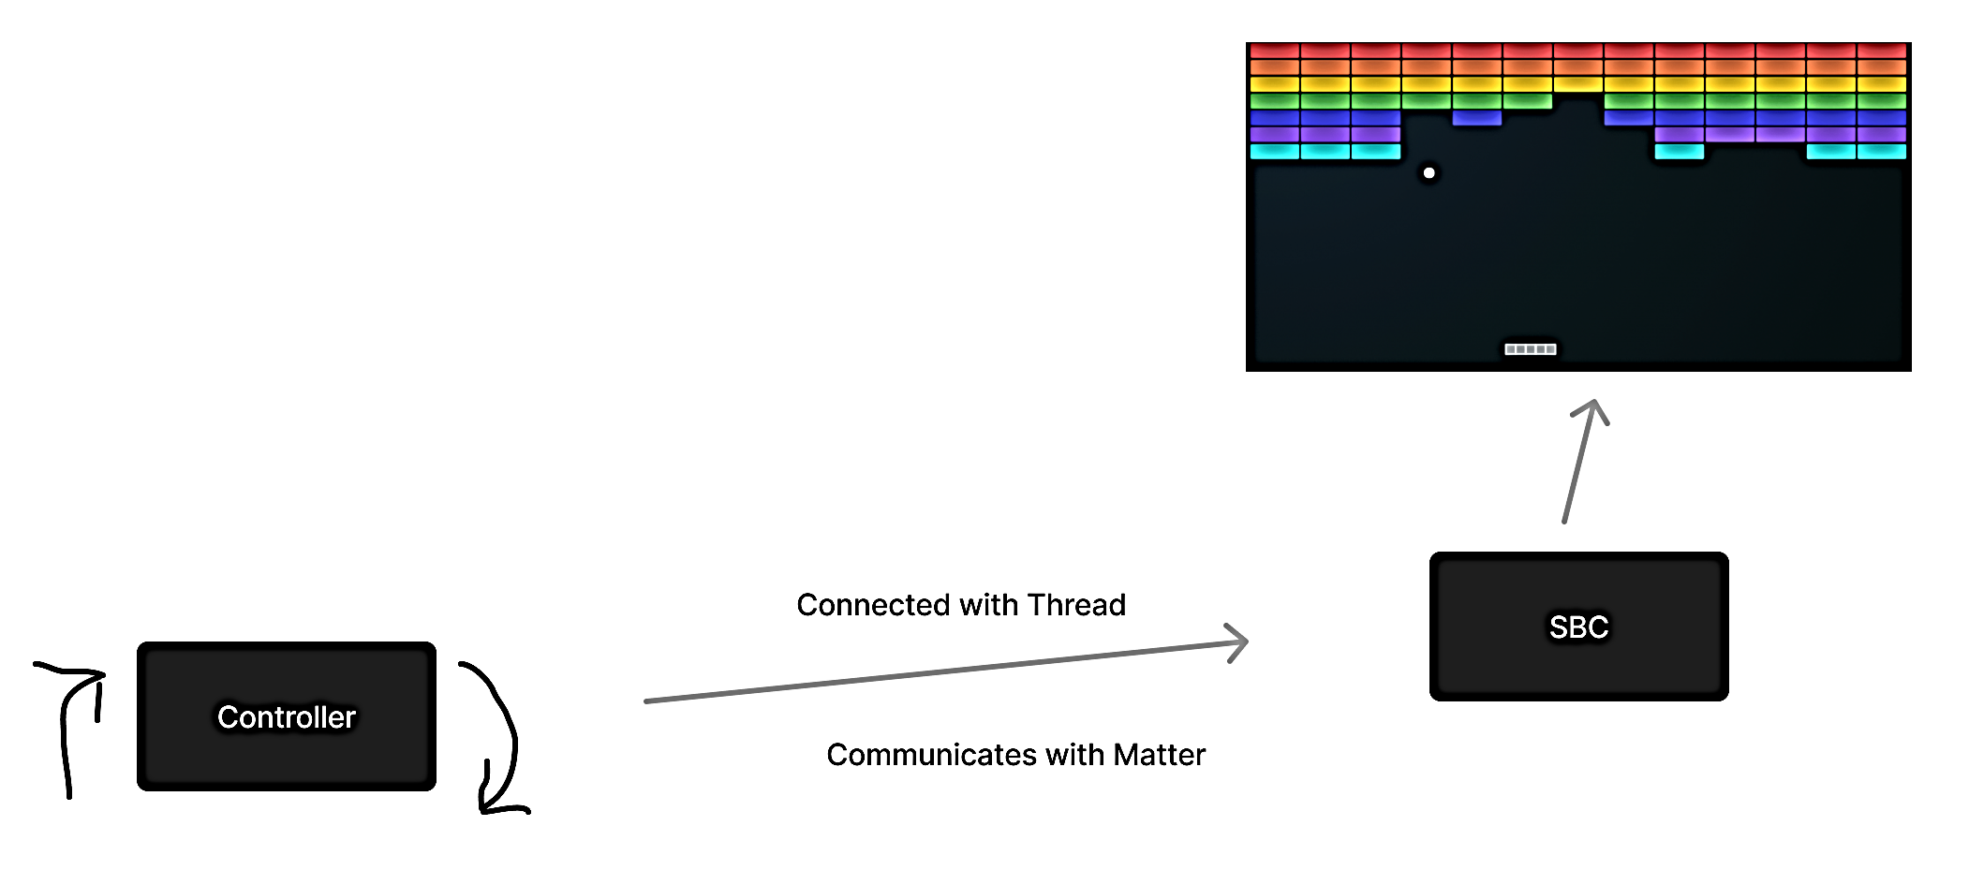
Project overview
Matter demo
Breakout game
Controlled with motion

Slide 5
Matter - contents
About
Architecture
Data Model
Interaction Model
Network
Security
Commissioning
Hub & Bridge
CSA membership & certification
Develop with Matter

Slide 6
Matter - About
Open source connectivity standard for the smart home
Connectivity Standards Alliance
Connected Home over IP (CHIP)
interoperability and compatibility
Reliability
Secure
First official release V1.0 in September 2022
Release V1.1 in May 2023 – bug fixes and SDK improvements
Release V1.2 in October 2023 – expanding with new device types
Notes:
CSA formerly Zigbee Alliance Rebranding in 2021

Slide 7
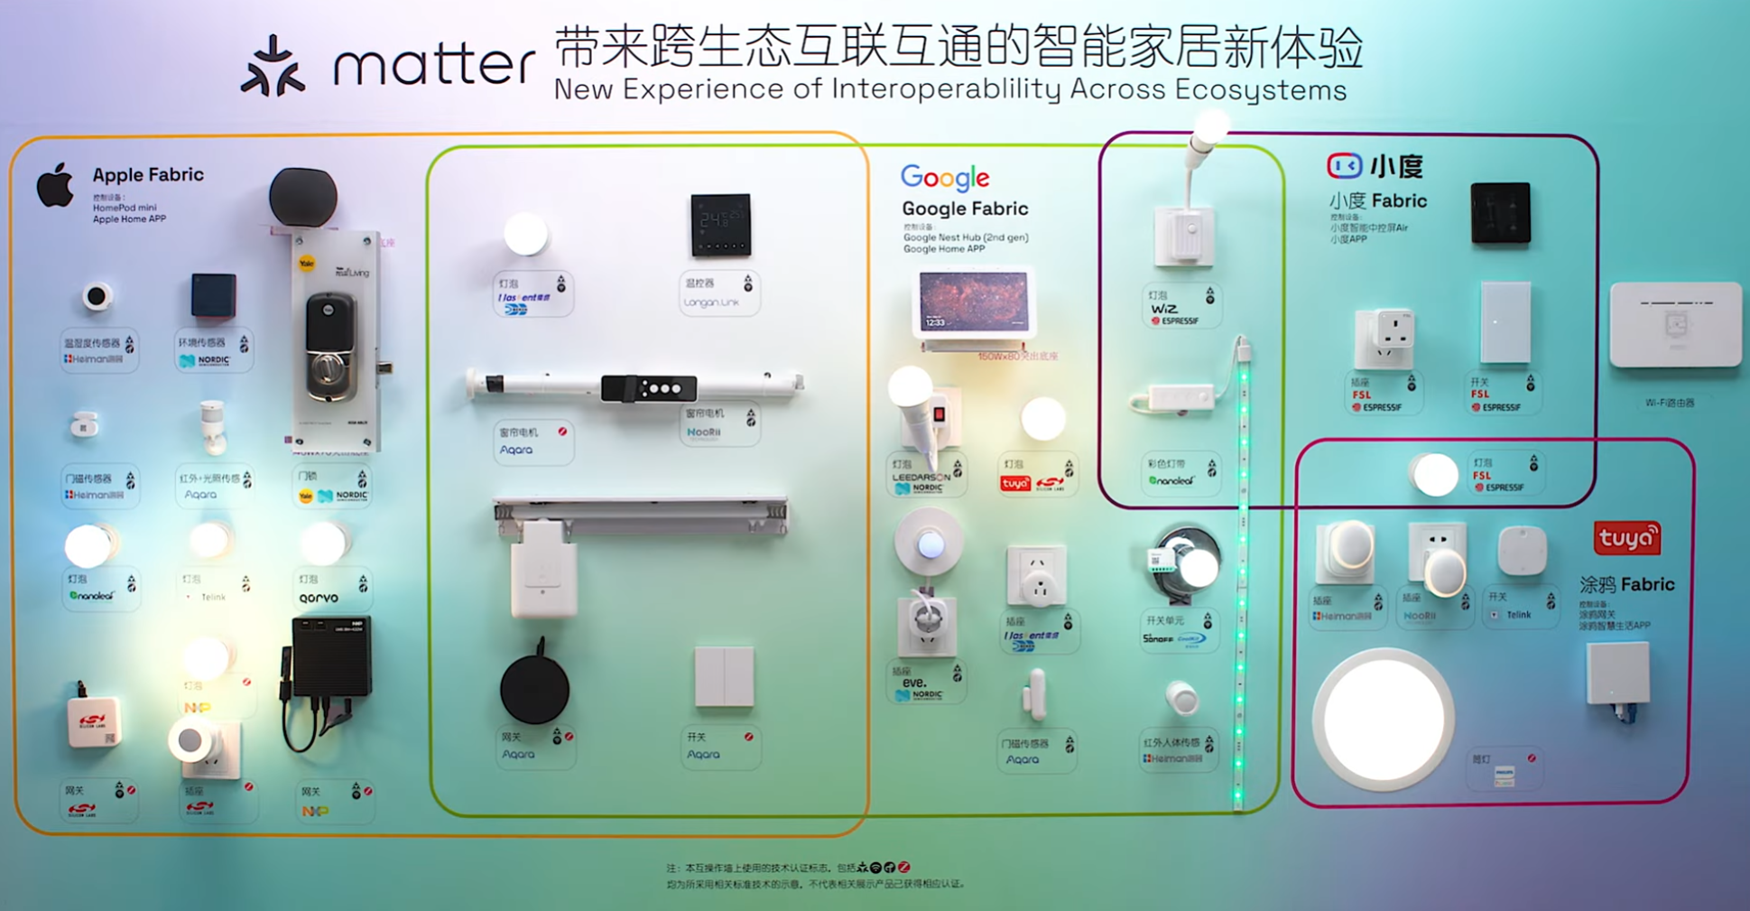

Slide 8
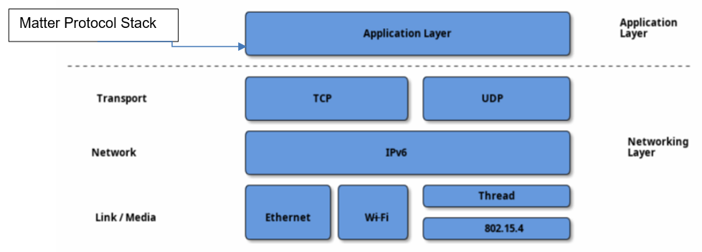
Matter – Architecture
Notes:
Application layer TCP/IP mode

Slide 9
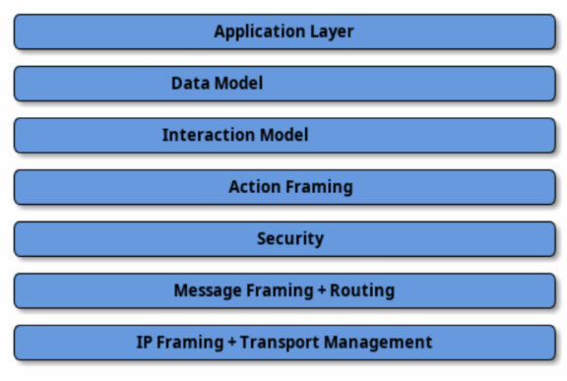
Matter – Architecture
STUDY THIS!!!!!
Notes:
Divided into layers

Slide 10
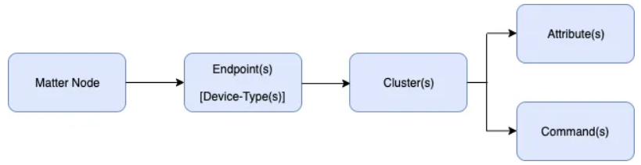
Matter – Data Model - Concept
Hierarchical model
Device features

Slide 11
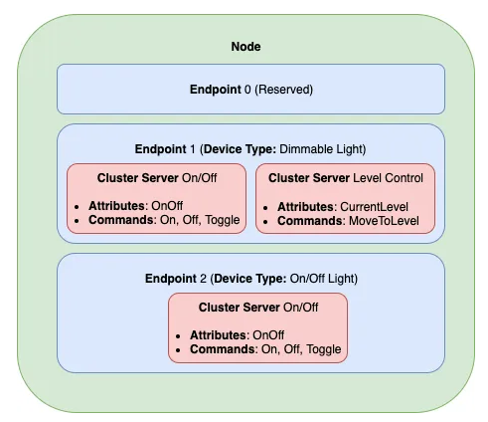
Matter – Data Model - Node
Uniquely addressable entity
Set of behaviors
One or more endpoints
Commissioner
Controller
Controlee
OTA Provider
OTA Requestor

Slide 12
Matter – Data Model - Endpoint
Set of functionality’s
Contains clusters

Slide 13
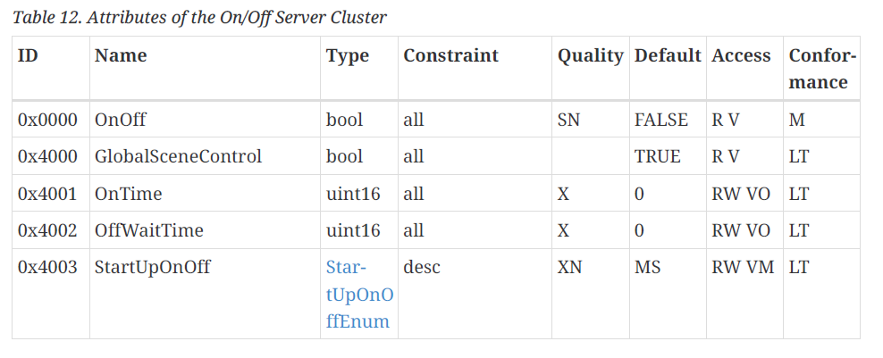
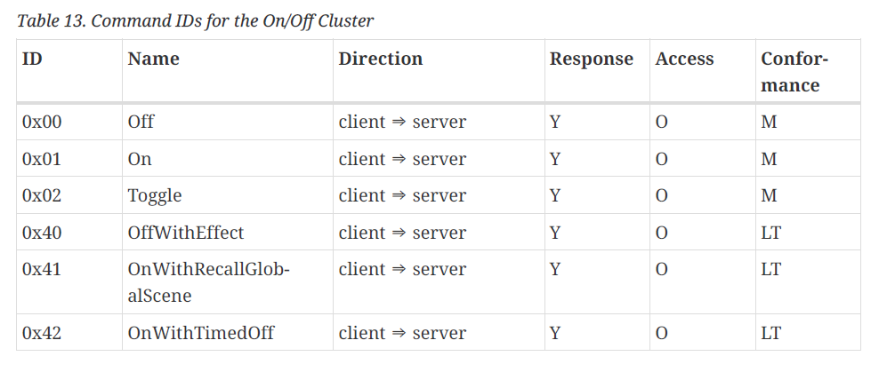
Matter – Data Model - Cluster
Reusable building blocks
Grouping commonly used functionality
Commands
Attributes
Events
Application cluster specification

Slide 14
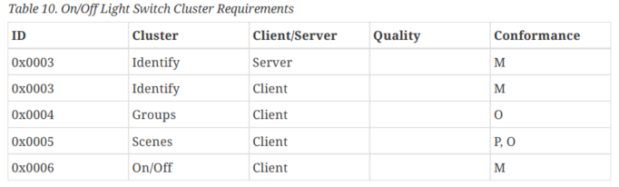
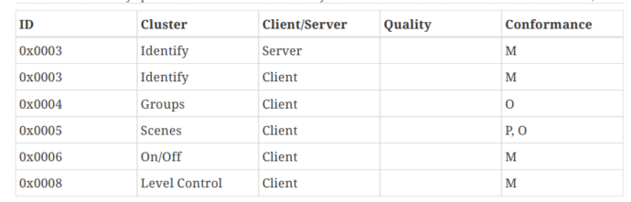
Matter – Data Model – Device Type
Officially defined collection of requirements
Intended to ensure interoperability
Device library specification

Slide 15
Matter – Data Model – Custom Cluster
Designed to add functionalities
Reusing or extend a existing cluster will only work with custom controller
A new cluster specification only possible with a least an adoption-level member

Slide 16
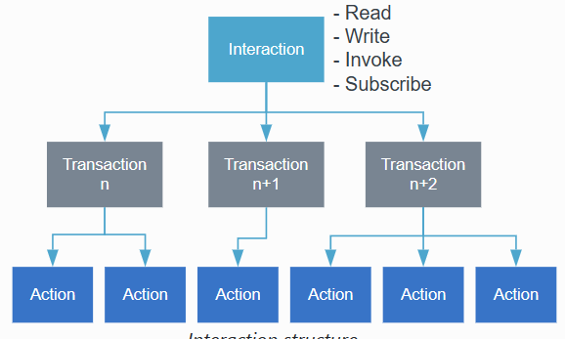
Matter – Interaction Model
Defines the methods of communication
Communicates through interactions that are a sequence of transactions
Transactions are a sequence or actions
Initiators - Targets
4 types of interaction
Read
Write
Invoke
Subscribe
Notes:
Every interaction except Subscribe consists of one transaction

Slide 17
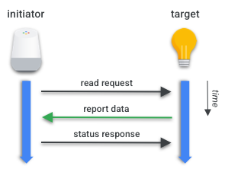
Matter – Interaction Model – Read
Get attributes and/or events
Restricted to unicast
Initiator requests a list of attributes and/or events
Target responds with requested list and a suppress response flag
Initiator generates a status response, not send when suppress response flag is set

Slide 18
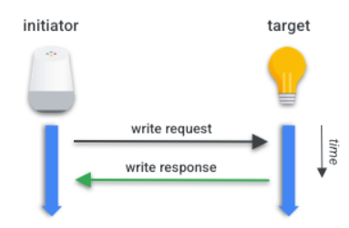
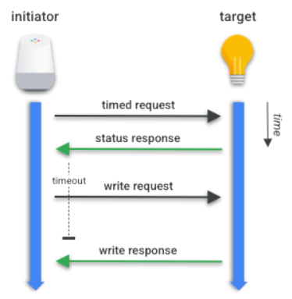
Matter – Interaction Model - Write
Modify values of attributes
Untimed or Timed transaction
Untimed two actions
Timed four actions
Notes:
Write action = Write request, Timed Request, Suppress Response flag

Slide 19
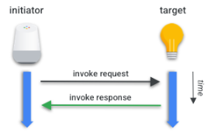
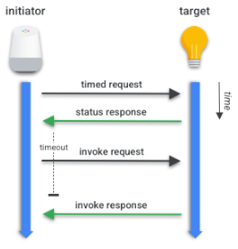
Matter – Interaction Model - Invoke
To invoke commands
Similar to write interaction
Untimed / Timed
Notes:
Used for e.g. By the controller to invoke one of the commands of the data link layer.

Slide 20
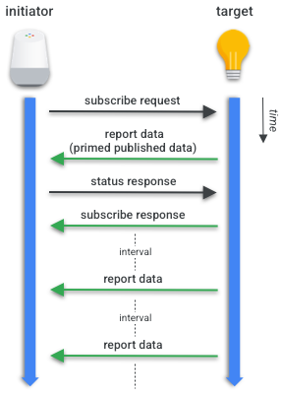
Matter – Interaction Model - Subscribe
Used to automatically receive updates
Restricted to unicast
Initiator send the request
Target respond with first batch of data
Will be checked with status and subscribe response

Slide 21
Matter – Network
IPv6
Focus on three link layer technologies
Single Network Topology
Star Network Topology
Notes:
The Matter protocol can operate without a globally-routable IPv6 infrastructure and allows the flexibility of having multiple Matter networks run over the same set of constituent IP Networks.

Slide 22
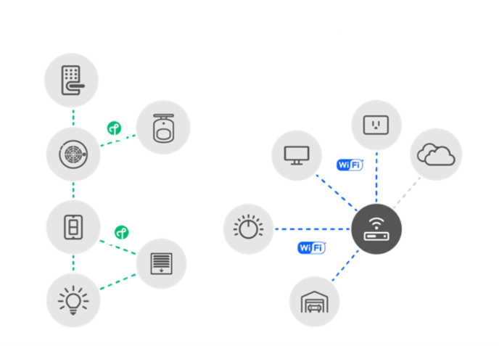
Matter – Network – Single Network Topology

Slide 23
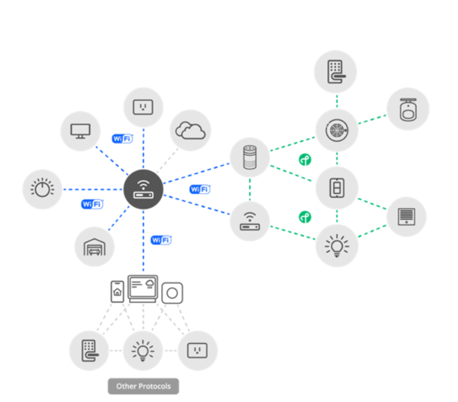
Matter – Network – Star Network Topology

Slide 24
Matter - Commissioning
Pairing method
Performed over BLE
Controller needs onboarding payload:
QR Code
QR Code Payload used in command line tools
Manual pairing code
Security steps

Slide 25
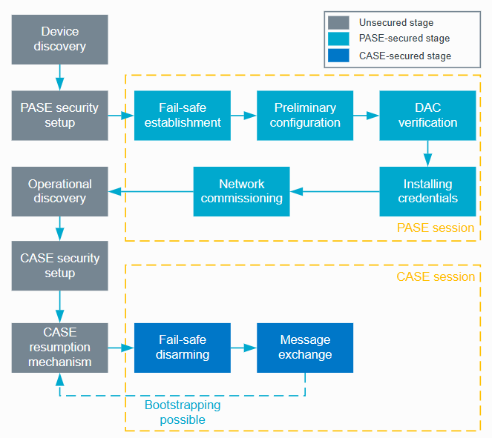
Matter - Commissioning

Slide 26
Matter – Fabric
The whole network
Sharing the same security domain

Slide 27
Matter – Multiple Fabrics
Notes:
Specification

Slide 28
Matter – Hub & Bridge
Hub
Bridge
Serves as controller
Not tied to ecosystem
Often functions as Border Router
Add more flexibility
Acts as translator for non-Matter devices

Slide 29
Matter – CSA Membership & certification
Membership necessary for certifying
Official resources
Authorization to contribute
Unique Vendor ID

Slide 30
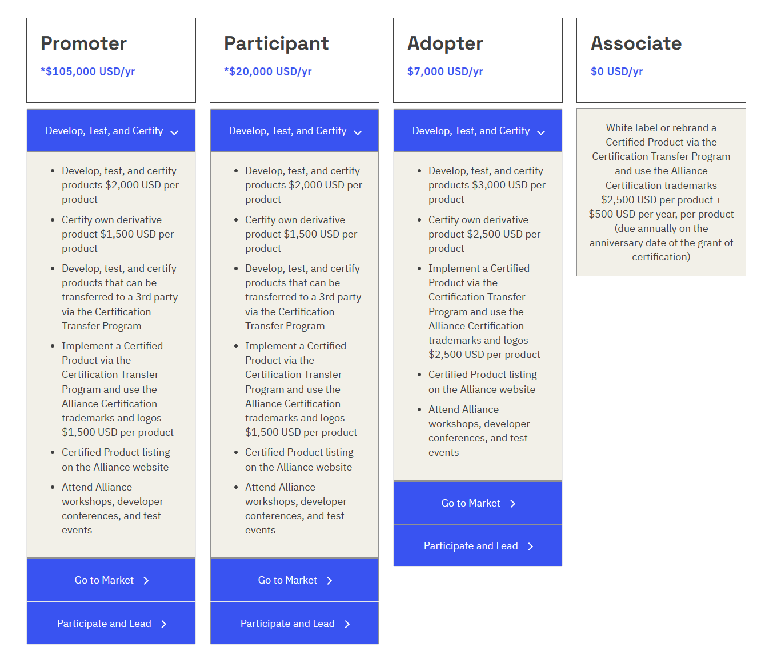

Slide 31
Matter – Develop with Matter
Github project-chip
SDK
Documentation
Certification tool
Manufacturer SDK
Manufacturer IDE
A lot of examples you can use

Slide 32
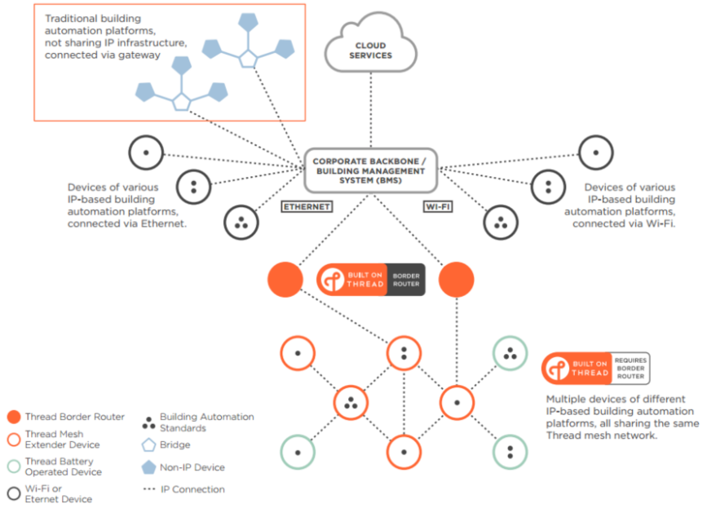
OpenThread
Mesh Network-protocol
IPv6
Low-power
Ideal for smart-home devices
Border Router

Slide 33
Game controller

Slide 36
Q&A

