Slide 1


Breakout game with controller using Matter over Thread
By Bart Gysen

Slide 2
Goals
Knowledge
Demo

Slide 3
Contents
Project overview
Matter
OpenThread
Accelerometer
Controller application

Slide 4
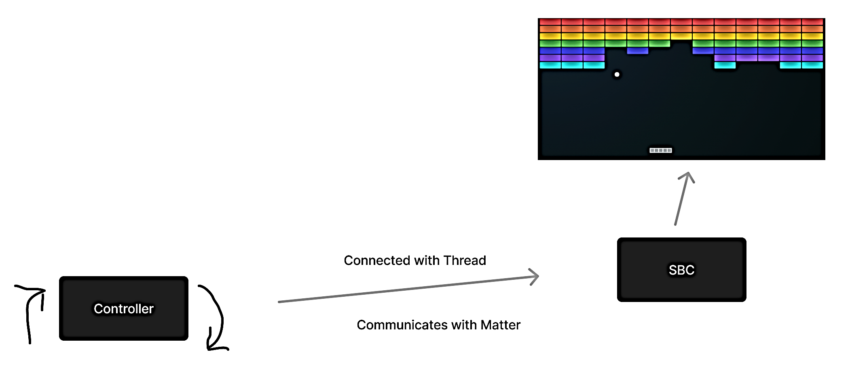
Project overview
Matter demo
Breakout game
Controlled with motion

Slide 5
Matter - contents
About
Network
Data Model
Interaction Model
Security
Commissioning
Hub & Bridge
CSA membership & certification
Hardware
Develop with Matter

Slide 6
Matter - About
Open source connectivity standard for the smart home
Connectivity Standards Alliance
Connected Home over IP (CHIP)
interoperability and compatibility
Reliability
Secure
Easy to use
First official release V1.0 in September 2022
Release V1.1 in May 2023 – bug fixes and SDK improvements
Release V1.2 in October 2023 – expanding with new device types
Notes:
CSA formerly Zigbee Alliance Rebranding in 2021

Slide 7
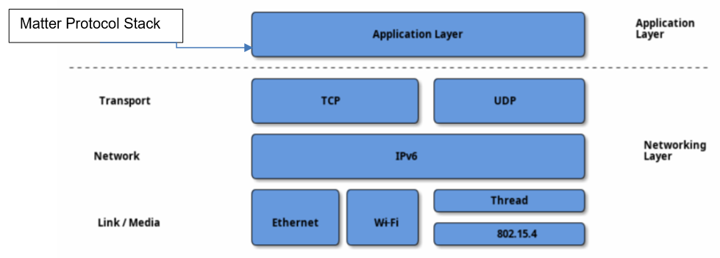
Matter – Network
Notes:
Application layer TCP/IP mode

Slide 8
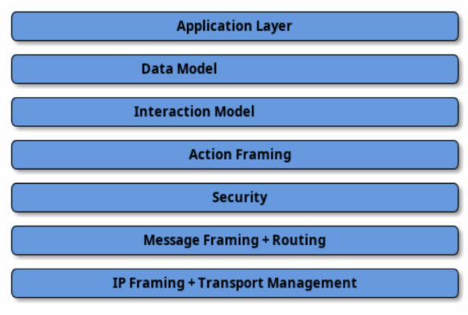
Matter – Network
STUDY THIS!!!!!
Notes:
Divided into layers

Slide 9
Matter – Network
IPv6
Focus on three link layer technologies
Single Network Topology
Star Network Topology
Multiple fabrics possible
Notes:
The Matter protocol can operate without a globally-routable IPv6 infrastructure and allows the flexibility of having multiple Matter networks run over the same set of constituent IP Networks.

Slide 10
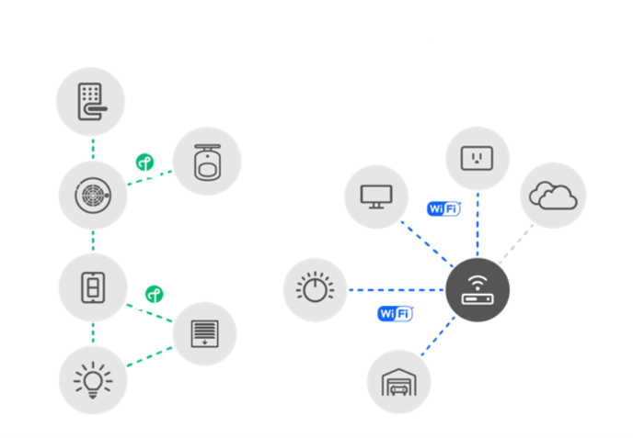
Matter – Network – Single Network Topology

Slide 11
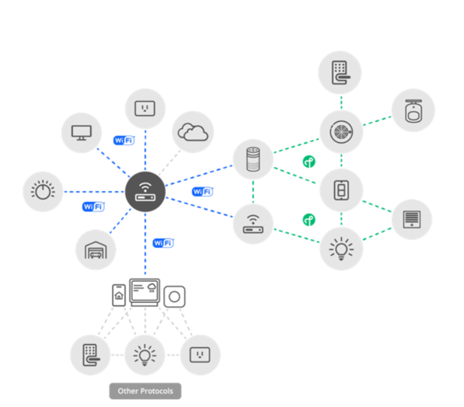
Matter – Network – Star Network Topology

Slide 12
Matter – Network – Fabric

Slide 13
Matter – Network – Multiple fabrics

Slide 14
Matter – Data Model

Slide 15
Matter – Interaction Model

Slide 16
Matter - Security

Slide 17
Matter - Commissioning

Slide 18
Matter – Hub & Bridge

Slide 19
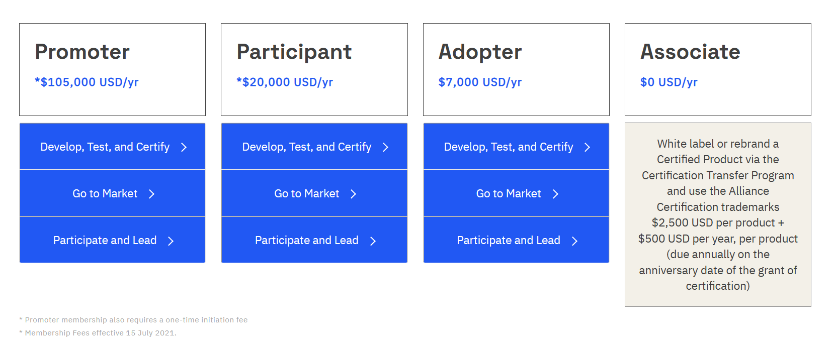
Matter – CSA Membership & certification

Slide 20
Matter – Hardware

Slide 21
Matter – Develop with Matter

Slide 22
OpenThread
IPv6 mesh network
Low-power

