Slide 1
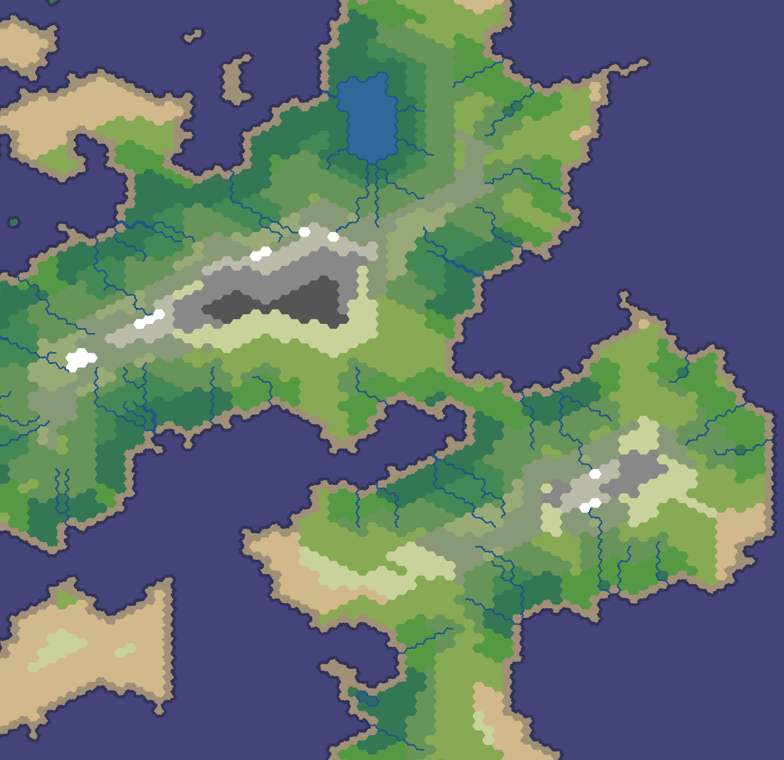
Rulers of Kepler
By Gábor Borics-Kürti, Cristian Chirion, Viktor Taskov, Petar Petrov, Aleksejs Panfilovs

Slide 2
Project Overview
photo of the game

Slide 3
Design Specification Issues
Merging conflicts?
Model changes (had to change er diagram)

Slide 4
Technologies used
Html
Css
JavaScript
Python 3
Django 1.10
Python Anywhere
Git
GitHub
4
1
Bootstrap 3
2

Slide 5
Technologies used
Html, CSS, Bootstrap3, JavaScript
Python3, Django1.10, PythonAnywhere
Git - Github

Slide 6
Contributions
Gábor Borics-Kürti
[Text]
[Text]
Cristian Chirion
[Text]
[Text]
Viktor Taskov
[Text]
[Text]
Petar Petrov
[Text]
[Text]
Aleksejs Panfilovs
[Text]
[Text]

Slide 7
Contributions
Gábor Borics-Kürti
[Text]
Cristian Chirion
Viktor Taskov
[Text]
[Text]
[Text]
Petar Petrov
[Text]
Aleksejs Panfilovs
[Text]
[Text]
[Text]
[Text]
[Text]

Slide 8
Contributions
Gábor Borics-Kürti –
Cristian Chirion –
Viktor Taskov -
Petar Petrov -
Aleksejs Panfilovs -

Slide 9
Game Demonstration
Link to our game

Slide 10
Questions?

