Slide 1
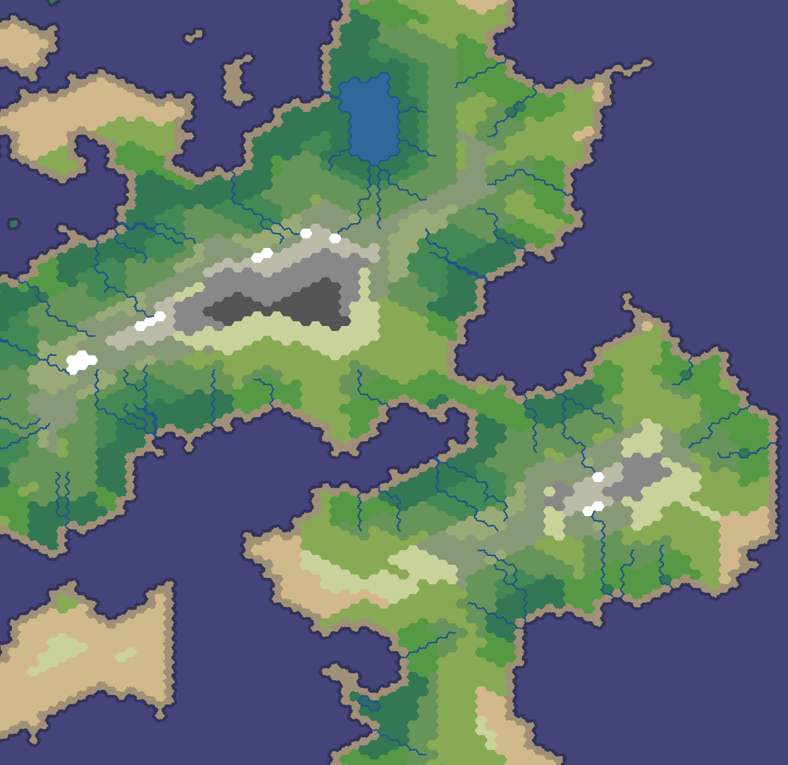
Rulers of Kepler
By Gábor Borics-Kürti, Cristian Chirion, Aleksejs Panfilovs, Petar Petrov, Viktor Taskov

Slide 2
Project Overview
In Rulers of Kepler you are the one who must conquer the realm of Kepler. Do you have the strategical skills and cunning to crush your foes and lead your nation to victory? Are you ready to build an empire which lasts through the ages?
Rulers of Kepler is a strategic war game in which you start by controlling a territory and you have to expand by conquering other territories and defeating other players.
Every territory has its own resources and population that you can use to expand your army. Throughout the game you will be expected to use these resources to expand your research, win points and defeat your opponents.
The best players ever are shown off on the scoreboard. Do you have the guts to be one of them?

Slide 3
Design Specification Issues
We often had merge conflicts in the team, when working on the same files, better communication and a more proficient use of Git would resolve this.
We had to change the database schema

Slide 4
Technologies used
Html
Css
JavaScript
Python 3
Django 1.10
Python Anywhere
Git
GitHub
4
1
Bootstrap 3
2

Slide 5
Technologies used
Html, CSS, Bootstrap3, JavaScript
Python3, Django1.10, PythonAnywhere
Git - Github

Slide 6
Contributions
Gábor Borics-Kürti
[Text]
[Text]
Cristian Chirion
[Text]
[Text]
Viktor Taskov
[Text]
[Text]
Petar Petrov
[Text]
[Text]
Aleksejs Panfilovs
[Text]
[Text]

Slide 7
Contributions
Gábor Borics-Kürti
[Text]
Cristian Chirion
Viktor Taskov
[Text]
[Text]
[Text]
Petar Petrov
[Text]
Aleksejs Panfilovs
[Text]
[Text]
[Text]
[Text]
[Text]

Slide 8
Contributions
Gábor Borics-Kürti –
Cristian Chirion –
Viktor Taskov -
Petar Petrov -
Aleksejs Panfilovs -

Slide 9
Game Demonstration
Link to our game

Slide 10
Questions?

