Slide 1





Rulers of Kepler
Design Specification
Cristian-Liviu Chirion
Gabor Borics-Kurti
Petar Petrov
Viktor Taskov
Aleksejs Panfilovs

Slide 2
Team c – rulers of kepler
In Rulers of Kepler you are the one who must conquer the realm of Kepler. Do you have the strategical skills and cunning to crush your foes and lead your nation to victory? Are you ready to build an empire which lasts through the ages?
Rulers of Kepler is a strategic war game in which you start by controlling a territory and you have to expand by conquering other territories and defeating other players.
Every territory has its own resources and population that you can use to expand your army. Throughout the game you will be expected to use these resources to expand your research, win points and defeat your opponents.
The best players ever are shown off on the scoreboard. Do you have the guts to be one of them?

Slide 3
Requirements
Users must be able to create/edit/delete their account
Users must be able to login/logout of their account
Users must be able to join a lobby or create one
Users must be able to view the leaderboard and their own statistics
Users must be able to play the game in a selected lobby
Users should be able to attack territories, move armies and research technologies (interact with the game)
Users must be able to see the rules of the game
Users should be able to contact the game developers

Slide 4
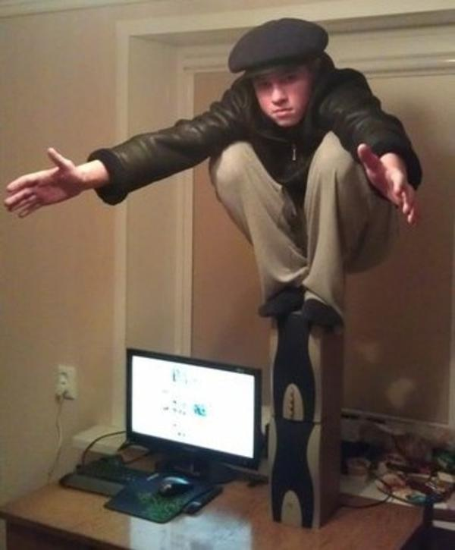
Persona one
Dimitri is a 25-yrs old male and still lives with his parents trying to compensate for that by dominating other people over online games. He always strives to be on the top of the scoreboard and that's why you can find him in the game 24/7. Dimitri has been playing strategy games since the age of 7 and finds the game interesting because it is not based on the real world hence there is less drama.
Dimitri playing video games

Slide 5

Persona two
Pierre is a french nationalist with a lack of humour and always striving to prove other people wrong on the internet. He does not understand the fact that the game is not based on a real world and is always angry when someone else takes "his" territories. Pierre always tries to bring back the French Empire even though there is no place on the map called France.
Pierre getting back from his daily shopping

Slide 6
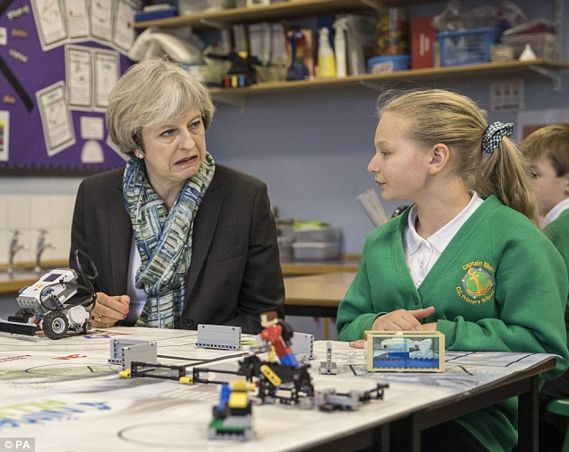
Persona three
Lorna Mcancheese is a scottish girl-gamer who wants to develop critical thinking by playing online games, but her grandma doesn't approve of the game. She likes uniting different territories under her rule and enjoys playing 3-4 hours a day. She hopes to develop the skills needed to be a government official one day.
Lorna with her grandma

Slide 7
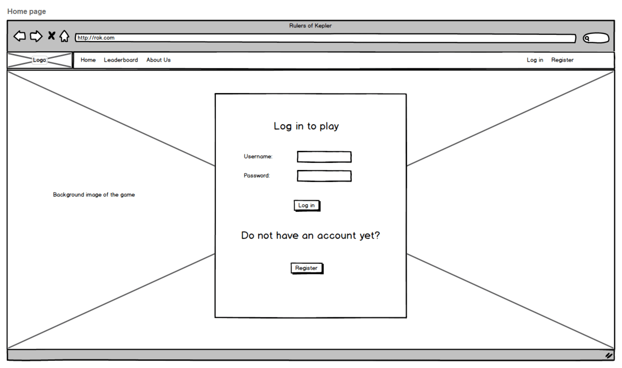
Wireframe – index (login)

Slide 8
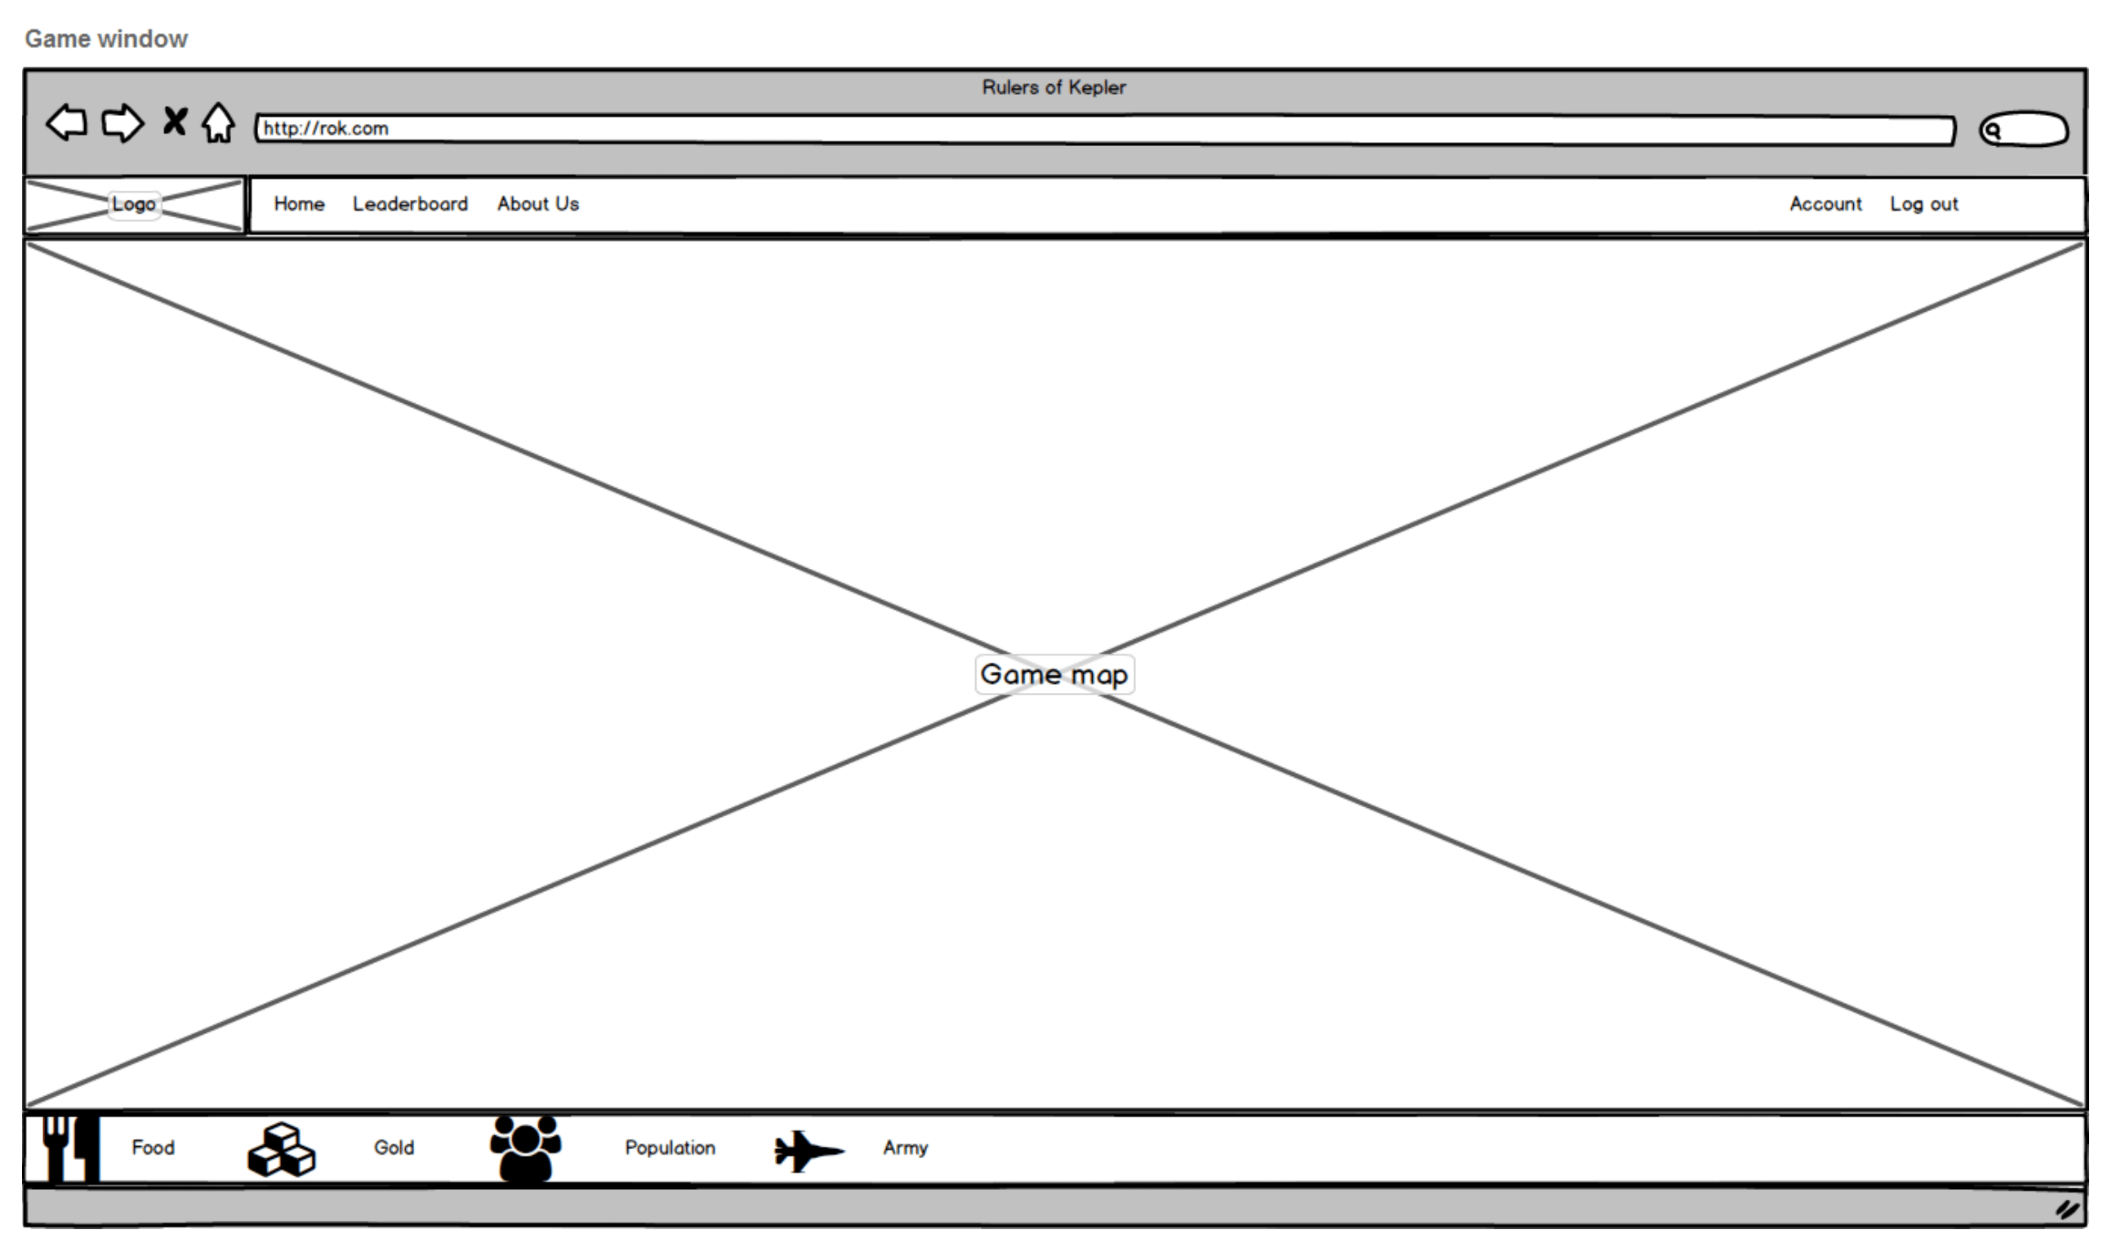
Wireframe – Game Window

Slide 9
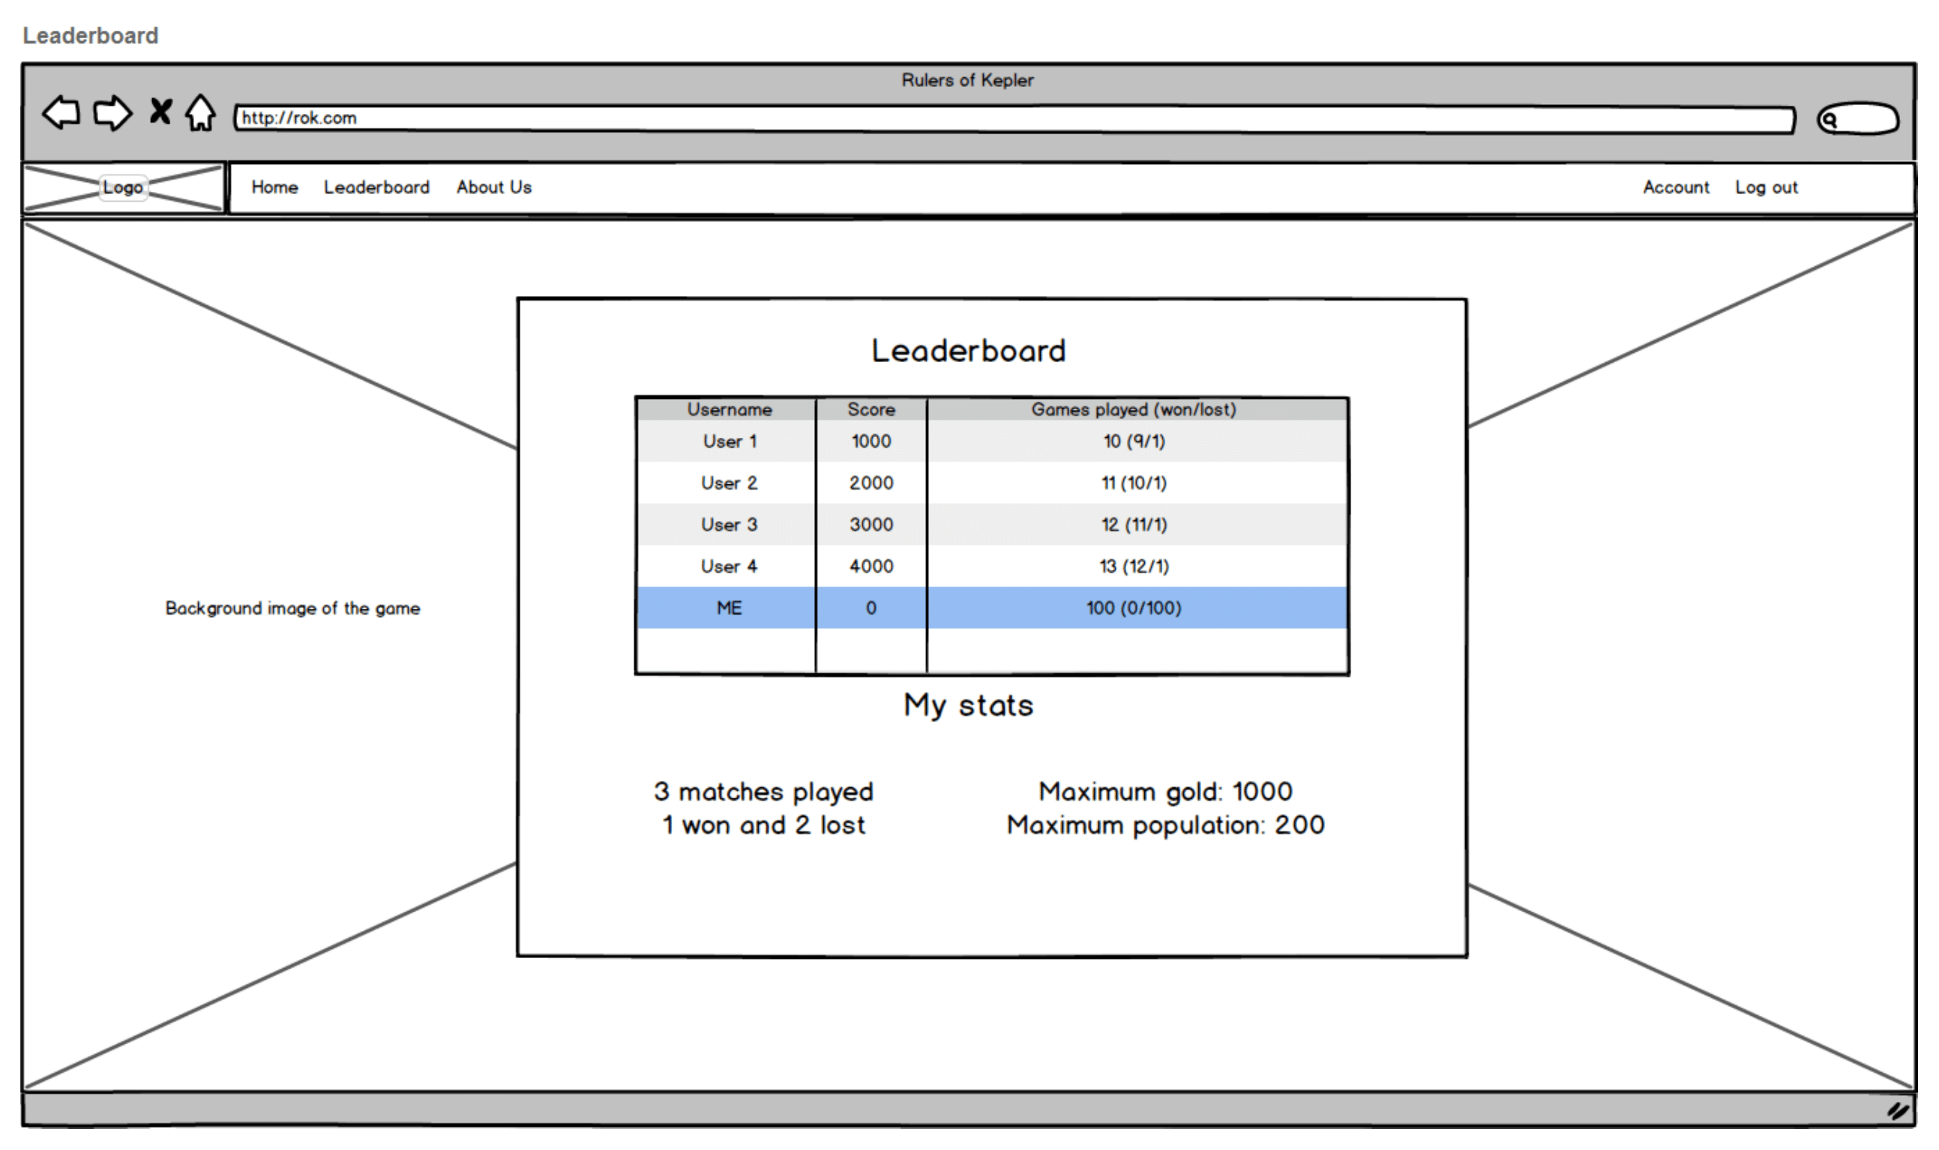
Wireframe – Leaderboard

Slide 10
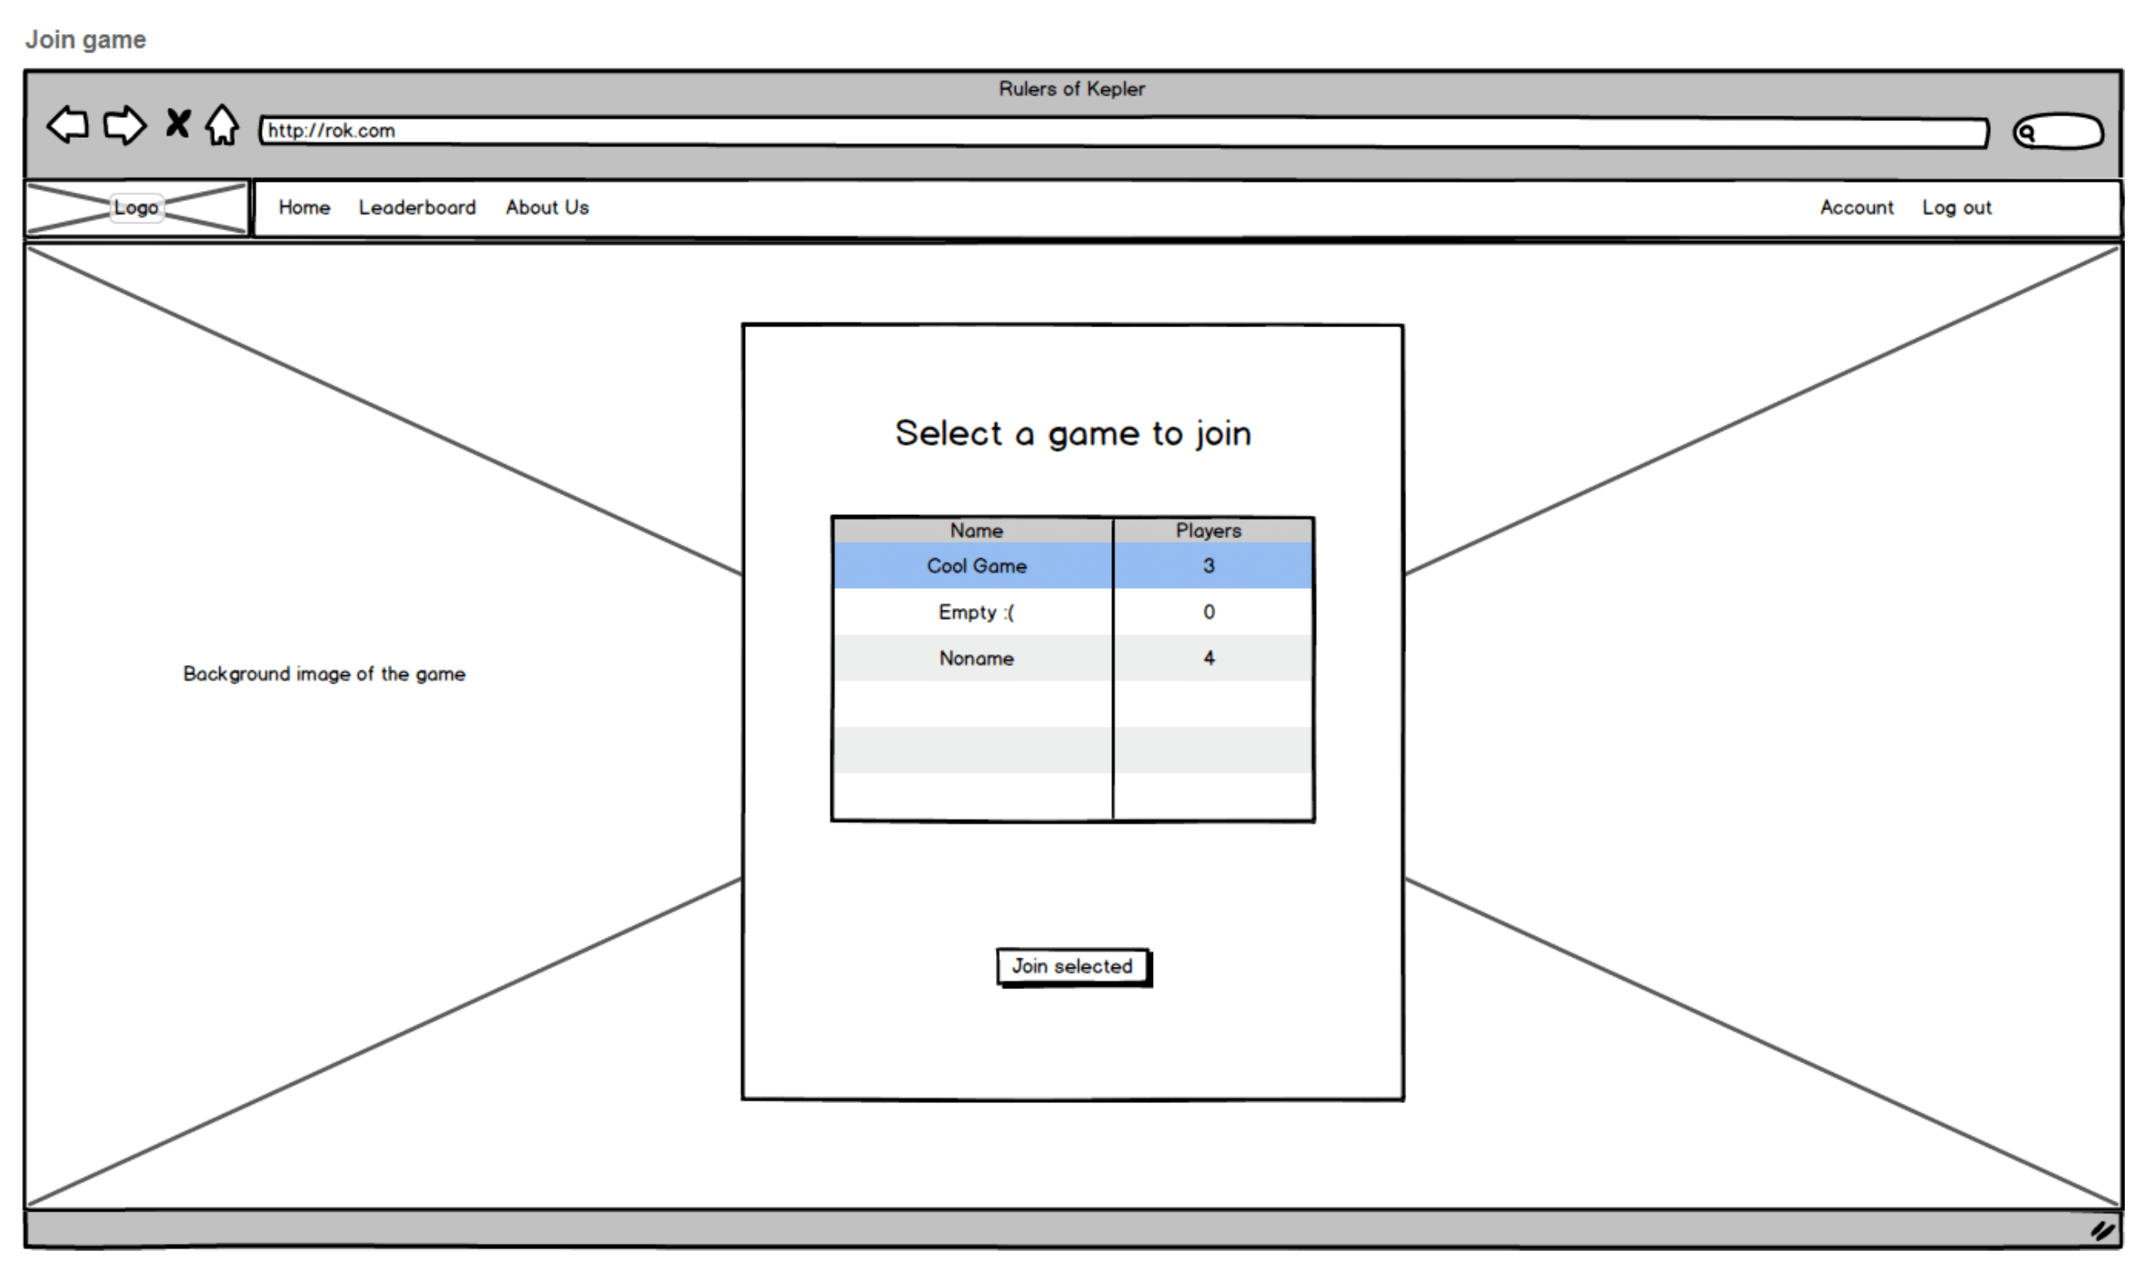
Wireframe – lobby list

Slide 11
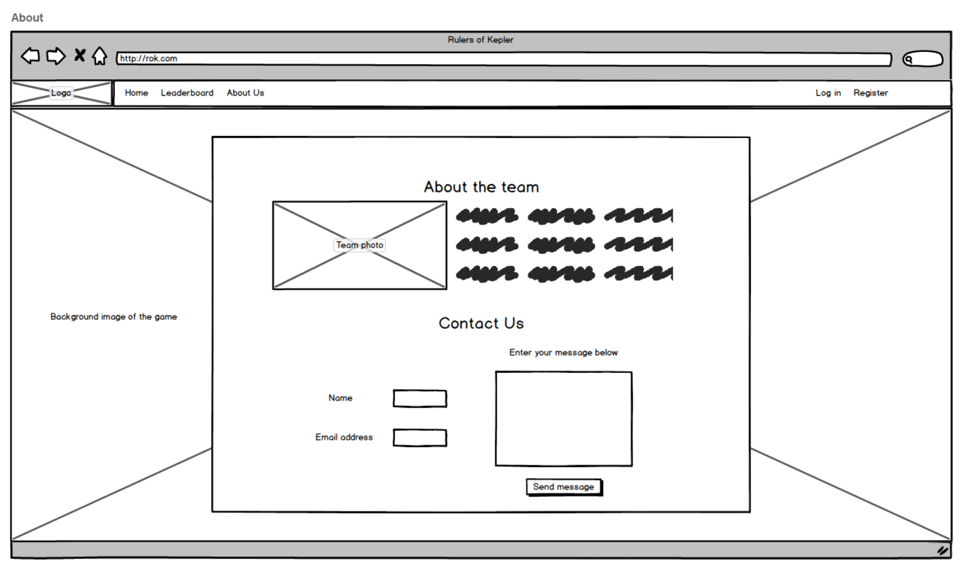
Wireframe - About/Contact Page

Slide 12
System Architecture

Slide 13
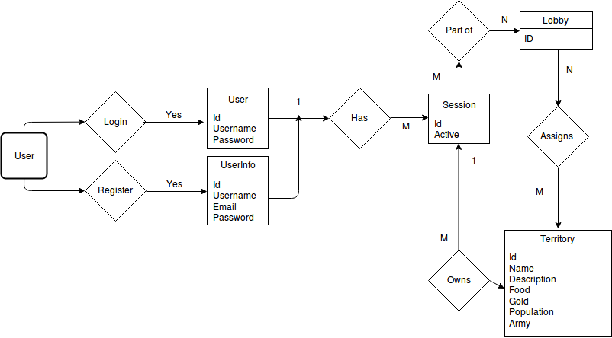
ER Diagram

Slide 14
Sitemap

Slide 15
Site URLs
/login (POST)
/register (POST)
/logout
/lobby/list
/lobby/{ID}/JOIN
/lobby/create (POST)
/about
/game/{ID}
/leaderboard
/account/{ID}/view
/account/settings (POST)
/terms-and-conditions
ALL POST REQUESTS
/game-ajax/{GAME_ID}/TERRITORY/{TER_ID}/DATA
/GAME-AJAX/{GAME_ID}/TERRITORY/{TER_ID}/SET-POPULATION
/GAME-AJAX/{GAME_ID}/ARMY/MOVE/{TER_ID_1}/{TER_ID_2}/{AMOUNT}
/game-AJAX/{GAME_ID}/ARMY/ATTACK/{TER_ID_1}/{TER_ID_2}/{AMOUNT}
/GAME-AJAX/{GAME_ID}/REFRESH-STATE
/GAME-AJAX/{GAME_ID}/RESEARCH/{RES_ID}
/GAME-AJAX/{GAME_ID}/RESEARCH/LIST

