Slide 1
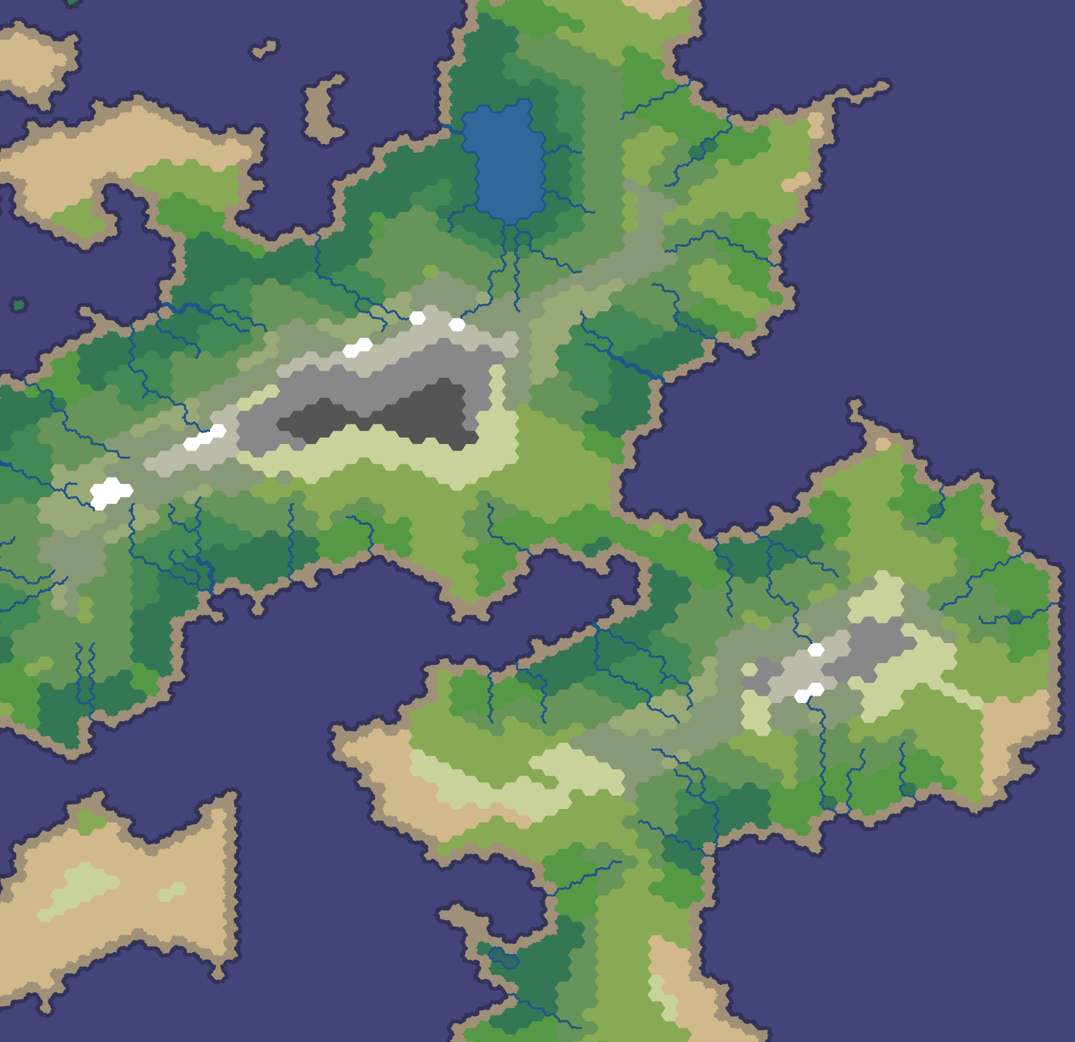
Rulers of Kepler
By Gabor Borics-Kurti, Cristian Chirion, Aleksejs Panfilovs, Petar Petrov, Viktor Taskov

Slide 2
Project Overview
In Rulers of Kepler you are the one who must conquer the realm of Kepler. Do you have the strategical skills and cunning to crush your foes and lead your nation to victory? Are you ready to build an empire which lasts through the ages?
Rulers of Kepler is a strategic war game in which you start by controlling a territory and you have to expand by conquering other territories and defeating other players.
Every territory has its own resources and population that you can use to expand your army. Throughout the game you will be expected to use these resources to expand your research, win points and defeat your opponents.
The best players ever are shown off on the scoreboard. Do you have the guts to be one of them?

Slide 3
Design Specification Issues
We often had merge conflicts in the team, when working on the same files, better communication and a more proficient use of Git would resolve this.
We had to change the database schema as our concept of the game mechanics was refined. This issue could have been avoided by spending more time on the ER diagram and initial game design.

Slide 4
Technologies used
Client Side
JavaScript and jQuery
Bootstrap 3
HTML
CSS
Server Side
Python 3
Django
SQLite database
Git and Github for version control
Deployed on PythonAnywhere

Slide 5
Contributions
Gabor Borics-Kurti –models, views, design specification and presentation
Cristian Chirion – models, views, population script, design specification and presentation
Aleksejs Panfilovs – templates, Bootstrap, presentation
Petar Petrov – JavaScript, templates, views, design specification and presentation
Viktor Taskov – tests, views, design specification and presentation

Slide 6
Game Demonstration
http://rulersofkepler.pythonanywhere.com

Slide 7
Questions?

