Slide 1
Predicting the 'Usefulness' of Yelp Reviews
Presented by Gyujin Seo | UCLA | Major in Statistics and Data Science

Slide 2
Table of Contents
Introduction
Pre-processing
Modeling
Results
Conclusion

Slide 3
1. Introduction
Background
Today, we live an era where users’ experiences are highly valued and expressing them is crucial.
Companies recognize the importance of such experiential data(review data) and utilize them as significant marketing resources.
Through the "yelp" website, which provides consumer review datasets, these data are collected.
Problem
Excessive time spent on purchase decision-making due to the ambiguity of consumer review data reliability.
Companies spending excessive time determining the usefulness of review data.

Slide 4
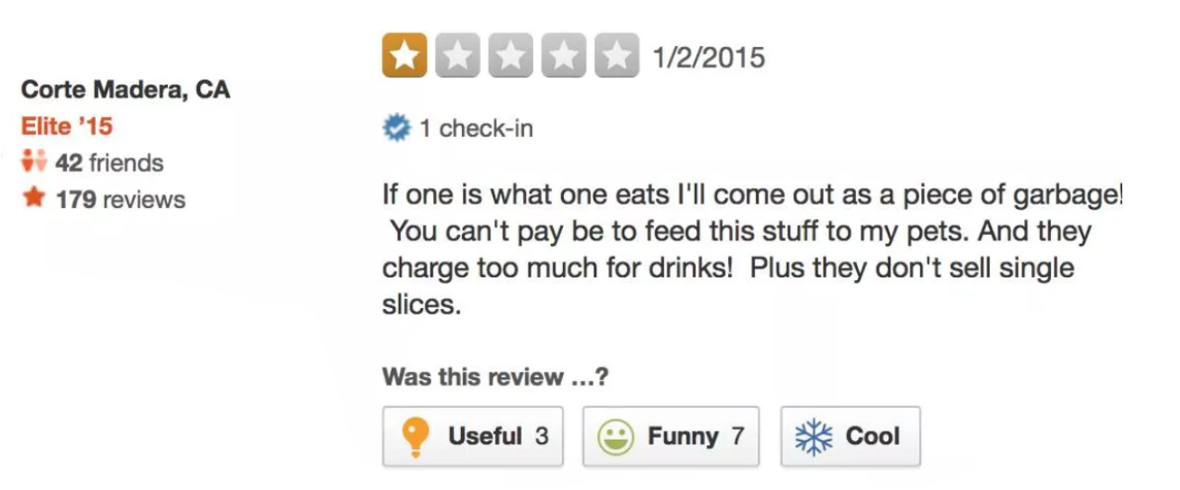

1. Introduction(Cont’d)
Aim of my Project
To predict the usefulness of a review prior to user interaction.
Yelp Overview
Yelp is a consumer-driven platform providing business information, photos, and user reviews.
The 'useful' button on Yelp, which plays a critical role in guiding user decisions.

Slide 5
1. Introduction(Cont’d)
Programming language
R
Data overview
It has 53,845 unique observations, with 17 variables.
For the variables, I have User ID, Business ID, Star, Useful, Cool, Funny, Review, State, City, Business average count, User review count, User useful count, Userfunny count, User cool count, Elite, User fans, and User average star.

Slide 6
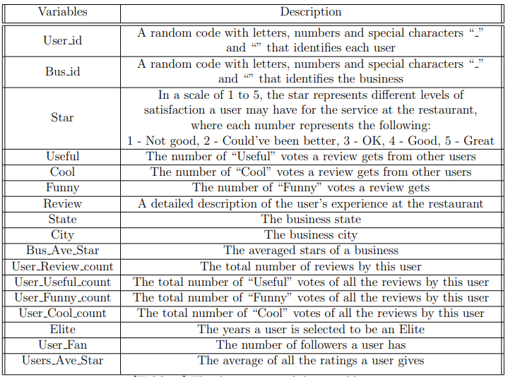
1. Introduction(Cont’d)

Slide 7
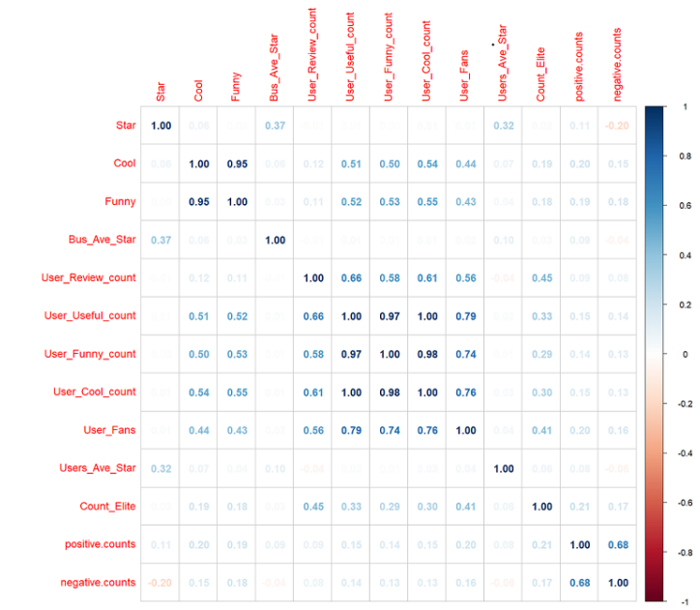
2. Pre-processing
Transforming Useful to binary: "Not Useful" (0) if less than or equal to 1, "Useful" (1) otherwise.
Review analysis with NLP: Counted positive and negative words in each review.
Eliminating highly correlated variables: Dropped Funny, User Funny count, User Cool count due to high correlation (>90%).

Slide 8
3. Modeling
3.1 Model Validation
3.2 Methods
Data Partitioning: 70% Training Data, 30% Test Data.
Cross-Validation: Applied 10-fold Cross-Validation for more accurate performance estimation.
5 Machine Learning Methods Applied:
Random Forests
Logistic Regression
LASSO Regression
Decision Tree
K-NN

Slide 9
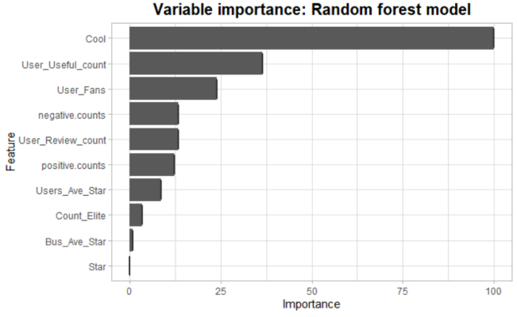
3. Modeling(Cont’d)
3.2 Methods - Random Forest

Slide 10
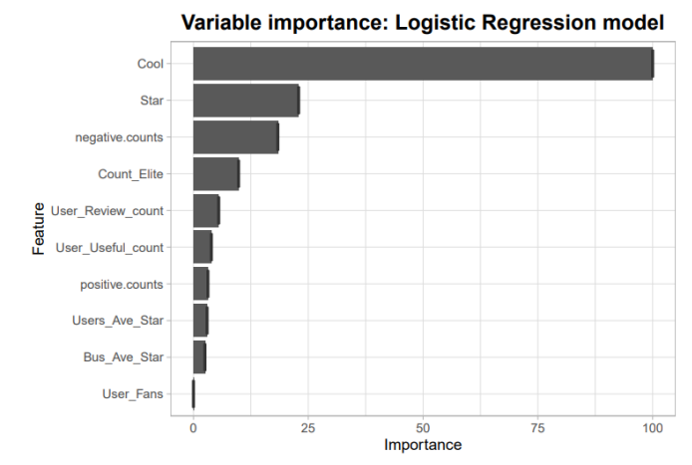
3. Modeling(Cont’d)
3.2 Methods - Logistic Regression

Slide 11
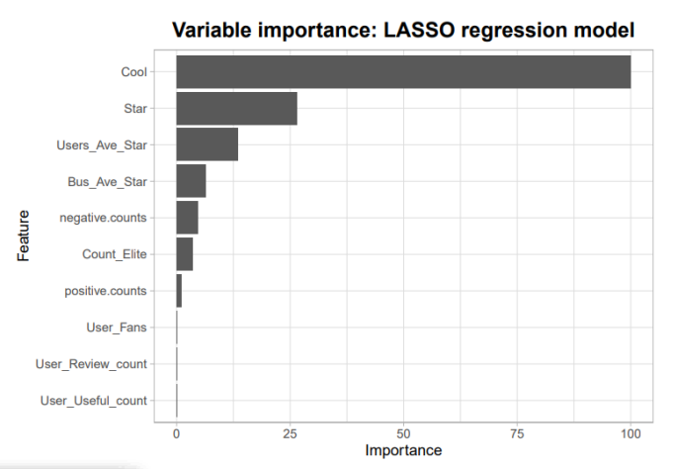
3. Modeling(Cont’d)
3.2 Methods - LASSO Regression

Slide 12
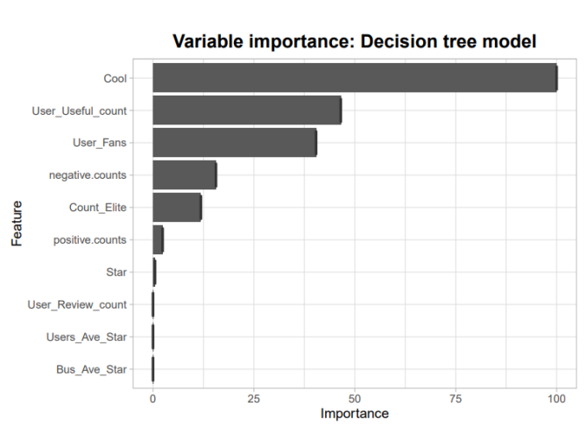
3. Modeling(Cont’d)
3.2 Methods - Decision Tree

Slide 13
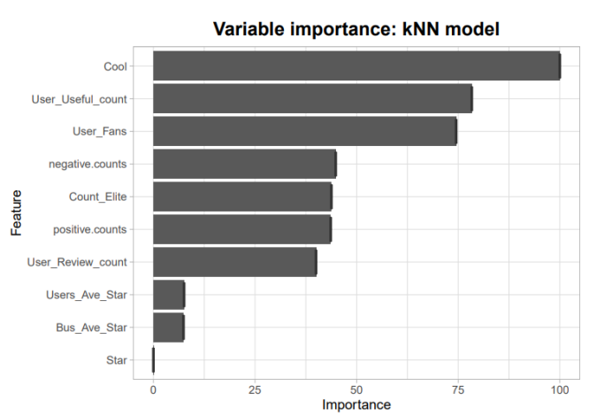
3. Modeling(Cont’d)
3.2 Methods - K-NN

Slide 14
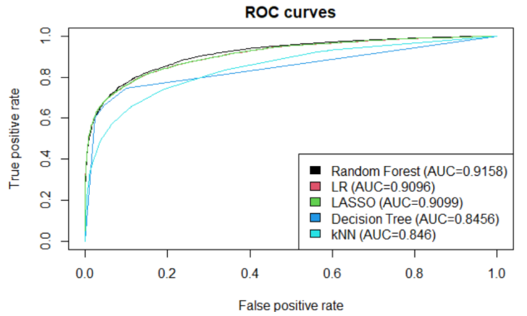
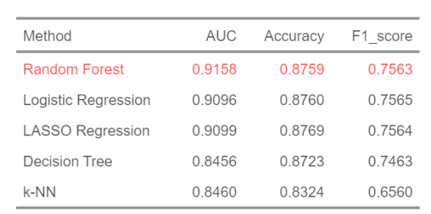
4. Results
‘Random Forest’ has an AUC score of 91.58% that shows the model is learning the data well enough.

Slide 15
5. Conclusion
Consumer Perspective
By predicting the usefulness of reviews, we can secure the trust of buyers and expedite their purchase decision-making process.
Restaurant Perspective
Predicting the 'usefulness' of reviews not only allows for swift utilization as marketing material, but can also enhance customer service satisfaction.

Slide 16
Thank you!

