Slide 1


GROUP RESEARCH REPORT
Exploratory Data Analysis
House Prices - Advanced Regression Techniques
TEAM
Prepared by:
Nguyễn Tấn Đại (Team leader)
Lê Nguyễn Anh Bảo (Slide design)
Trần Tiến Phát (Content)
Nguyễn Khải Hoàn Ca (Content)
WEEK 3

Slide 2
AGENDA
4. Exploratory Data Analysis
1. Introduction
2. Data
5. Proposed Methods
3. Data Preprocessing
6. Conclusion

Slide 3





1. Introduction
Describing a dream home
79 explanatory variables
Predicted SalePrice
Input
Model
Output
79 variables
OverallQual GrLivArea YearBuilt GarageCars Neighborhood ...
Decision Tree
Id | SalePrice
1461 | 169277.0524984
1462 | 187758.393988768
1463 | 183583.683569555
1464 | 179317.47751083
... | ...
XgBoost
ANN

Slide 4
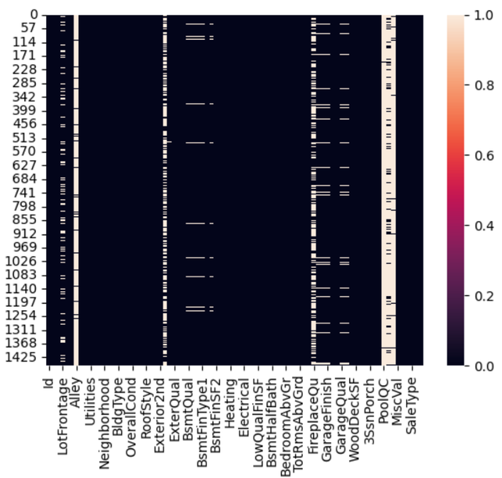
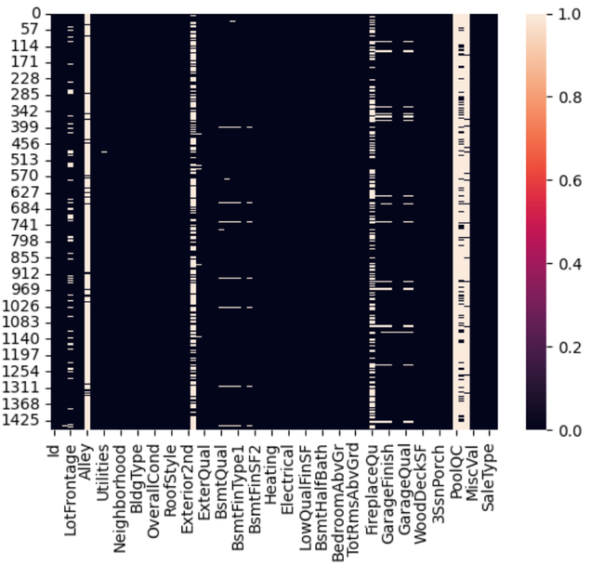


Missing data in the training set
Missing data in the test set
2. Data
Ames Housing dataset
Dataset | Rows | Columns
Train.csv | 1460 | 81
Test.csv | 1459 | 80
Descriptive statistics for numerical characteristics
Feature | Mean | Std | Q2 | Q3 | Q1 | Min-Max
MSSubClass | 56.90 | 42.30 | 50 | 70 | 20 | 20 - 190
LotFrontage | 70.05 | 22.02 | 70.05 | 79 | 60 | 21 - 313
LotArea | 10516.83 | 9981.26 | 9478.50 | 11601.50 | 7553 | 1300 - 215245
... | ... | ... | ... | ... | ... | ...
YrSold | 2007.77 | 1.30 | 2008 | 2009 | 2007 | 2006 - 2010
data_description.txt

Slide 5




3. Data Preprocessing
Before imputation
Where:
yᵢ: missing value to be imputed
yⱼ: observed value
n: number of observed values
No. | GarageType | GarageFinish | GarageYrBlt
1 | BuiltIn | Fin | 1995
2 | Attchd | Unf | 1991
3 | BuiltIn | Fin | 2005
4 | Detchd | RFn | 2009
5 | NA | NA | NA
6 | NA | NA | NA
7 | Detchd | Unf | 1950
8 | Attchd | Unf | 1961
9 | Detchd | Unf | 1921
10 | Detchd | Unf | 1900
No. | GarageType | GarageFinish | GarageYrBlt
1 | BuiltIn | Fin | 1995
2 | Attchd | Unf | 1991
3 | BuiltIn | Fin | 2005
4 | Detchd | RFn | 2009
5 | Detchd | Unf | 1966.5
6 | Detchd | Unf | 1966.5
7 | Detchd | Unf | 1950
8 | Attchd | Unf | 1961
9 | Detchd | Unf | 1921
10 | Detchd | Unf | 1900
Numerical imputation
Categorical imputation
Mode(GarageType) = Detchd
Mode(GarageFinish) = Unf
After imputation

Slide 6
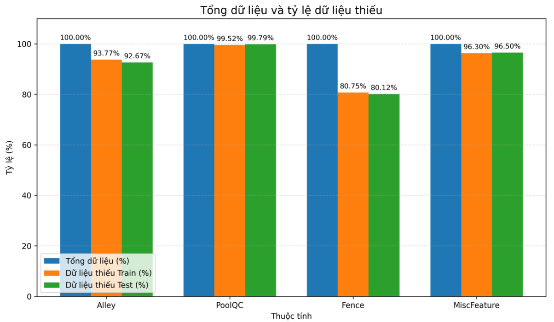


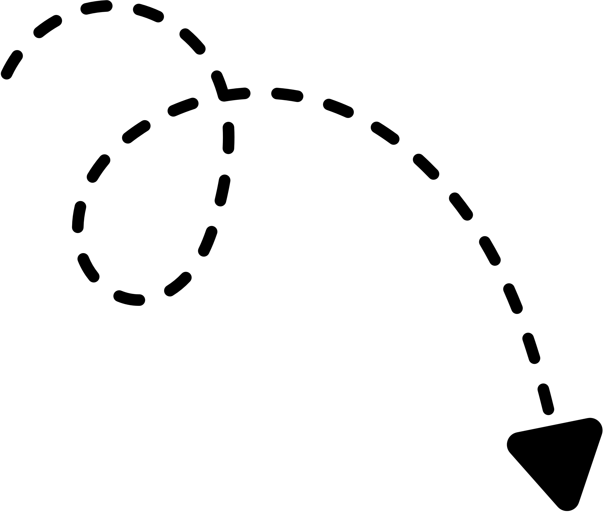
3. Data Preprocessing
Total data and missing-value percentages
Remove columns with many missing values
The rate of missing data is excessively high.
Percentage (%)
Data that is not meaningful for the prediction process
Total data (%)
Missing train (%)
pre-processed data
Missing test (%)
Feature
Dataset | Rows | Columns
Train | 1460 | 76
Test | 1459 | 75
Features with over 80% missing values in both datasets were excluded, specifically Alley, PoolQC, Fence, and MiscFeature. Furthermore, the Id column was dropped because it acts solely as a unique identifier

Slide 7
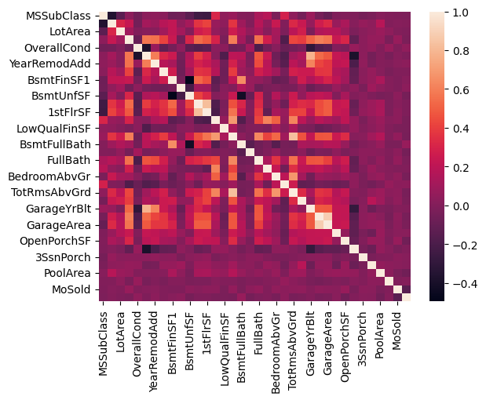
4. Exploratory Data Analysis - Correlation
CORRELATION BETWEEN NUMERICAL FEATURES
GarageCars and GarageArea
Garage capacity is positively associated with garage area.
GrLivArea and TotRmsAbvGrd
Larger above-ground living areas tend to have more rooms.
TotalBsmtSF and 1stFlrSF
Basement area and first-floor area are clearly related.

Slide 8
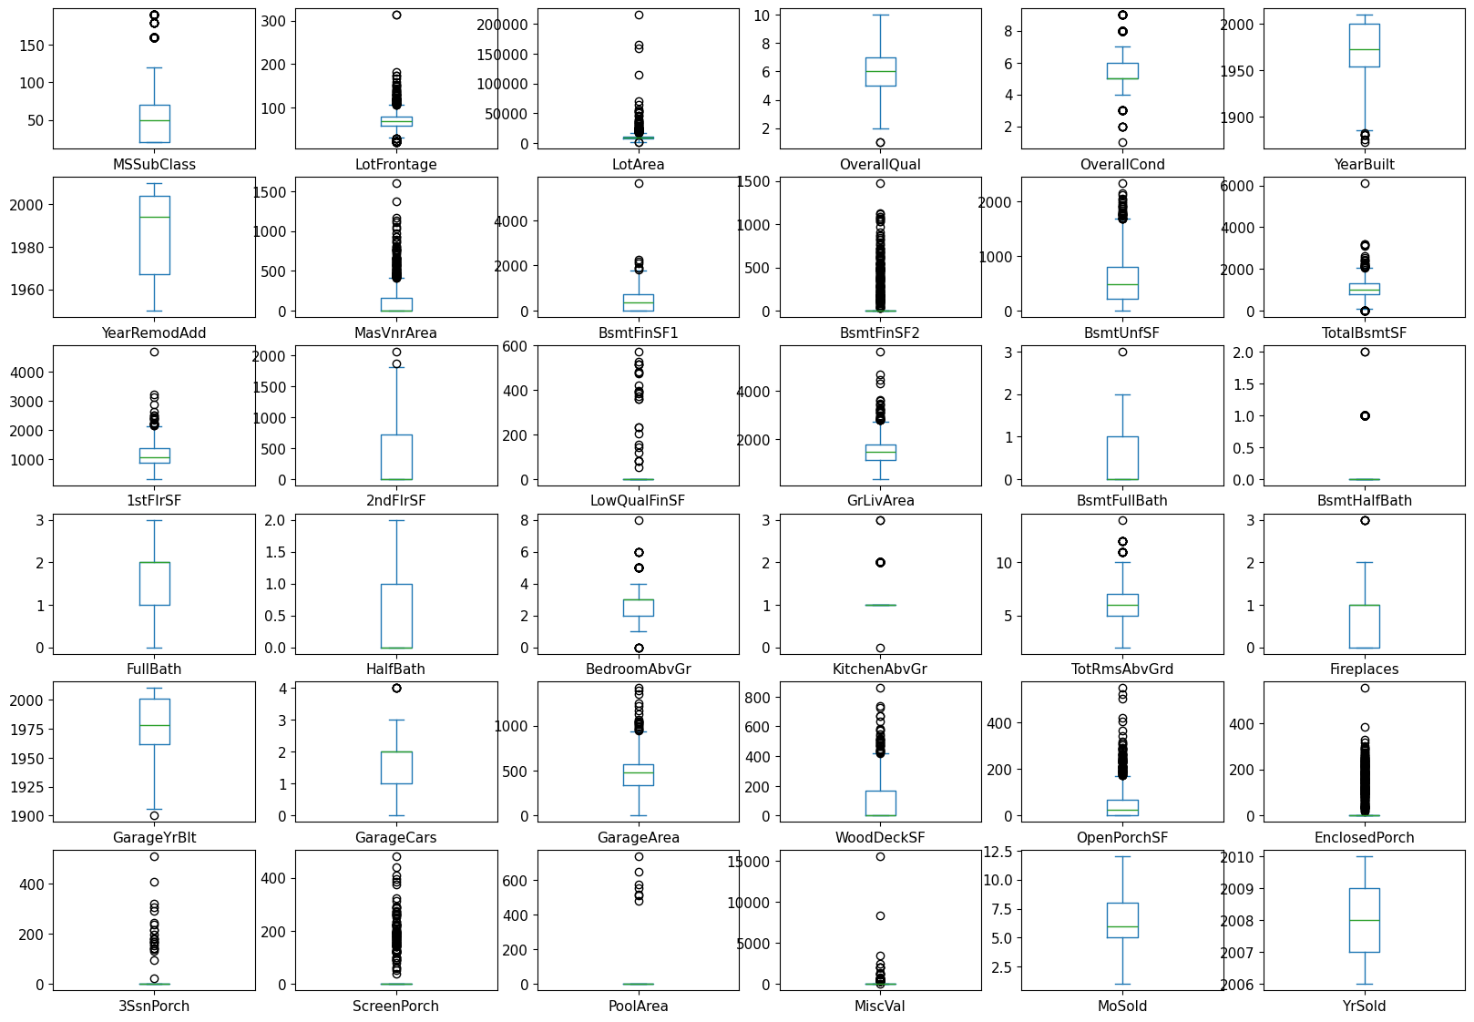
4. Exploratory Data Analysis - Outliers
DISTRIBUTIONS AND OUTLIERS
LotArea
Median: 9,478.5 ft²
Maximum: 215,245 ft²
GrLivArea
Median: 1,464 ft²
Maximum: 5,642 ft²
Most values of PoolArea, MiscVal and 3SsnPorch are zero.

Slide 9
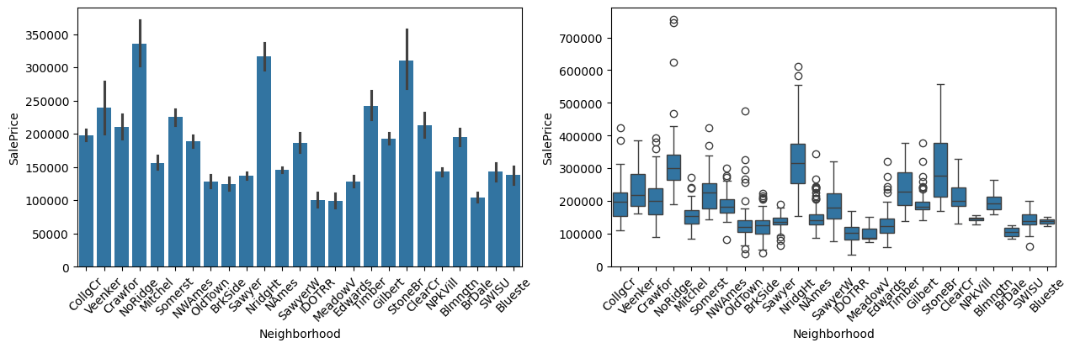
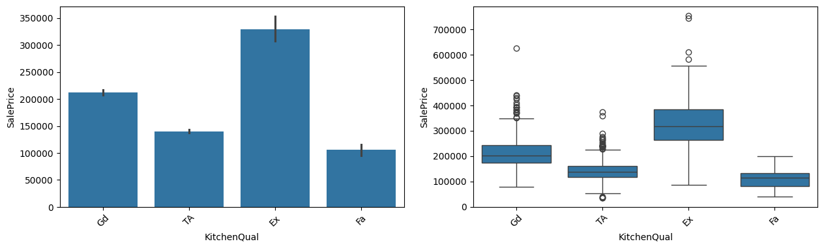
4. Exploratory Data Analysis - SalePrice
NEIGHBORHOOD
HOUSE PRICES BY CATEGORY
Neighborhood
Sale-price distributions vary considerably across neighborhoods. Location may contribute to price prediction.
KitchenQual
Sale prices tend to vary with kitchen quality. The report identifies a clear predictive signal for this categorical feature.
KITCHENQUAL

Slide 10

5. Proposed Methods
Preprocessing model inputs
The aforementioned preprocessing involves the following key steps:
  Step 1: Separate descriptive features and target features.
  Step 2: Train the model.
  Step 3: Perform predictions.
FEATURE EXTRACTION
SPLIT INTO TRAINING AND TESTING SETS
  Temporary concatenation
TRAINING SET
ORIGINAL DATASET
Train.csv + Test.csv
TRAINING SET ( 50% ) | VALIDATION SET ( 0% ) | TESTING SET ( 50% )
Impute missing values
Categorical: mode
Numerical: mean
  Merge data temporarily
  Ensure consistent encoding
  All categories recognized
CONSTRUCT MODEL
HYPERPARAMETER TUNING
FINAL EVALUATION
Drop columns
Id, Alley, PoolQC, Fence, MiscFeature
TESTING SET
COMBINED DATAFRAME
  Train the algorithm on pattern recognition
  Fine-tune model settings
  Prevent overfitting
  Assess predictive capabilities
  Measure generalization performance
  Unseen by the model during training
Temporarily combine train + test
  One-hot Encoding
One-hot encoding
pd.get_dummies(drop_first=True)
Convert distinct categories into binary columns
0
0
. . .
1
1
0
. . .
1
0
0
. . .
1
1
0
. . .
1
Split back at n_train
...
CATEGORICAL FEATURE
(e.g. Neighborhood, ...
Drop original string columns
BINARY INDICATOR FEATURES
df_train
X: drop SalePrice
y: SalePrice
df_test
Drop SalePrice

Slide 11
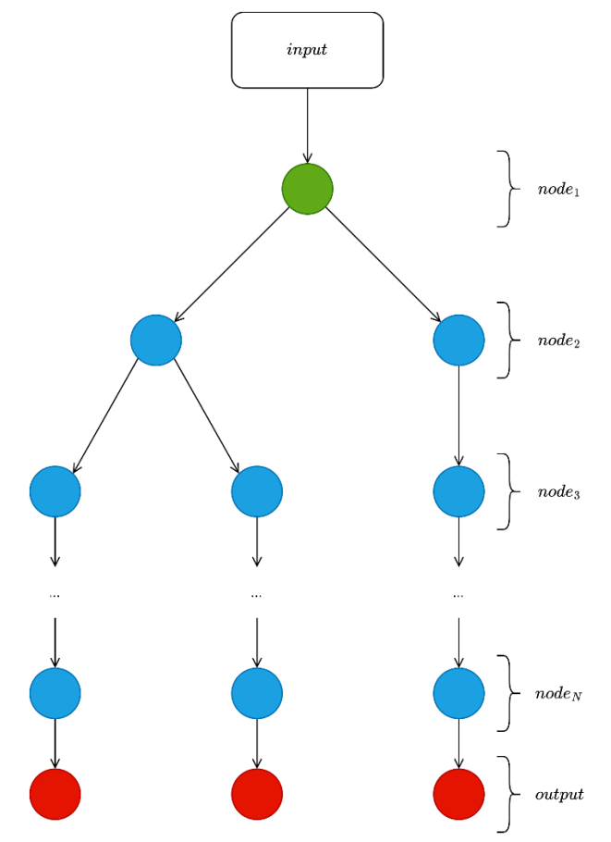
5. Proposed Methods
DECISION TREE REGRESSOR
In this study, a Decision Tree Regressor is employed as the baseline regression model. The model receives the preprocessed property features, executes a sequence of data splits through decision nodes, and routes each sample to a leaf node to predict the SalePrice.
Working Principle:
  Decision Trees operate by recursively partitioning the dataset into smaller subsets via a sequence of decision rules.
  At each internal node, the model selects an optimal feature and a split threshold to divide the data into child branches.
  If a sample satisfies the condition, it is routed to the left branch; otherwise, it proceeds to the right branch.
  This process repeats across multiple depth levels of the tree until specified stopping criteria are met, forming the final leaf nodes.

Slide 12

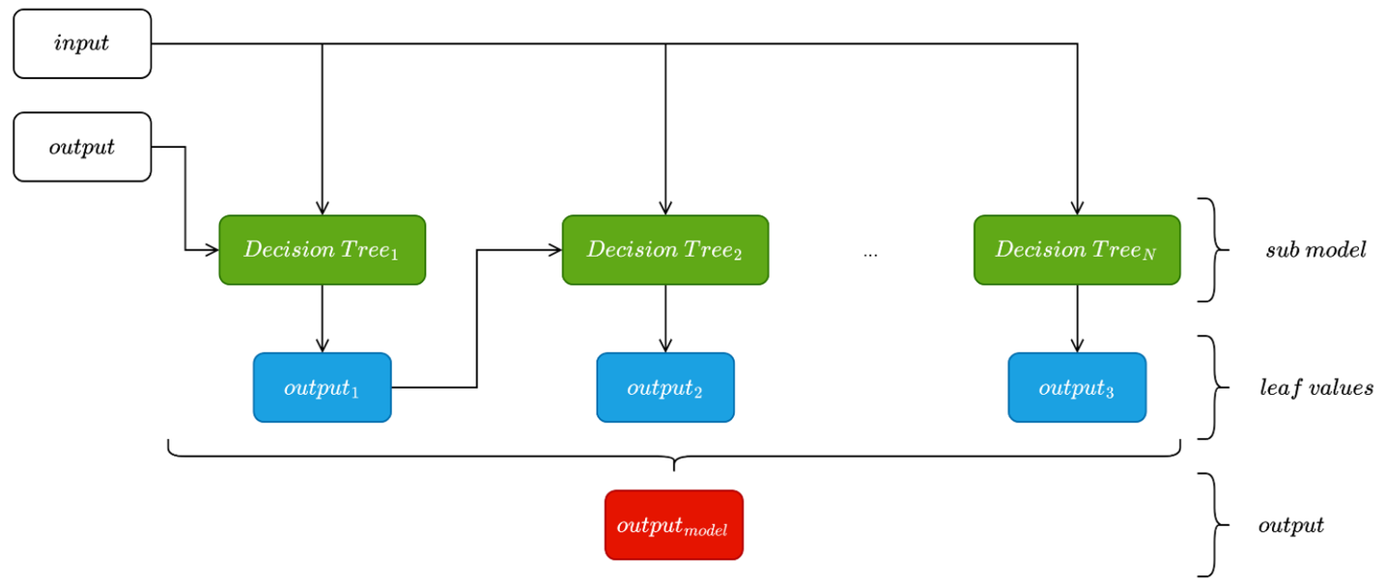
5. Proposed Methods
XGBOOST
Algorithm representation
XGBoost is an ensemble learning algorithm that leverages multiple decision trees to generate predictions. Unlike a single Decision Tree model, XGBoost constructs an ensemble of trees sequentially using the Gradient Boosting framework, where each subsequent tree is trained to correct the residual errors of its predecessors.
  x: feature vector of a house;
  fₖ(x): prediction score of the k-th decision tree;
  k: total number of decision trees in the ensemble;
  ŷ(x): predicted SalePrice value.
Working Principle:
  The input data is processed by the initial decision tree to generate a base prediction.
  Subsequent trees are constructed iteratively to model the residual errors or unexplained variance of the current ensemble.
  Each new tree adds a functional contribution to the overall model, and this boosting process continues until a predefined number of trees is reached.
During inference, each sample traverses the decision nodes of individual trees until it reaches a terminal leaf node. Each leaf node holds a target prediction score (leaf weight). The output scores from all trees are aggregated to yield the final predicted SalePrice.

Slide 13
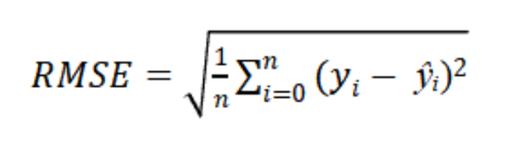
5. Proposed Methods
ARTIFICIAL NEURAL NETWORKS
INPUT LAYER
Artificial Neural Networks are deep learning models designed to capture complex mapping functions between input features and target variables. In this study, an ANN model is implemented using the Keras framework as a Sequential feedforward network to predict housing prices (SalePrice).
Working Principle:
  The network receives preprocessed house attributes at the input layer and propagates data sequentially through fully connected (Dense) layers.
  Each neuron performs a linear transformation on its input features using trainable weights and biases, followed by an activation function to generate output activations for the subsequent layer.
Loss Function: Root Mean Square Error (RMSE) is adopted as the objective loss function to measure the disparity between actual and predicted target values:
Input
HIDDEN LAYERS
Dense 1
  yᵢ : the ground-truth SalePrice value of the i-th instance;
  ŷᵢ : the predicted SalePrice value outputted by the ANN model;
  n: the total number of samples.
Dense 2
A lower RMSE value indicates a smaller prediction error relative to the actual housing prices.
Optimization: The Adamax optimizer is utilized to update network weights based on the loss function gradients. The training procedure executes via forward propagation to generate target predictions, computes the RMSE loss, and subsequently performs backpropagation to propagate errors backward and update model parameters.
Dense 3
OUTPUT LAYER
Dense output
Output

Slide 14
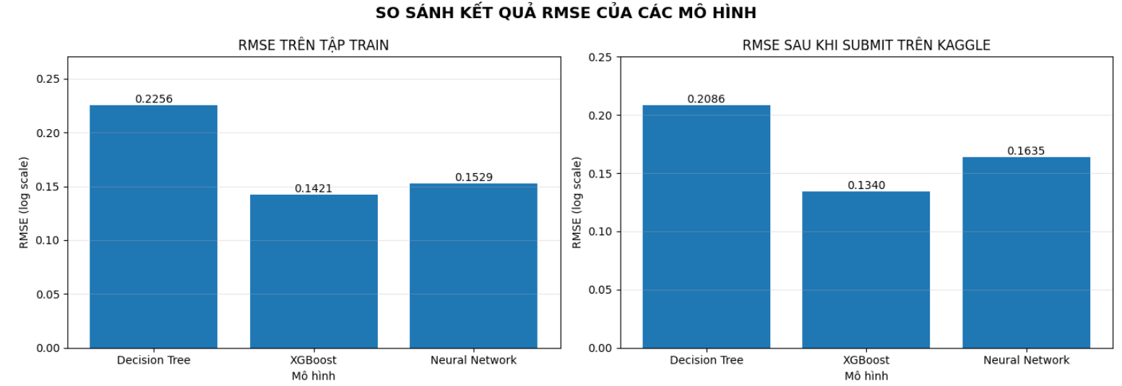
6. Conclusion
Experimental environment
Library | Version
numpy | 1.26.4
pandas | 2.2.3
matplotlib | 3.10.0
seaborn | 0.13.2
scikit - learn | 1.6.1
xgboost | 2.1.4
tensorflow | 2.10.0
keras | 2.10.0
MODEL RMSE COMPARISON
RMSE on the training set
RMSE after Kaggle submission
Model
Model
  This chapter presented the experimental setup and the training process of three house price prediction models on the Ames Housing dataset: Decision Tree, XGBoost, and Artificial Neural Network.
  All three models were evaluated consistently on the same validation set to ensure an objective comparison. The experimental results demonstrated that XGBoost achieved the best performance, followed by ANN, with the Decision Tree model ranking last.
  These findings serve as the rationale for selecting XGBoost as the primary proposed model for this task, while also suggesting directions for future improvements, including the implementation of early stopping for the neural network and fine-tuning hyperparameters for the Decision Tree model.

